Slide 1
2017 Employee Survey
Instructions for:
(ETC Name and Worksite)

Slide 2
Thank you for completing your 2017 Employee Survey Reservation form
You reserved Tuesday March 14th as the first day of your worksite’s survey.
Friday March 10rd is the last day to set up your survey preferences.
March 2017
Sun | Mon | Tues | Wed | Thurs | Fri | Sat
 |  |  | 1 | 2 | 3
 | 6 | 7 | 8 | 9 | 10
 | 13 | 14 | 15 | 16 | 17
 | 20 | 21 | 22 | 23 | 24

Slide 3
Set-up Steps Required Before Survey Week
1. Log into the survey website
2. Share survey dates with IT and Management
3. Set up methods: Email Domain or Uploaded List
4. Add supplemental questions
5. Rollout survey to employees
6. Monitor survey success
7. Close out and submit survey results
8. More resources

Slide 4
Step 1…Log into the survey website
Log into the survey website to set up the employee survey on WSDOT’s CTR tool at www.ctrsurvey.org/admin.
Your unique CTR Tool information:
Login Name: Password: ______________
P.S. Save these in a safe place for future reference.

Slide 5
Step 2…Share Survey Dates with IT & Mgmt
Tell your IT department that a hyperlink to a web based survey is being emailed to all employees.
Ask Management for their support and help.
Use some of these sample Messages to assist in getting the word out.

Slide 6
Step 3…Select Setup Method (listen up on this one)
Two survey set-up methods..
By Email Domain
or
By Uploaded List of Email Addresses

Slide 7
Step 3…Setup Method – EMAIL DOMAIN
Email Domain:
Anyone with an email account @yourcompany.com can fill out the survey.
Advantage:
Easy to set up.
Disadvantages:
No way to track non-respondents.
Multi site companies risk employees selecting the incorrect worksite at login.
Check the Email Domains listed on your CTR survey tab. Are all domain names listed? Missing domains will prevent your employees from being able to access the survey. Contact us to make updates.

Slide 8
Step 3…Setup Method – Uploaded List of Email Addresses
Uploaded List of Email Addresses:
Upload email addresses for each employee to be surveyed.
Employees use their own email address to log in to the survey. Only email addresses you uploaded can access the survey.
Advantages:
Greater control over who may access online survey
You can track and email people who have not yet completed survey.
Disadvantages:
Takes time to set up.
You must compile and upload the list before survey begins.
Once you start this method, a “how to” wizard on WSDOT’s CTR Tool will guide you through upload process
If you need more instructions, please go to this link.

Slide 9
Step 3…Select Setup Method
Important! The default survey method is Email Domain.
To change to Upload List of Email Addresses, please notify Employer.services@kingcounty.gov.
(The settings need to be changed and setup needs to be complete before the survey period starts.)

Slide 10
Step 4…Add supplemental questions (optional)
Additional questions can provide more insight into employee’s thoughts and more information about your specific commute program.
Set up as many questions as you choose before the survey launches.
Find the list of available questions and set up instructions here.

Slide 11
Step 5…Roll out survey to employees
On the first day of survey:
Email employees information about the survey, its purpose and why management supports Commute Trip Reduction.
Include the survey link https://www.ctrsurvey.org/ and instructions on how and when to complete the survey.
We have some sample communications to help.
Successful response rates are directly correlated to awareness!

Slide 12
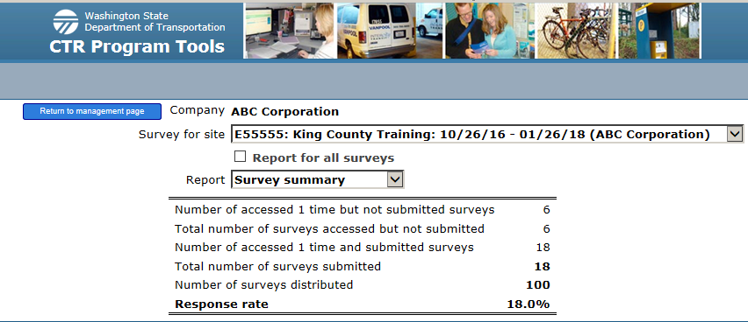
Step 6…Monitor survey success
During the survey check response rate and send reminders. A 70% response rate is your goal.
Successful response rates are directly correlated to awareness!

Slide 13
Step 7…Close out and submit survey results
The survey is open for ten (10) business days .
If the number of surveys distributed is different from the number of employees reported on the Survey Reservation form,
# Surveys
distributed
# Employees reported on your Survey Reservation form
Then email the new employee counts to Employer.Services@kingcounty.gov

Slide 14
Step 8…Need more help?
(Click on image for help)

Slide 15
That’s it!
Let’s make the 2017 Employee Survey your best yet.
Still have questions? We are here to help!
Contact us before your survey week.
Pamela.cook@kingcounty.gov
206-477-5819
Anne.ward-ryan@kingcounty.gov
206-477-5835
Employer.services@kingcounty.gov

Slide 16
Thank you!

