Slide 1
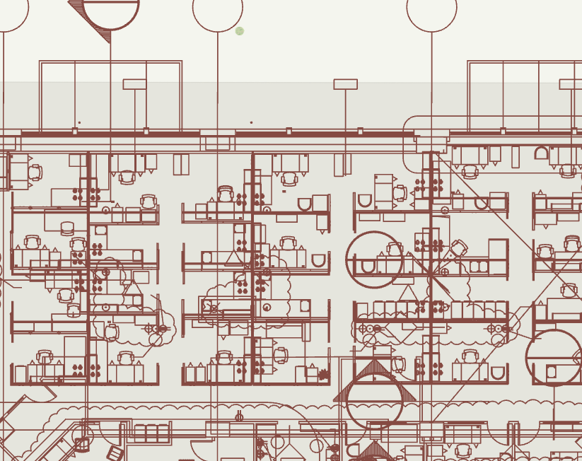
Using GIS Floor Plans for Office Space Coordination
Patrick Sowers
King County Wastewater Division

Slide 2
Background
Office Reorganization in Times of COVID-19
“We can pilot remote work for this one department (Natural Resources and Parks), and determine whether and how to expand across the County …to clean the air, ease gridlock, get more work done, and lead by example.”

Slide 3
Uses for GIS Floorplan
Move Staff from 5th Floor
Coordinate move out of workspaces
Equipment/office asset management
Safe Office Environment Moving Forward
Safe distance analysis
Pathways
Sanitation Stations
Staff Scheduling/Tracking

Slide 4
Products
1. GIS Layers of office spaces
2. Prototype staff scheduling system

Slide 5
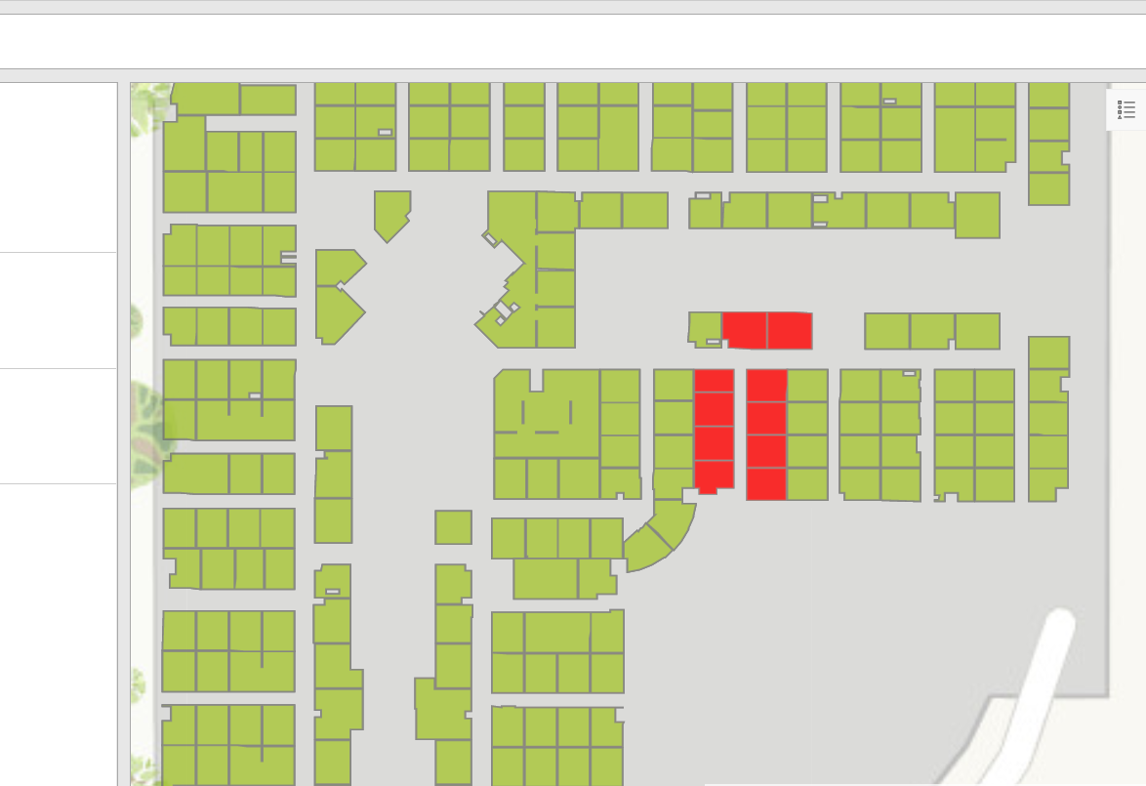
Goal - Staff Scheduling System

Slide 6
Software Options
ArcGIS Portal – App Templates
ArcGIS Indoors
More features, but likely more work to manage
Extra licensing costs

Slide 7
ArcGIS Indoors

Slide 8
Process
Data Development
Host Data
Staff Scheduling Form
Applications - Edit and Dashboard

Slide 9
Data Development

Slide 10
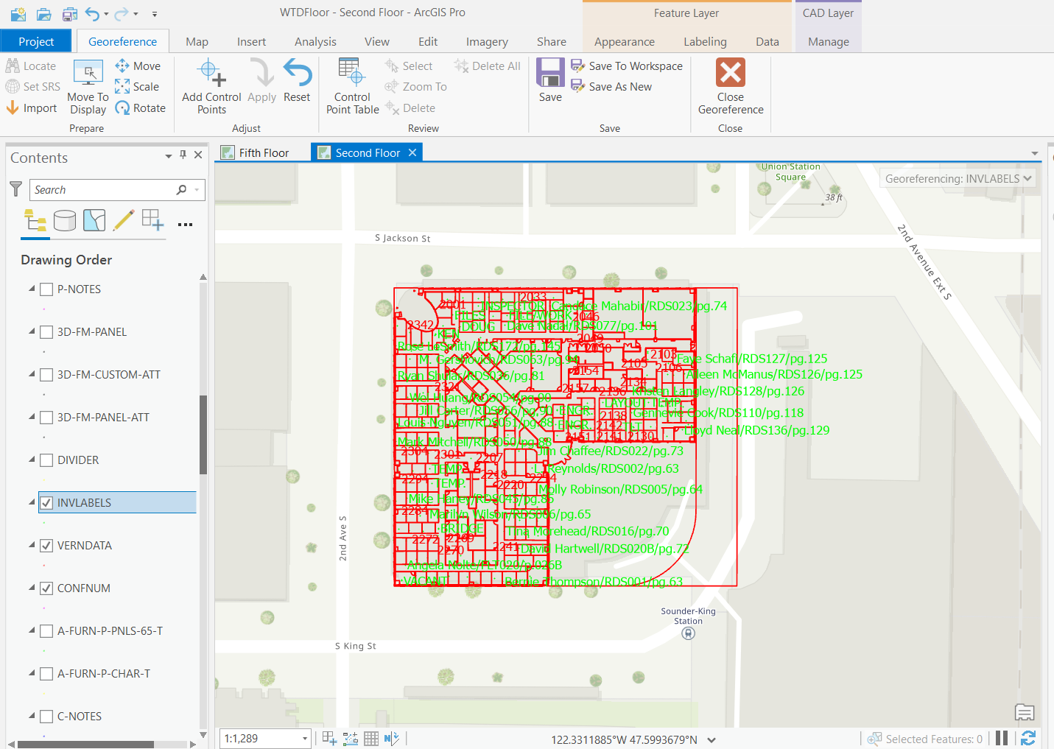
Data Development 1. Georeference CAD .dwg file 2. Convert to GIS Line Feature Class

Slide 11
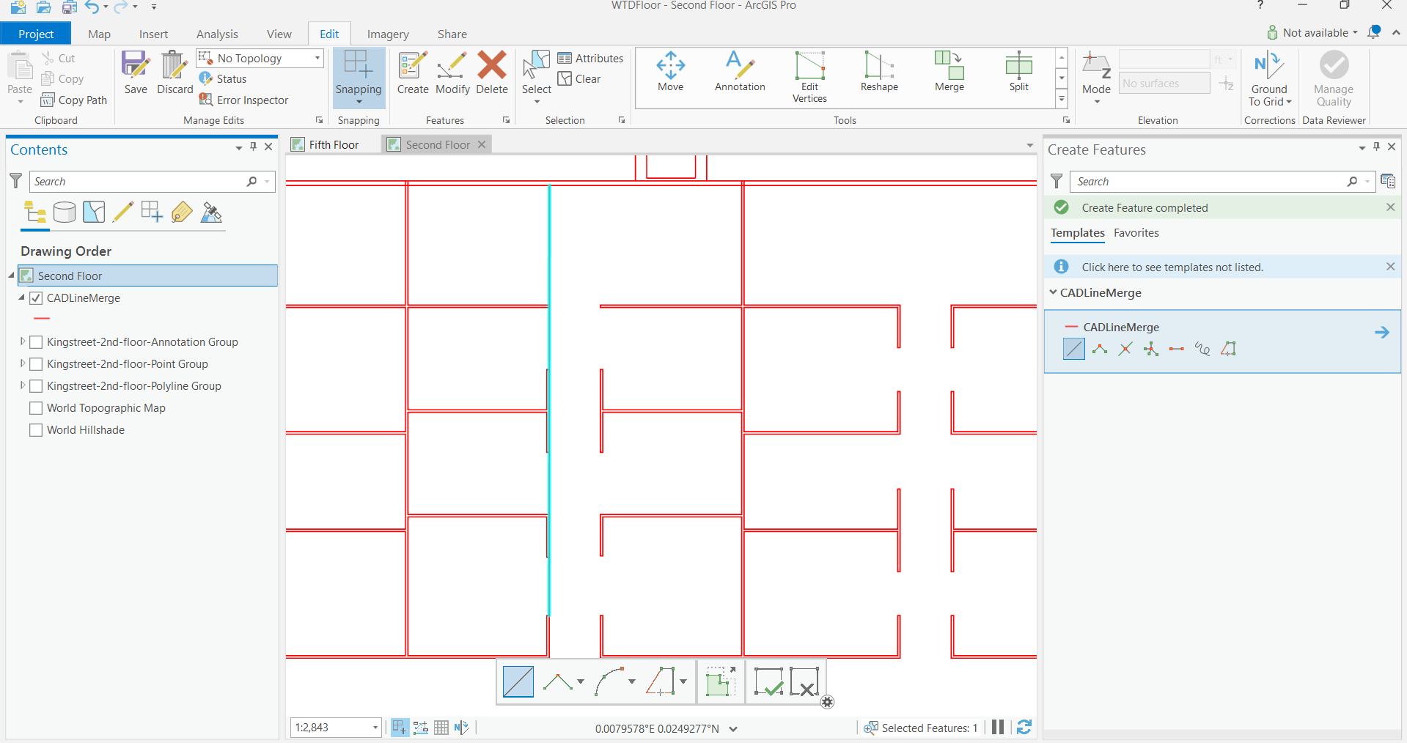
Data Development - Mind the Gaps

Slide 12
Creating Cubes – Feature to Polygon tool

Slide 13
Data Development - Sections

Slide 14
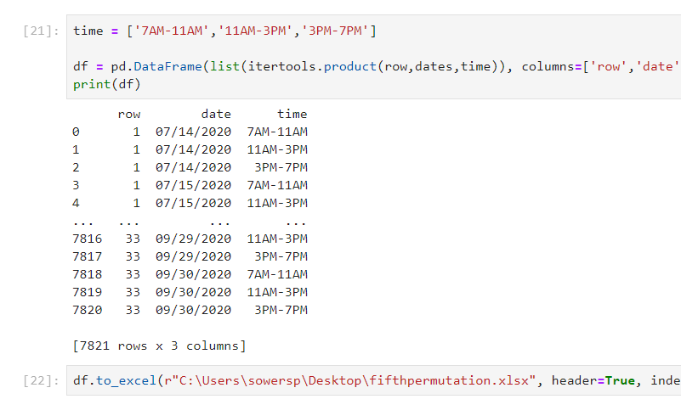
Data Development – Scheduling Table
Python itertools – permutation tool

Slide 15
Data Development – Host data to ArcGIS Portal
Cubes
Sections
Scheduling table

Slide 16
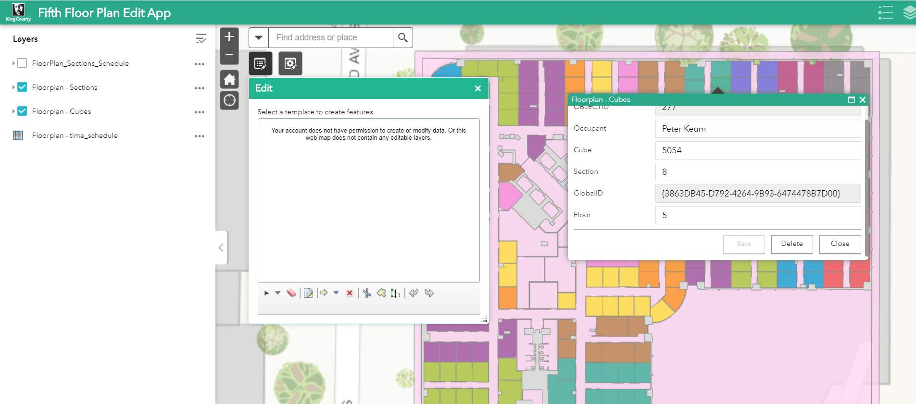
Making Edits - ArcGIS Web App Builder

Slide 17
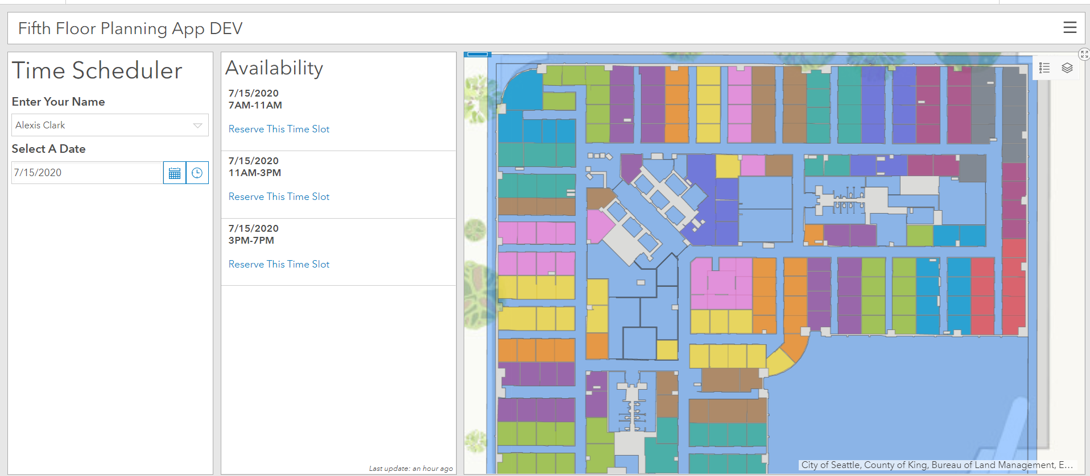
ArcGIS Dashboard - Scheduling App
Consumes Web Map

Slide 18
Survey123 Scheduling Form

Slide 19
Survey123 – URL Parameters
https://survey123.arcgis.com/share/565b9665721d4c04aa5f4a971f5fee36?portalUrl=https://gisenterprise-dev.kingcounty.gov/portal&mode=edit&objectId=5281

Slide 20
App Demo

Slide 21
Issues – Displaying Occupancy Status
Related Data – No good way to symbolize out of the box
SQL Views – Slow rendering
Multiple Features per Date/time – Slow Rendering

Slide 22
Future Development Opportunities
Calendar Integration
Automated Emails
Asset Management
Staff Tracking

