Slide 1
Putting People First: Nonprofit Wage & Benefits Survey
King County Veterans, Seniors & Human Services Levy | 501 Commons | February 2022

Slide 2
Just released!
Overall Favorability for All Questions:
86% - All Favorable
14% - All Unfavorable

Slide 3
Contact us if you have recommendations or questions
Nancy Long
Executive Director
ADD NAME
nancy@501commons.org
Study was conducted by
Rita Haronian
Principal
Nonprofit Compensation Associates
Margaret Hennings Farber 501 Commons Sr. Human Resources Consultant
(SPHR, SHRM-SCP and CCP - Certified Compensation Professional) from World at Work.
Margaret @501commons.org
Notes:
Nancy
Carol McCaulley Human Resources Consultant at 501 Commons
Rita is the co-founder and principal of NCA Nonprofit Compensation Associates. She has completed more than 5 studies .
Carol has more than 25 years of human resource experience. Carol has been very active in the nonprofit community for many years.. She has 5 degrees including a law degree with a focus on employment law with the from Northwestern School of Law at Lewis and Clark College.

Slide 4
About the Survey Nancy Long
1
The King County Nonprofit Wage & Benefits Survey Report contains salary information on 171 job titles, benefit offerings, and compensation policies.
This resource can help you set fair wages, recruit and retain talented employees, and strengthen our sector. Compare compensation data from several job titles: 501 Compensation Tracker: https://bit.ly/3If9YXk Download the report: https://bit.ly/34GFK1K
Share this information!
Notes:
Nancy

Slide 5
Putting People First: Wage & Benefits Survey
Outreach was conducted over 4 months to:
4,995 executives
349 influencers
531 finance & HR leads
233 organizations responded
Data on 10,000+ salaries categorized into 171 job titles
To assure data reliability, compensation for job titles reported by less than five organizations were not included
Next Report
The study will be repeated in 2023. We expect the results to be available by November 2023.
Purpose
The study illustrates nonprofit compensation and benefits practices within organizations that serve King County or are located in King County.
King County Nonprofit Wage & Benefits Survey Report
Goal
Help nonprofits offer competitive compensation and good benefits and maintain equitable compensation practices.
Notes:
Nancy
A critical challenge facing nonprofit organizations is attracting, recruiting, and retaining well-qualified professional and support staff. Our goal is that this report will help our sector offer competitive compensation, attractive benefits packages, and equitable policies. Accurate and comprehensive data on salaries and benefits in the nonprofit field will help organizations evaluate their own compensation and benefits practices and guide these policies moving forward. We use the phrase "Putting People First" as a call-to-action: Nonprofit organizations: Support the sector’s dedicated employees with competitive compensation and avoid operational practices which favor programs resources over people. This behavior perpetuates discriminatory pay for people of color, people not born in the U.S., people living with a disability, women, and others.
We have done a lot of work dispelling the “Overhead Myth,” but more work needs to be done to persuade funders and donors that “administrative costs” are important. Charity watchdog groups have altered their thinking in recent years in this regard, but the problem still persists. Our goal is to build a future where the people who carry out the important work of building and sustaining our communities feel supported and empowered to reach further heights in their nonprofit careers.

Slide 6
Call to action Strategies for change
Funders
Nonprofits
Support the full cost of services provided by nonprofits, including wages & benefits that are comparable to related sectors like government, education, health, & philanthropy
Contract with (provided grants to) nonprofits like you contract with businesses
State your intention to support the full cost of services including salaries above the living wage.
Inquire if the applicant’s salaries are above the living wage.
Improve compensation practices:
Develop a compensation policy
Implement a base salary =/+ the living wage
Examine salaries for internal pay equity
Benchmarking your salaries to organizations similar to yours
Set a goal for benchmarking to a higher level
Increase transparency of your practices
Address operational practices in recruiting, hiring, and promotions that perpetuate discriminatory pay
Determine the full cost of services and get that cost covered by grants and contracts or fees.
Notes:
Nancy

Slide 7
Benefits
2
Notes:
Nancy

Slide 8
Benefits
Insurance
Medical coverage: 85% of nonprofits offer some medical insurance to full-time employees
Eligibility for part-time staff: Among respondents that offer medical insurance and have part-time employees, 69% make coverage available to part-time employees who work a minimum number of hours.
Retirement
Type of plan: 70% of organizations provide some retirement benefit to full-time employees. Tax-sheltered annuities such as 401(k) and 403(b) plans are the most popular (49%), followed by IRA/SEP-IRA plans (21%).
Employer contribution: In 74% of organizations with retirement benefits, both the employer and the employee contribute to retirement.
Among organizations that contribute to retirement plans, 90% contribute a percentage of an employee’s salary. The average contribution is 4.66%.
Notes:
Nancy
Benefits: Insurance
Medical coverage: Eighty-five percent (85%) of surveyed nonprofits offer some type of medical insurance to full-time employees. Seventy-six percent (76%) of organizations offer a traditional health plan, 6% offer a cafeteria plan, 3% pay a stipend directly to employees so that they may purchase their own coverage, and 15% offer no insurance benefits.
Eligibility: Of the respondents that contribute to some type of medical insurance and have part-time employees, 23% indicate that only full-time employees are eligible; 69% indicate that their part-time employees are eligible for medical insurance coverage, as long as they maintain a minimum number of hours per week (on average, 23 hours per week), while 8% make their benefits available to employees regardless of the number of hours worked.
Retirement
Type of plan: Seventy percent (70%) of surveyed organizations provide some type of retirement benefit to their full-time employees. For these employers, tax-sheltered annuities such as 401(k) and 403(b) plans are the most popular type (49% of all organizations participating in this survey), followed by IRA/SEP-IRA plans (21%). Around three-fourths (74%) of those with retirement benefits have plans in which both the employer and the employee contribute to retirement. In 15%, only the employee contributes, and in 7%, only the employer contributes.
Employer contribution: Organizations that contribute to employees’ retirement plans were asked to describe that contribution. Ninety percent (90%) indicated that they contribute some percentage of each employee’s annual salary, usually the same for all employees. If the percentage increases with an employee’s length of service, organizations entered the highest percentage, or cap, of an employee’s salary that would be contributed. The range of all percent of salary responses is from 1% to 21%, with an average response of 4.66%.

Slide 9
Employers with PTO, 31% - same benefits to exempt and non-exempt
Employers offering distinct vacation, sick leave, and holidays, 59% provide the same benefits to exempt and non-exempt
85% allow unused vacation or PTO to be carried over
63% have separate vacation, sick leave, and holiday benefits
33% have “Paid Time Off” (PTO)
35% allow employees to “donate” unused PTO to an employee on medical or other extended leave
Time-off Practices
Offer separate vacation, sick-leave, and holidays:
84% give PT employees paid vacation, generally pro-rated.
Offering PTO:
Average starts at 18.5 days in the first year, up to 27.7 days after 11+ years of employment.
Notes:
Nancy
Benefits: Paid Time Off
Sixty-three percent (63%) of participating nonprofits provide full-time employees with specific, separate numbers of paid days off for vacation, holiday and sick leave.
Thirty-three percent (33%) have a PTO (Paid-Time-Off) program instead, giving employees a set number of days off to be taken for any purpose.
Another 4% have some other policy. Most of these are small organizations with a less formal policy.
Eighty-four percent (84%) of nonprofits that offer separate paid vacation time offer it to their part-time staff. More than half of these organizations (55%) require that those employees work a minimum work schedule to be eligible, with an average of 21 hours per week required.
Ninety percent (90%) of participants report a formal policy regarding paid time off with one vacation schedule for all employees, which often gives an increasing number of vacation days the longer an employee remains with the organization; 6% have two or more schedules depending on the type of employee. Many of the remaining 4% have a less formal policy.
Surveyed nonprofits provide an average of 10.4 paid holidays and 10.9 paid sick days per year.

Slide 10
Using the Compensation Data
3
Notes:
Rita

Slide 11
Compensation Tables
The report includes 171 pages of job listings with
Position descriptions
Base salary
Eligibility for incentive/Bonus
Bonus paid
Total compensation
Salaries sections by
Budget categories
Field of service
FTEs
Employees managed
If a field has less than 5 data points reporting, the cell is left blank.
Notes:
Rita

Slide 12
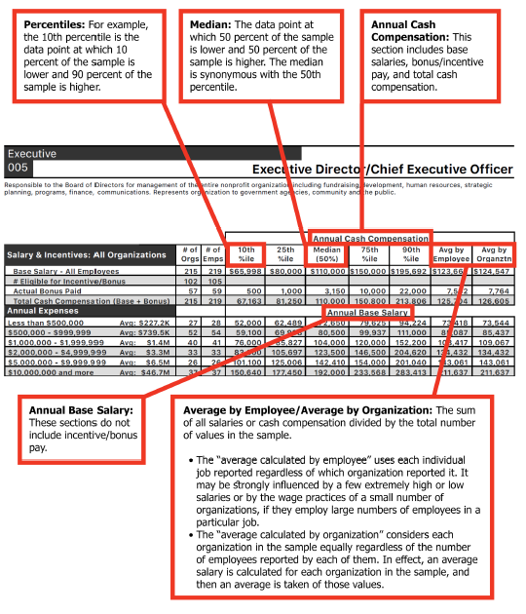
Notes:
Rita

Slide 13
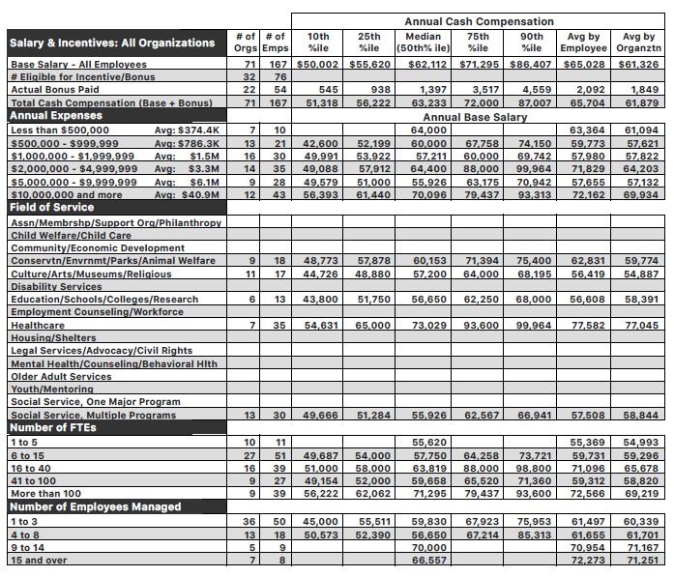
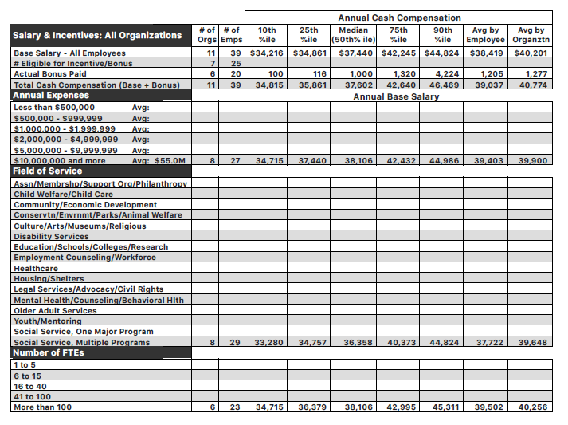
Amount of information varies based on how often the job was reported
Program Manager
Driver
Notes:
Rita

Slide 14
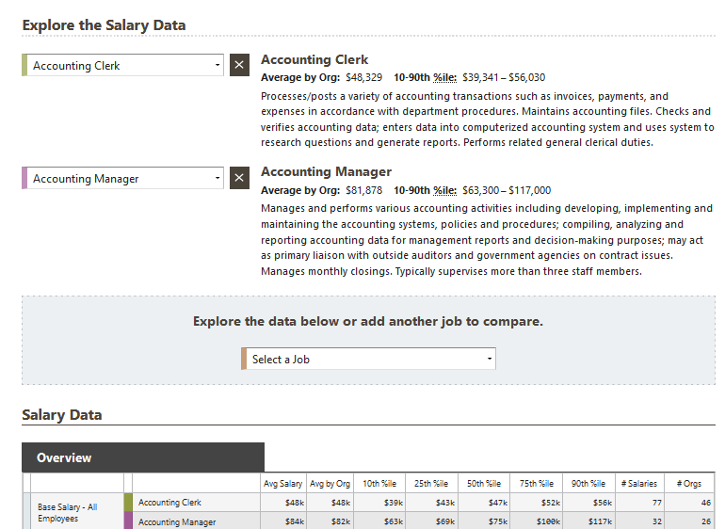
501 Compensation Tracker on the 501 Commons website allows you to compare two or more job summaries and salaries. This is important because many nonprofit jobs have a unique mixture of roles that need to be considered in determining compa-ratios. This information is free to nonprofits and to employees. This will give employees the ability to evaluate how their pay aligns with the comparable jobs in the nonprofit sector.
Notes:
Nancy

Slide 15
Adjusting the data for time
To update the salaries in the report, increase them by a minimum of.25% for every month after March 2021. This would provide a 3% annualized increase.
Notes:
Nancy

Slide 16
Compensation Practices Margaret Henning Farber
4
Notes:
As I talk about compensation philosophy – please know we are talking about a TOTAL Rewards philosophy.
If I use any terms that I have not defined – please raise your hand!! (we HR pros do this a lot)
Also know that while you may not be the individual that has the agency or responsibility to make the changes that this presentation recommends we want you to have the information to share this with your organization – so please ask questions! Additionally, I am guessing that all have you have either been effected by turnover, being unable to find staff or feeling underpaid…yes??
Please also know that there will be a resource sheet that will be given that will give you more resources to assist your understanding

Slide 17
Compensation Philosophy
What is a compensation philosophy?
Why should our organization have a compensation philosophy?
How should we go about developing one?
Notes:
In reviewing my practice with nonprofits over the last two years, I reviewed what organizations have had the most successful pay programs, and they were those that had a thoughtfully developed and thoroughly communicated compensation philosophy.

Slide 18
What is a compensation philosophy?
A document outlining your position and goals for employee compensation that is communicated to staff
Two components
Philosophy statement for all pay practices and
Practice guideline for all things related to employee pay
Notes:
Yes – you need to put it in writing! A statement of intention is not enough.

Slide 19
Sample Statement
“Reward employees fairly for meaningful work. Pay competitively to similar work at organizations like ours, and equitably to similar positions in our organization”
Great start, but…..
A 2021 World at Work survey showed that while 62% of organizations have a compensation philosophy only 50% of employees understood it
Notes:
This is where the practice guidelines come in
The reasons
Not written down
No written guidelines explaining how it was applied
We will go into guidelines in a moment after we discuss why we should so a compensation philosophy
Explain World at Work

Slide 20
Why a compensation philosophy?
Cultural reasons for a compensation philosophy
Best way to insure you are paying fairly and equitably – your built in “backstop”
Keeps employees aware of the organization’s available resources
Reinforces your organization’s mission, vision, and values
Encourages transparency and hard conversations
Notes:
Reinforces your credibility….
Everyone has the same playbook

Slide 21
Why a compensation philosophy?
Competitive Reasons
Clarifies expectations for current staff – assisting in retention
Attracts candidates that are in alignment with your compensation parameters and philosophy
Expectation of transparency
Nearly 42% of Generation Z workers (ages 18-25) and 40% of millennials (ages 26-41) have shared their salary information with a co-worker or other professional contact, compared with 31% of Gen Xers (ages 42-57) and 19% of baby boomers (ages 58-76), according to a nationwide Bankrate survey from March.
Notes:
Many of you may have seen the Seattle Times article from May 8 that cited the Bankrate Survey above. Gone are the days, legally, where one can say, “don’t talk about your pay”
Recently saw an ERI blog that encourages organizations to share ranges in the offer letter, how often increases happen and what they are based on
Explain ERI

Slide 22
Why a compensation philosophy?
Regulatory Reasons
Employment Laws
Federal and State
Title VII, ADEA (Age Discrimination in Employment Act), WLAD (WA Law Against Discrimination Act), etc.
Compensation Laws
Federal and State
FLSA (Fair Labor Standards Act), Equal Pay Act of 1963, Lily Ledbetter Act, WMWA (WA Minimum Wage Act), WA EPOA (WA Equal Pay and Opportunities Act)
Notes:
Each of the employment laws above prohibits discrimination in employment practices, which includes compensation, based on protected criteria

Slide 23
WA Equal Pay and Opportunities Act (WAEPOA)
Requires Internal Pay Equity
Ensure that all jobs that are similar in terms of skill effort, responsibility, and working conditions are compared to one another and paid equitably
It is not enough to compare based on job title
WA law states gender only; this is not best practice
Notes:
TALK A BIT ABOUT POSTING
Make sure that you are in compliance with WA EPOA by including an internal pay equity review in your compensation philosophy
What does the internal pay equity review mean? Expand on above

Slide 24
How to develop a compensation philosophy?
SEVEN Important Questions
How does this philosophy support our mission, vision, and values?
What counts as employee compensation?
How should we structure our salary ranges?
How should we increase pay?
How transparent should the process be?
How can we drive greater pay equity?
How do we communicate this?
Notes:
One of my clients who is committed to providing low income housing has a pay practice that has lowest workers at a higher comparatio (define compa-ratio)
This is where we start to use the term TOTAL REWARDS
Determine not only width and overlap, but percentage between ranges, what if someone is at the top? Need to explain what salary ranges are.
COLA, merit, seniority, throwing a dart at a board
Remember earlier
Follow the WA EPOA
Over communicate

Slide 25
How to develop a compensation philosophy?
SEVEN Important Tips
Engage your board in the process.
Tie to your strategic plan (e.g.: will you be adding staff)?
Seek out samples and practices that have worked for similar organizations.
Do backwards planning and timing.
Commit to over-communicating with your team.
Empower your managers to be the ones to answer questions – THAT is how transparent it should be.
Include HR challenges in your philosophy (recruitment, hiring out of state, in place CBAs, retention, etc.).
Notes:
Let me talk about geographic differentials for a moment
CBAs?

Slide 26
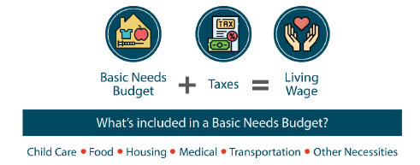
What is the “living wage?”
The Living Wage Calculator was created by Dr. Amy K. Glasmeier (MIT). It is updated in the first quarter of every year.
Using the King County (Seattle WA area) tables, the 2021 living wage for a single person is $19.57, and for two working adults and a child, it is $19.68. If you use the average of these rates and apply a 3% escalator, the rate would be $20.22. The base annual rate would be $42,058.
Notes:
Margaret

Slide 27
Living Wage
There are 3,000 counties in the United States.
In how many of these counties would the minimum wage be considered a living wage?
218
Notes:
Margaret
Why is it important to stabilize these lower paid workers with a living wage?

Slide 28
Please promote the report & discussion of the issues facing nonprofits
501 Commons will continuously promote the report through monthly newsletter articles and social media posts throughout 2022.
Additional discussions and trainings will be arranged based on feedback and requests in the public briefings.
Please share the report!
Talk with your staff and board members about the compensation problem nonprofits face.
Talk to legislators, councilmembers, and philanthropy.
Notes:
Nancy

