Slide 1
Evictions After the Moratorium

Slide 2
About the Housing Justice Project
Serve tenants facing eviction who have received a Summons, court date, or writ of restitution to be evicted
Can assist on other claims based on capacity
Assists tenants with emergency rental assistance
More information at housingjusticeproject.org

Slide 3
What Causes Eviction?

Slide 4
Causes of Eviction (2019 King County)
Lease violation/ Behavior | 183
Mutual termination | 40
No cause termination/expiring lease | 192
Nonpayment of rent and/or other charges | 3914
Other | 96
Unauthorized occupant(s) | 51
Grand Total | 4476

Slide 5
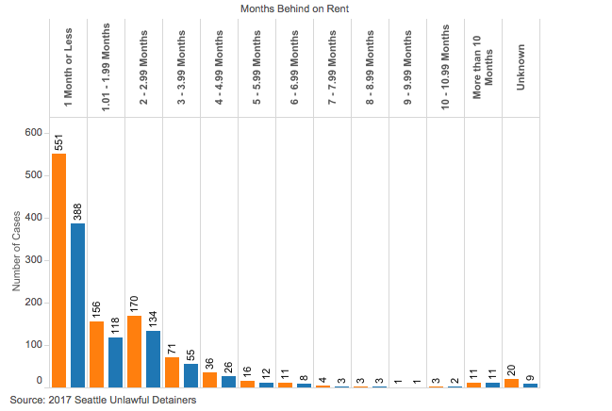
The majority of evictions are for one month of rent or less

Slide 6
King County Renter Demographics
72% of Black Households Rent
69% of Latinx Households Rent
37.3% of White Households Rent

Slide 7
In Pierce County, 1 in 6 black adults has had an eviction between 2013 and 2017.
In King County, 1 in 11 black adults has had an eviction in King County over the same time period.
For white adults, 1 in 50 in Pierce County and 1 in 100 in King were evicted.
Prior to 2021, only 8% of unlawful detainer defendants in WA had legal representation at some point in their eviction process.

Slide 8
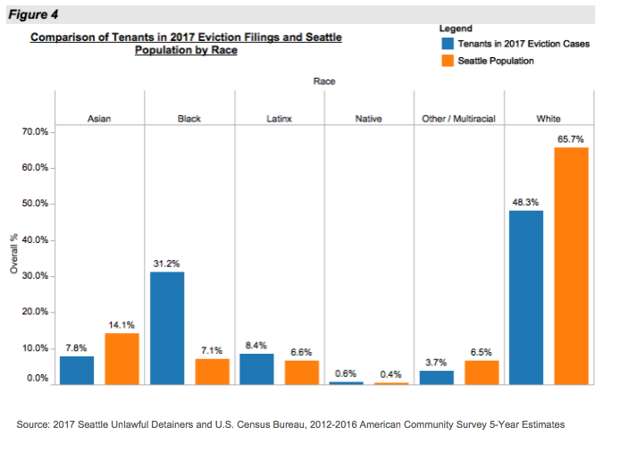
Who is impacted by eviction?

Slide 9
Demographics of Individual Seattle Landlords (%)

Slide 11
Current Trends

Slide 12
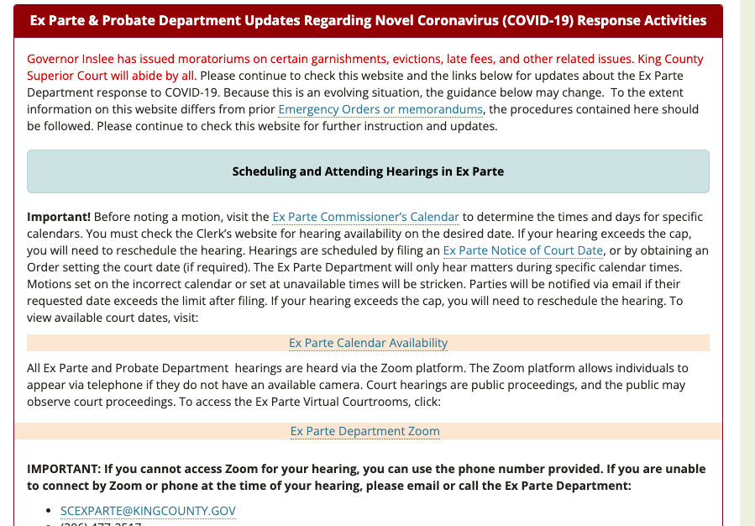
Court Process:
Only Burien has an active eviction moratorium
After Seattle lifted its own on 2/28/2022, we have seen roughly 2,100 calls in March compared to 1,100 in February
The Dispute Resolution Center provides some mediation services through June, 2023
Eviction hearings are over Zoom

Slide 15
How do nonpayment of rent evictions work?
If tenant misses rent payment:
Landlord must offer a reasonable repayment plan
Landlord must provide information about the Eviction Resolution Pilot Program
If tenant fails to respond or refuses payment plan, then:
Landlord serves a 14 day notice to pay or vacate (may be longer for some properties)
After 14 days, Landlord can serve a Summons to start a court case.
Tenant has 7 days to respond to the Summons
If Tenant responds, the Landlord will schedule an eviction hearing with the court.
At that hearing, if tenant loses, then Landlord can evict in five court days.

Slide 16
The Tenant can still stop the eviction:

Slide 17
Rental Assistance Pledges
A non-profit or government agency can issue a pledge letter to tender the amount
Landlord must accept the pledge and stop all court activity upon receipt. RCW 59.18.410(2)

Slide 18
Common Issues
Landlords refusing rental assistance
Tenants not being processed in time for rental assistance
Tenants signing mutual terminations when Landlord refuses or due to other pressure
Tenants missing court dates
Tenants not receiving proper notice to vacate
Landlords ignoring the new Just Cause Law

Slide 19
Landlords Refusing Rental Assistance
Housing Justice Project can assist
May violate Anti-Source of Income Discrimination Laws (RCW 59.18.255) and RCW 59.18.410(2)
Some landlords do not understand the terms

Slide 20
Tenants not being processed in time for rental assistance
If tenant has a Summons, court date, or writ of restitution, Housing Justice Project can request to expedite the application

Slide 21
Tenants signing mutual terminations when Landlord refuses or due to other pressure
Tenants should not be giving up rights without speaking to an attorney
Some tenants are giving up rights at the Dispute Resolution Center’s Eviction Resolution Pilot Program
Seattle and Federal Way have specific protections against this
RCW 59.18.650 and RCW 59.18.230 prohibit a tenant from waiving protections
Housing Justice Project can assist tenants being evicted after waiving rights

Slide 22
Tenants missing court dates
Roughly half of tenants are missing their court dates
The Superior Court’s process is difficult to navigate for many tenants
Some don’t have phones or computers to log on to Zoom
Housing Justice Project sends a letter to each tenant with a filed court case
Housing Justice Project provides in-person services at the courthouses in Seattle and Kent where evictions take place for persons who need assistance with getting to their court date

Slide 23
Tenants not receiving proper notice to vacate
New changes went into effect requiring new notices
Federal law requires a 30 day notice to vacate for any tenants in subsidized or federally-insured properties
*state law provides for 14 days to vacate for a tenant who falls behind on rent
Tenants should be receiving notices under RCW 59.18.650 (just cause law) or local ordinances (Seattle, Unincorporated King County, Auburn, Federal Way, Burien)

Slide 24
Landlords ignoring the new Just Cause Law
New law requires a landlord have “cause” to evict as cited in RCW 59.18.650
Local laws may provide greater protection in Seattle, Federal Way, Auburn, Unincorporated King County, or Burien

Slide 25
W H O W E A R E
LCYC protects the interests and safety of youth in Washington by advancing their legal rights. We accomplish our mission through direct legal representation, strong community partnerships, and systemic advocacy.
LCYC is a legal services nonprofit that practices in four major areas: Child Welfare, Juvenile Court, Immigration, & Youth Homelessness
W H A T W E D O
LCYC provides free civil legal services to youth and young adults, aged 12-24, who are experiencing homelessness or housing instability in Washington state.

Slide 26
Eviction Prevention:
How can lawyers help address the underlying causes of evictions?
Rhea Yo – rhea@lcycwa.org
Director of Legal Services – Youth Homelessness Program

Slide 27
How can civil legal aid help prevent evictions?
Part 1: Understanding and advocating for tenants’ rights.
Part 2: Accessing safety for survivors of domestic violence.
Part 3: Accessing benefits and reducing debt.

Slide 28
Habitability issues and repairs
Landlord harassment
Illegal lockouts
Landlord negotiations
Understanding the terms of your lease
Security Deposits
Orders of Limited Dissemination
Tenants’ Rights

Slide 29
Habitability

Slide 30
Orders of Limited Dissemination

Slide 31
Safety for Survivors of Domestic Violence
Domestic Violence Protection Orders
Confidential Petitions for Name Changes
Ending your lease early
Rights in Subsidized Housing

Slide 32
Rights of DV Survivors

Slide 33
Accessing Benefits & Reducing Debt
01
Medical Debt, Fines/Fees (tickets), Consumer Debt
03
Benefits: Social Security disability or survivors’ benefits, TANF, Child Support
Identity Issues: Identification documents, Identity Theft, Name and Gender Marker Changes
04
Criminal issues: Vacating criminal records, reducing or waiving Legal Financial Obligations
02

Slide 34
Community Engagement and
Strong Partnerships
Holistic Legal Representation
Centering the client:
addressing multiple legal issues, meeting them in the community, accessible language and materials
Making Civil Legal Aid more visible and accessible
Understanding and addressing Nonlegal needs

Slide 35
Where to find a lawyer
Housing Justice Project
Eastside Legal Assistance Program
Legal Counsel for Youth and Children
Tenant Law Center
Solid Ground
Legal Voice
Benefits Law Center
Unemployment Law Project
TeamChild
Northwest Justice Project
Neighborhood Legal Clinics

Slide 36
Housing stability program
Eastside Legal Assistance Program
We are a nonprofit dedicated to working with people facing domestic violence, housing, financial, healthcare, immigration and other issues that need a legal solution.
We also educate communities about their legal rights.
We work for free to solve legal issues and provide resources for our community members because not everyone can afford a lawyer.
Legal aid is a tool that can prevent poverty and injustice.
Tenants who are facing eviction prior to receiving a Summons and Complaint
DV related lease breaks
DVPOs to necessary to maintain current housing
Repair requests / habitability issues
Reasonable accommodations
Subsidized housing terminations and/or denials
Other emergencies that affect tenant’s ability to pay rent

Slide 37
Subsidized Housing
Public Housing
Section 8 Housing Choice Vouchers
Project Based Vouchers
Project Based Rental Assistance
Section 2020 and Section 811 Programs for the Elderly or Persons with Disabilities
Low-Income Housing Tax Credits
USDA Rural Homeownership Programs
USDA Rural Rental Housing Programs
Photo by Brandon Griggs on Unsplash

Slide 38
Subsidized Housing: In Washington
204,900 people in 104,000 Washington households use federal rental assistance to afford modest housing
21% are seniors
32% have a disability
55% are families with children
Source: Center on Budget and Policy Priorities, Federal Rental Assistance Fact Sheets, January 19, 2022 https://www.cbpp.org/research/2022-federal-rental-assistance-factsheets-sources-and-methodology

Slide 39
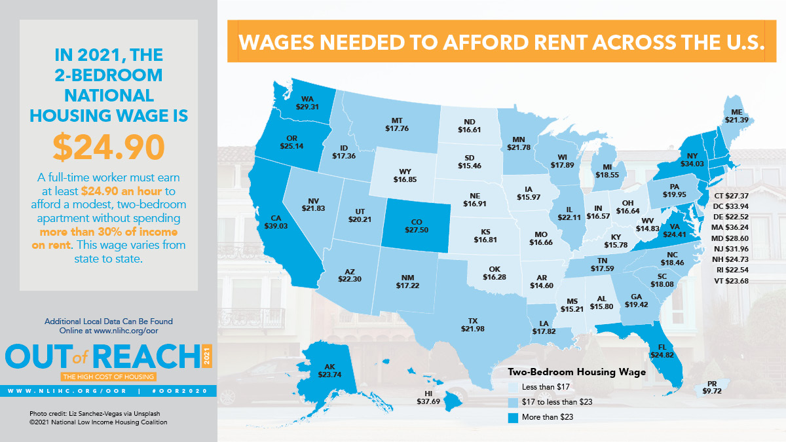
Subsidized Housing: In Washington
Washington has the 7th highest state housing wage in the country
Subsidized housing helps tenants remain housed
Loss or denial of the subsidy has devastating consequences

Slide 40
Subsidized Housing: Legal Intervention
Before Tenancy | During Tenancy | During Termination / Eviction
Application for subsidy is denied “Use it or Lose it” | Annual and Interim Recertification Issues Notice of Increase of Rent Payment Plans Failed Inspections | Termination of subsidy vs. termination of tenancy Administrative procedures and appeal rights Additional legal defenses
Bottom Line: subsidized housing issues can be complicated and convoluted and tenants are often unaware they have additional rights and protections. Loss of a subsidy is devastating and can affect tenant’s ability to be eligible for a subsidy in the future.

