Slide 1
Mental Health Literacy
Lauren Ashbaugh, Ph.D., NCSP
May 10, 2022
www.pacificnwpsychology.com

Slide 2
Mental Health LITERACY Objectives
Where are we now?
What can we do?
How do we do it?

Slide 3
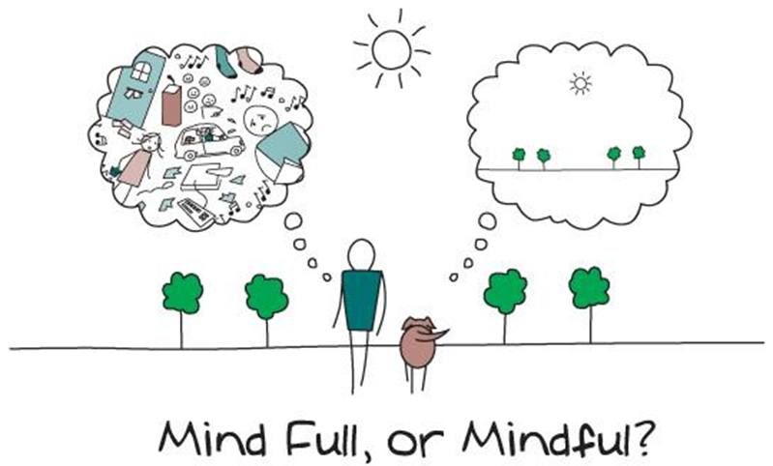
Lauren Ashbaugh, Ph.D., NCSP

Slide 4
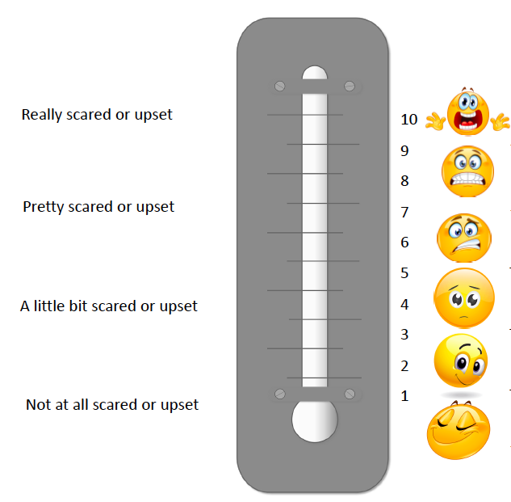
Feelings Thermometer
A.
Fists of 10 POLL:
How are you feeling about your work right now?
B.
C.
D.
Lauren Ashbaugh, Ph.D., NCSP

Slide 5
Strongest feelings you are having right now?
(Choose as many as you’d like. Feel free to use your own words, too!)
Low energy/tired
Overwhelmed
Relaxed/happy
Frustrated/angry
Hopeful/optimistic
Worried/afraid
Sad/Depressed
Anxious/stressed
Connected/belonging
Grieving/mournful
Disappointed
Isolated/lonely
Confident
Grateful/thankful
Uncertain/cautious
Confused
Silly/playful
Excited
Lauren Ashbaugh, Ph.D., NCSP
Notes:
As this slide appears, have them choose the strongest feelings they’re having right now. If you can anticipate difficulty with definitions/reading, read and explain them as you go.

Slide 6
Notice: Emotional Granularity
I’m feeling…. nervous
I’m feeling….nervous
excited
hopeful
wanting connection
capable
drained
apprehensive
self-conscious
stressed
Lauren Ashbaugh, Ph.D., NCSP

Slide 7
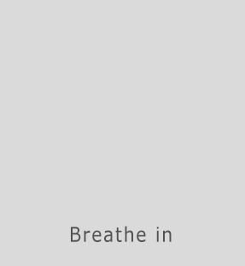
Lauren Ashbaugh, Ph.D., NCSP
Notes:
See, Smell, Touch (feel), Taste, Hear

Slide 8
Gratitude
Lauren Ashbaugh, Ph.D., NCSP

Slide 9
Feelings Thermometer
Lauren Ashbaugh, Ph.D., NCSP

Slide 10
My Requests
Do your best to be present.
Be kind to yourself.
Remember that vulnerability often leads to growth.
Do no harm.
Lauren Ashbaugh, Ph.D., NCSP

Slide 11
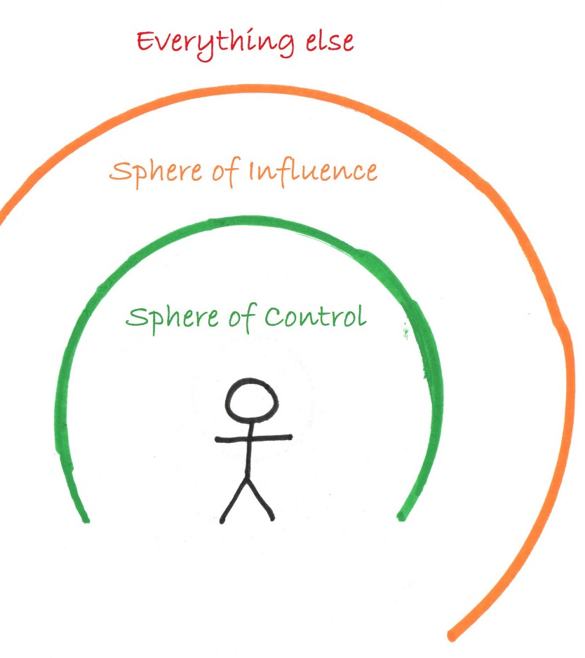
What do you control?
What can you change?
What do you need to accept?
Lauren Ashbaugh, Ph.D., NCSP

Slide 12
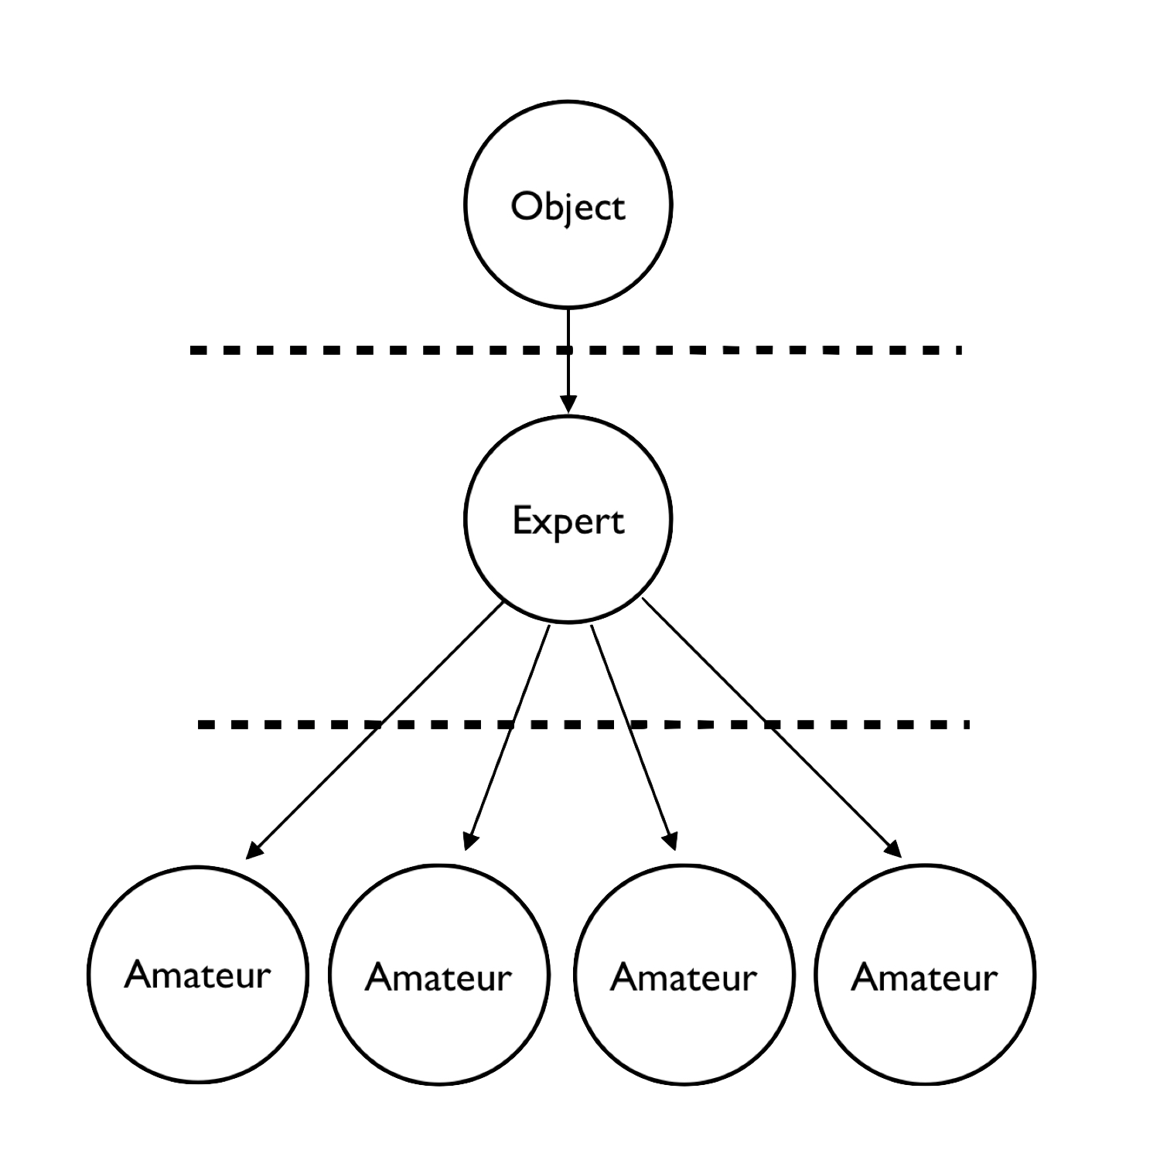
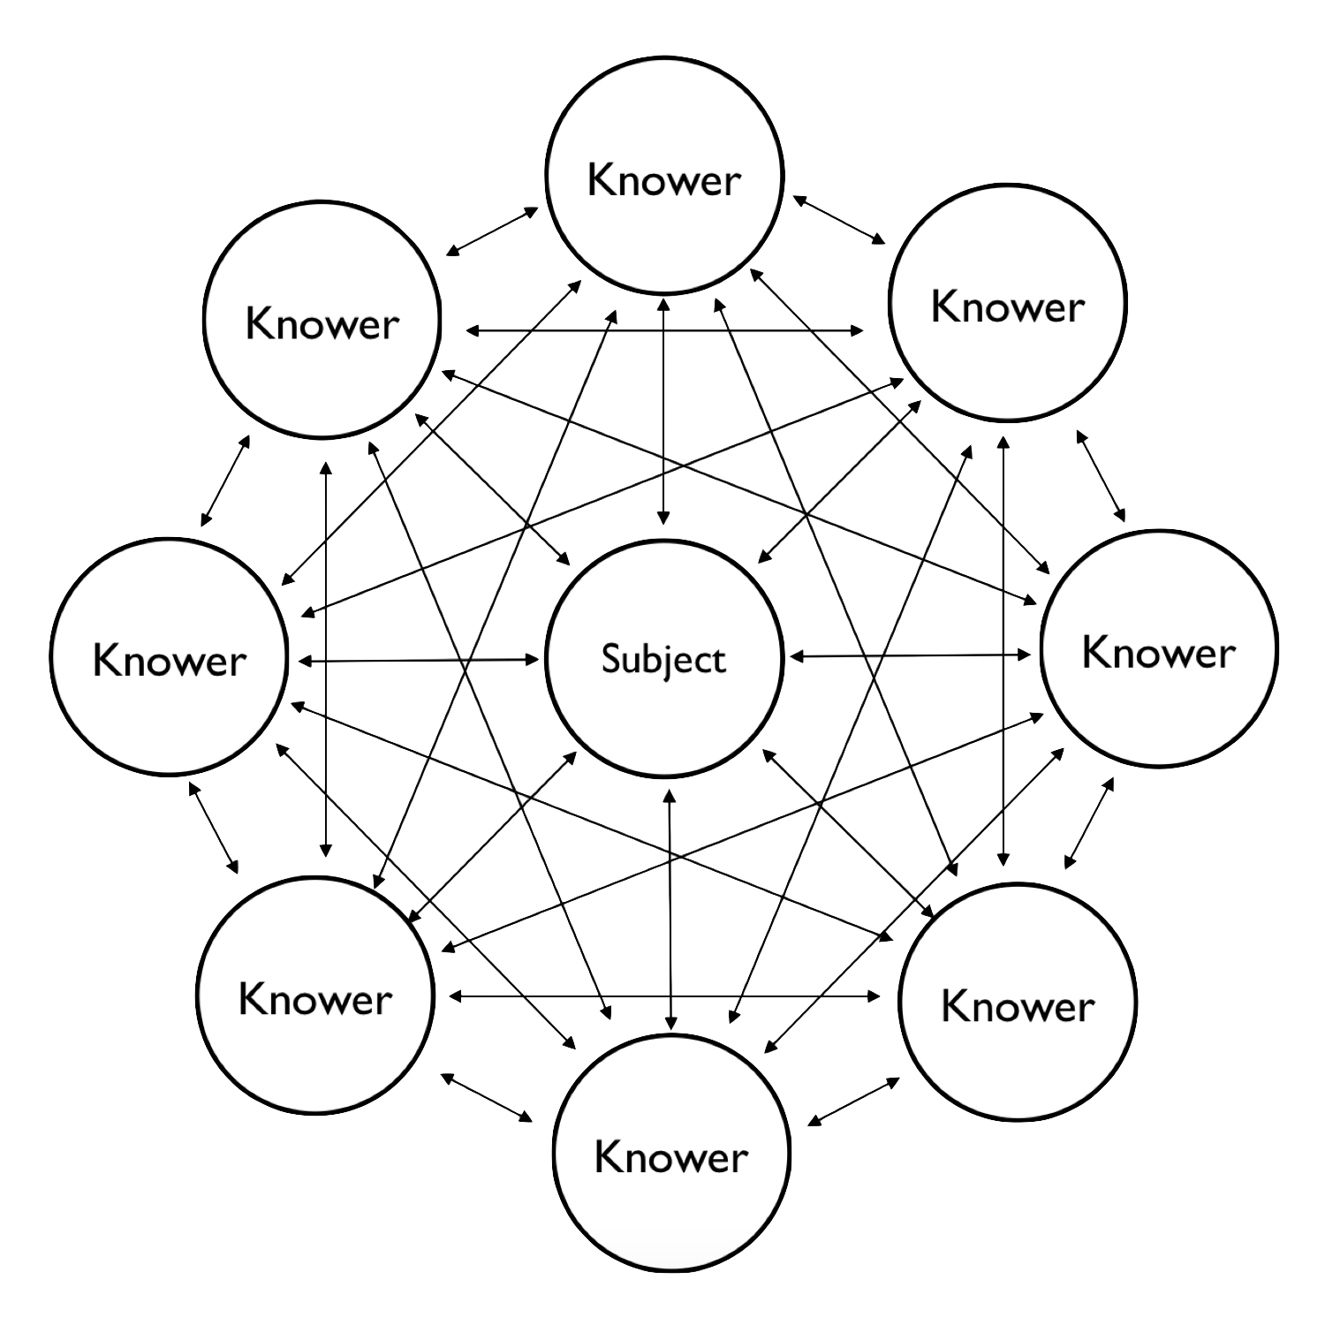
Frame: We are all knowers of Mental Health
Mental Health
Mental Health
Lauren Ashbaugh, Ph.D., NCSP

Slide 13
What is mental health?
Mental health includes our emotional, psychological, and social well-being. It affects how we think, feel, and act. It also helps determine how we handle stress, relate to others, and make healthy choices.¹
-CDC, 2022
Lauren Ashbaugh, Ph.D., NCSP
Notes:
Citation: National Center for Chronic Disease Prevention and Health Promotion, Division of Population Health

Slide 14
What is mental ILLNESS?
Diagnosable mental disorders:
Significant changes in thinking, feeling, and/or behavior
Distress and/or functional impairment
*Work, school, family, relationships
Can we reasonably separate mental and physical health?
Lauren Ashbaugh, Ph.D., NCSP
Notes:
SMI: Diagnoses that involve psychosis or require high levels of care, such as hospitalization

Slide 15
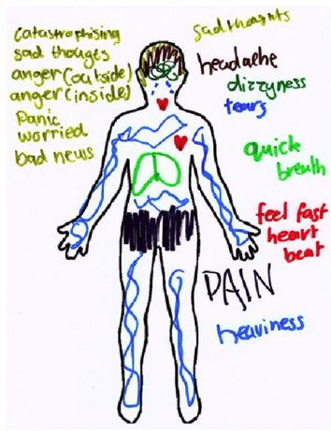
Physical Symptoms Of Mental Illness
Insomnia (trouble sleeping)
lightheadedness
Racing heart
sexual problems
shortness of breath
stiff neck
sweating
upset stomach
weight gain or loss
back pain
change in appetite
chest pain
constipation or diarrhea
dry mouth
extreme tiredness
general aches and pains
headaches
high blood pressure
Lauren Ashbaugh, Ph.D., NCSP

Slide 16
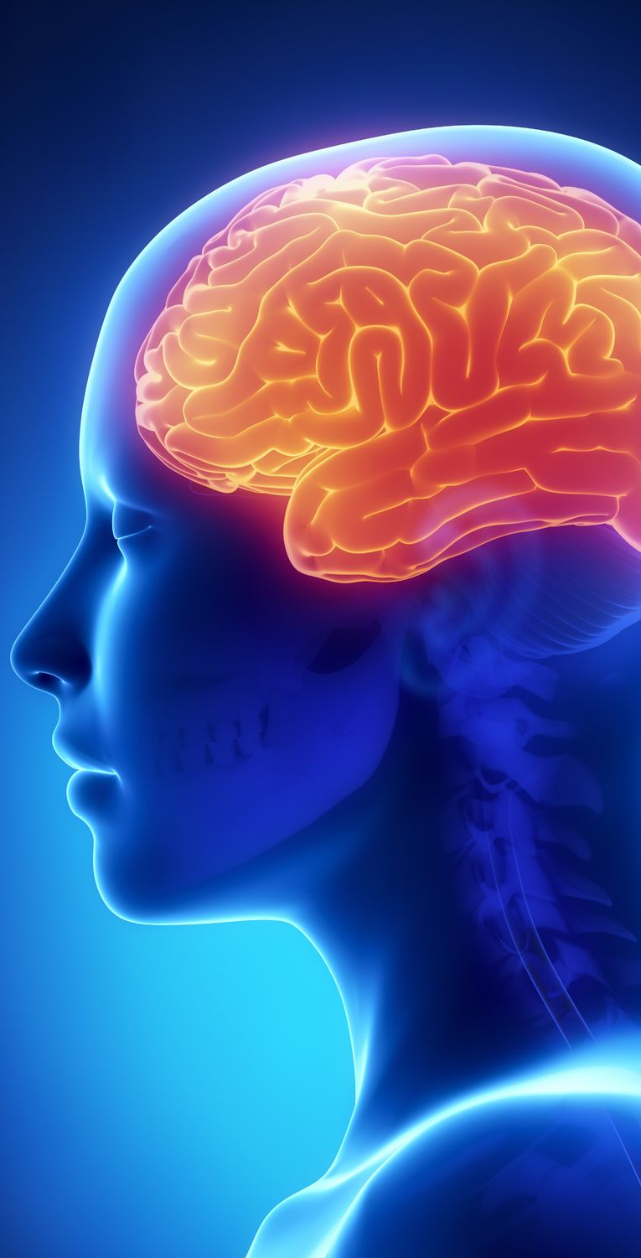
Metal Health: History & Western Dualism
Plato: Mind vs. Body
Catholicism: Mind over Body
Descarte: Mind-Body dualism
Darwin
Freud
What is your body?
What is your mind?
What is your soul?
Lauren Ashbaugh, Ph.D., NCSP
Notes:
Citation: National Center for Chronic Disease Prevention and Health Promotion, Division of Population Health

Slide 17
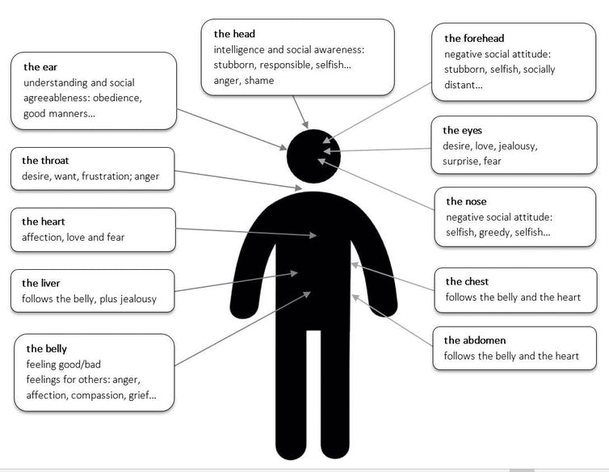
EXPLORE: Where are emotions in the body?
Distribution of emotions across the body, based on 67 Indigenous languages of Australia. Maïa Ponsonnet, 2021
Lauren Ashbaugh, Ph.D., NCSP
Notes:
Seeking truth
Engaging authentically
Positive action

Slide 18
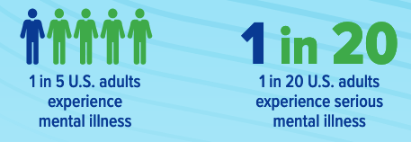
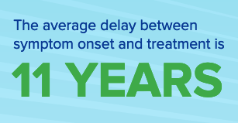
Adult Mental Illness: United States
Source: Statistics summarized by NAMI, 2020

Slide 19
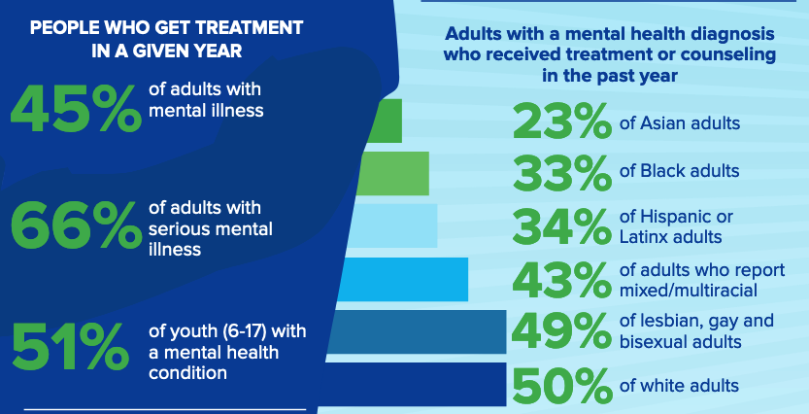
Adult Mental Health: United States
Source: Statistics summarized by NAMI, 2020

Slide 20
Adult Mental Health: United States
Source: Statistics summarized by NAMI, 2020

Slide 21
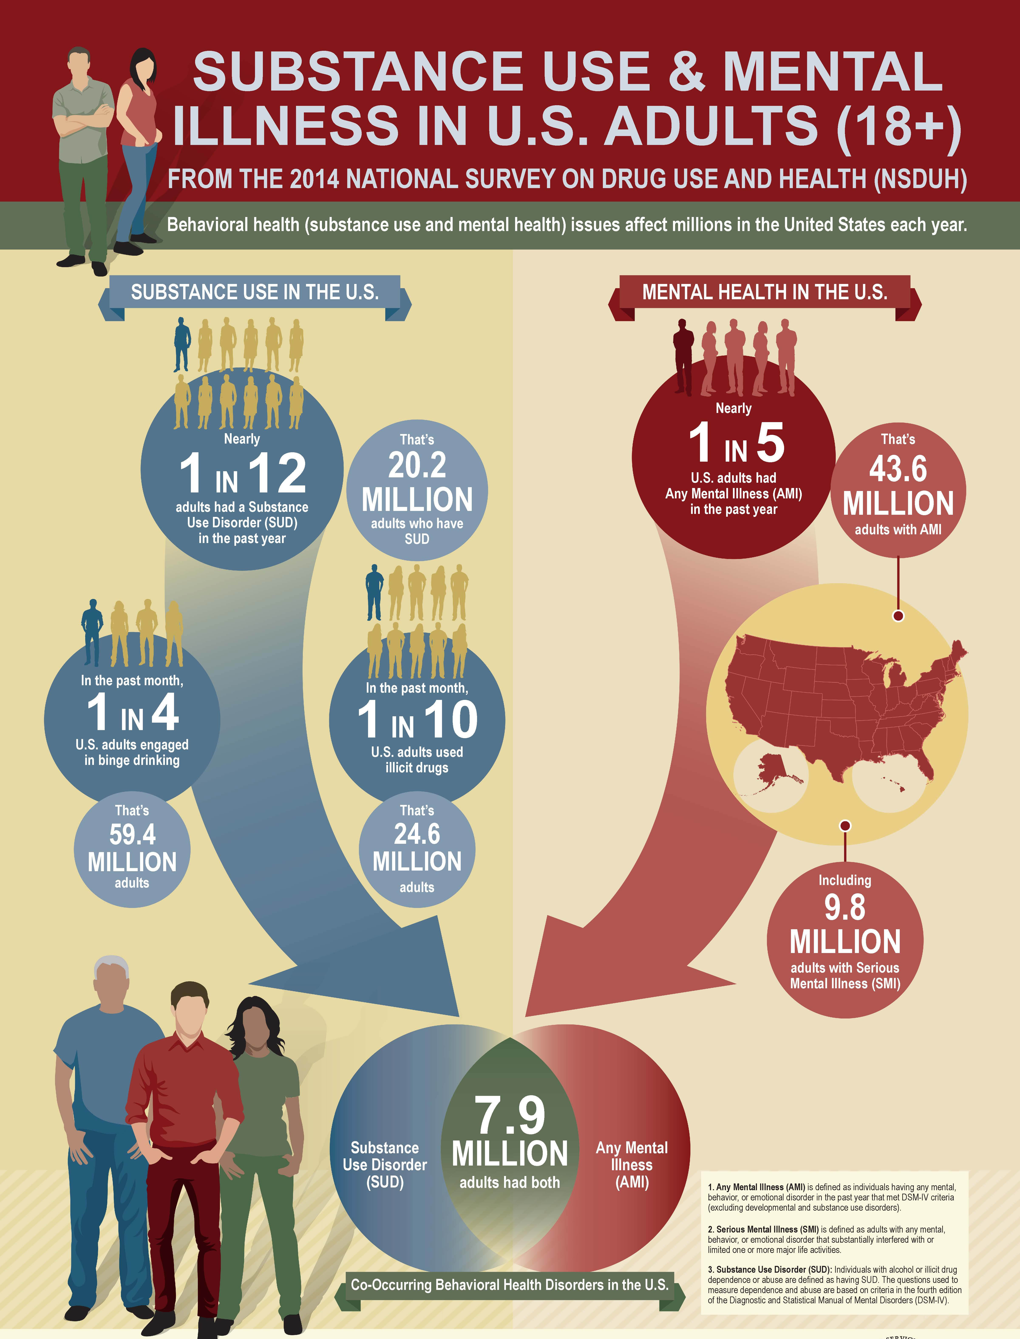
Lauren Ashbaugh, Ph.D., NCSP

Slide 22
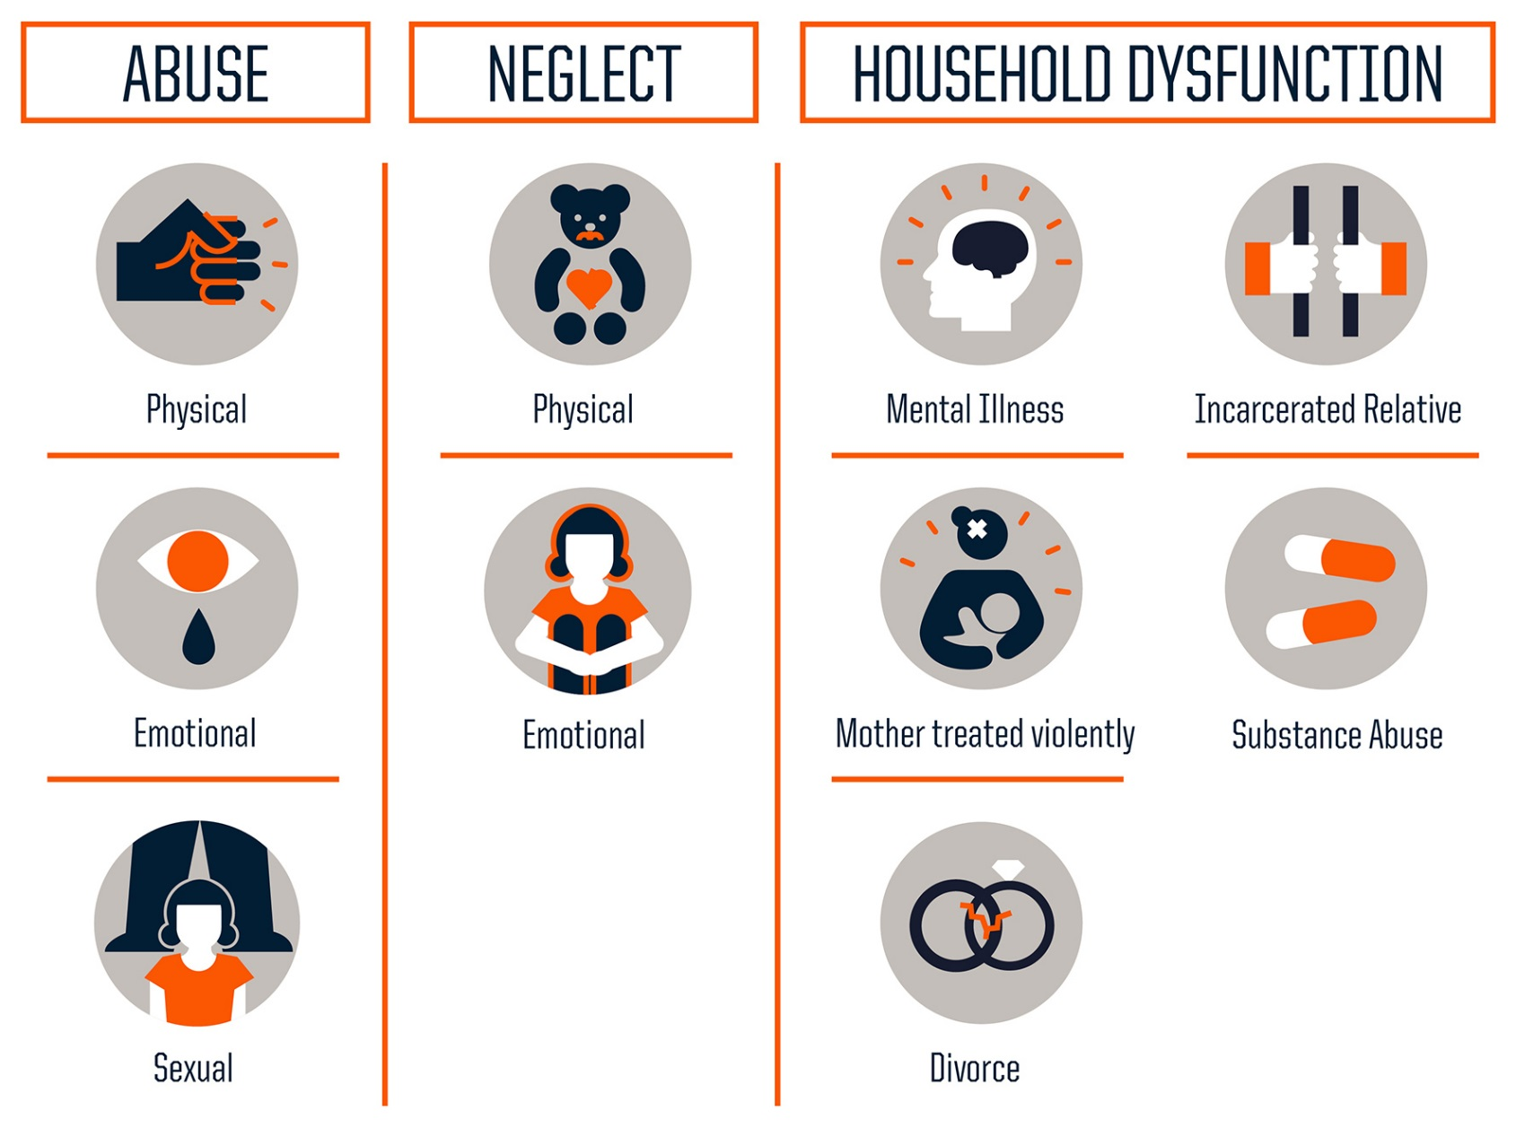
What are Adverse Childhood Experiences (ACEs)?
Source: Robert Wood Johnson Foundation
Lauren Ashbaugh, Ph.D., NCSP

Slide 23
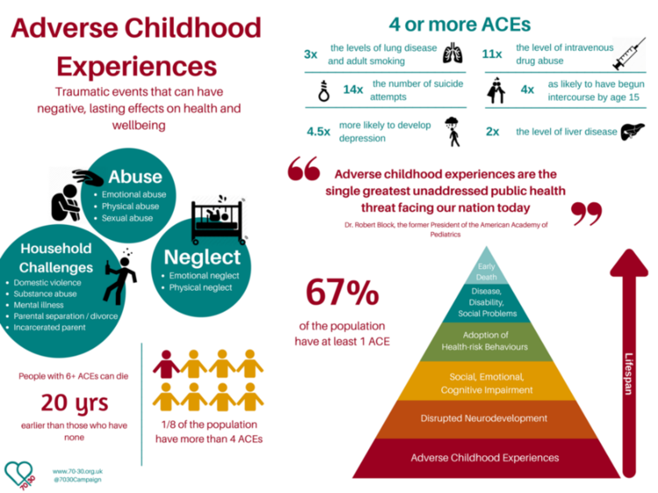

Slide 24
ACEs and Homelessness
Lauren Ashbaugh, Ph.D., NCSP

Slide 25
Mental Health & Covid 19

Slide 26
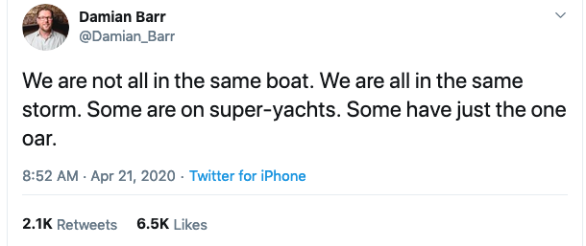
Disproportionality
Lauren Ashbaugh, Ph.D., NCSP

Slide 27
Chronic exposures
Rejection
Exclusion
Oppression
BELONGING
Threat
VALUE
Neglect

Slide 28
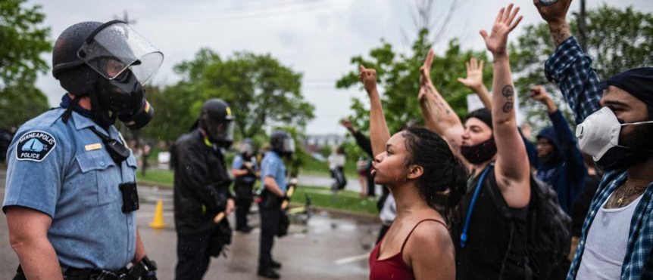
A Pandemic of Racism
@_afrodiziak -Jane Cartwright
Lauren Ashbaugh, Ph.D., NCSP

Slide 29
The “Weathering¹” Hypothesis
Chronic exposure to social and economic disadvantage leads to accelerated decline in physical health outcomes and could partially explain racial disparities in a wide array of health conditions.
1. Geronimus, AT 1996; Forde et al, 2019 Annals of Epidemiology (33)
Lauren Ashbaugh, Ph.D., NCSP

Slide 30
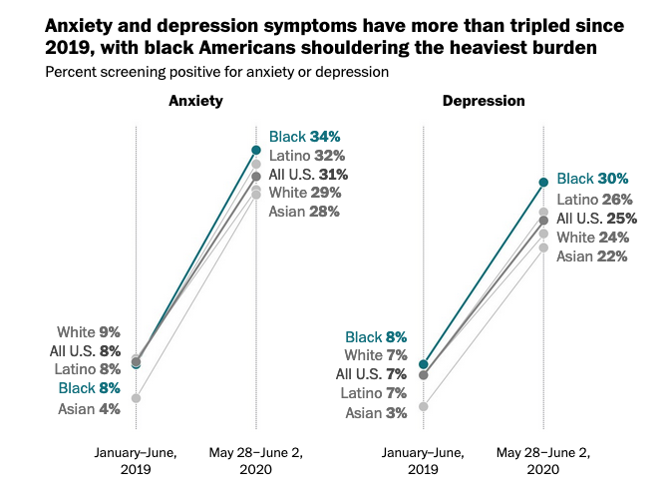
Lauren Ashbaugh, Ph.D., NCSP
-Washington Post, 6/12/2020

Slide 31
Lauren Ashbaugh, Ph.D., NCSP
-Washington Post, 6/12/2020

Slide 32
Most Common
Scariest/
Most confusing
Anxiety (19%)
Depression (9%)
PTSD (4%)
Dual Diagnosis with SUD (4%)
Bipolar Disorder (3%)
Obsessive Compulsive Disorder (1%)
Eating Disorders (1%)
Borderline Personality Disorder (1%)
Schizophrenia (1%)
Severe Depression with Suicidality
Psychotic Disorders
Substance Use Disorders/Overdose
Borderline Personality Disorder
Obsessive Compulsive Disorder Post-Traumatic Stress Disorder
Anxiety
Grief
***Aggression/Violence

Slide 33
Scariest/
Most confusing
Most Lethal
Severe Depression with Suicidality
Psychotic Disorders
Substance Use Disorders/Overdose
Borderline Personality Disorder
Obsessive Compulsive Disorder Post-Traumatic Stress Disorder
Anxiety
Grief
***Aggression/Violence
?
Notes:
Eating disorder deaths: 10,000 per year
Opioid-use disorders: from 21,000 in 2010 to 47000 in 2018 to 68000 in 2020 (CDC)
Suicide: 47,000 in 2019 (Increased 35% between 1999 to 2019)

Slide 34
What is one thing that might stick with you? What do you want to learn more about?
!?

Slide 35
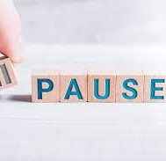
Break

Slide 36
So what do we do?
The approach
Crisis response
Interventions
Provider sustainability

Slide 37
The Approach: Humility & Curiosity
Humility: the belief that you have no special importance that makes you better (or worse) than anyone else
Curiosity: Relentless and nonjudgmental
heart work is hard work
Lauren Ashbaugh, PhD • Vincent Perez, MPA
Notes:
Witnessing

Slide 38
The Approach: Humility
Realize it’s mostly not about you.
We must try not to take it personally.
That can be exceptionally hard to do.
Notes:
Witnessing

Slide 39
The Approach: Humility
Realize our own power and control is limited.
We are helpers, hopefully some of many.
We can’t predict, prevent, or rewind.
We usually can’t “fix.”
Notes:
Witnessing

Slide 40
The Approach: Humility
Realize we are swimming in the American soup.
What we “know” may be an assumption based in stereotype.
Use rating scales, data, consultation, and check-ins. We are human and fallible.
Notes:
Witnessing

Slide 41
The Approach: Relentless, Nonjudgmental Curiosity
What interferes with your curiosity?
Notes:
Witnessing

Slide 42
Humility: We’re All Trying to Cope
Pain and Discomfort
Emotions: Sadness, fear, anxiety, anger, boredom, loneliness, numbness/emptiness, grief/heartbreak, hopelessness, unjustly harmed, confused/lost
shame/humiliation, embarrassment, guilt

Slide 43
Trying to Cope: Pain vs. Suffering
The Two Arrows
Buddhism
PAIN
SUFFERING
INEVITABLE
OPTIONAL

Slide 44
Humility: Coping with Pain
Negative Self-Talk/
Inaccurate meaning-making
PAIN
Suffering
Depression, Shame, Anxiety, Anger, Guilt, Hopelessness

Slide 45
The Approach: Considering Coping
How do we try to cope with intense amounts of pain or discomfort?

Slide 46
The Approach: Considering Coping
How do we try to cope with intense amounts of pain or discomfort?
Short-term helpful
Long-term helpful
Short-term unhelpful
Long-term helpful
Short-term helpful
Long-term unhelpful

Slide 47
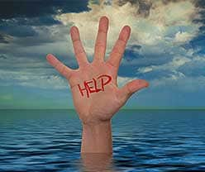
CRISIS RESPONSE
What basic approach/skills help us navigate a crisis with someone?

Slide 48
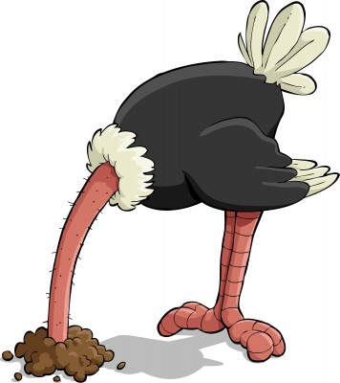
What we do Sometimes when we’re scared
Noticing Your Own Fear Response
Minimize
Avoid
Deflect
Numb
Give advice
Be directive
Doubt ourselves
Freeze
False Confidence
Notes:
Minimize: Just a way of getting attention, not really going to do it, her “usual” way of avoiding managing stress
Avoid: Refer, try to forget about it. Fail to ask the question. Ask once, don’t follow-up because it’s scary and traumatic
Deflect: Not my problem – really the outpatient therapist’s purview
Desensitized: ok, he needs to go inpatient. Someone should watch him. Fail to express and feel concern
Advice: You know, you and your mother should really sit down and talk about this. You should….
Be directive: STOP IT!
Doubt ourselves: I’m not the person to be able to do this, I will do this wrong – appear anxious and uncertain, fumble and struggle
Freeze: fail to act

Slide 49
Crisis Response
When you get scared, get curious.

Slide 50
General tenant:
The harder you try to gain control, the more out of control the situation becomes.
The person across from you feels out of control.
Seek to help them regain it within themselves.
Notes:
The less authoritative, less controlling, less directive, less confrontational you become, the more control you will have.

Slide 51
General tenant:
Mirroring: Project what you want to see.
Safe distance
Calm, gentle voice
Non-threatening body language
Seeing a desire to connect, understand
Find something you genuinely like/admire about this person.
Notes:
The less authoritative, less controlling, less directive, less confrontational you become, the more control you will have.

Slide 52
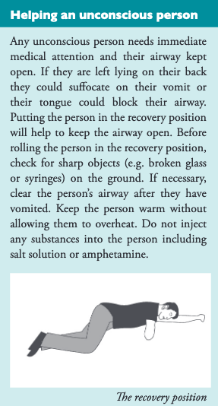
Overdose & Acute Intoxication
Get trained in use of naloxone.
Check airways, breathing, & circulation.
Know and use the recovery position.
Watch for dehydration/overheating.
Call ambulance, relay information.
Mental Health First Aid Australia, 2019

Slide 53
Helping someone who is Suicidal
Response:
Assess for risk of harm: Thoughts, Plan, Intent, Means
Listen non-judgmentally. REALLY LISTEN. Sit in it with them.
Give reassurance and information
Encourage professional help (DBT, CBT)
Encourage self-help and other support strategies
Mental Health First Aid USA, 2020
Notes:
Ask them if it’s happened before and if they think they’re having one now. If it’s something they’re familiar with and they suspect it is, ask them if they’d like help. If they do, introduce yourself (if it’s a stranger).
Ask directly what they think might help (for example, moving away from a crowded area or sitting down). Don’t assume you know what’s best for them.
Remain calm and reassure the person that they’re most likely experiencing a panic attack and that it’s not dangerous. Explain that while what they’re feeling is frightening, the symptoms will pass. As you talk, use short sentences and speak in a clear, firm manner. Be patient and stay with them throughout the attack.
When the panic attack is over, provide the person information related to panic attacks if they don’t know about them or don’t know where to acquire relevant resources. If they seem concerned, explain that there are effective treatments for panic attacks and that there’s help available to them.
Encourage the person to tap into other support sources, like family, friends or any communities they’re part of. Support groups of people who also experience panic attacks could be useful, as well.

Slide 54
Helping in a crisis: Panic Attacks
Response:
Assess for risk of harm (RULE OUT CARDIAC!)
Listen non-judgmentally
Give reassurance and information
Encourage professional help
Encourage self-help and other support strategies
Mental Health First Aid USA, 2020
Notes:
Ask them if it’s happened before and if they think they’re having one now. If it’s something they’re familiar with and they suspect it is, ask them if they’d like help. If they do, introduce yourself (if it’s a stranger).
Ask directly what they think might help (for example, moving away from a crowded area or sitting down). Don’t assume you know what’s best for them.
Remain calm and reassure the person that they’re most likely experiencing a panic attack and that it’s not dangerous. Explain that while what they’re feeling is frightening, the symptoms will pass. As you talk, use short sentences and speak in a clear, firm manner. Be patient and stay with them throughout the attack.
When the panic attack is over, provide the person information related to panic attacks if they don’t know about them or don’t know where to acquire relevant resources. If they seem concerned, explain that there are effective treatments for panic attacks and that there’s help available to them.
Encourage the person to tap into other support sources, like family, friends or any communities they’re part of. Support groups of people who also experience panic attacks could be useful, as well.

Slide 55
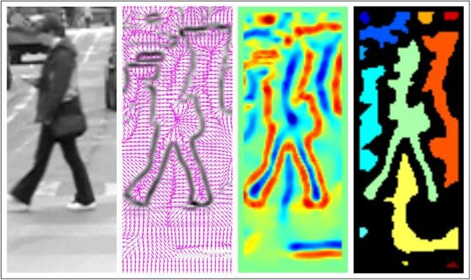
Interventions
Pattern Recognition

Slide 56
Resilience: Two-Prongs, Same idea
PREVENTION
INTERVENTION
harm/exposures
regulation & coping
Enhance:
positive identity formation
tenacity, competence
connection
harm/exposures
regulation & coping
Enhance:
positive identity formation
tenacity, competence
connection
Lauren Ashbaugh, Ph.D., NCSP

Slide 57
Mental Health Literacy: Intervention
Human beings are:
Social/Relational: seen, heard, valued
Storytellers: why, how, who, when
Control seekers: autonomy, choice, agency
Experiential learners: teach me to fish

Slide 58
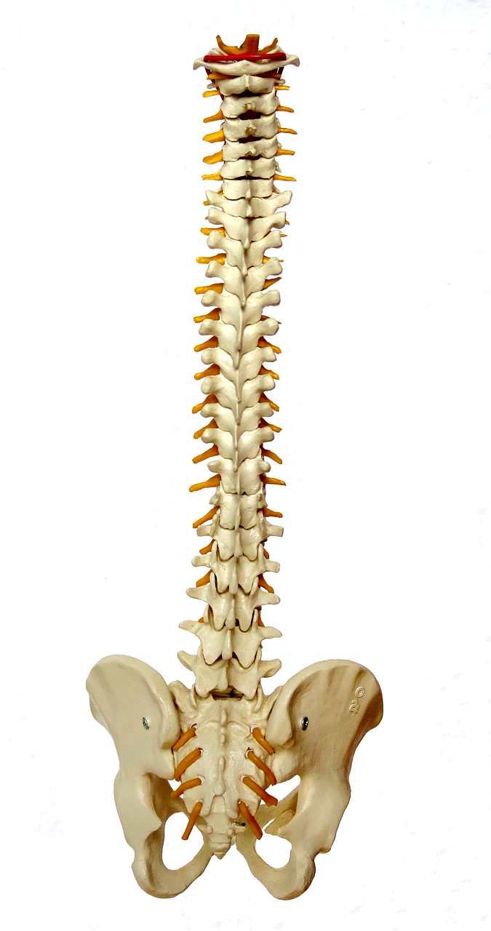
Cognitive Behavioral Therapy (CBT): The Backbone
Dialectical Behavior Therapy (DBT)
Mindfulness-Based Stress Reduction (MBSR)
Acceptance and Commitment Therapy (ACT)
Behavioral Activation
Cognitive Processing Therapy (CPT)
Exposure and Response Prevention (ERP)
Motivational Interviewing (MI)
Lauren Ashbaugh, Ph.D., NCSP

Slide 59
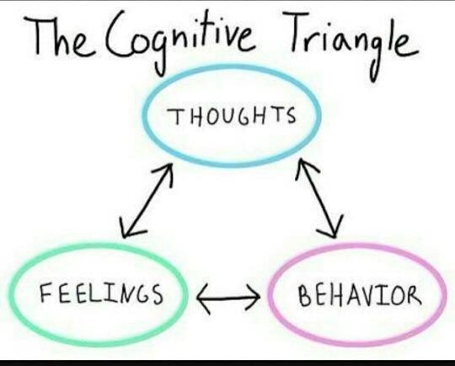
STIMULUS
Core Components of CBT
Noticing & Self-monitoring
Calm the body
Balance the thinking
Evaluate evidence
Generate alternatives
Choose behavior
Exposure
Behavioral Activation
Lauren Ashbaugh, Ph.D., NCSP

Slide 60
CBT: Exploring & Balancing Thinking
WE GET…
USUALLY…
“Don’t say that! That’s not true! You have this group!”
“I’m all alone. I have no one.”
CBT:
Reliance on “Socratic” questioning
“Detective” approach to test beliefs
Teach how to get to balanced thinking themselves.
Lauren Ashbaugh, Ph.D., NCSP

Slide 61
What do you notice about these thoughts?
This is all my responsibility.
I’m not doing enough.
If only I ____, this never would have happened.
I don’t need rest.
If I rest, bad things will happen.
My work is more important than my health.
If I’m unappreciated, it’s because I haven’t earned it.
My value is in my ability to withstand stress and care for others.
This is never going to get better.
If I know how to do this and no one else does, it’s my duty to do it.
If I don’t step in, no one will.
This system depends on me and I have to be there for them, always.
I’m responsible for meeting my own needs.
If I need help, it means I’ve failed.
I can rest when I’m done with this job.
Lauren Ashbaugh, Ph.D., NCSP

Slide 62
Research-backed treatment of Substance Use Disorders
Motivational Interviewing, Cognitive Behavioral Therapy, Dialectical Behavioral Therapy
Looking objectively at behaviors, impact
Examining behaviors, feelings, thoughts driving SU
Self-monitoring: recognizing triggers
Replacement behaviors for overcoming cravings
Step-wise, incremental progress
SOCIAL support/repairing harm to connect with others
Providing mentorship, guidance
Notes:
Behavioral treatment, not pharmacology

Slide 63
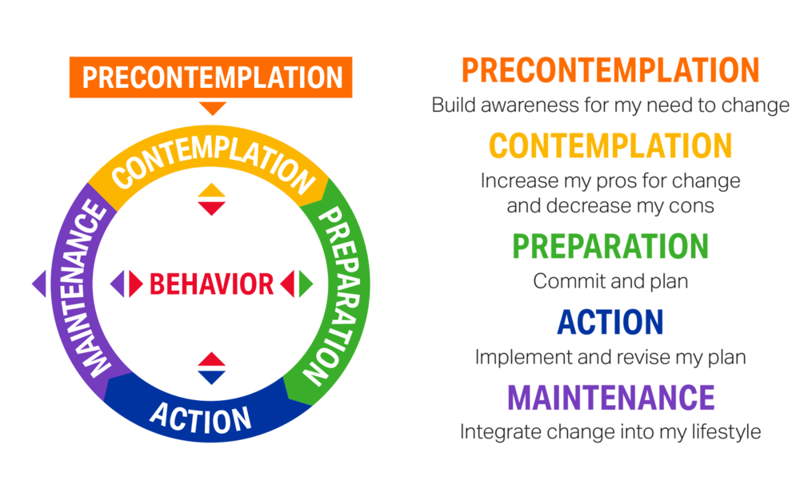
Stages of Change Model
Prochaska & DiClemente
Lauren Ashbaugh, Ph.D., NCSP

Slide 64
Assessing Baseline
Review the clients you are working to connect with.
What is baseline currently??
Do your goals need to be adjusted in order to be attainable?
Can you break your goal down into smaller steps?
What strengths can you lean on to help make steps?
Lauren Ashbaugh, Ph.D.

Slide 65
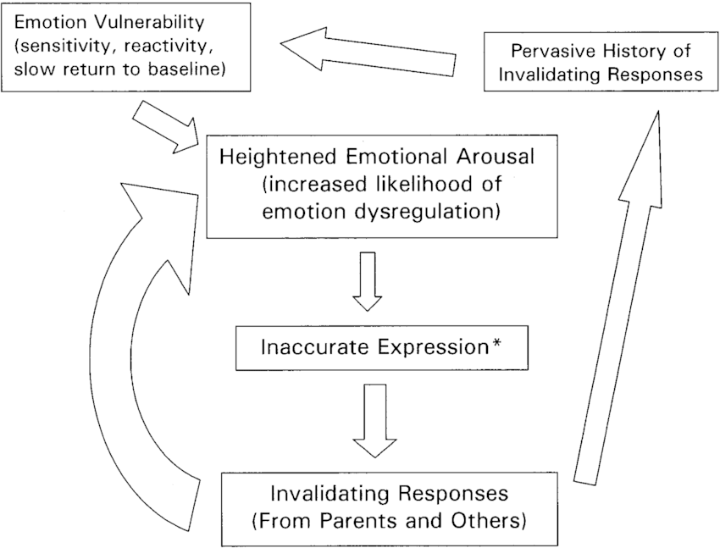
Chain Analysis: Suicidality & Dialectical Behavior Therapy
Marsha Linehan, PhD 1993

Slide 66
Provider Sustainability

Slide 67
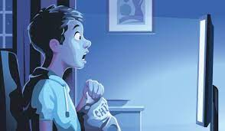
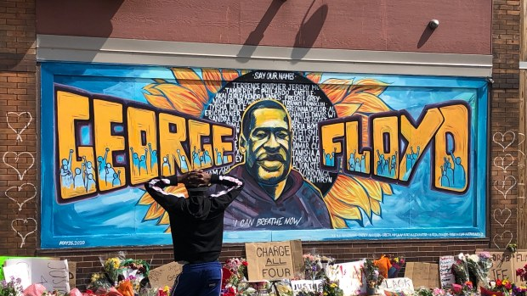
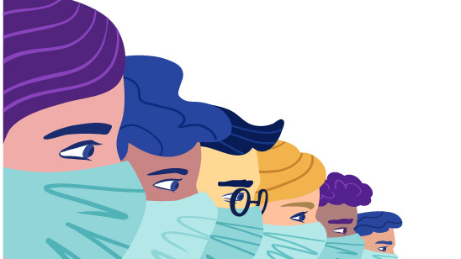
Events of 2019-2022 have been *really* hard
Lauren Ashbaugh, Ph.D., NCSP

Slide 68
Compassion Fatigue
Compassion Fatigue is a state experienced by those helping people or animals in distress; it is an extreme state of tension and preoccupation with the suffering of those being helped to the degree that it can create a secondary traumatic stress for the helper.
-Dr. Charles Figley Professor, Paul Henry Kurzweg Distinguished Chair Director, Tulane Traumatology Institute Tulane University, New Orleans, LA

Slide 69
Moral Injury
Moral injury is the damage done to one’s conscience or moral compass when that person perpetrates, witnesses, or fails to prevent acts that transgress one’s own moral beliefs, values, or ethical codes of conduct.
-The Moral Injury Project, Syracuse University

Slide 70
Beyond the Cliff: Laura vandernoot Lipsky
Notes:
From 9:25 on

Slide 71
We need your exquisite quality of presence.
We need people who have come alive.
Notes:
Crushing experiences, moments:
Think about who was present with you; what they offered, how it felt. Did not change the outcome or the circumstance, but changed totally how you felt about it

Slide 72
Tending to your web
Self-monitoring:
Your health
Personal relationships
Work relationships
Students

Slide 73
Evidence-based Resilience Building
Sleep Mindfulness
Exercise Healthy Relationships
Nutrition Mental Health
Lauren Ashbaugh, Ph.D., NCSP
Notes:
Mindfulness: nonjudgmental awareness of your emotional state, behaviors, thoughts
Center for Youth Wellness

Slide 74
What do we need to do?
Self-monitor: What is happening with me?
Evaluate rationally: Why is it happening?
Choose response: How can I respond constructively?

Slide 75
“We all carry within us places of exile, our crimes, our ravages. Our task is not to unleash them on the world; it is to transform them in ourselves and others.”
― Albert Camus
Notes:
We are starting with the people in this room.

Slide 76
Hope & Gratitude

Slide 77
Questions? Feedback?
Lauren Ashbaugh, Ph.D., NCSP
Licensed Clinical Psychologist
Pacific Northwest Psychology & Consulting, LLC
Ph: 253-260-3141; Fax: 253-753-2080
www.pacificnwpsychology.com
lauren@pacificnwpsychology.com

