Slide 1
King County
Growth Management Planning Council
July 22, 2015
Climate Change
Panel Discussion
Mayor Nancy Backus
City of Auburn

Slide 2
Quick Facts – City of Auburn
Incorporated in 1891
2015 Population: 75,545
70% Caucasian/30% Non-Caucasian (US Census Bureau)
Economic Evolution: Farming to railroad and movement of goods to warehouse and distribution and manufacturing
Mayor/Council form of government (Mayor is Chief Administrative Officer)
415 City staff
$253 million City Budget
Key City Departments:
  Mayor’s Office
  City Attorney
  Community Development & Public Works
  Finance
  Human Resources/Risk Management
  Information Technology
  Parks, Arts and Recreation
  Police

Slide 3
We are Working on It
Policy & operational decisions to address climate change concerns including but not limited to:
  2007: Signatory to US Mayors Climate Protection Agreement
  2009: Flexible Development Standards adopted
  2010: Municipal & community greenhouse gas inventory
  2011: Comprehensive Plan policies added (climate change and air quality)
  2016: Greenhouse gas inventory update & climate action plan
  On-going: Internal operational policies
  On-going: Environmental asset property management program
  On-going: Promotion of community sustainability efforts
Notes:
Flexible Development Standards = increased flexibility in residential and mixed use development to promote sustainable development
Internal operation policies examples - fuel efficient vehicles, idling reduction, reduced building energy use
Environmental asset property management program - unique for our size of City in region
Community sustainability efforts - low-flow showerhead give away program, yard waste and food recycling programs, waste reduction & recycling outreach education to residents, and businesses, support residential collection events for difficult to recycle commodities and coordinate the proper disposal of illegally dumped hazardous waste

Slide 4
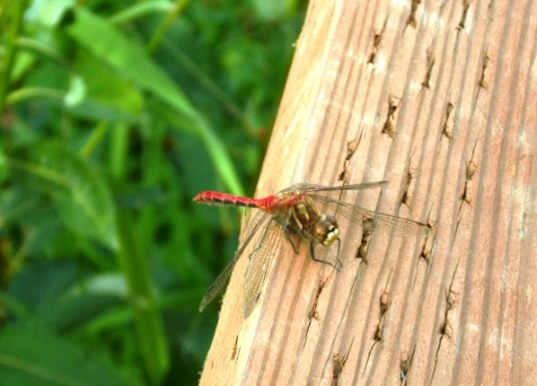
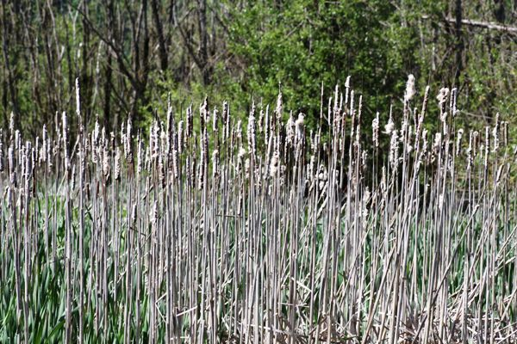
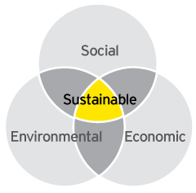
Internal Sustainability Efforts – Past, Present & Future
Change in Staff Focus
2005:
  1st first environmental planner hired
2006 – 2014:
  2 environmental planners
  Natural resources focused
2014:
  Stand-alone Environmental Services Program
  Change to Sustainability focus
Notes:
Environmental Services Program – Under direct supervision of Director of Community Development & Public Works; program reorientation to focus on broader issues of sustainability

Slide 5
Key Issues for Moving Forward on Sustainability
Sustainability as Council policy budget priorities
Shifting internal & external mindsets & perceptions (i.e. “Turning the Titanic”)
Growing beyond our comfort zone
Sustainability equal to Cost, ROI & other considerations

Slide 6
Municipal Investments - Sustainability
Purposeful and non-purposeful efforts
Climate change is not yet automatic investment factor
Cost control, timing & community benefit = current key investment factors
Federal & State funding programs
Notes:
The City is directly and indirectly addressing sustainability in its municipal investments
City’s efforts on sustainability are tied to changing internal mindsets - “Turning the Titanic”
Federal/state funding - Requiring increased focus on climate change and sustainability; Will push cities like Auburn to prioritize climate change & sustainability in investment decisions

Slide 7
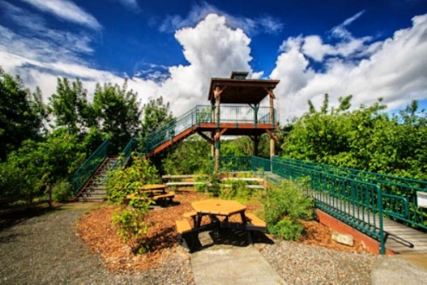
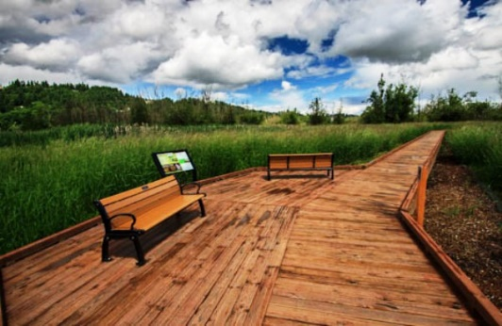
Auburn Environmental Park – Natural Stormwater
Systems, Birding Tower & Elevated Wetlands
Boardwalk (Environmental)
200 acres acquired by City since 2000
Both sides of SR-167
Key Goals:
  Natural urban stormwater system
  Habitat restoration to support fish and wildlife
  Catalyst for environmentally-focused development
  K-12 and post-secondary education and research
  Passive recreation
Notes:
Natural urban stormwater system chosen by City Council versus a $40-50 million built system
Passive recreation opportunities include bird watching, walking, environmental education)
Key AEP features: K-12 and post-secondary education and research
Catalyst for environmentally-focused economic development
Installation of bicycle racks at both park entrances
2-story birding tower (2009)
Over 1,000 feet of elevated wooden boardwalk constructed (2012) on pin pile foundations to minimize construction impact to wetlands
Pervious pavement used for surface trails and parking area
Restoration of wetland vegetation through removal of invasive plants and planting of native trees and shrubs

Slide 8
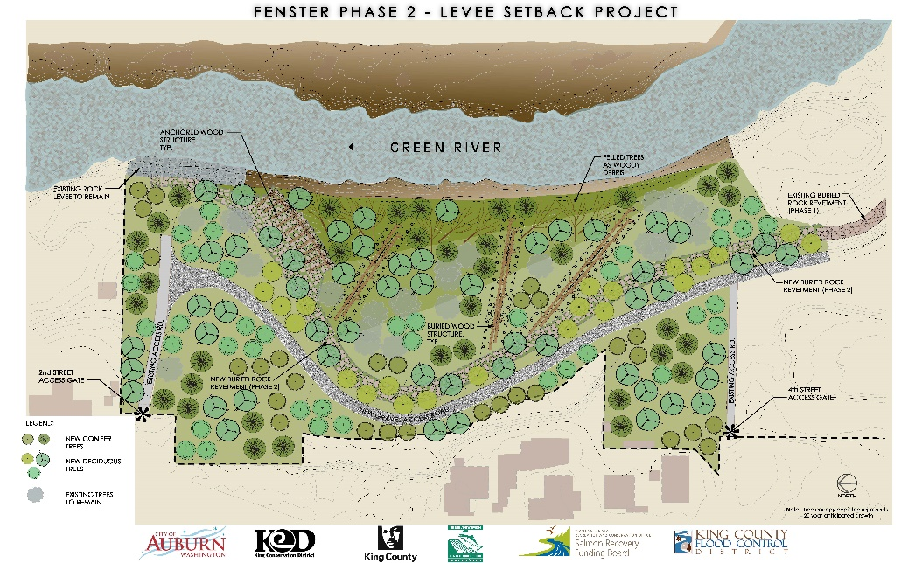
Fenster Phase 2 Levee Setback (Environmental)
  Completed in 2015
  Last piece in a restoration corridor on the Green River totaling nearly 2.5 miles
  Project Cost: $1.3M
  Multiple agency partners involved
Notes:
Goals/benefits of Project:
Salmon habitat enhancement while maintaining existing level of flood protection to homes and infrastructure
Reconnection of Green River to approximately 5 acres of its historic floodplain
Key Features:
Project accomplished in two phases over ten years
Removed over 1,200 linear feet of existing rock levee confining the Green River
Installed new buried revetment further away from river to maintain flood protection while providing for improved habitat
Planted over 10,000 native trees and shrubs

Slide 9
Mill Creek Ecosystem Restoration Project (Environmental)
  2016 completion
  Primary partners – U.S. Army Corps and City of Auburn
  Numerous financial partners
  Total cost $6.5M:
    $4.22M Federal Funds;
    City share = $2.28M (35%)
Notes:
Goals/benefits of Project:
Salmon habitat enhancement
Flood control benefit through increased flood storage capacity
Key Features:
New 26’ wide fish passable culvert at 15th St NW
Restoration of more than a mile of existing stream channel
Creation of new/additional stream channel to enhance habitat and provide increased flood storage
Removal of invasive plants species, and over 70,000 native trees and shrubs to be planted
Long term monitoring and management to maintain beneficial ecological and flood storage functions

Slide 10
Auburn Community Center & Teen Center (Social + Environmental)
Opening in June 2016
$9 million community project
  $3 million – State of Washington
  $6 million – City of Auburn
LEED Silver Status
Notes:
Key Features:
Dedicated parking spaces for such environmentally friendly transportation choices
Natural stormwater on-site stormwater flow on‐site - rain gardens and bio‐swales
Low‐flow and water‐efficient plumbing fixtures in bathrooms and other
service areas of the building - 35% reduction in water use
Managed energy usage through smart controls, efficient heating and cooling systems, efficient lighting and intelligent zoning of interior spaces – 30% reduction in energy use
Construction waste management plan – 75% of construction waste salvage or recycled
Green Housekeeping Program – Manual and staff training to guide sustainable cleaning practices and reduce use of toxic cleaning chemicals

Slide 11
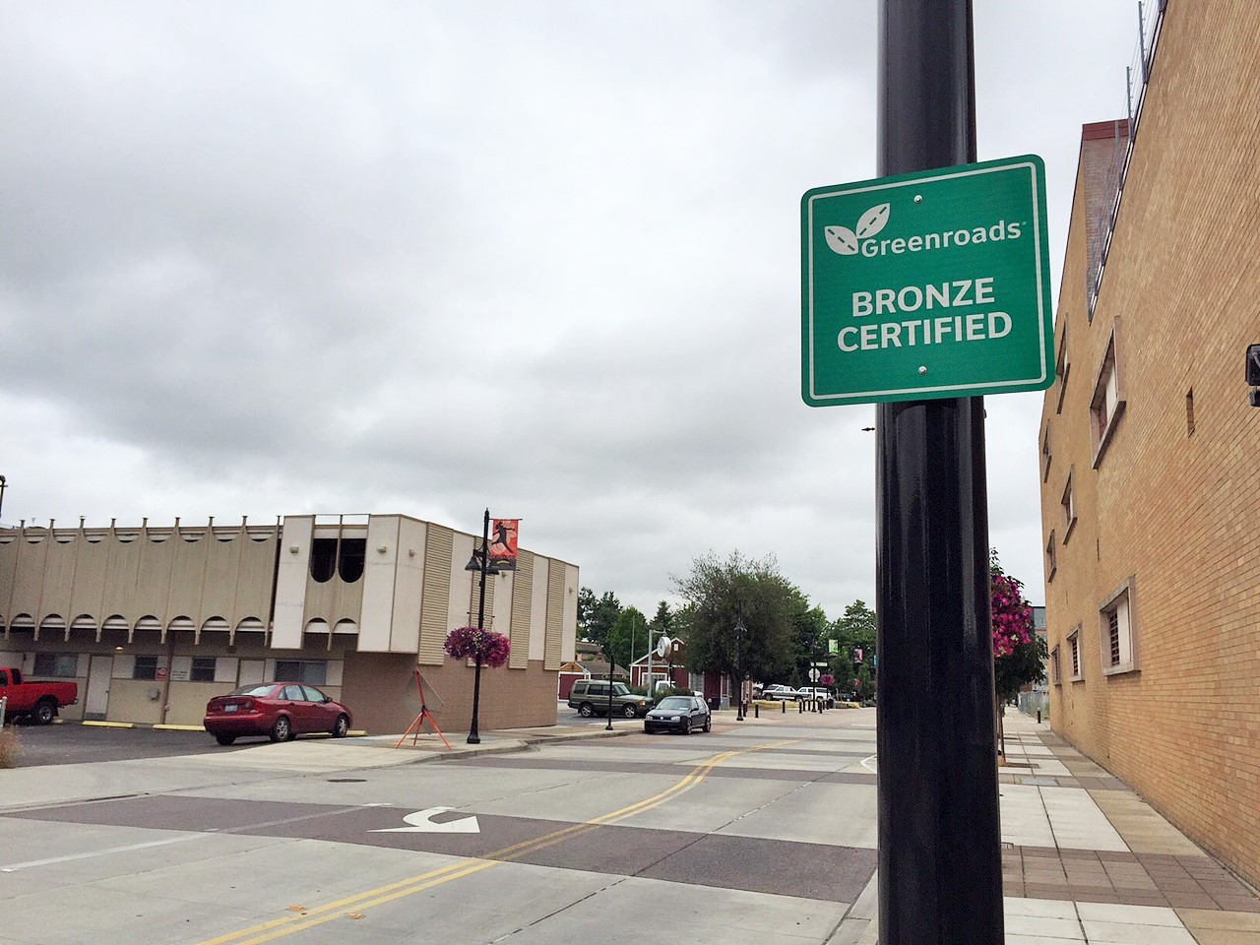
South Division Street Promenade Project - Downtown Auburn (Economic)
Completed in 2012
$10 million project:
  $3 million Economic Development Administration grant
  $7 million bonded debt – State supported
Greenroads Bronze Certification:
  Result of incorporating & applying sustainable practices and techniques into project construction
Notes:
Key Features:
Rainwater infiltration and on-site treatment through the porous concrete
Increased sidewalk widths
Bicycle racks in multiple locations
Dark sky compliant LED lighting – reduced power consumption
Performed lifecycle inventory of CO2 emissions to determine the total CO2 emissions produced by street construction
Implemented stormwater pollution prevention plan to during construction to limit the amount of pollution and construction debris entering the stormwater system
Incorporated porous-concrete pavement that allows stormwater to infiltrate into the ground below the road instead of entering the stormwater system
Developed site maintenance plan for proper maintenance of the porous concrete roadway
Planted only non-invasive plant species
Combination of light-colored pavement and porous pavement will not result in the typical "heat island" effect caused by asphalt roadways that absorb more heat

Slide 12
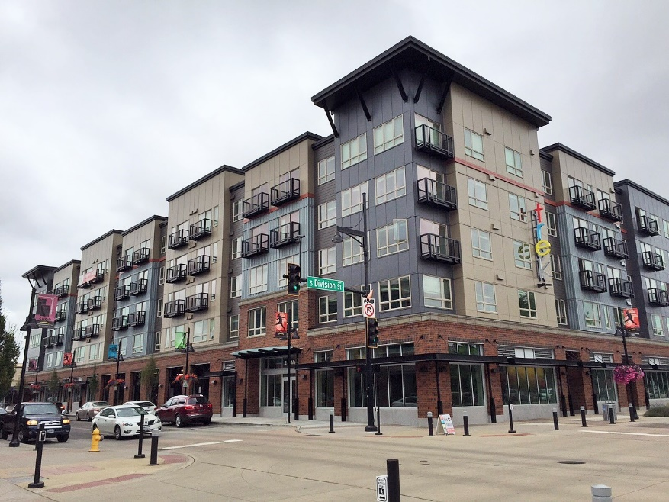
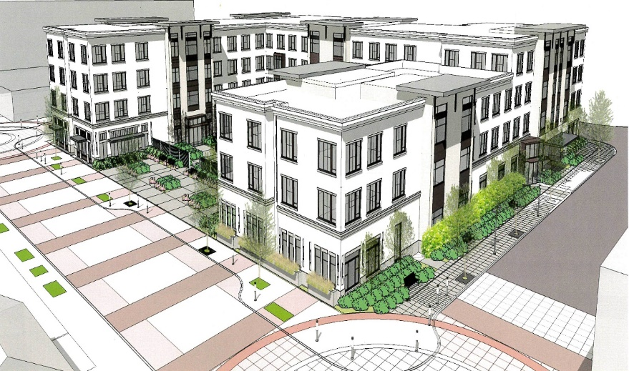
Trek Mixed Use Development & Merrill Gardens Senior Housing – Downtown Auburn (Economic)
Downtown Auburn = PSRC Designated Regional Center
Capacity for 900 downtown residents
Auburn Sounder Station – Sounder, King County Metro and Pierce Transit Service
Downtown Plan & EIS (2001)
Downtown Design Standards
Multi-Family Property Tax Abatement
City acquisition and sale of Downtown Properties
Trek – 126 apartments with ground-floor commercial (completed)
Merrill Gardens – 111 market rate senior housing units (under construction)
Notes:
Downtown Plan & EIS – City completed plan and EIS to provide expedited project and environmental review – if projects are consistent with Plan and & EIS, no significant environmental review required
Property tax abatement - provide limited 8 exemptions from ad valorem property taxation for qualified new multifamily and rehabilitated multifamily housing
constructed in the downtown core and 12-year exemptions from ad valorem property taxation for qualified new affordable multifamily and rehabilitated multifamily housing constructed in the downtown core
City purchased properties in Downtown to facilitate property clean up and increased private sector interest in Downtown
City investments for Private Sector Investment:
City payment of Traffic Impact Fees for 4-Block Downtown Catalyst Area
Relocated public and private utilities out of alleyways to remove infrastructure barriers for redevelopment of adjacent properties
Upgraded water, sewer, storm and private utilities - excess underground stormwater capacity exists for private new development to use
Installed new street paving
Constructed 10 to 20 foot wide sidewalks and landscaping
Installed new LED streetlights throughout Downtown Placed new street furniture, trash receptacles
Installed new ornamental gateway arch
Constructed new and improved downtown plazas
Implemented outdoor rotating sculpture gallery
Installed pedestrian way-finding kiosks

Slide 13
Concluding Thoughts
Climate change and sustainability is local & political
Triple bottom line capacities
Need staff “champions”
Lead by example for community action
Cumulative efforts
Small steps and actions matter
Internal mindset changes
Capacity building is needed
Notes:
Cities have capacities to address and invest across the full triple bottom line perspective (economic, environmental, social)
Need staff focused on issues of climate change and sustainability
Local governments can and should lead by example, but changing community mindsets is an organic process
Efforts towards addressing climate change and sustainability are cumulative and build on each other
Changing internal mindsets takes time, patience, education and a firm push sometimes
Capacity building is needed to make elected officials, staff and community members prioritize climate change and sustainability

Slide 14
Thank You!
Nancy Backus
Mayor, City of Auburn
253-931-3041
nbackus@auburnwa.gov
www.auburnwa.gov

