Slide 1
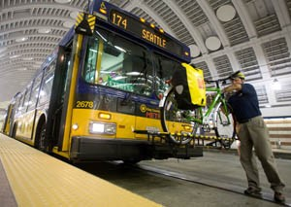
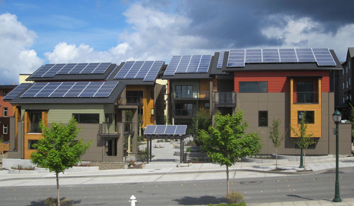
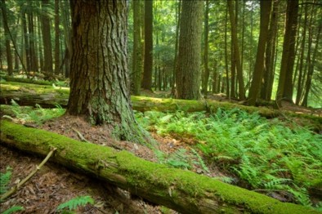
King County-Cities Climate Collaboration July 2015 Update to the GMPC matt.kuharic@kingcounty.gov www.kingcounty.gov/climate
Notes:
Note: I will bring copies of (1) the SCAP, (2) the Joint K4C commitments and (3) general background about the K4C.
1

Slide 2
Growth Management Planning Council – July 2014
Unanimous adoption of shared, countywide, near and long term greenhouse gas (GHG) emission reduction goals
Long term vision: at least 80% below 2007 emissions by 2050
Stair steps on the way: 25% by 2020; 50% by 2030
Supporting Measurement and Monitoring Policies
Assess and report countywide GHG emissions associated with resident, business, and other local government buildings, on road vehicles and solid waste at least every two years.
Update a comprehensive GHG emissions inventory that quantifies all direct local sources of GHG emissions as well as emissions associated with local consumption at least every five years.
Notes:
As Karen outlined, in the summer of 2014, cities and King County unanimously agreed to new countywide climate policies that include ambitious shared greenhouse gas emissions reduction targets
It’s an example of how we are beginning to coalesce around confronting climate change as a key regional issue
Part of this progress builds on the efforts of the King County-Cities Climate Collaboration (K4C)
Today I wanted to provide an update of recent work by the K4C. My overview also helps frame the examples of projects and efforts that diverse cities are taking and that will be outlined by Mayor Backus, Paul from Bellevue and Nicole from Snoqualmie.

Slide 3
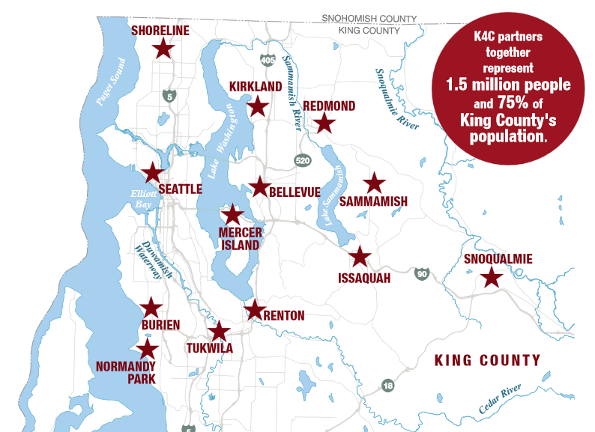
Notes:
3

Slide 4
What is the K4C?
Voluntary but formal (Interlocal Agreement) partnership between 13 cities and King County
Partnering on climate change related outreach, coordination, solutions and funding/resources
Focus areas include green building, renewable energy, climate messaging,
and sustainable transportation
Notes:
King County and cities are taking action, but it has sometimes been uncoordinated; Since it’s formation in 2012, the K4C has been helping to ramp up regional progress on climate.
Jurisdictions often must overcome financial, technical, information and/or capacity related challenges; the K4C is helping to address these challenges with a collective action approach
In support of the development of the targets that were adopted as Countywide Planning policies last year, the K4C did the math, and supporting engagement through forums such as the Sound Cities Association, to show what it will take to achieve these targets. The K4C has also developed a set of pathways and commitments that would get us on track towards these long term goals.

Slide 5
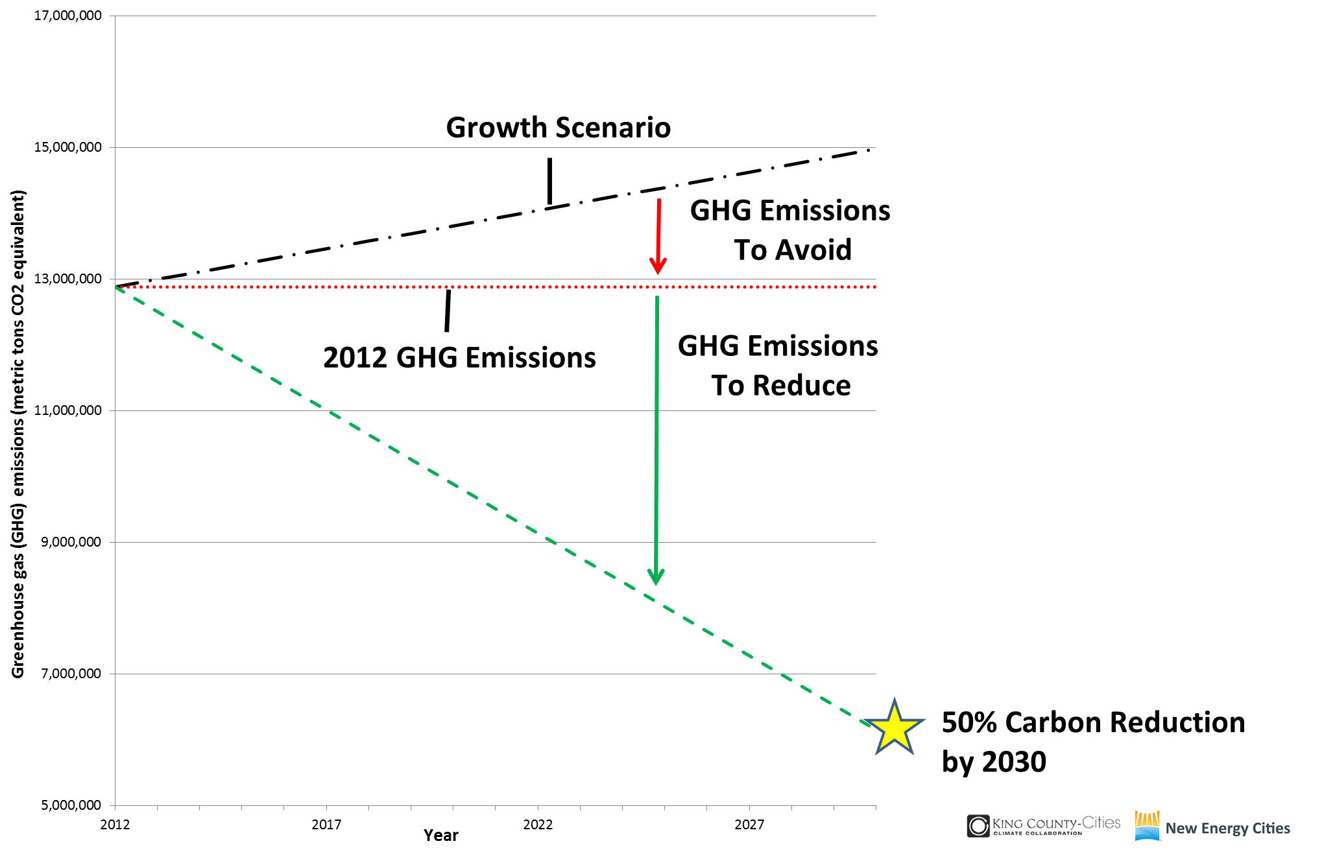
Climate Targets - Ambitious but Achievable
Avoid
Reduce
Avoid
Reduce
Notes:
A key outcome of the K4C has been, in partnership with a local non-profit called Climate Solutions, to do the math about what it will take to achieve Countywide GHG reduction targets. In two minutes I want to revisit these findings as they help frame many of the GHG reduction strategies that others on the panel will be discussing.
This graph depicts the reductions necessary to achieve a 50 percent reduction by 2030.
The red line represents 2012 emissions.
The green line represents a pathway to 50 percent reduction by 2030. The gap between the black and green lines is what needs to be reduced to hit the 50x30 target, on the path towards our 2050 goals. This is ambitious but achievable because of 1) laws already in place and 2) the best practices that other cities are exploring, including some that are already underway here in King County.

Slide 6
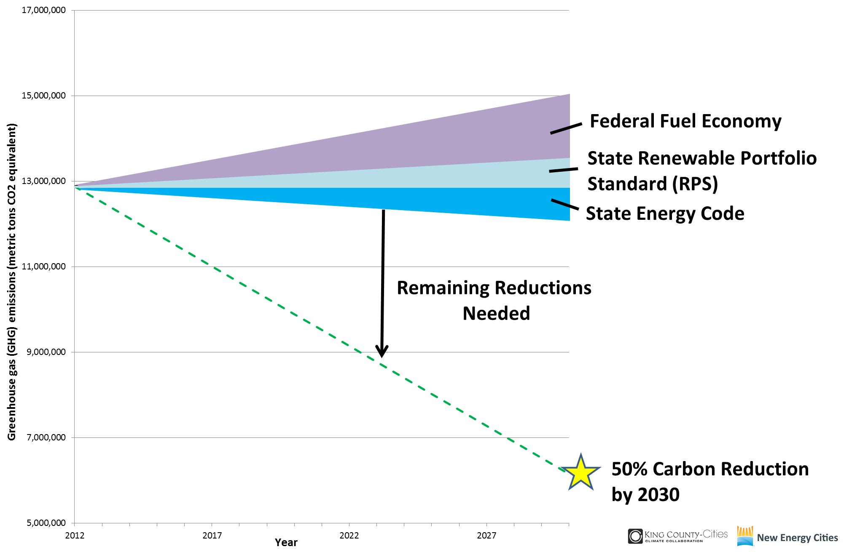
Climate Targets - Ambitious but Achievable
Fed. Fuel Standard
State Renewable Portfolio
WA Energy Code
Notes:
You can see the modeled combined reductions of three existing federal and state laws, and the remaining reductions needed.
Federal fuel economy refers to the CAFÉ standard.
State clean energy standard includes both renewables and efficiency
State energy code for buildings
Cities play a vital role in particular in compliance with the energy code, as you know, and it remains important to protect these laws. The next slide is focused on what can be done to close that gap – to achieve 50 percent reduction by 2030.
--------------------
Note: that what is modeled here does not cover all of the reduction drivers that are currently in play. There are other examples of things that are committed to that will help further reductions: the EPA power plant rules, federal and state grant programs, including the results of the stimulus-funded energy efficiency and renewable energy programs, federal and state tax incentives, and market trends such as the rapid declines we’ve seen in solar panel prices in recent years.

Slide 7
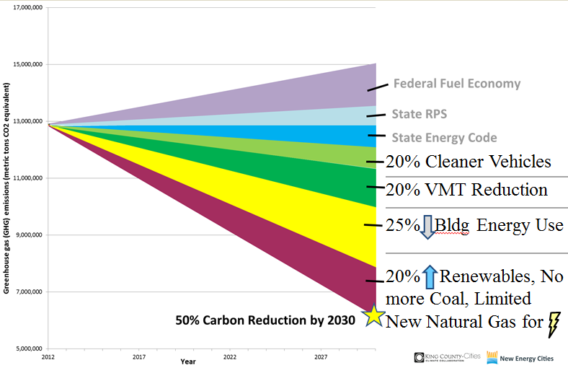
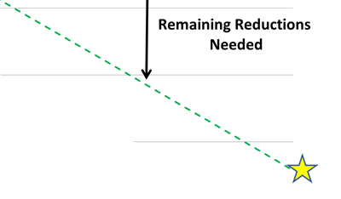
Climate Targets - Ambitious but Achievable
Levels of Influence
Local | State
 | X
X | X
X | X
\ | X
Notes:
This slide summarizes the solutions pathway for achieving 50x2030 reduction, on which the K4C’s joint commitments for action are based. You’ll learn more about the K4C joint commitments shortly.
The two green wedges relate to transportation –
15% cleaner vehicles - could be achieved partially through a statewide clean fuel standard, and additionally through a stretch by cities to do more on electrified transportation.
20% VMT reduction - is on pace with trends that we are seeing nationally and locally, but will require additional investment in public transit and livable, affordable housing.
The yellow and red wedges are focused on our buildings–
25% reduction in building energy use - through a significantly scaled-up regional retrofit economy, and dramatically reducing natural gas consumption for heating.
20% increase in renewable electricity combined with phase out of coal and no new natural gas plants. The new EPA power plant rules play a role in this strategy.

Slide 8
Climate Targets - Ambitious but Achievable
Levels of Influence
Local | State
 | X
X | X
X | X
\ | X
Notes:
This slide summarizes the solutions pathway for achieving 50x2030 reduction, on which the K4C’s joint commitments for action are based. You’ll learn more about the K4C joint commitments shortly.
The two green wedges relate to transportation –
15% cleaner vehicles - could be achieved partially through a statewide clean fuel standard, and additionally through a stretch by cities to do more on electrified transportation.
20% VMT reduction - is on pace with trends that we are seeing nationally and locally, but will require additional investment in public transit and livable, affordable housing.
The yellow and red wedges are focused on our buildings–
25% reduction in building energy use - through a significantly scaled-up regional retrofit economy, and dramatically reducing natural gas consumption for heating.
20% increase in renewable electricity combined with phase out of coal and no new natural gas plants. The new EPA power plant rules play a role in this strategy.

Slide 9
Joint County-City Climate Commitments
www.kingcounty.gov/climate/pledge
Notes:
Beyond the technical assessment of what it would get us on track to our targets, the K4C has developed a set of joint County-city climate commitments, focused on shared, regional action to help get us on track. These commitments cover diverse issues, as highlighted on the slide. You can find the commitments online at www.kingcounty.gov/climate and I’ve also brought copies of the commitments.
-------------------------
A few examples of the commitments are below if there are questions:
Transportation and Land Use
Catalytic Policy Commitment: Partner to secure state authority for funding to sustain and grow transit service in King County.
Catalytic Policy Commitment: Focus new development in vibrant centers that locate jobs, affordable housing, and services close to transit, bike and pedestrian options so more people have faster, convenient and low GHG emissions ways to travel.
Energy Supply
Catalytic Project or Program: In partnership with utilities, develop a package of county and city commitments that support increasingly renewable energy sources, in areas such as community solar, green power community challenges, streamlined local renewable energy installation permitting, district energy, and renewable energy incentives.
Green Building
Catalytic Policy Commitment: Join the Regional Code Collaboration and work to adopt code pathways that build on the Washington State Energy Code, leading the way to “net-zero carbon” buildings through innovation in local codes, ordinances, and related partnerships.
Forests and Farming
Catalytic Project or Program: Restore the health of urban and community trees and forests, for example through public-private-community efforts such as Forterra’s Green Cities Partnerships.

Slide 10
Feb, June 2014 & Jan 2015
K4C Elected Official Climate Working Summits
www.kingcounty.gov/climate/pledge
Notes:
Today, the commitments have been signed by Executive Constantine and Mayors of 10/13 K4C cities, which combined represent the local government’s of 70% percent or 1.4 million of King County’s 2 million residents.
And the momentum of the K4C is growing. I hope your cities consider partnering on this work.

Slide 11
Joint County-City Climate Commitments

Slide 12
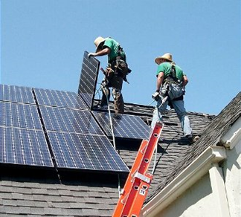
2015 K4C Subcommittees
Transportation and Land Use
Electric Vehicles Everywhere
Group Purchasing (vehicles and fuels)
Energy Supply
Commercial Energy Benchmarking
City Solar Efforts
Clean Energy
Regional Code Collaboration (stand-alone group that is older than the K4C)
Measurement and Reporting
Scope 5
Notes:
The joint commitments cover a number of topic areas and will require sustained work. For 2015 and 2016, the K4C is focusing on 1) energy supply and efficiency, which are intertwined priorities and 2) transportation and land use, and 3) measurement and reporting.
Commercial Energy Benchmarking
Work starting later this fall, ~ 5 meetings between now and end of the year. Elizabeth will reach out to subcommittee during the summer but first formal meeting in Sept.
Participants (7 K4C partners): Megan (Issaquah), Valerie (Tukwila), Cathy (Redmond), Nicole (Snoqualmie), Scott (Kirkland), Emma (Bellevue), David Broustis (King County)
City Solar Efforts
Smaller project collecting what cities have been doing on solar campaigns (Solarize, community solar, etc.).
Participants (6 K4C partners): David (Kirkland), Ross (Mercer Island), Paul (Bellevue), Nicole (Snoqualmie), Miranda (Shoreline), David Broustis (King County)
Regional Code Collaboration
Work primarily on technical and land use codes with respect to high performance building.
Currently working on LBC Demonstration ordinance, solar-ready construction appendices for building and energy codes, C&D recycling ordinance, education around toxics in building materials and codifying reductions. They will be asking for support from jurisdictions in Sept. and Oct. when proposals at the state level are open for public comment. They will provide more direction on how you can help.
Miranda, Patti, and Stacia Miller (ILFI) are talking on Wednesday at 3 pm; Miranda will send an email for those who want to join.
The RCC is an existing team; additional/existing representatives identified at this meeting included: Lisa Verner and Chris Ricketts (King County), Paul Hintz (Renton), Heidi Bedwell (Bellevue), Redmond, Shoreline, Scott and David (Kirkland)
EV Everywhere
Goal for each K4C partner to work with at least one business near-term and later broadening to more employers. Climate Solutions’ interns will be supporting this work.
Participants (5 K4C partners): Ross (Mercer Island), Cathy (Redmond), Amanda (Normandy Park), David (Kirkland), Autumn Salamack (King County Metro), Frana Milan (King County DNRP)
Group Purchasing
May need to draw in other committee members (e.g. fleet managers, etc.), so let us know if your city has interest.
Participants (5 K4C partners): Representative from Redmond (Cathy will find the right person), Bellevue fleet manager, Cheryl Ooka (Shoreline Fleets & Facilities Manage)r, Tim Llewellyn (Kirkland Fleet Manager), Don Harris (Snoqualmie Fleet Manager); Autumn Salamack, Jennifer Lindwall, Chris Gavigan (King County)
Scope 5 (sustainability measurement and reporting system and dashboard)
Clean Energy: PSE Engagement, Community Renewables and Efficiency Analysis
Participants (4 K4C partners): Ross (Mercer Island), Paul (Bellevue), Nicole (Snoqualmie), Kirkland (maybe); Matt Kuharic, David Broustis, Bob Burns, Frana Milan, Megan Smith, Chris Ricketts, Lisa Verner (King County)

Slide 13
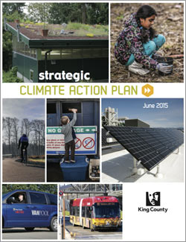
2015 King County Executive Proposed Strategic Climate Action Plan (SCAP)
Charts out diverse and ambitious commitments and priority actions that ensure King County’s climate leadership
Clearly links actions to outcomes in reducing GHG emissions and achieving climate goals
Strengthens the climate change adaptation goal area and maps out enduring framework for engaging community in preparedness
Highlights and integrates work of the County’s climate related partnerships, such as the K4C
Quantifies the GHG benefits and the cost effectiveness of select climate strategies
www.kingcounty.gov/climate
Notes:
I will briefly mention the Executive’s proposed Strategic Climate Action Plan here.
Transportation and Land Use
Energy Supply
13

Slide 14
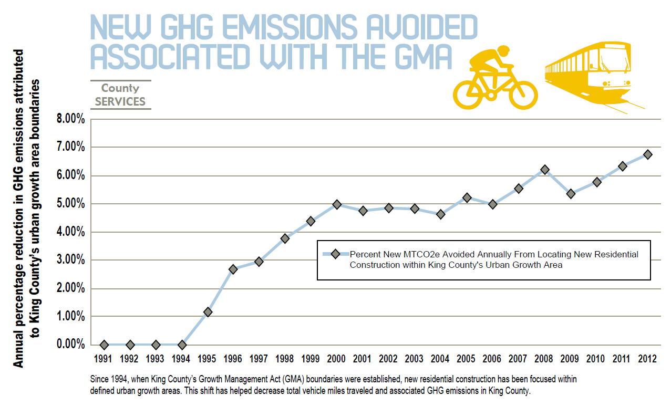
Notes:
The County’s 2015 Strategic Climate Action Plan does a much better job at quantifying the GHG emissions reduction benefits of various County targets and actions. One example that relates to the GMPC’s work on land use issues is highlighted in my last slide.
This chart from the Transportation and Land Use goal area of King County’s proposed 2015 Strategic Climate Action Plan shows the percentage reduction in GHG emissions associated with new development attributed to focusing new countywide residential construction and development inside the defined urban growth area (UGA). Over the last few years, a reduction of 6-7% in GHG emissions is estimated, based on avoided development in rural areas and resultant decrease in total vehicle miles traveled.
Since 1994, when King County’s Growth Management Act (GMA) boundaries were established, new residential construction has been increasingly focused within the UGA. Since 2011, less than two percent of new residential construction has occurred in the rural area, exceeding the climate plan’s target of maintaining 97 percent of new residential growth within the urban growth boundary.
The quantity of the GHG emission reduction varies depending on how much new development there is each year; for 2012, the estimated GHG reduction was 4,700 MTCO2e. 4,700 MTCO2e is equivalent to taking roughly 1,000 cars off the road for a year. Importantly, these land use impacts are long lasting, so the cumulative effect of implementing the UGA is much bigger than the snapshot of any single year’s development patterns.

Slide 15
King County-Cities Climate Collaboration July 2015 Update to the GMPC matt.kuharic@kingcounty.gov www.kingcounty.gov/climate
Notes:
Note: I will bring copies of (1) the SCAP, (2) the Joint K4C commitments and (3) general background about the K4C.
15

