Slide 1
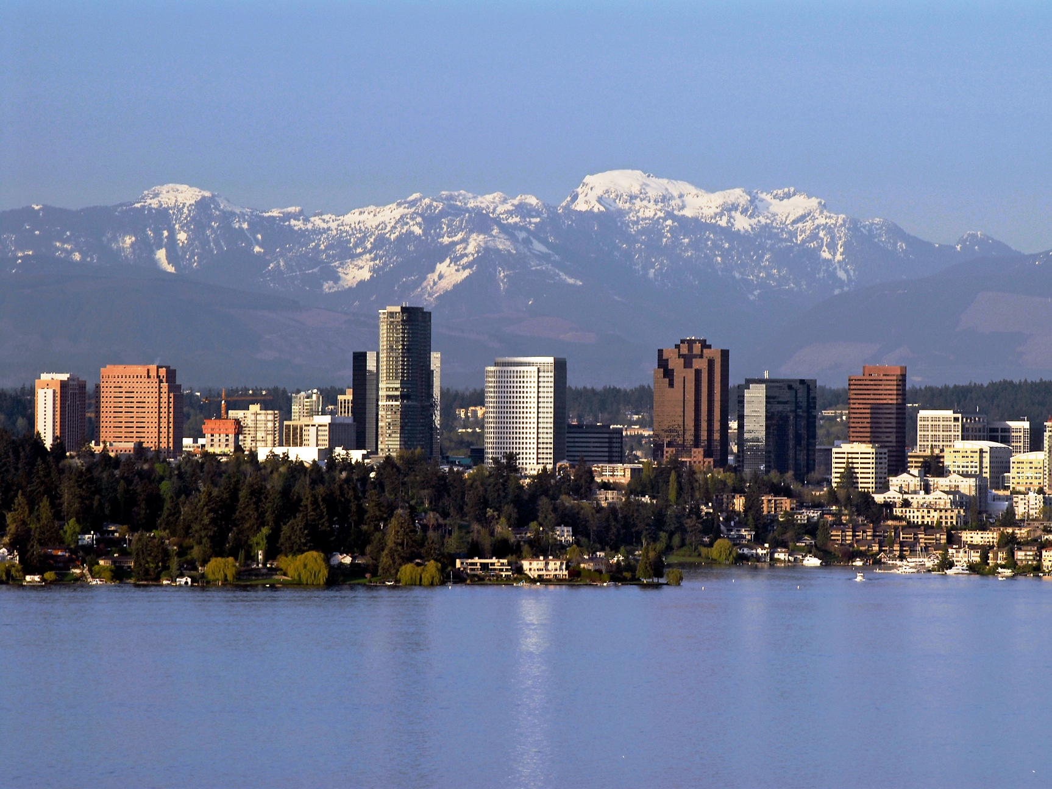
Addressing Climate Change, Locally and Practically
City of Bellevue’s Four Step Process
Paul Andersson
City of Bellevue Environmental Stewardship Initiative
King County Growth Management Planning Council
Notes:
Today’s presentation is how Bellevue is addressing climate change, locally and practically.
While many cities are deeply involved in resilience planning for major natural disasters or resource constraints, our strategies to date mostly focus on mitigating greenhouse gas emissions throughout our own operations and our community.

Slide 2
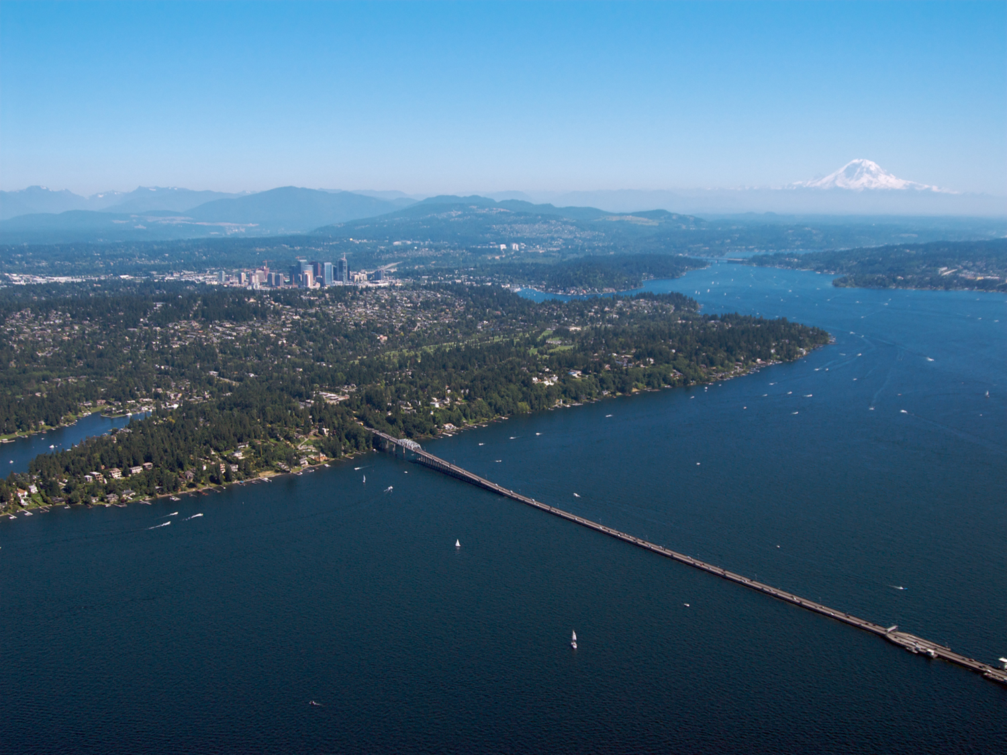
Addressing Climate Change, Locally and Practically
City of Bellevue’s Four Step Process
Objective 1:
Addressing climate change is local & practical in its nature
Objective 2:
Climate change mitigation is economic development
Objective 3:
Significant progress is being made
Lead by Example
Engage the Community
Collaborate Regionally, Nationally
Constantly Improve
Notes:
Our strategies prove that addressing climate change is first and foremost, a local and practical endeavor.
Also prove that climate change mitigation is economic development and fiscal stewardship –indicated by cost savings figures and investments in local jobs that programs have enabled.
Through our strategies significant progress is in fact being made – qualitatively and quantitatively.
In City of Bellevue’s four-step process, each step is benefitted by the previous one.
Started by getting our own house in order – ensuring we were a leader ourselves before telling our community that we were or asking for residents and businesses to be leaders too.
Next came community engagement efforts –campaigns, actions, and fun opportunities for residents and businesses to go green.
Next we have begun collaborating more regionally, and even nationally. This holds us to our commitments, allows us to borrow or lend resources from others, and raise the profile of the work we are doing.
Before we succeed in meeting regional greenhouse gas reduction targets, will need to keep improving upon what we’ve started

Slide 3
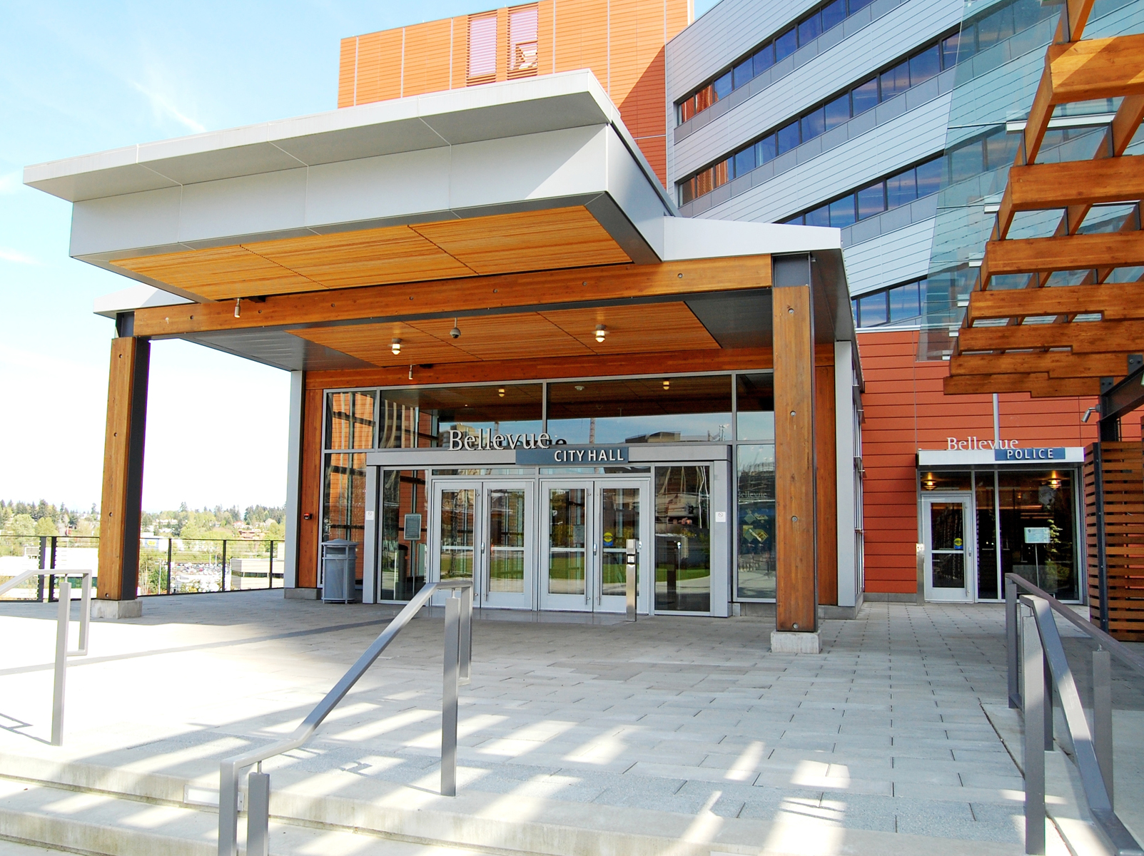
Leading by Example (Municipal Operations):
5% Energy Savings Every Year – RCM Program*
Municipal Solar Production and Green Buildings*
LED Streetlight Conversions*
Electric Vehicle Charging Network
Green Fleet Initiatives*
Greenhouse Gas Measurement
Comprehensive Plan Updates*
*Integrated Effort & Staffing Across Departments
Lead by Example
Engage the Community
Collaborate Regionally, Nationally
Constantly Improve
Notes:
Many successes to note in terms of leading by example
Many are things that cities are doing all around the world. They work for them, they work for us, and they can work in your cities if they haven’t already.
We’ll go into greater detail on a few of these to show the cost savings, environmental benefits, and other performance metrics of these actions.
RCM = Resource Conservation Manager (explained in next slide)

Slide 4
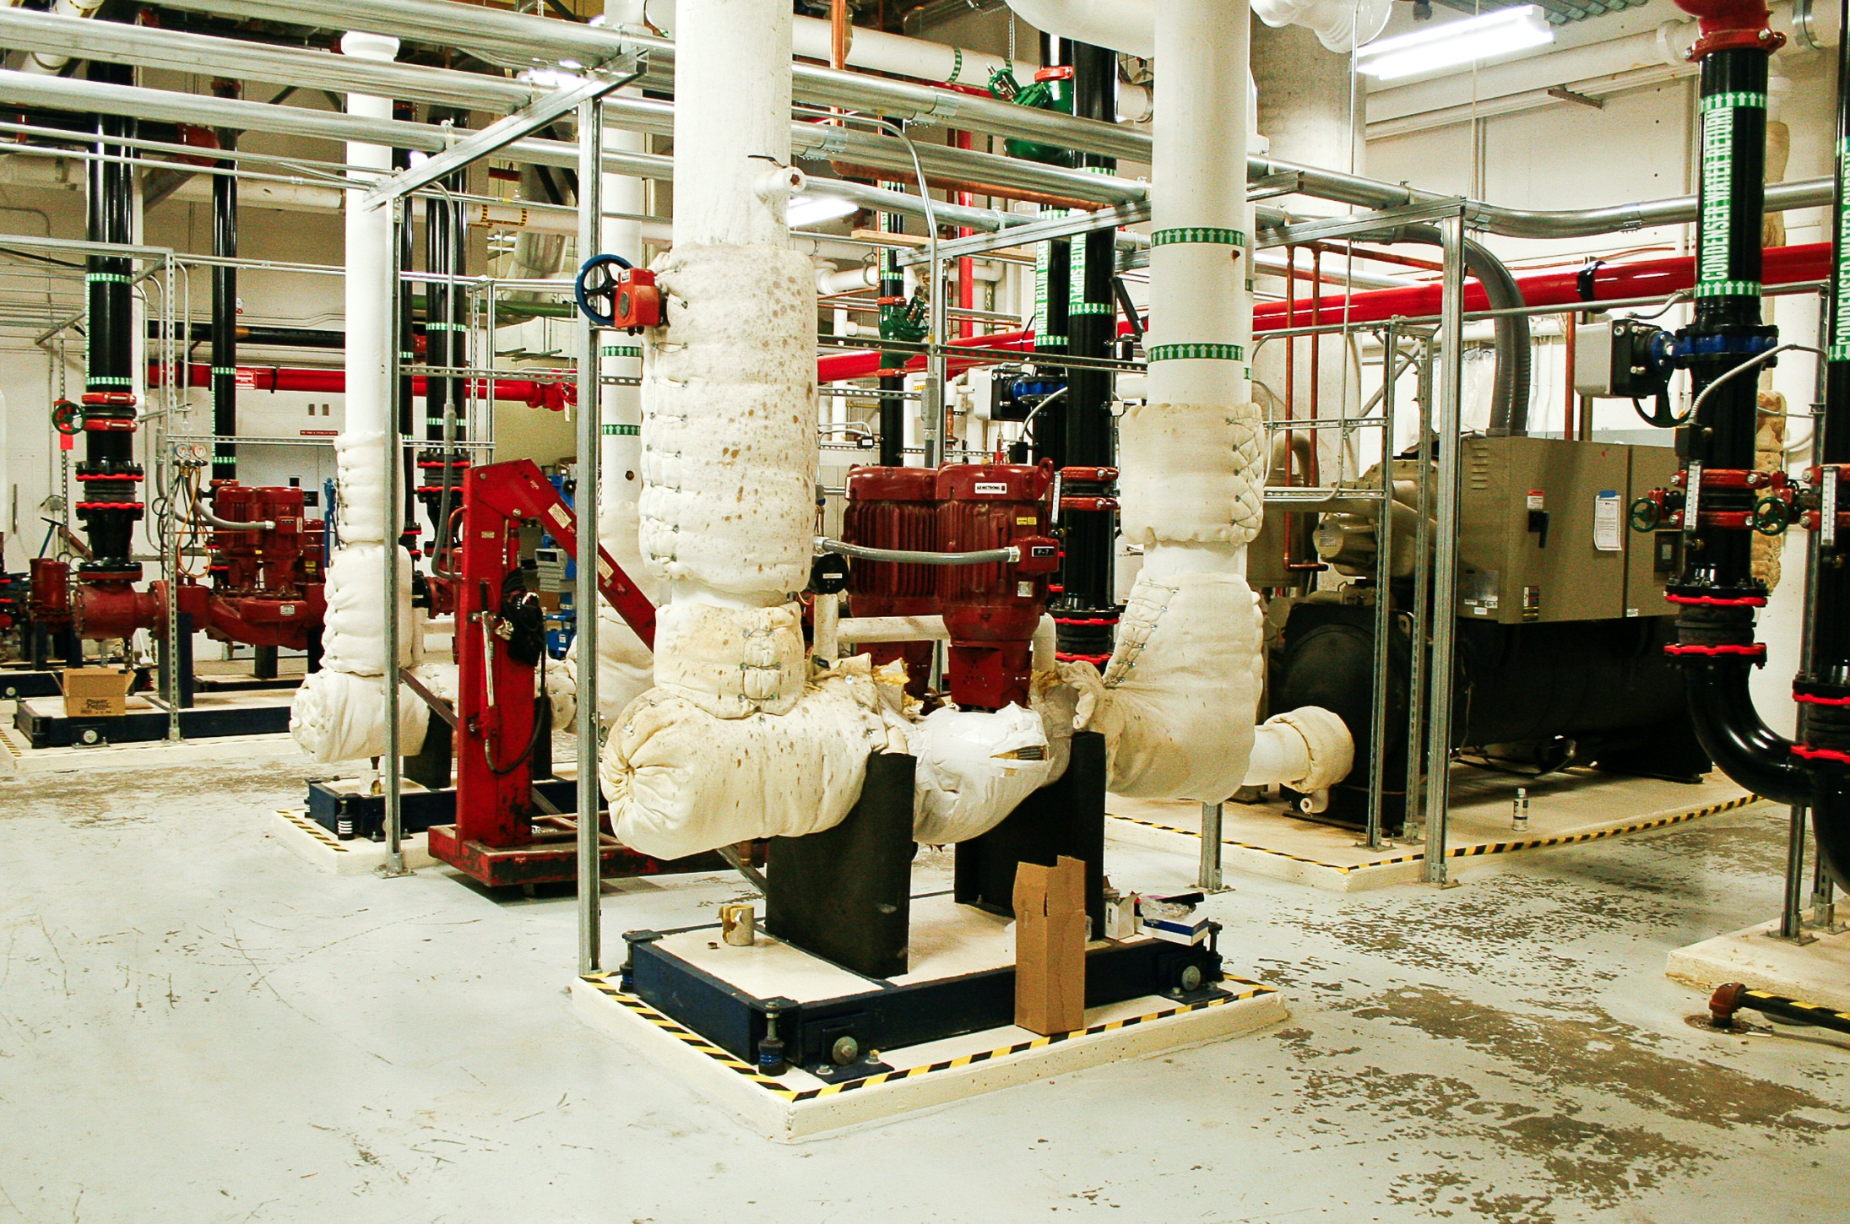
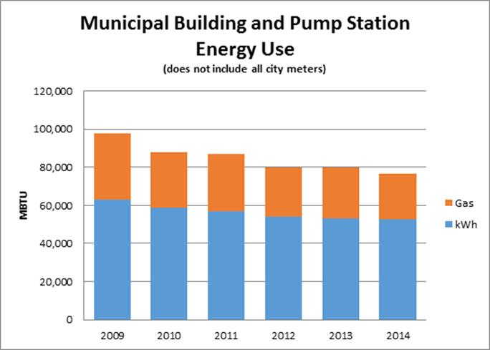
Resource Conservation Manager Program*
99 EPA ENERGY STAR score for Bellevue City Hall
$905,031 saved since 2009
6,633 Metric tons CO2 equivalent (MTCO2e) reduced
Lead by Example
Engage the Community
Collaborate Regionally, Nationally
Constantly Improve
Notes:
Resource Conservation Manager (RCM) is a dedicated employee on staff dedicated specifically tasked with saving 5% on energy and water consumption every year.
RCM has saved the city nearly $1 million to date and provided some of the largest contributions to our operational greenhouse gas reductions –equivalent of taking over 1,300 vehicles off the road for a year.
At City Hall, the RCM has boosted our national EPA EnergyStar rating from 92 to 99 (out of 100), meaning it is outperforming most city hall’s in the nation.
[About EPA ENERGY STAR - the score assesses how your building is performing as a whole: its assets, its operations, and how the people inside use it, relative to other buildings of the same type and use nationwide.]
Program is supported financially by Puget Sound Energy. Many utilities offer programs like this.

Slide 5
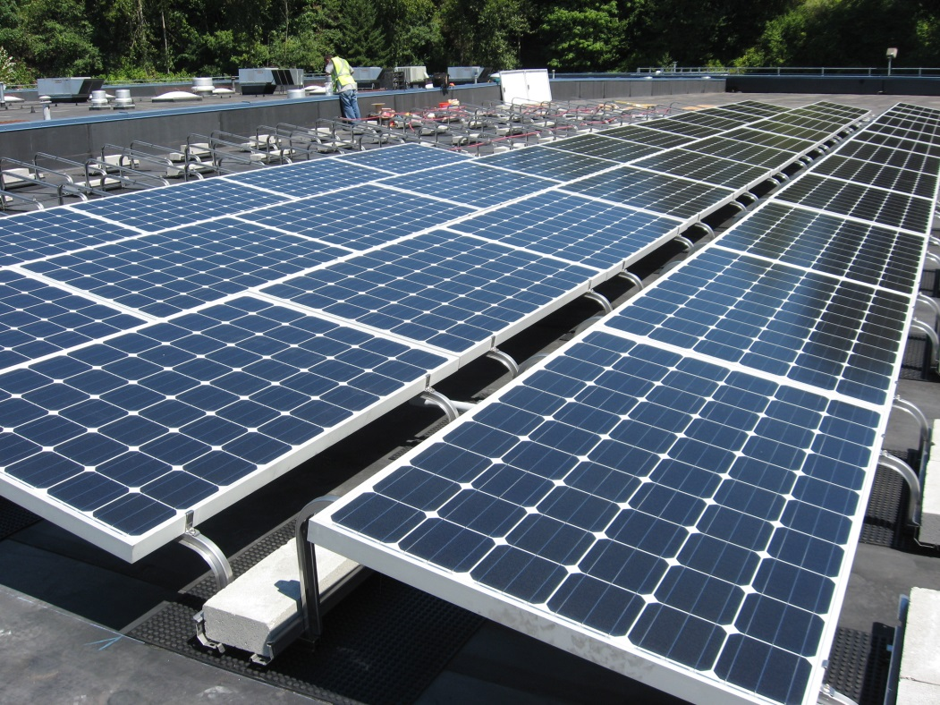
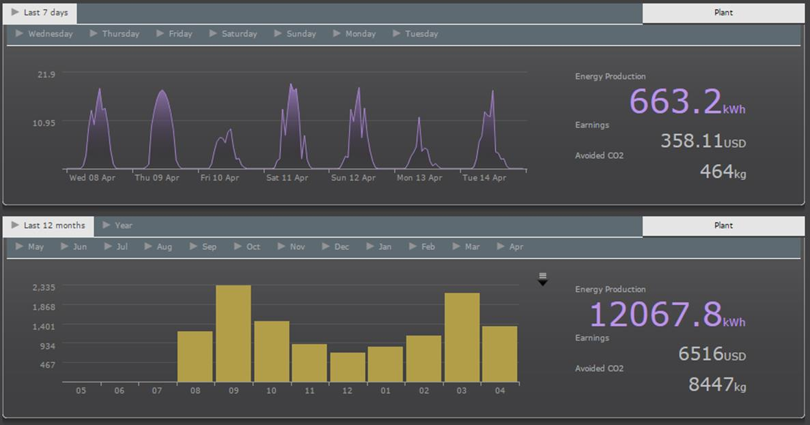
Bellevue Service Center Solar System
86 modules – Made in WA
23 kW system
2.5 homes equivalent electricity production
Lead by Example
Engage the Community
Collaborate Regionally, Nationally
Constantly Improve
Notes:
Fortunate to land a significant solar array on our 2nd largest city facility – the Bellevue Service Center – in 2014.
Installation occurred right as we were kickstarting a new campaign for our whole community to go solar,
Once again could “walk our talk.”
System is comprised almost entirely of parts manufactured in the state of Washington.
It produces the equivalent of 2.5 homes worth of energy each year.

Slide 6
LED upgrade 2.0*
$173,000 annual savings
760 MTCO2e annual savings
3.4 year simple payback
To [City of Bellevue],
I'm writing this to let you know I really like the new streetlights. They were installed yesterday, the 12th.
I'm somewhat of an amateur astronomer and set up a telescope in my driveway when conditions allow. I always had to hide behind some tree limbs to avoid the old lights that scattered light everywhere. These new ones act like "full cutoff" lights that put the light where it should be, on the ground, and not up in the sky.
I know that cost saving was the prime factor but you just might improve the view of the night sky as well. [Bellevue Resident]
Lead by Example
Engage the Community
Collaborate Regionally, Nationally
Constantly Improve
Notes:
Undertaking second round of comprehensive LED streetlight retrofits this year
First round reduced energy costs by roughly $1 million.
Retrofitting 4000+ lights
Payback of 3.4 years and $173,000 in annual energy savings.
Feedback from the community has been more positive than negative, and always interesting,
Letter from a resident who can enjoy greater access to stargazing and not have to “hide behind the tree limbs” to avoid the scattered light of the old bulbs.

Slide 7
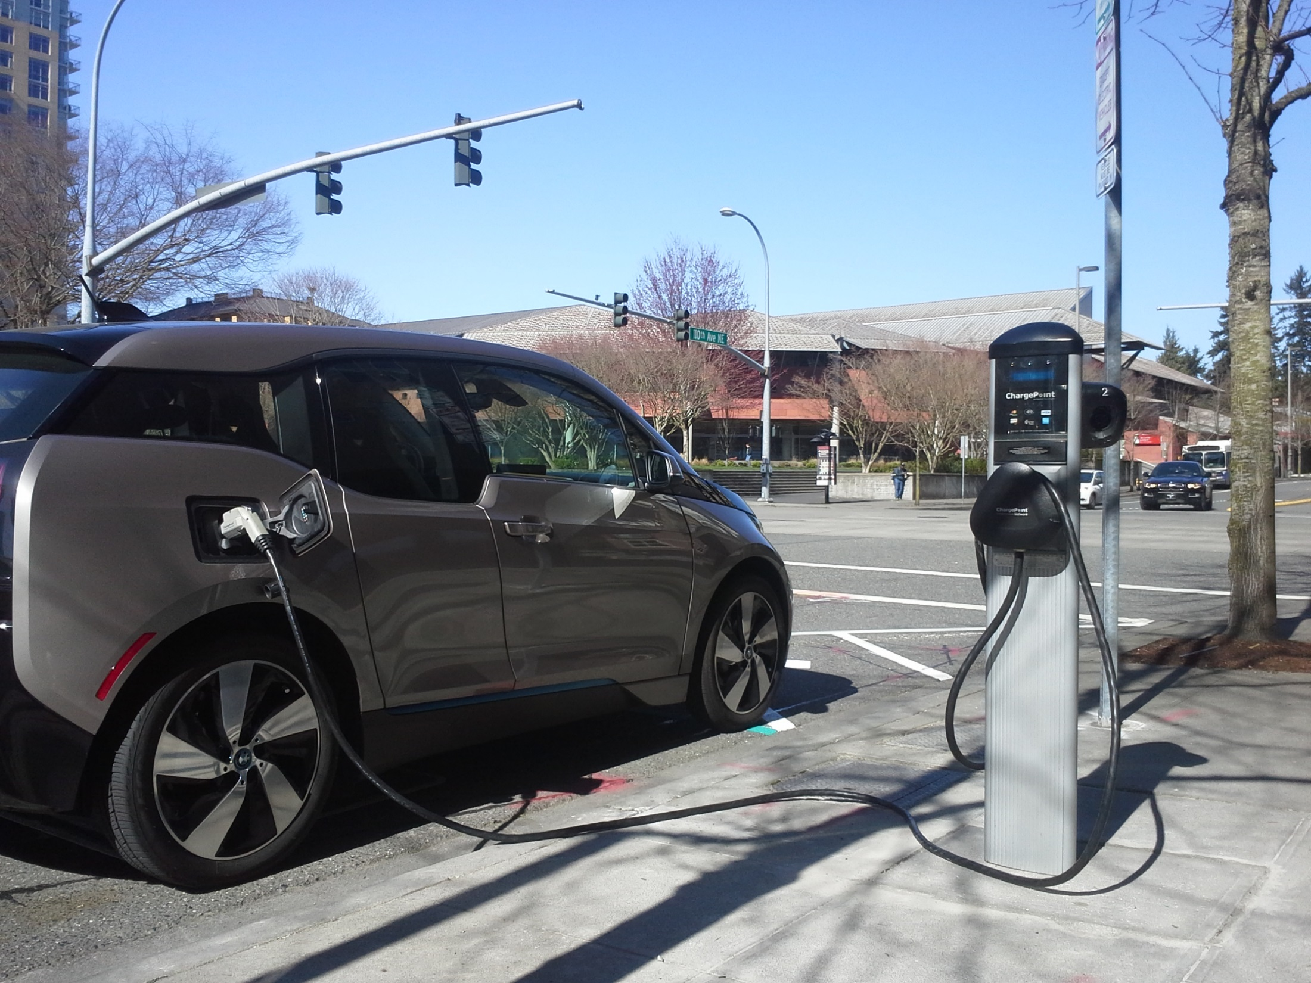
Electric Vehicles
16 City-owned stations available to public
15,000+ Plug-ins since 2011
$3,600 Annual gas savings from 1 Bellevue EV commuter
Lead by Example
Engage the Community
Collaborate Regionally, Nationally
Constantly Improve
Notes:
The city is a national leader in electric vehicles
We installed public charging stations when there were barely any cars on the road – this helped educate the community that their decision to drive electric was supported
Our charging network of 16 public station has facilitated over 15,000 plug-ins and been matched by the private sector, who have added over 60 more stations throughout the city.
There is both a Nissan and Tesla dealership in Bellevue – Nissan selling more Leafs than any other dealer nationwide;
Tesla generating more than 10 times the revenue per square foot of other stores in the Bellevue Square Mall (yes, it’s in a mall!) (source: http://www.bizjournals.com/seattle/blog/techflash/2015/02/what-a-jolt-teslas-sales-at-bellevue-square-reach.html?page=all)
Over 50% of the city’s light duty fleet are hybrid and electric vehicles – saving us an estimated $30,000 on fuel costs each year.

Slide 8
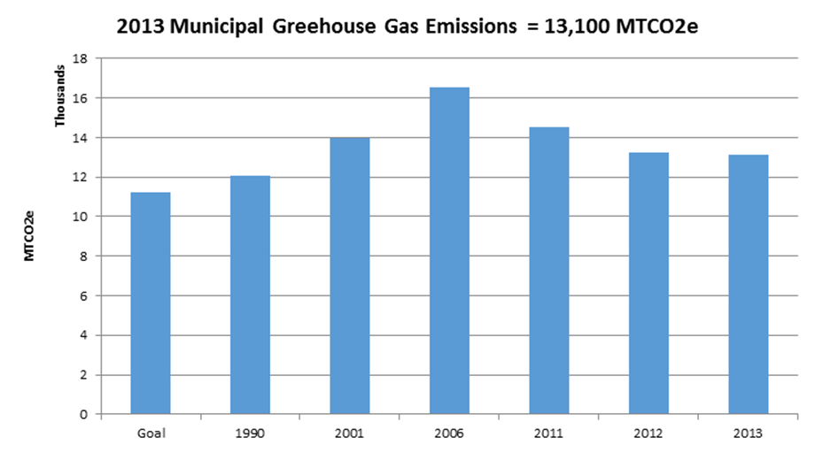
Municipal Greenhouse Gas Reductions
22% municipal GHG reduction since 2006
25% by 2020 countywide target
50% emissions reduction from LED street light projects
25% by 2020 reduction goal!
Lead by Example
Engage the Community
Collaborate Regionally, Nationally
Constantly Improve
Notes:
These and many other endeavors prove that changing out the lights, going solar, driving electric, all work.
The city has cut its greenhouse gas emissions by over 20% since 2006.
This puts us on track to meet our newly established Countywide GHG reduction targets of 25% by 2020 – at least within our own operations
The savings realized by the city from these actions, and the industries that our investments have supported, , comprise an important economic development argument for climate change mitigation

Slide 9
Engaging the Community:
Solarize Bellevue
Eastside Energy Corps
Green Power Challenge
Georgetown University Energy Prize
GreenWA.org
Lead by Example
Engage the Community
Collaborate Regionally, Nationally
Improve
Notes:
We switch gears now from Step 1 – Leading by Example, to Step 2 – Engaging the Community.
This is where things get fun and creative, and – considering Municipal greenhouse gas emissions are less than 1% of our total Community emissions – these actions are critical.
Not going to talk about every one of these but want to point out some that you may find unique and useful for your community.
Summary of items not discussed in presentation:
Green Power Challenge – a community challenge, from our Utility, to increase purchase of “Green Power.” Meeting the target increase will result in a $40,000 solar array for the Bellevue Crossroads Park, which is conveniently the site of EV charging stations, our renowned Spray Park, and major summertime festivals like Strawberry Festival.
GreenWA.org – a community sustainability website that maps different sustainability assets (solar arrays, salmon-bearing streams, community gardens) throughout Bellevue, in addition to providing information about local non profits and ways to get involved.

Slide 10
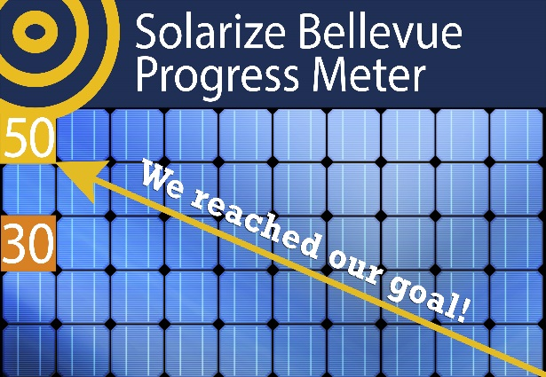
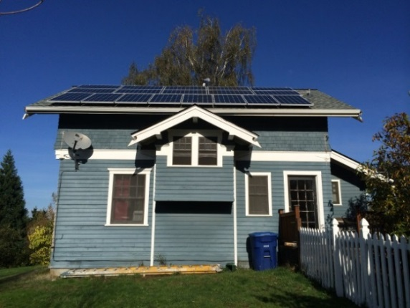
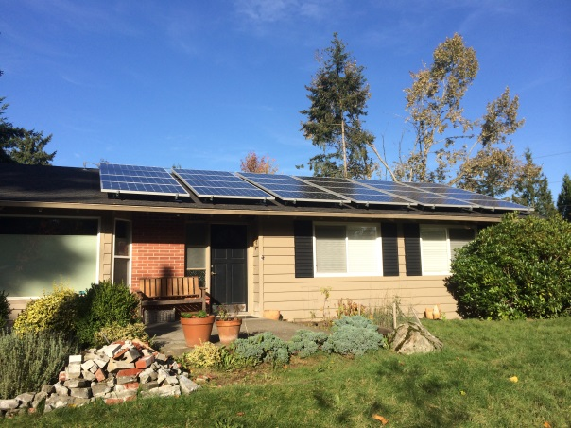
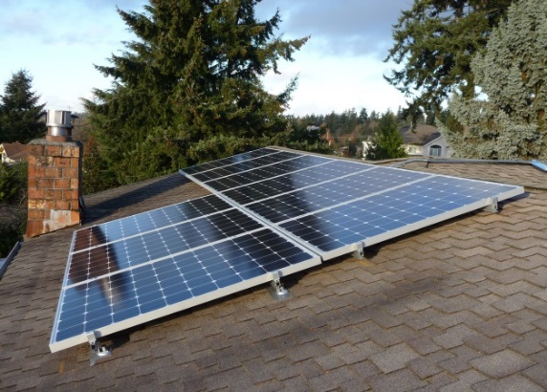
Solarize Bellevue - 2014
50 new systems – 268 kW!
$16,000 system donated to Boys and Girls Clubs Teen Center
$1 million in private investment in solar
150% increase in 2014!
Lead by Example
Engage the Community
Collaborate Regionally, Nationally
Improve
Notes:
Solarize Bellevue has been the talk of the town lately
A great showcase project for our community engagement efforts.
Through this campaign, funding a non-profit partner of ours in the amount of $10,000, the city helped spur community investment in 50 new solar arrays around town.
The value of these systems equates to an investment of over $1 million in what again are clean technologies manufactured in Washington and green jobs in the local service and labor industries.
[Click slide]
The city is proud to now have over 1 megawatt of solar installed.
This chart shows what a boost recent programming and other large installations have provided

Slide 11
Collaborate Regionally, Nationally:
Georgetown University Energy Prize (GUEP)
King County Cities Climate Collaboration (K4C)
Scope 5 Performance Dashboard
Lead by Example
Engage the Community
Collaborate Regionally, Nationally
Constantly Improve
Notes:
Once we think we’ve started making a dent in our community emissions through engagement programs, it’s important to engage regionally and nationally
We do this to share best practices, agree to mutual targets, or even engage in some friendly competition,
We’ll switch gears from community engagement to Collaborating Regionally and Nationally.

Slide 12
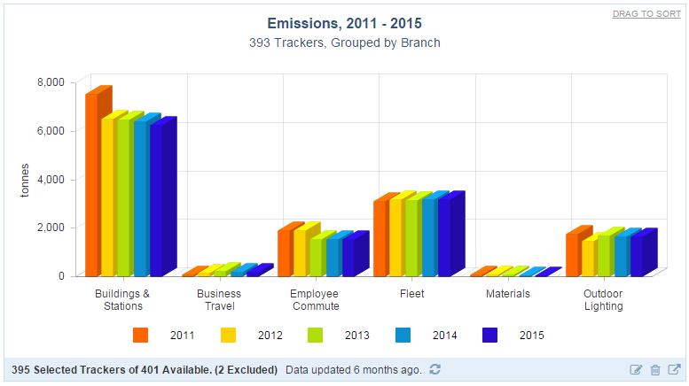

Slide 13
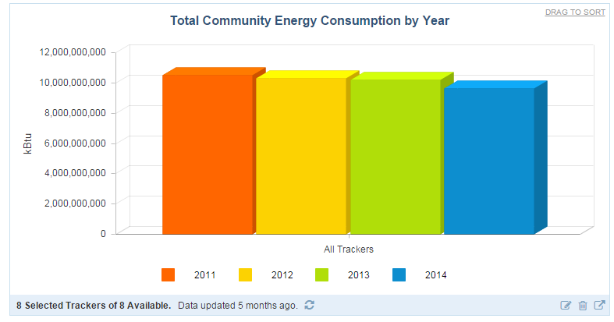

Slide 16
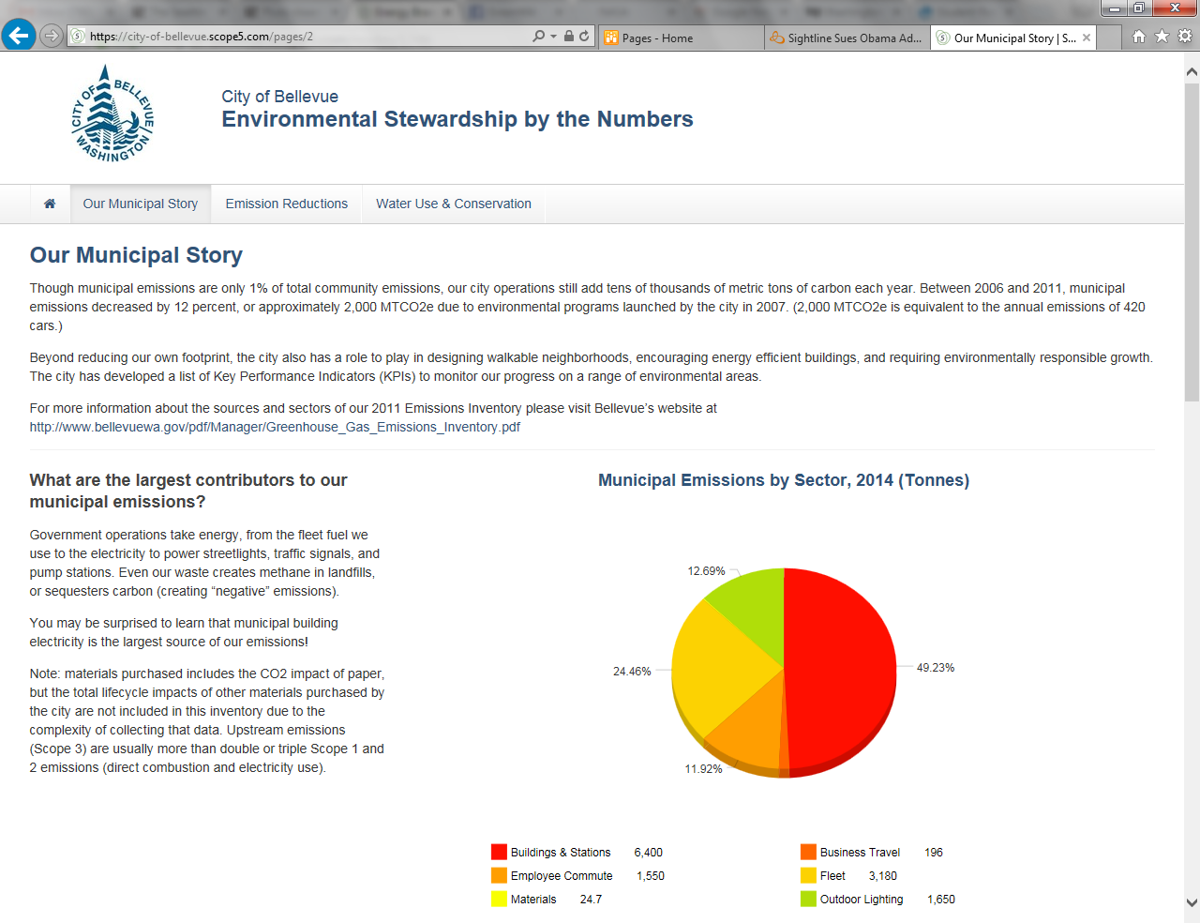

Slide 17
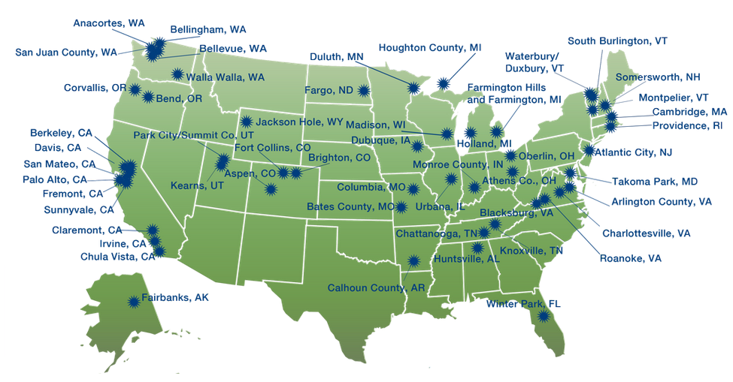
Georgetown University Energy Prize
$5 Million Prize for 2-year competition
50% of all energy produced in U.S. is wasted
20-30% average reduction potential in homes built before 1991
Lead by Example
Engage the Community
Collaborate Regionally, Nationally
Constantly Improve
Notes:
Community Engagement becomes critical as we move to the next step in Bellevue’s process – Regional and national collaboration.
Bellevue has been selected among 50 cities competing nationwide to compete for the Georgetown University Energy Prize – a $5 million competition to see who can reduce the most reduce residential and municipal energy consumption.
we are excited for this opportunity to be more creative, more productive, and more rewarded
We will need to be – Energy Efficiency has been identified by Georgetown University as a “Stuck Problem”
While many resources exist to increase the efficiency of our homes, how many of us feel like we’ve done everything we probably could? [SHOW OF HANDS]
How do you fix a stuck problem? The first flight across the Atlantic, food preservation, even measuring longitude were all similar problems – solved eventually by a big challenge with a grand prize cash purse. (Lindbergh needed money and a reward was issued, Napoleon issued food preservation challenge, led to canned food)
A representative from a competing city said, “The grand prize is something like $5 million and change. One community will get the $5 million – but we’ll all get the change.”
This is a 2-year prize competition and our Eastside Energy Corps are functioning as the mind, body, and voice of the community’s efforts to win.

Slide 18
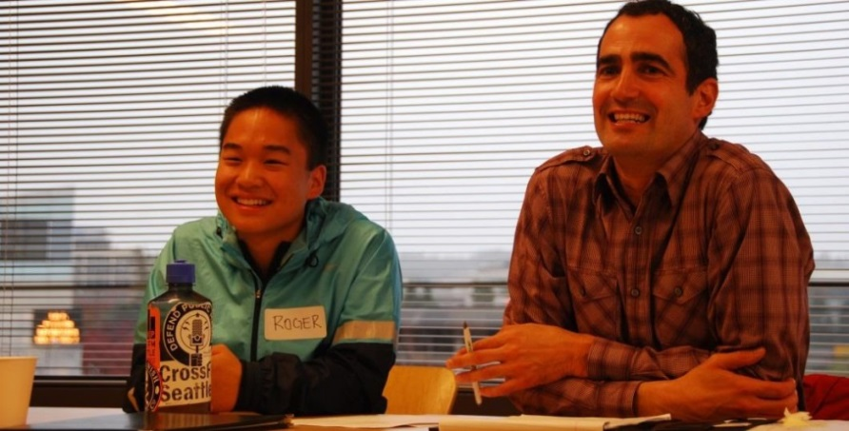
Eastside Energy Corps
Culture shift: From energy ambivalence to energy attentiveness
Youth involvement
Lifelong learning
Lead by Example
Engage the Community
Collaborate Regionally, Nationally
Constantly Improve
Notes:
Equally important to engaging homeowners and leading by example, is engaging our youth.
Bellevue has developed a new partnership with Bellevue schools and students called the Eastside Energy Corps
EEC is a way for youth to solve tomorrow’s problems in their own backyards today.
Sustainability is not only about recycling anymore, but we can learn from the success that recycling gained as a concept that was brought home to parents, by students, over the past 20 years.
“Mom, why aren’t you recycling this” has turned to “Dad, why aren’t we driving a Prius,” will turn to “Hey, who is leaving all the lights on around the house?”
The Eastside Energy Corps aims to create a culture shift in Bellevue – from energy ambivalence to energy attentiveness,
Since its launch in January this year has recruited over 100 Bellevue high school students with some pretty cool projects and plans.
Roger Chen, the student pictured here in the lower left corner, is seen working with King County Energy Manager David Broustis on a Community Energy Efficiency Plan.
Since becoming involved with the Corps, Roger has turned into something of a Bellevue Energy Superhero [CLICK ANIMATION]– so watch out!

