Slide 1
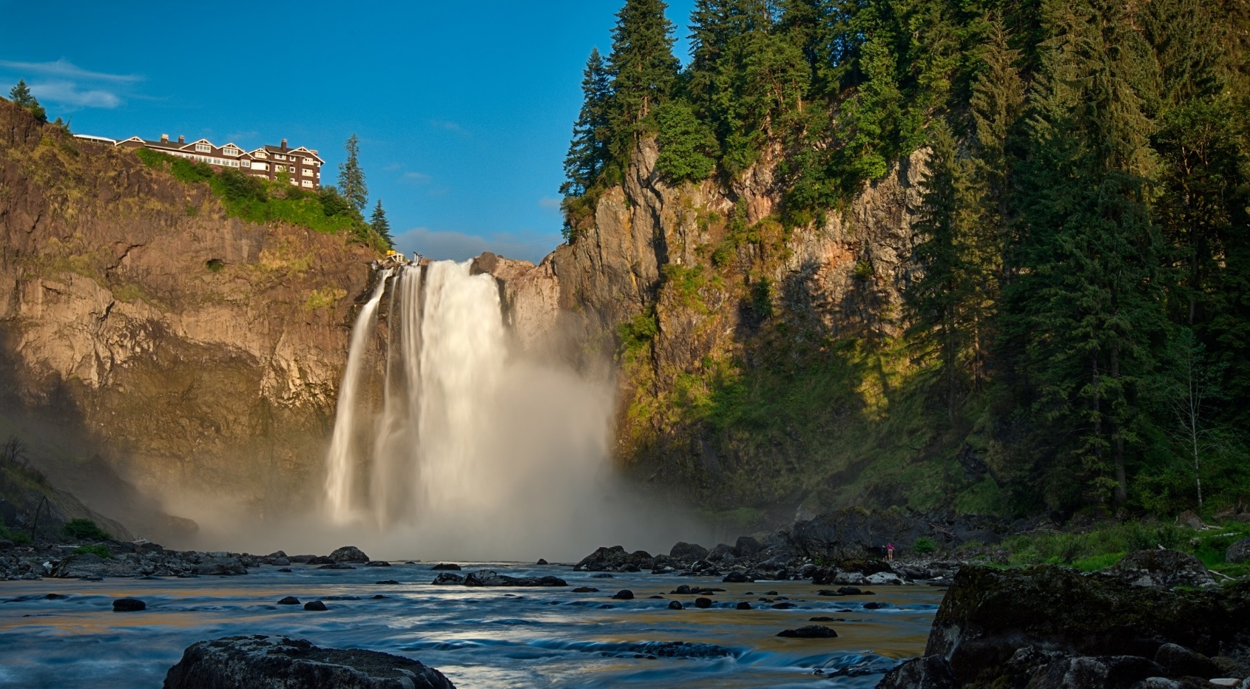
120 MILLION VOICES
Photo courtesy Jim Reitz
Notes:
63% of Adult Americans (adults aged over 25) believe climate change is happening.
-- Anthony Leiserowitz, the director of the Yale Project on Climate Change Communication, (http://www.weather.com/science/environment/news/more-americans-dont-believe-global-warming-happening-survey-20140117 & http://environment.yale.edu/poe/v2014/)

Slide 2
OVERVIEW
Small Cities
Small Staff
First Steps
Urban Forest
Commute
Green Power
Solarize
Big Change
Photo courtesy Jim Reitz

Slide 3
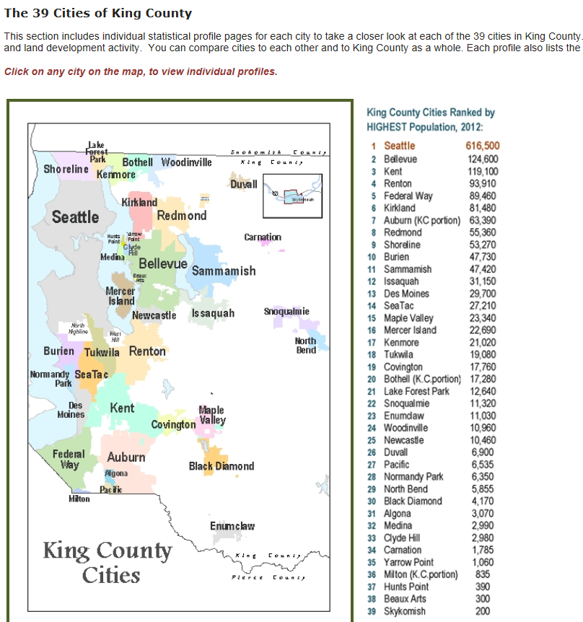
80% of the US lives in urban areas.
~20% big cities
~60% towns/suburbs ≤ 20,000
US Census:
Urban Areas are Towns> 2,500
Notes:
1. Different priorities: Vehicles/homes vs. mass transit/multifamily
2. More nimble
Screenshot from: http://www.kingcounty.gov/exec/PSB/Demographics/KCGrowthReport/KC-CitiesandProfiles.aspx
SOURCE:
UC Berkeley CoolClimate Network (2013).
http://coolclimate.berkeley.edu/maps

Slide 4
About 80% of US lives in urban areas.
~20% big cities
~60% towns/suburbs ≤ 20,000
In King County,
half our cities are small.
Notes:
1. Different priorities: Vehicles/homes vs. mass transit/multifamily
2. More nimble
Screenshot from: http://www.kingcounty.gov/exec/PSB/Demographics/KCGrowthReport/KC-CitiesandProfiles.aspx
SOURCE:
UC Berkeley CoolClimate Network (2013).
http://coolclimate.berkeley.edu/maps

Slide 5
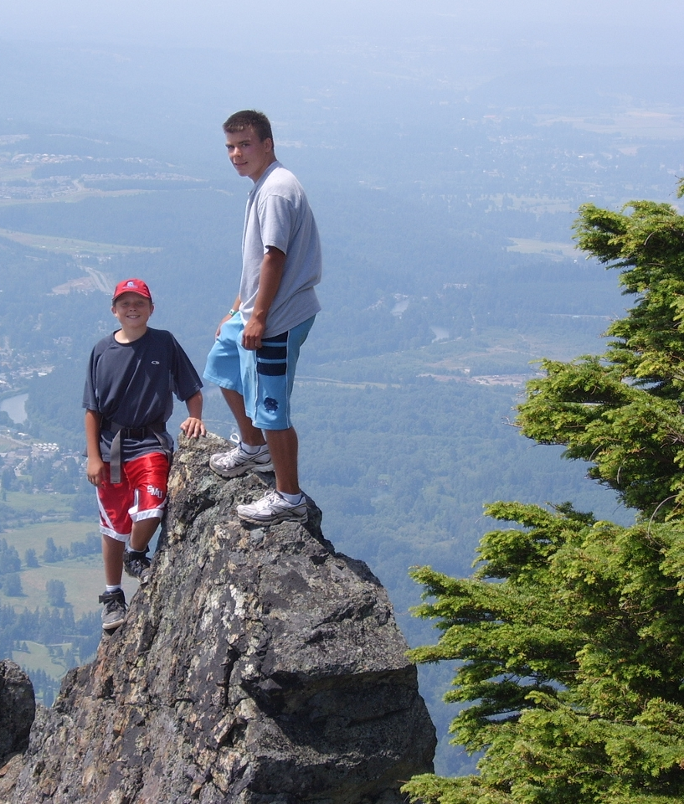
Small Cities, Big Problem
Small Cities
1. Different emissions. Homes & Cars vs. Multifamily & Buses
2. Different Priorities.
Average annual household carbon footprint:
33 zip codes
5 zip codes
Source: UC Berkeley CoolClimate Network http://coolclimate.berkeley.edu/maps
Notes:
Small-City households usually have a larger climate impact.
Here, we see that the average Snoqualmie Household generates twice the emissions of a Downtown Seattle resident

Slide 6
What Can We Do?
Staffing
Assignment.
One staff
Department
The First Action
Is Assigning Someone to Take Action.
Someone with passion

Slide 7
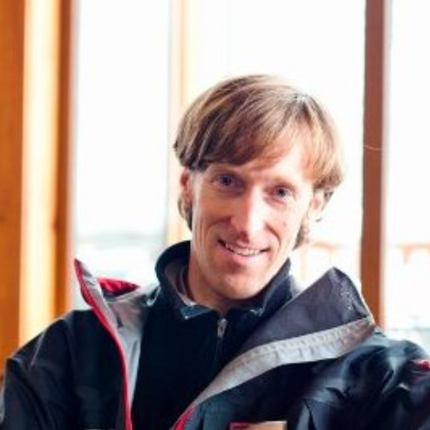
What Can We Do?
Staffing
Assignment.
One staff
Department
One Staff
Snoqualmie Model:
One staffer, Non-Explicit
2. Mercer Island Model:
…or Explicit.
Ex. Sustainability & Communications Coordinator
Notes:
Explicit is recommended, or else you may lose programming if one passionate staffer leaves.

Slide 8
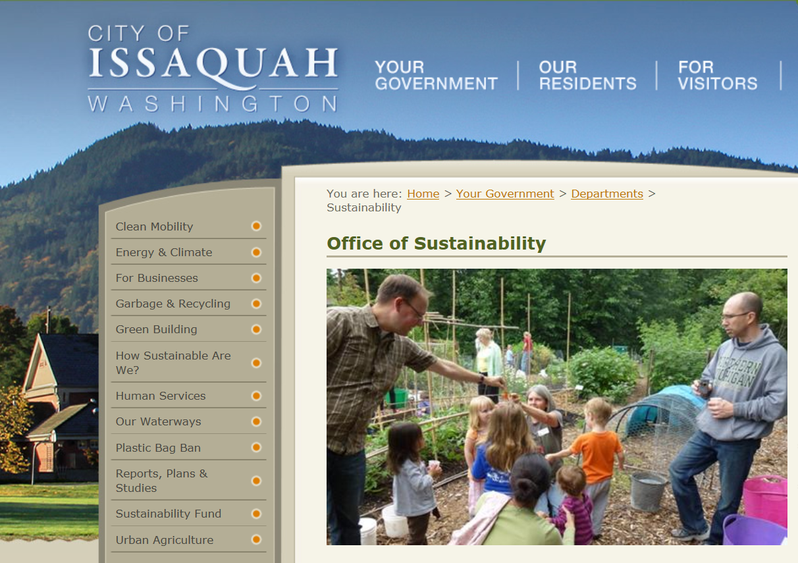
What Can We Do?
Staffing
Assignment.
One staff
Department
1. Targeted Program.
Ex. Environmental Stewardship,
Bellevue
2. Full Department.
Ex. Office of Sustainability,
Issaquah
Notes:
Another Ex: Environmental Services, Auburn

Slide 9
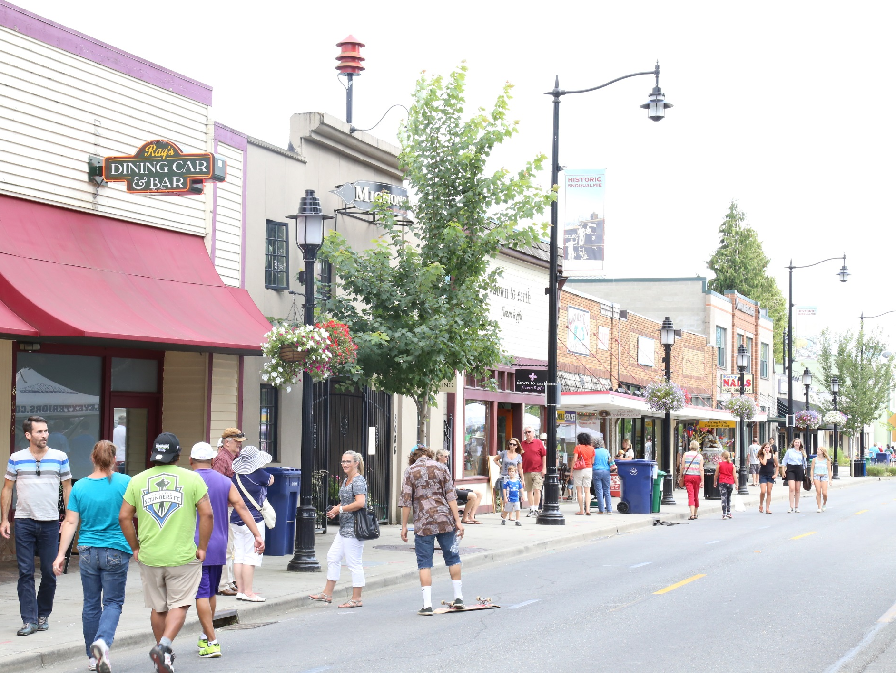
What Can We Do?
Focus on Co-Benefits.
Small Steps
Urban Forest
Commute
Green Power
Solar
Trees Help Business
15% Higher consumer ratings.
Prices 10% higher.
Notes:
There are multiple economic benefits associated with trees to citizens and places of commerce. For commercial properties, it has been found that customer service ratings were about 15% higher for business districts with trees, and that average prices were between 9-11% higher for products in landscaped areas: “Trees in Business Districts: Positive Effects on Consumer Behavior,” University of Washington, College of Forest Resources Center for Urban Horticulture

Slide 10
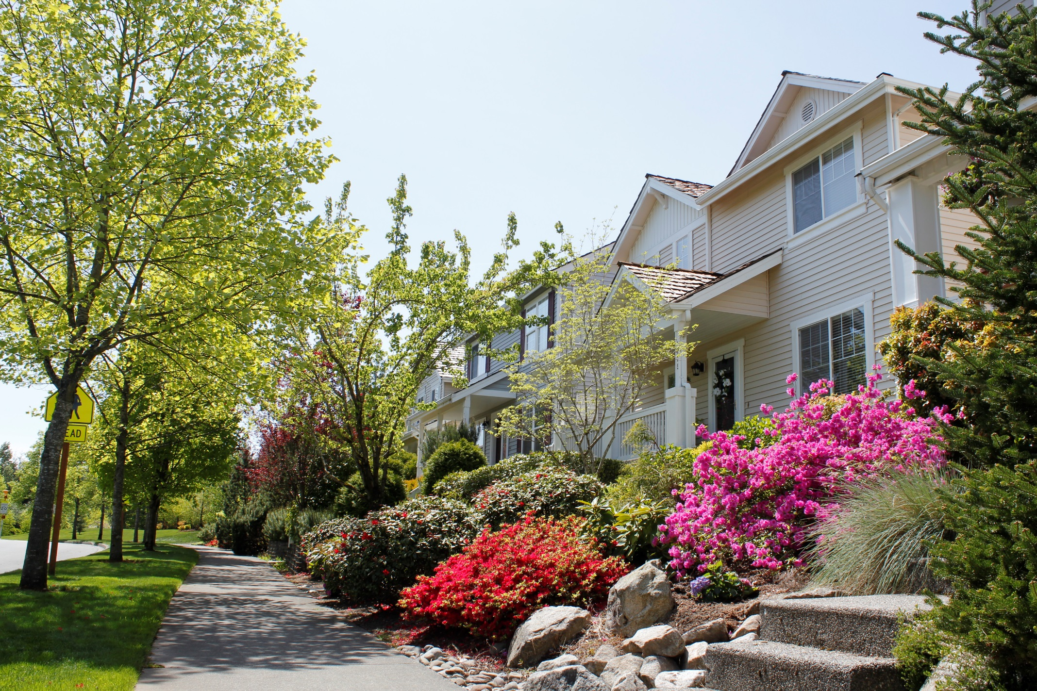
What Can We Do?
Small Steps
Urban Forest
Commute
Green Power Solar
Trees Help Residents
10% Higher home values
Cleaner air
100 trees remove 123 lbs air pollution annually
Notes:
Residences also benefits from trees, with a mature tree capable of adding 10% to a home’s property value – a benefit to the residents upon property sales, and a benefit to cities in municipal property tax revenues: Pacific Southwest Research Station (in partnership with the National Forest Service; US Department of Agriculture. “Trees Pay Us Back in the Pacific Northwest,” May 2011. http://www.fs.fed.us/psw/programs/uesd/uep/products/18/812uesd_uep_tpub_PacificNorthwest.pdf
The 2008 PNW Research Station found a positive effect of street trees on home sales price.
On average, street trees add $8,870 to sales price
Benefit – cost ratio of 12:1
– G . Donovan & D. Butry, “Trees in the City: Valuing street trees in Portland, OR”, Landscape & Urban Planning

Slide 11
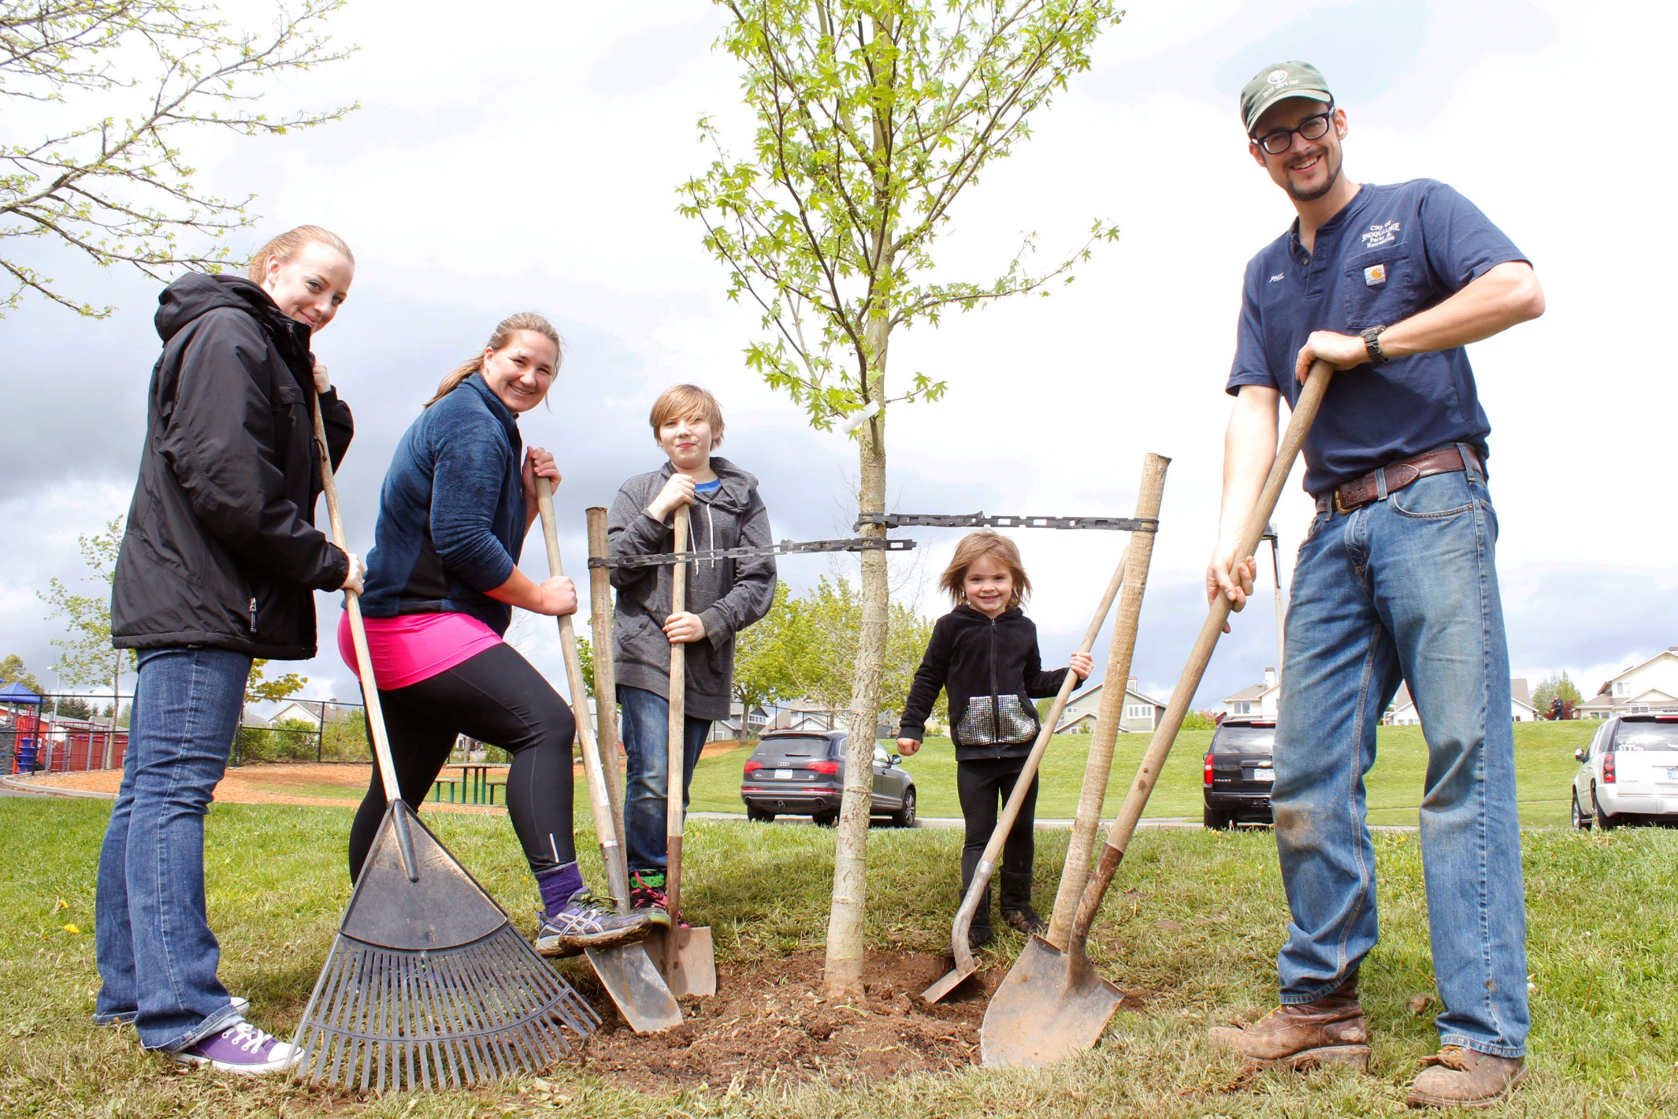
What Can We Do?
Small Steps
Urban Forest
Commute
Green Power Solar
Trees Help Residents
100 trees also removes 13 tons carbon/year
…& diverts 54,000 gallons of rain
Notes:
In one year, 100 street trees will remove 13 tons of carbon dioxide (CO2), 123 pounds of other air pollutants and catch about 54,900 gallons of rainwater. They also provide bird and wildlife habitat and can grow food and materials for human use: Pacific Southwest Research Station (in partnership with the National Forest Service; US Department of Agriculture. “Trees Pay Us Back in the Pacific Northwest,” May 2011. http://www.fs.fed.us/psw/programs/uesd/uep/products/18/812uesd_uep_tpub_PacificNorthwest.pdf

Slide 12
What Can We Do?
Small Steps
Urban Forest
Commute
Green Power
Solar
Tree Tips
WA DNR grants: $10,000/yr
KCD grants
Vancouver & Kirkland = storm rates
Notes:
Vancouver, WA, population 161,000
Kirkland, WA, population 84,000

Slide 13
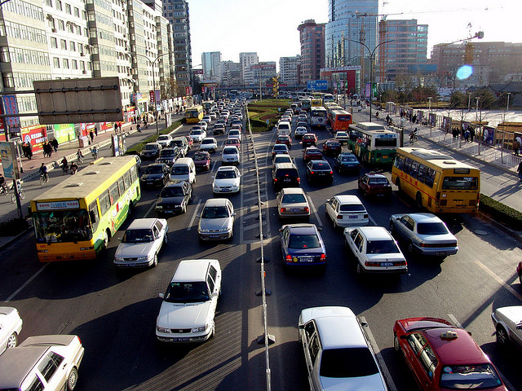
What Can We Do?
Small Steps
Urban Forest
Commute
Green Power
Solar
Cars =
1 pound per mile
(of carbon)
Promote Carpooling
&
Transit.
Photo courtesy Saad Akhtar
Notes:
Sightline Institute, “How Low Carbon Can You Go…”
Cars (solo) = 1.1 lbs/mile,
SUVs (solo) = 1.6
Photo under creative commons. See https://www.flickr.com/photos/saad/1908337/

Slide 14
What Can We Do?
Small Steps
Urban Forest
Commute
Green Power
Solar
RideshareOnline:
a great resource
(need to promote it)

Slide 15
What Can We Do?
Small Steps
Urban Forest
Commute
Green Power
Solar
Car Tips
Connect Human Resource depts. in Business Districts.
Run a “1 Day a Week” Campaign.
Notes:
R Trip: https://www.gortrip.com/
Recorded Commutes
6,223,041
CO_{2e} reduced (lbs.)
113M
Gas saved (gals.)
13M
Trips Eliminated
4.4M
Money Saved
$25M

Slide 16
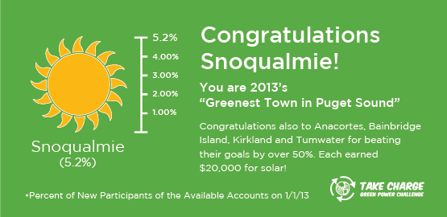
Green Power Challenge
Small Steps
Urban Forest
Commute
Green Power
Solar
Existing Utility program.
Residents add $4/month green energy
Enrollment doubled+, from 3.2% to 8.3%
The 1st place award = $40,000 solar array (9.9 kw)
Power Tips
Use Existing Utility Programs
2014, DOC awarded $22 million solar & energy efficiency grants
(incl. 21 local governments)
Notes:
We started at 3.2% of accounts.
Goal: increase by 30%.
Ended at 8.3%: a 152% increase
PSE avg. = 3.7%
Increased participation 152%, in 8 months.
State Energy efficiency & Solar: http://www.commerce.wa.gov/Programs/services/CapitalFacilities/Pages/EnergyEfficiencyGrants.aspx

Slide 17
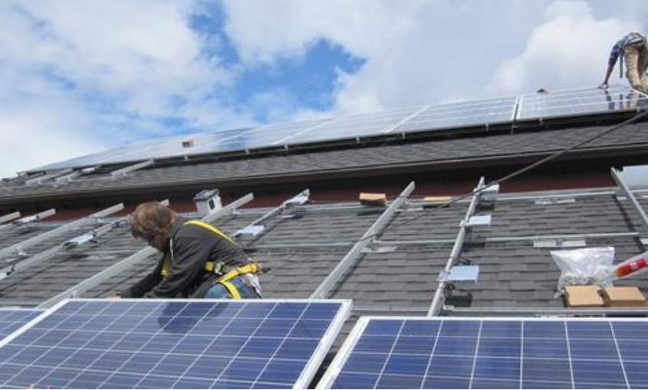
What Can We Do?
Small Steps
Urban Forest
Commute
Green Power
Solarize
Solarize
Citizens all agree to buy from One Installer…
Who in return offers a 10-12% discount
Usually get 20-50 systems in one year
Notes:
City of Renton: Renton Will Replace City Street Lights with Energy-Efficient LED Lights
http://rentonwa.gov/news/default.aspx?id=37967
Renton, WA – Beginning August 26, the City of Renton will replace 3,865 street lights with energy-efficient LED (light-emitting diode) lighting. These new lights will significantly reduce the city's electricity use and will save the city an estimated $55,000 in the first year of use and even more in succeeding years. LED lights last longer thereby reducing maintenance costs, provide much better illumination and color distinction at night, and can be directed to focus the light where it is needed. They also reduce the sky glow–the artificial illumination of the night sky—and help lower greenhouse gas emissions.
“ This $4.3 million project is mostly funded by grants and a low interest bond including $500,000 from the state Department of Commerce, $589,000 from Puget Sound Energy, and $3.2 million from a 15-year low interest Qualified Energy Conservation Bond.
* * * * *
Renton Reporter
http://www.rentonreporter.com/news/220696981.html#
Public Works director Gregg Zimmerman said the new lights will save the city about $271,000 per year in energy costs, before debt service is factored in.
“You can see this is a really good investment in terms of saving money,” he said.
Zimmerman said the city presently spends more than $1 million per year on power costs for the city’s street lights
…
The $4.3 million project is funded in part by two grants. The city received a $589,000 Utility Incentive Grant from Puget Sound Energy and a $500,000 grant from the Department of Commerce.
* * * * *
Northwest Solar Communities
Bellevue (50 arrays)
Edmonds
Kirkland
Mercer Island (47 arrays)
Seattle
* * * *
Snoq green power enrollments went from 3.2% to X
Mercer Island went from 4.5% to 7% (450 to 650 households)
National average is 1.8%

Slide 18
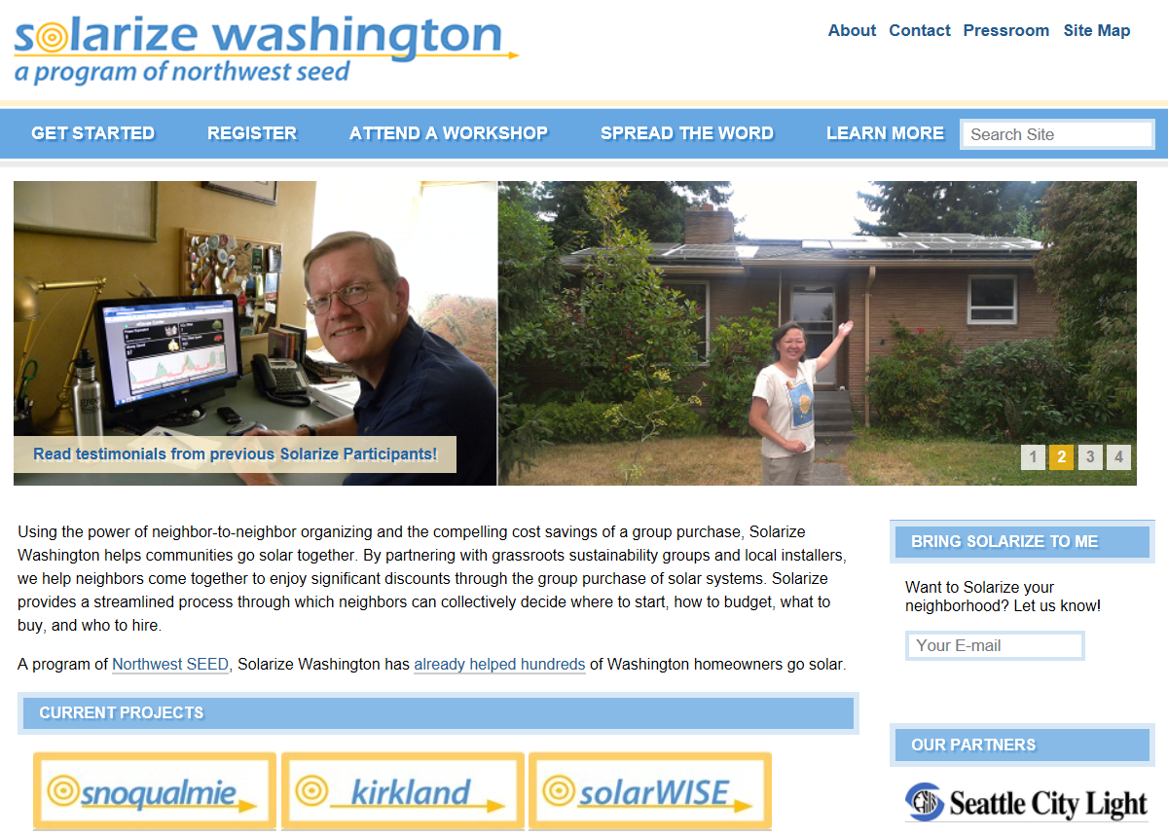
What Can We Do?
Snoqualmie
Aiming for 30 installations:
130 local kWh
$750,000 in local investment
City Cost: $10,000 + $10k grant.
NW Seed
10 Campaigns, 714 installs
3.5 Megawatts
$17 million investment
Since 2011
Small Steps
Urban Forest
Commute
Green Power
Solarize
Notes:
* * * * * This $4.3 million project is mostly funded by grants and a low interest bond including $500,000 from the state Department of Commerce, $589,000 from Puget Sound Energy, and $3.2 million from a 15-year low interest Qualified Energy Conservation Bond.
* * * * *
Renton Reporter
http://www.rentonreporter.com/news/220696981.html#
Public Works director Gregg Zimmerman said the new lights will save the city about $271,000 per year in energy costs, before debt service is factored in.
“You can see this is a really good investment in terms of saving money,” he said.
Zimmerman said the city presently spends more than $1 million per year on power costs for the city’s street lights
…
The $4.3 million project is funded in part by two grants. The city received a $589,000 Utility Incentive Grant from Puget Sound Energy and a $500,000 grant from the Department of Commerce.
* * * * *
Northwest Solar Communities
Bellevue (50 arrays)
Edmonds
Kirkland
Mercer Island (47 arrays)
Seattle
* * * *
Snoq green power enrollments went from 3.2% to X
Mercer Island went from 4.5% to 7% (450 to 650 households)
National average is 1.8%

Slide 19
Summary:
1. Start, period.
Assign Someone. Be Specific.
2. Start where you are.
3. Start on co-benefits.
4. Small Steps & Small Cities matter.
Urban Forestry • Commutes • Green Power • Solarize
Notes:
Elizabeth’s Slide

Slide 20
120 MILLION
Subtitle
IN SMALL CITIES
ACROSS AMERICA
BELIEVE IN CLIMATE CHANGE
Together, We Can Make a Big Difference.
Photo courtesy Jim Reitz
Notes:
Current US population = 319 million
80% of US population lives in “urban areas”
--20% in big cities,
--60% in towns/suburbs of 20,000, or less
SO
*0.6 : As 60% of US population lives in “small towns” = 191 million
And
*.63 : (See below) = 120 million
63% of Adult Americans (adults aged over 25) believe climate change is happening.
-- Anthony Leiserowitz, the director of the Yale Project on Climate Change Communication, (http://www.weather.com/science/environment/news/more-americans-dont-believe-global-warming-happening-survey-20140117 & http://environment.yale.edu/poe/v2014/)
Climate Change Communication, Yale maps: http://environment.yale.edu/poe/v2014/ (originally highlight in grist, http://grist.org/science/meet-the-united-states-of-divided-climate-beliefs/ ) Berkeley Carbon Footprint Maps http://coolclimate.berkeley.edu/maps Center for Climate and Energy Solutions Maps http://www.c2es.org/us-states-regions/policy-maps

