Slide 1
Testing Your Private Medication Center Bioterrorism Attack Tabletop Exercise
<<Organization Name>>
<<Date>>

Slide 2
Agenda
Introduction & overview 30 minutes
Exercise Play 30 minutes per Situation Update
Break 10 minutes
Debrief/Hotwash 30 to 45 minutes
Notes:
Do we want the timeframes in the facilitator notes?

Slide 3
What is a Tabletop Exercise?
Informal discussion using a scripted disaster scenario as a catalyst
No time pressures
Designed to promote free and open exchange of ideas
Notes:
3

Slide 4
What is a Tabletop Exercise?
Familiarizes players with roles, responsibilities, functions, plans, and procedures
Identify issues requiring further work
Introductory narrative, followed by “problem statements” and subsequent updates
Notes:
4

Slide 5
Procedural Notes
Parking Lot: as you come up with things that need further action as an organization, write them on a Post-It note, hand to the facilitator and he/she will place it in the “parking lot”
Your Specific Department: make notes of things you want to follow up on later with your department leadership and/or colleagues
Notes:
5

Slide 6
Organizational Planning for Private Medication Centers(PMC)
<Describe Private Medication Center planning currently underway in your organization>
Notes:
6
Does organization have Private Medication Center Plan? If so, are staff aware of it?

Slide 7
Exercise Objectives
Determine how to communicate to employees about the activation of a Private Medication Center (PMC)
Assess steps needed to make the decision to open a PMC
Evaluate process for activating PMC leadership and operations staff roles
Determine how required information will be compiled for local health departments

Slide 8
Assumptions
Scenario is plausible
Players are familiar with the organization’s Private Medication Center plan
All response partners across the Seattle area are involved in the response to this incident

Slide 9
Scenario
The local police department notified the state department of health that they received an anonymous tip that the deadly bacteria, tularemia, was purposefully released at a local mall during this weekend’s art festival.
The local public health department conducted an investigation and confirmed the presence of the bacteria.
Notes:
9

Slide 10
Situation Update 1 - DAY ONE
You find that 60% of your staff and their families visited the mall the day the bacterial was released into the air
Employees are concerned, impacting productivity
Notes:
Local media begin reporting on an unusual number of “suspicious disease cases” in local hospitals.
There is growing concern among your employees, and it begins to interfere with productivity at work.

Slide 11
Questions
What information would you provide to staff about the current bioterrorism situation?
Do you also have communication mechanisms to relay information to employees’ families?
What information would you want from Public Health at this time?
Notes:
11
These questions address Objective 1.
If your employee is absent from work and you have critical information to convey (e.g. a worksite closure, information on accessing health benefits), the ability to communicate directly with employees’ families can be beneficial.

Slide 12
Situation Update 2 – DAY TWO
An increased number of hospitalized patients test positive for Tularemia
All who visited mall, as well as their household members, advised to take antibiotics for prophylaxis
Public Health asks partners to activate PMC plans
Notes:
Samples from several hospitalized patients have come back positive from the Washington State Public Health Laboratory for the bacteria Tularemia
Public Health announces that the ill individuals all visited a busy shopping mall near your worksite prior to becoming sick, and that environmental samples from the mall have tested positive for Tularemia. People who visited the mall the previous weekend are at risk for contracting Tularemia.
The Local Health Officer recommends that individuals who visited mall and their household members be treated with antibiotics to prevent Tularemia infection. Taking medication to prevent infection is called prophylaxis. The Local Health Officer has requested antibiotics from the Strategic National Stockpile be shipped to Washington State to assure sufficient medications are available for all who need them.
Public Health advises its partners to activate Private Medication Center plans and prepare to dispense antibiotics to staff and families who may have been exposed.

Slide 13
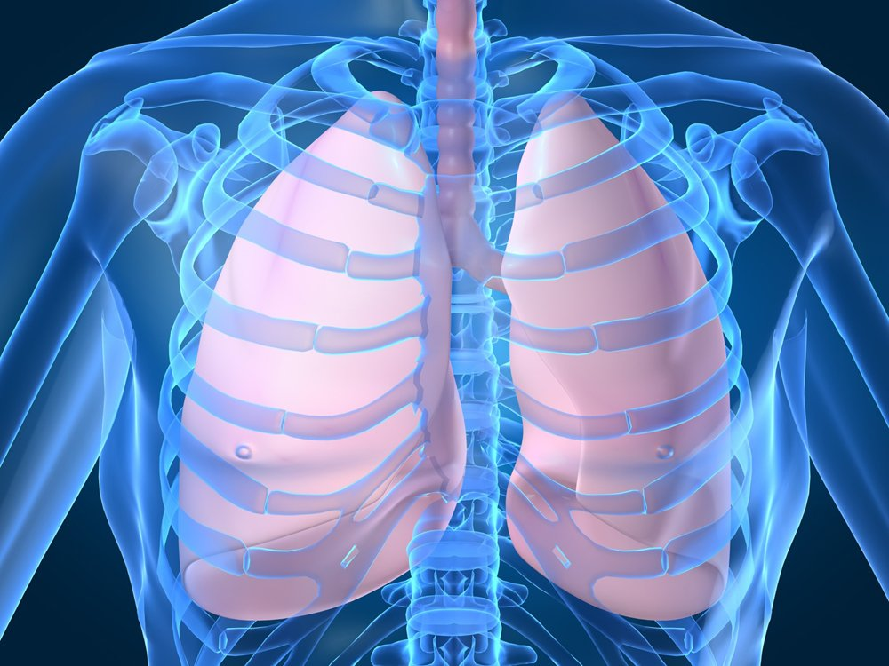
Tularemia Treatment Overview
Tularemia can be treated with antibiotics, such as doxycycline and ciprofloxacin
Emergency dispensing includes 10 days worth of antibiotics
Treatment usually lasts 10 to 21 days
* Information retrieved from Centers for Disease Control and Prevention website.
Notes:
After the 10 day emergency antibiotics are taken, the exposed should see their primary care physician for further treatment and follow up.

Slide 14
Tularemia Treatment - Continued
Symptoms may last for several weeks
Groups at high risk of complications include children, elderly, and individuals with already compromised or weak immune systems.
* Information from Centers for Disease Control and Prevention website.
Notes:
After the 10 day emergency antibiotics are taken, the exposed should see their primary care physician for further treatment.

Slide 15
Questions
Would your organization follow through with Public Health’s recommendation to activate the PMC?
What information do you need to know to make an informed decision to activate a PMC?
How would you initiate activation of your PMC? Who in your organization, and outside it, would be involved?
Notes:
15
These questions address objectives 2, 3

Slide 16
Questions - Continued
If you activate a PMC, what steps need to be taken? Are staff aware of their role in the activation?
Do you have primary and alternate locations identified in your planning to use as a PMC?
What information would you communicate to employees?
Notes:
16
These questions address objectives 1, 2, 3

Slide 17
Break
Notes:
10 to 15 minutes

Slide 18
Situation Update 3 – DAY THREE
Your PMC operation is ongoing
Many supervisors and staff are choosing not to come into work for fear of exposure to Tularemia
Public Health is requesting a status update on your progress with dispensing medications to affected staff and their families
Notes:
18

Slide 19
Questions
Do you have primary and alternate staff identified to fill roles for your PMC and have they been trained?
Who would receive medications under your plan? Staff? Families? Others outside the organization?
How will you track and record medication dispensed for your own records and reporting to Public Health?
Notes:
19
Questions address objective 3, 4

Slide 20
Questions - Continued
How will you address the impact of this incident on day to day operations?
What steps would you take to address fear among your staff?
Notes:
20
These questions address objectives 1.

Slide 21
Hotwash
Have each participant identify...
3 successes
3 areas in need of improvement
Notes:
Invite them to take a 10 minute break before you begin the debrief.

