Slide 1
When to Submit an Error Ticket
Public Health-Seattle & King County
Callista Kennedy
Project Program Manager/Access & Outreach
(206) 263-8368

Slide 2
When to Reach Out to Enhanced Users for Assistance
Error Codes
Partnering
Starting New Applications
Carrier Issues
What We Cannot Do
How to Request a Ticket

Slide 3
Error Codes: How to Find them and What to Do

Slide 4
How to Locate Your Code in the Desk AID

Slide 5
You Found the Code, Now What
The Desk Aid Will Show You Triage, Resolution and Escalation
Triage: the reminder to review your code text and make sure you are in the right place
Resolution: These are the steps you can take or changes you can make as a Navigator to resolve the error code
Escalation: If the resolution does not work, these are your next steps.
DO NOT leave the application in error without going through both Resolution and Escalation

Slide 6
Workable Error Codes
There are error codes that are workable by Navigators and Certified Application Counselors. The 4 most common are 3043, 3036, 3069 and 3092. Navigators and Certified Application Counselors are required to work through these error codes. This information is not intended to replace the Troubleshooting Desk Aid. Please refer to the Desk Aid whenever you receive an error code to determine what your next steps should be with the application you are working.

Slide 7
3043
Occurs when an application is sent in Sync mode with data that impacts eligibility. In the event an applicant reports a change that impacts their eligibility and the application is sent in Sync mode, then Eligibility Services will return business error 3043. The most common reason for the error involves an address change.
Resolution: Click on “Report a Change” link and report a change in income by $0.01, if income has been claimed by at least one person on the application. (If income has not been claimed on the application refer to your Troubleshooting Desk Aid for further details.) Proceed with E-sign and submit.

Slide 8
3036
Occurs when an individual has indicated that they are married filing jointly and the spouse has either not been included on the application or it has been indicated that both spouses are the primary tax filer.
Resolution: Correct the error on the About Your Household screen. Ensure that both spouses are listed and that only one spouse is indicated as the primary tax filer; Also, check the Additional Household Tax Information screen to ensure that the relationships correlate with the appropriate tax filing status. If this does not resolve the issue refer to your Troubleshooting Desk Aid.

Slide 9
3092
Occurs when someone is listed as spouse on two separate applications OR a household member is listed as a spouse of two different people on the same application.
Resolution: Navigate to the relationships page located after the “household members” titled the “Primary Tax Filer assignment” page. Review the relationships to determine if someone is listed as a spouse to more than one member and if so fix the incorrect relationship; then navigate to the E-sign page and submit the application.

Slide 10
3069
Occurs when there is an existing change-reporting request that is pending in our system. This is also possible when an application is submitted when the system is very slow and clicks the submit button multiple times.
Resolution: Wait 5 minutes and log back into their account. Changes take time to take effect. Attempt to re-determine eligibility/resubmit the application. If you continue to get the same error code after following the resolution steps provided, refer to your Troubleshooting Desk Aid for further instructions.

Slide 11
What if the Resolution Doesn’t Work
This is when we refer to the Escalation in the Desk Aid
A ticket isn’t always necessary, many codes are resolved by the Exchange in over night batches. Follow the Desk Aid instructions for when to request a Ticket

Slide 12
HCA Error Codes
There are certain error codes that are generated by ACES and Must be resolved by HCA
3013
3059
3066
3068
3074
Contact one of the local HCA Reps or HCA
Customer Service at 800-562-3022

Slide 13
Partnering
With the April 2017 System Release there were enhancements to the Navigator functionality
Navigators now:
1 broker and 1 navigator can be partnered on an individual user account at the same time
Can decline pending partnership requests
Can terminate any partnership(s) you hold with a customer
However there are still times you may need help

Slide 14
Partnering Cont..
You may still need help and should submit a partnership request:
The Primary Applicant has no social security number
The Primary Applicants name(first or last) has less than 3 letters
You get connected to a closed application
There is an error in an existing required field so no application is found
You were connected to an application and the person your looking for is not the Primary Applicant
The person is sure they are in the system but they are not found via your client search

Slide 15
Starting New Applications
When to create a new application
The applicant is requesting their own coverage
The applicant is 18+
The applicant is not already the Primary Applicant (PA) on their own application

Slide 16
Starting New Applications Cont..
The Enhanced users can help create the new application without duplicating the Person ID. DO NOT USE WORK AROUNDS, ASK FOR ASSISTANCE

Slide 17
19 YR Olds Ageing Out of Children’s Apple Health
Just a word about 19yr olds…
Remember in most case they are not the Primary Applicant on their existing coverage. You may need to speak with the PA as well as the 19yr old
If they are still being claimed as a dependent by their parents then the tax filer and other household dependents must be included if they choose to do a separate application
They will not automatically be eligible for Adult Apple Health just because they were on the Free Children’s program

Slide 18
Carrier Issues
Most carrier issues need to be handled between the customer and the carrier. However you should ask for assistance if:
Customer has been shuffled back and forth between the carrier and the exchange
There have been repeated calls to the carrier with no resolution
There are times when the Enhanced User may contact our contact person at the carrier directly, this may not always result in a zendesk ticket

Slide 19
What Enhanced Users Cannot Do
Review Documents-we can make sure documents are uploaded correctly and are legible. The review of the documents must be completed by the Exchange Team for QHP and by HCA for Apple Health
Change an eligibility result or un-pend Medicaid

Slide 20
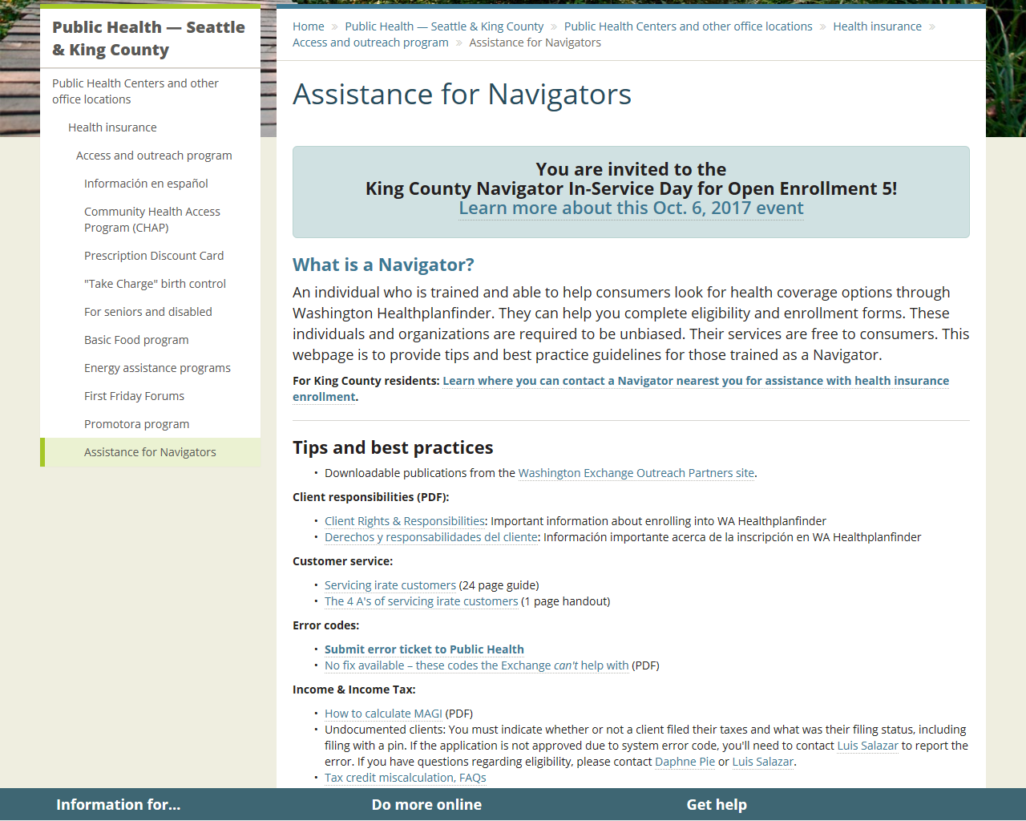
How To Send A Ticket Request
Go to King County’s assistance for Navigators page
http://www.kingcounty.gov/depts/health/locations/health-insurance/access-and-outreach/navigator-assistance.aspx

Slide 21
How To Send A Ticket Request

Slide 22
Access & Outreach Team Enhanced Users
Yvette Angel Education Specialist/Enhanced User (English/Spanish) (206) 477-7259 | Cindy Mai Education Specialist/Enhanced User (English/Vietnamese) 206-304-1892 | Miguel Urquiza Education Consultant I/Enhanced User (English/Spanish) 206-477-6965
Willie Allen Education Consultant II/Supervisor South County/Enhanced User (English) 206-263-8746 | Bishaw Gezie Education Specialist/Enhanced User (Amharic) 206-477-6961 | Carmen Olvera Education Specialist/Enhanced User (English/Spanish) 206-477-6827
Callista Kennedy Project Manager I/Enhanced User (English) 206-263-8368 | Luis Salazar Education Specialist/Enhanced User (English/Spanish) 206-263-8261 | Claudia Sierra Education Specialist/Enhanced User (English/Spanish) 206-477-7272
Jennifer Covert Project Manager II/Enhanced User (English) 206-263-117 | Elizabeth Winders PHASS/Enhanced User (English) 206-263-0857 | 1-800-756-5437 Community Health Access Program www.kingcounty.gov/health/access

