Slide 1
Trusted Partner Network
King County Emergency Management

Slide 2
Overview
The Trusted Partner Network is comprised of trusted community leaders from across King County
The Network is language-based and meant to ensure that all language communities have the information they need to deal with emergency situations
Partners receive alerts and share emergency and life-safety information with their community networks. They make sure no one is left behind
KCOEM will host orientations, drills, and provide as much pre-translated material as possible for TPN members
Notes:
The TPN is part of emergency management’s first response strategy, and it makes sure that we are able to reach language communities with all types of life-safety information.
The TPN is composed of individual leaders who work within their communities and are established and trusted voices of information. This helps reach people who may not otherwise enroll in alerts or respond to information from a government source.
Public Health and its partners have pre-translated emergency messaging in 17 different languages. We recognize that the county contains more than 100 language groups, and that we may need help translating unforeseen messaging. We are consistently working to improve our ability to communicate with every resident, and to take on as much as we can to improve the lives of our many community groups.
The TPN alerts come from Alert King County.
TPN enrollment is an internal notification group, and your contact information may be shared for the purpose of alerts. However, the full roster is private.
We’d like to conduct semiannual drills and keep updated on contact information, but our contact with you will be limited out of respect for your privacy and life balance.
We anticipate getting this off the ground in summer 2021, and you may not receive a welcome message until that time. If an emergency should occur in the meantime, you will still be notified.

Slide 3
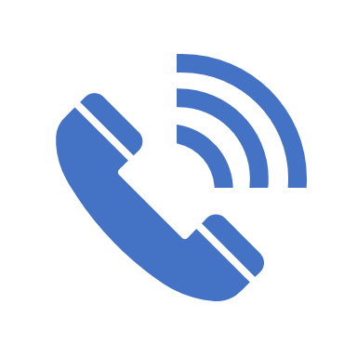
How It Works
Sign up for emergency alerts through Alert King County
You'll receive two texts for emergency information in English, one notifying you of the emergency and any relevant information, and another just for TPN members asking you to disseminate the information to your community.
You'll share alert information with phone trees, social media, relatives, community centers and groups, schools, faith-based organizations, etc.
Occasionally, King County may ask for some information about how the message was distributed.
TPN members may also report information about their community’s needs during emergencies to their local Emergency Management agencies or to King County.
Notes:
Dissemination Checklist:
Where do older members and seniors of your community live, if not at home or with family? How would you reach large senior centers in an emergency?
Do you have contacts in the schools that teach children from your community?
If people in your community reached out to organizations or churches for help, do those organizations have the information they need to respond?

Slide 4
How It Helps
The TPN ensures that every resident of King County receives critical lifesaving emergency alerts, regardless of whether they speak English.
By partnering with trusted leaders within every major language group in King County, the TPN will create a link between King County’s emergency alert system and the non-English speaking populations that it currently does not serve.

Slide 5
FAQ
How often will I be contacted?
Likely between 3-5 times a year for emergencies, plus a few practice drills.
Will my information/data be protected?
As community members, the contact information you provide, such as personal emails, cell phone numbers, etc. is not subject to release.
Am I always expected to translate?
The County has many messages pre-translated and will provide these as available
How do I know when to stop sharing information/when an emergency is over?
Please share to reach as many people as possible. If there is new or continuing information to share, you'll receive a new text.
Will there be an orientation?
Yes, multiple online orientations will take place in 2021.
Notes:
If considering joining the TPN:
Would you feel confident translating or spreading information regarding important public health announcements and disaster warnings?
How can we help you get this information to your community?
What else do we need to know?

Slide 6
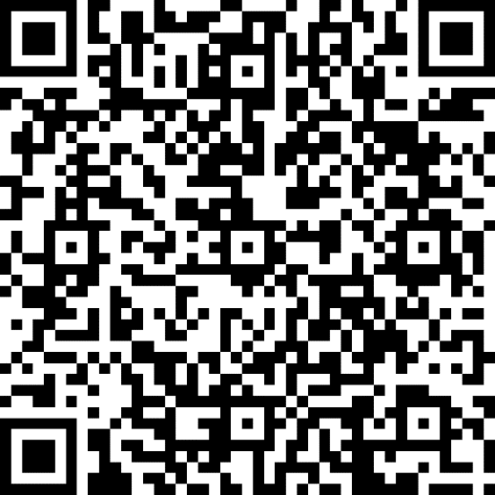
Enroll to be a TPN member now!
Fill out the enrollment form below, and then keep an eye out for an email from King County regarding a TPN member on-boarding and training session. We look forward to partnering with you!
Click this link
Visit:
www.kingcounty.gov/TPN
Or scan this QR Code:
If you have any further questions, contact Daniel Arauz - King County Emergency Management, at darauz@kingcounty.gov

