Slide 1
ArcGIS Enterprise Portal
Harkeerat Kang
KCIT
8.5.2020
Notes:
Use of Portal in KC, provide a overview, architecture and how it is being used

Slide 2
Portal vs. ArcGIS Online
Both are web-based platforms
Both provide similar functionality
But they run in different environments
ArcGIS Online – Runs in an Esri administered cloud infrastructure
Portal – Runs on your hardware or in cloud, build your architecture, upgrade your software
Notes:
Provisioning our servers, on-prem, both have content, group page etc, ready to use solution

Slide 3
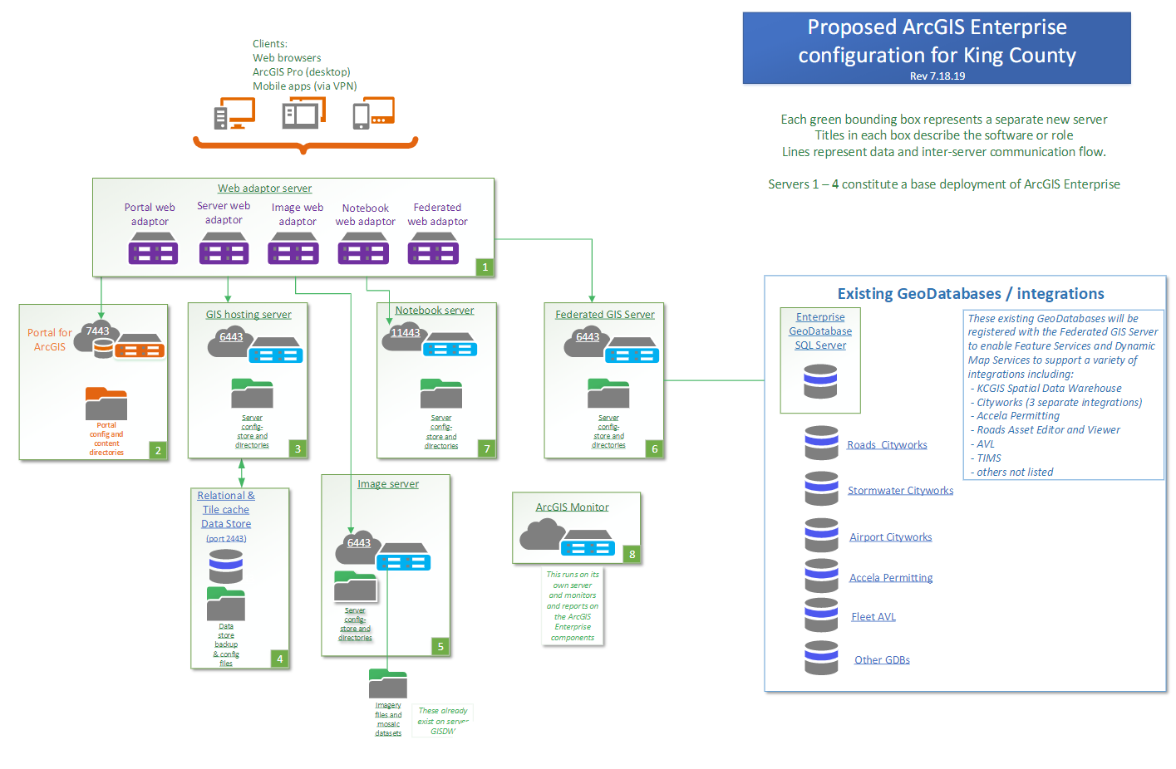
ArcGIS Enterprise Platform Architecture
Notes:
Technical limitations, Docker containers for notebook, virtual servers hosted in KC Data Center on Microsoft Hyper-V

Slide 4
Environments
Dev (development)
Prod (production)
Mirror architecture for Dev and Prod environments

Slide 5
Authentication
Using SAML authentication with Active Directory accounts
Viewer accounts created through automatic account creation
Use of Groups to share content
Use of Group Collaboration to edit content by assigned users
Future
Use of AD groups
Single Sign-On

Slide 6
River and Floodplain Management Project
Extending existing custom asset management (RFI) functionality
Site Management Plan (SMP)
Using Esri software, tools and apps
Manage maintenance work
Use of Arc Explorer, Survey123 and Web AppBuilder application
Collector (not needed)
QA/QC processes
Reporting in RFI
Notes:
Use of Survey123 and Explorer using Portal and not AGOL

Slide 7
Security
Each user has his/her own account
Is more secure
Use of VPN for field apps
No shared accounts
No limit on user accounts in Enterprise
No issues on remembering many accounts and passwords

Slide 8
Considerations for Portal
For internal use
Sensitive data
Use of AD accounts rather shared accounts
Editor tracking
Move from direct database connects to feature services and hosted services
Move from ArcGIS Desktop to Portal
Quick access to your maps anywhere and everywhere
Notes:
Another sort for question

Slide 9
Data storage and feature services
Use of Enterprise Geodatabase aka ArcSDE Geodatabase
Data Store
Use of federated ArcGIS Server
Use of hosted server
Notes:
Data Store component based on PostgreSQL, black box, introduced at 10.3. At 10.5 Web GIS Deployment constitutes Portal, federated AGS and Data Store

Slide 10
Content sharing
Portal accounts created by users with their AD accounts
Viewer accounts
User accounts permissions are elevated
Content is shared using Groups
Content is built in Dev portal and treated as test and dev
Migrated to Production portal

Slide 11
Features available in Portal (v 10.7.1)
Web AppBuilder
Operations Dashboard
Arcade Expressions
Story Maps
Collector for ArcGIS
Survey123

Slide 12
Features available in 10.8.1
Experience Builder (not Map Viewer yet)
ArcGIS Notebook Server
Improved Sharing and Collaboration
3D GIS
Arcade Expressions – new functions
ArcGIS Indoors, ArcGIS QuickCapture, ArcGIS StoryMaps, ArcGIS Tracker, ArcGIS Workforce, more widgets added to ArcGIS Web AppBuilder

Slide 13
Drawbacks (maybe…)
New functionality is not implemented right away
Way behind on ArcGIS Online
Coordinated effort is needed to upgrade software
More testing needed
Upgrades can break existing functionality
Under utilized servers in Dev

Slide 14
Go Portal!!
Thank you!
harkeerat.kang@kingcounty.gov
KCIT, Software Engineering GIS

