Slide 1
ArcGIS Hub Community Initiative & Webhooks
February 3rd, 2021
KCIT, Software Engineering GIS
Notes:
Introduce these topics and how I am using it. Also introduce the project

Slide 2
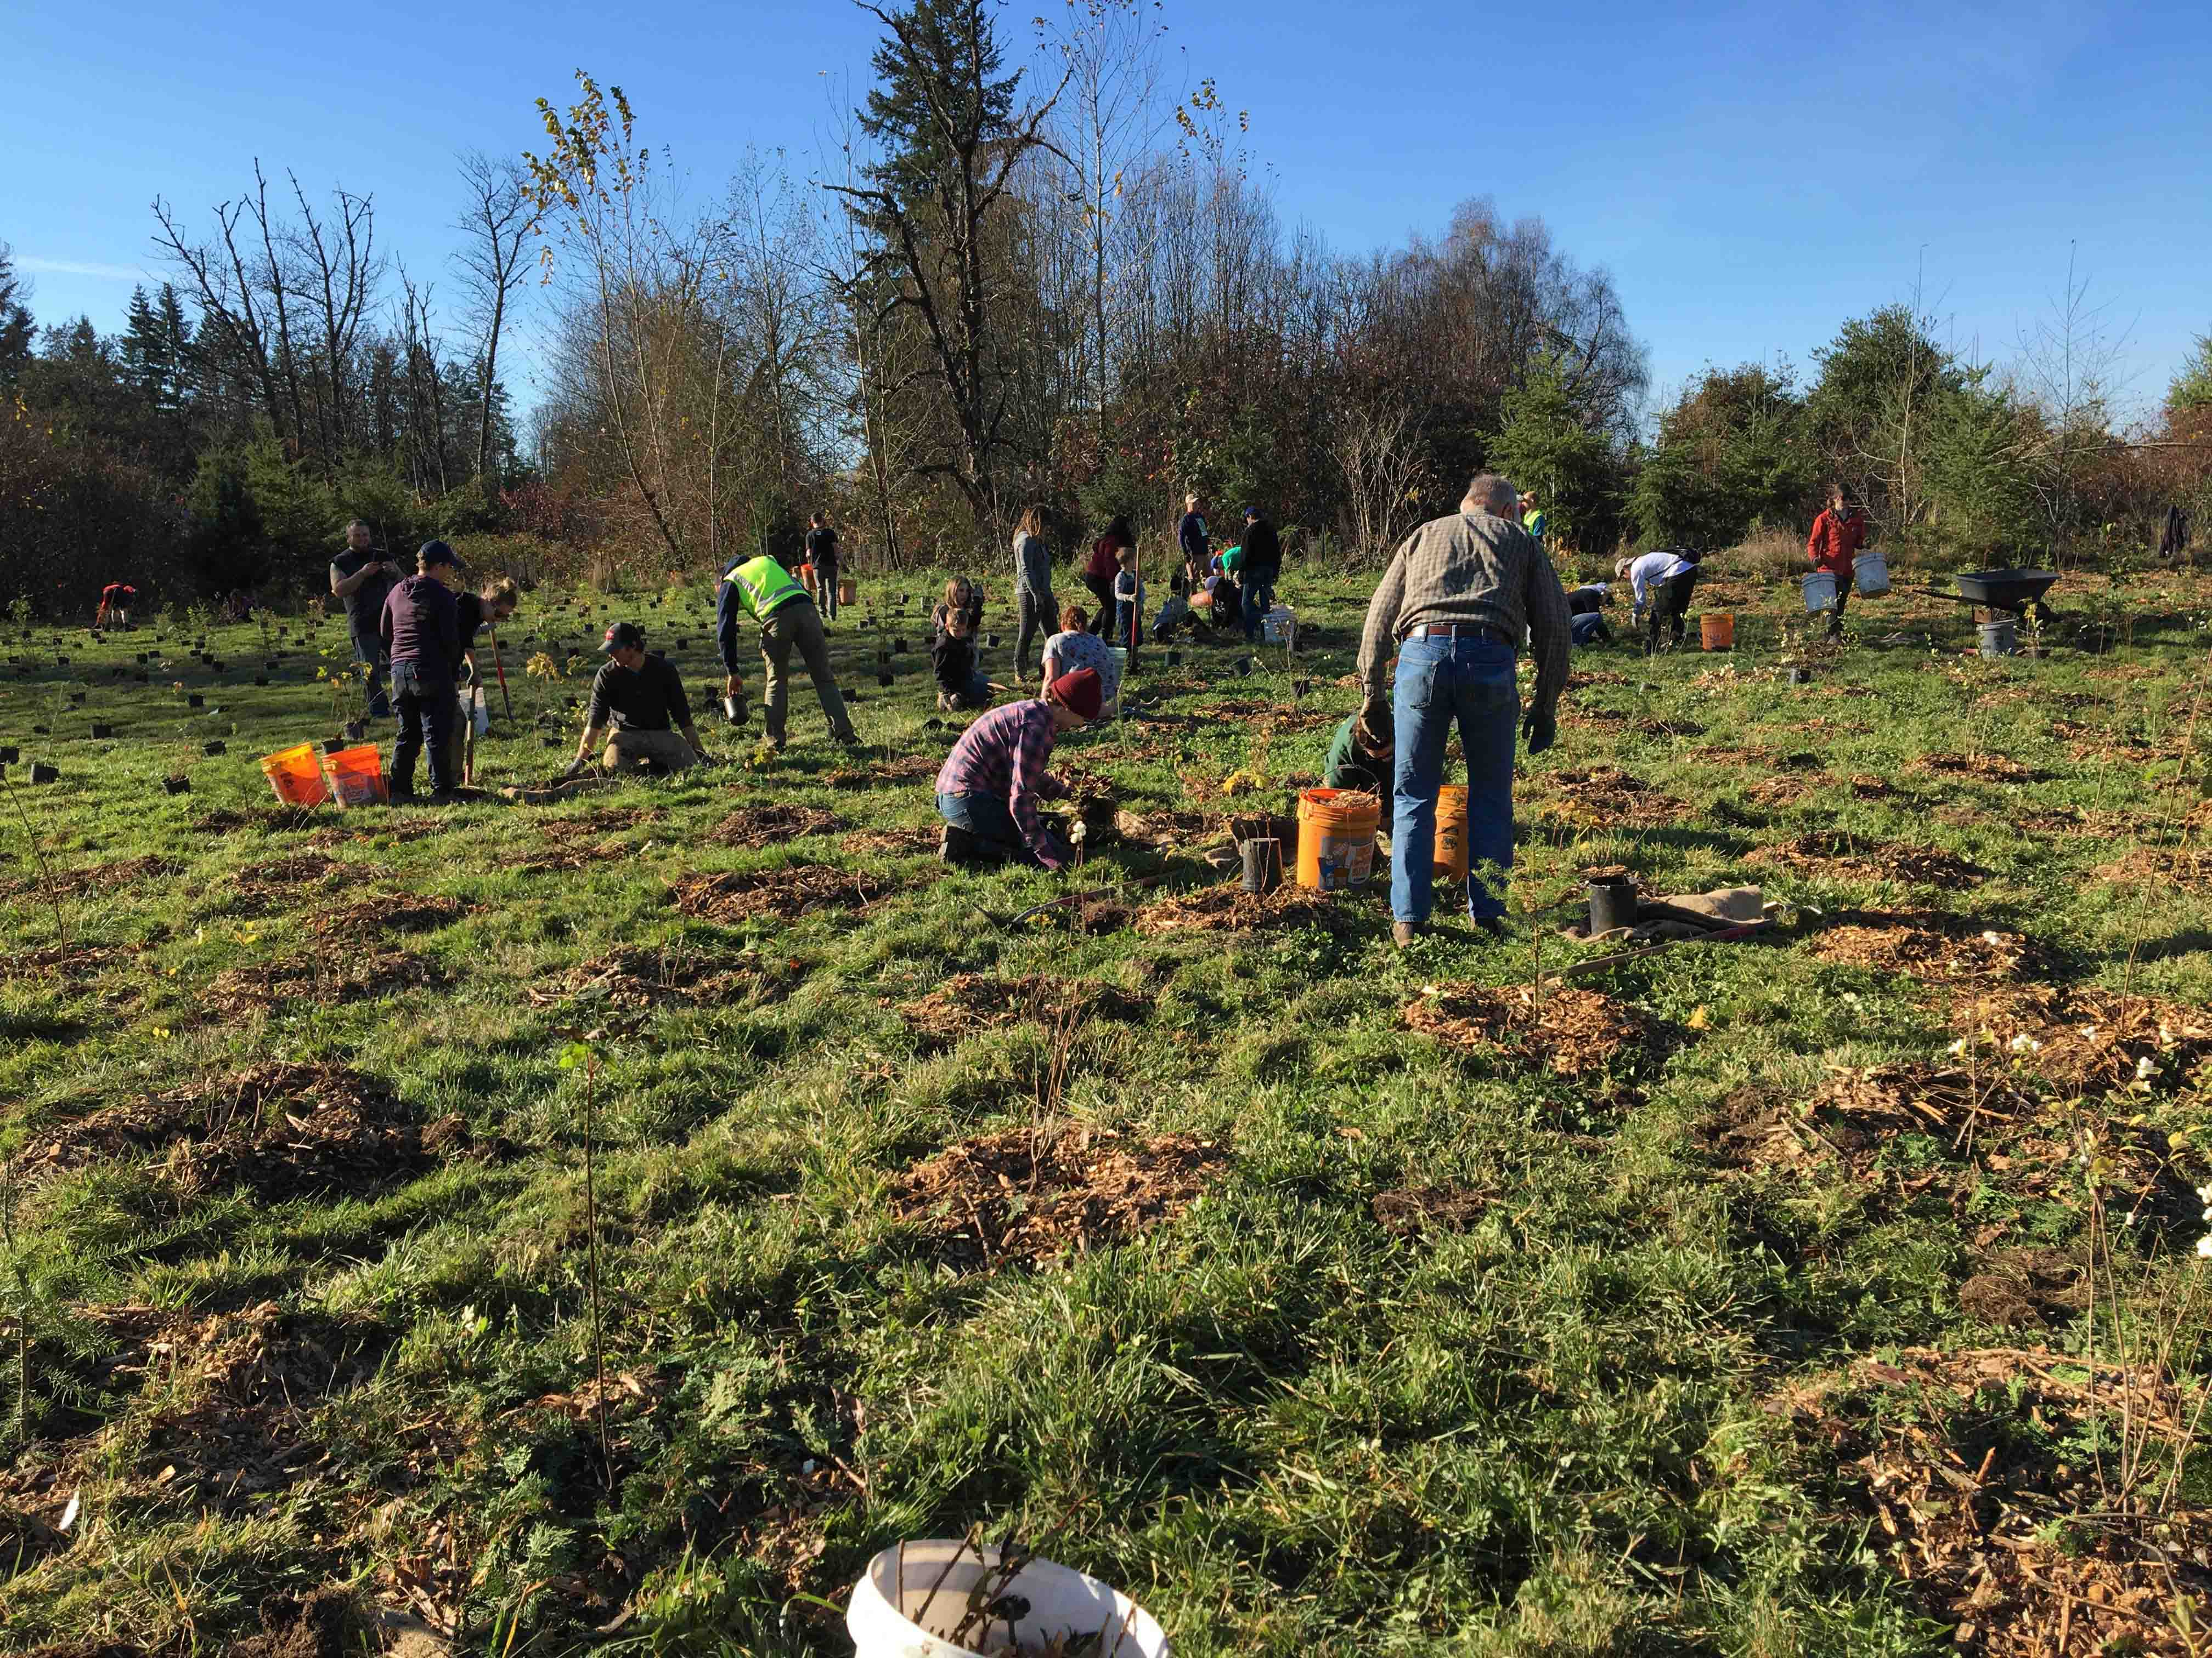
Revegetation Tracking Project
Track planting projects
From planning phase to maintenance
Field data collection
Notes:
This is the project where the community engagement hub initiative and web hook is used, this project is with WLRD

Slide 3
Why revegetation of native plants
Decreased forest cover over time
Lack of native riparian tall trees
Need shade producing canopies
Notes:
Urban sprawl

Slide 4
Project goals
Improve habitat for threatened species
Improve aquatic habitat conditions
Protect and restore chinook and salmon
Plant native plants
Restoration of trees in rural and urban areas
Reduce stormwater runoff

Slide 5
Participating Organizations
King County agencies
King County cities
Tribal communities
Non-profit organizations
Notes:
Green the green, Trees for streams

Slide 6
ArcGIS Hub – Community Initiative
Community engagement software
ArcGIS Online Premium
Bundle content
Use template
Configure solution
Creates groups – add share content
Customize it
Add/remove cards and buttons buttons
Follow initiative card
Using it as a landing page
Notes:
An initiative bundles content – apps, sites, surveys. Configure Follow initiative, message followers

Slide 7
Esri Hub Initiative
Notes:
Community engagement platform e.g. topics climate change, social and equity justice

Slide 8
Initiative content sharing
Content created in ArcGIS Online org
Manage access for users outside our org
Use of community members/accounts

Slide 9
Users
Project content not accessible to Everyone
Access to the collection site and content
Create accounts in the community hub vs. ArcGIS Online org
Community accounts are cheaper
Initially wanted to open it up to create new accounts
User accounts are requested
Privileges are granted
Notes:
Users affiliated with other organization, add community members that are not paid contractors

Slide 10
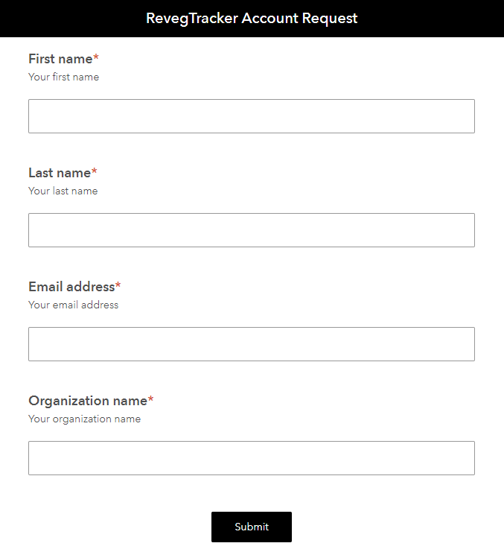
Survey123 form

Slide 11
Webhooks
Allow applications to interact with each other
Uses HTTP POST requests to pass callbacks
Set up in Integromat’s platform or Microsoft Power Automate (Flow)
Notes:
A way for applications to interact with each other

Slide 12
Power Automate (Flow)
Webhook created in Power Automate
Conditions
When a survey response is submitted
Meets one or many conditions
Perform an action/trigger – send an email
Uses two connectors
Survey123
Outlook
Notes:
With that – what I am doing with my workflow

Slide 13
Email generation

Slide 14
Use case story
Use of Survey123, webhooks and Hub community engagement initiative
Simple use case
Introduces new possibilities
What’s your use case story?
Explore it
Notes:
My use case story with Revegetation tracker project

Slide 15
Thank you!!
Harkeerat Kang
KCIT, Software Engineering GIS
Harkeerat.kang@kingcounty.gov

