Slide 1
Road Services Capital Improvement Program (CIP) data & public web application
Josh Popelka
King County GIS Center

Slide 2
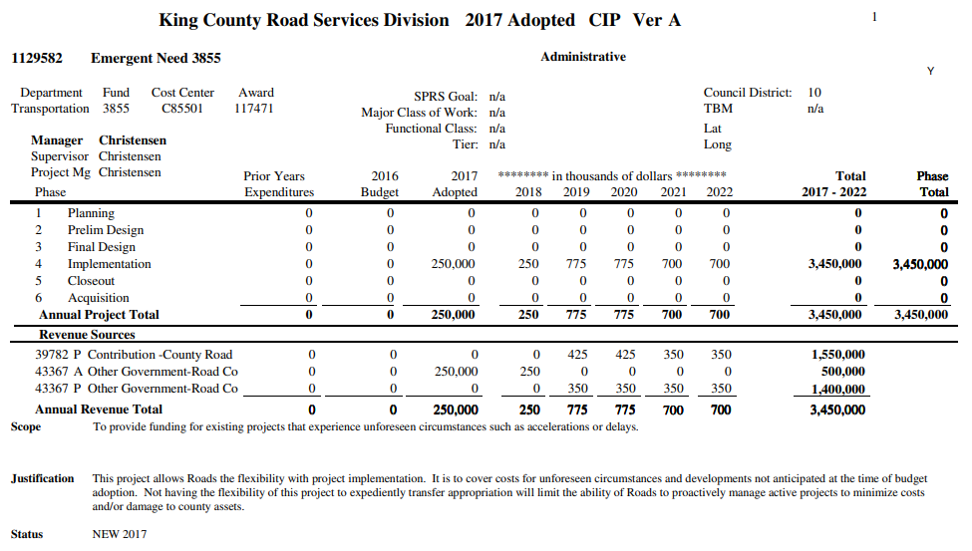
What is a capital improvement program?
Projects approved by council
All planned expenses must balance with planned revenue
Fund projects that create new assets or replace old ones
Projects vary from large to small

Slide 3
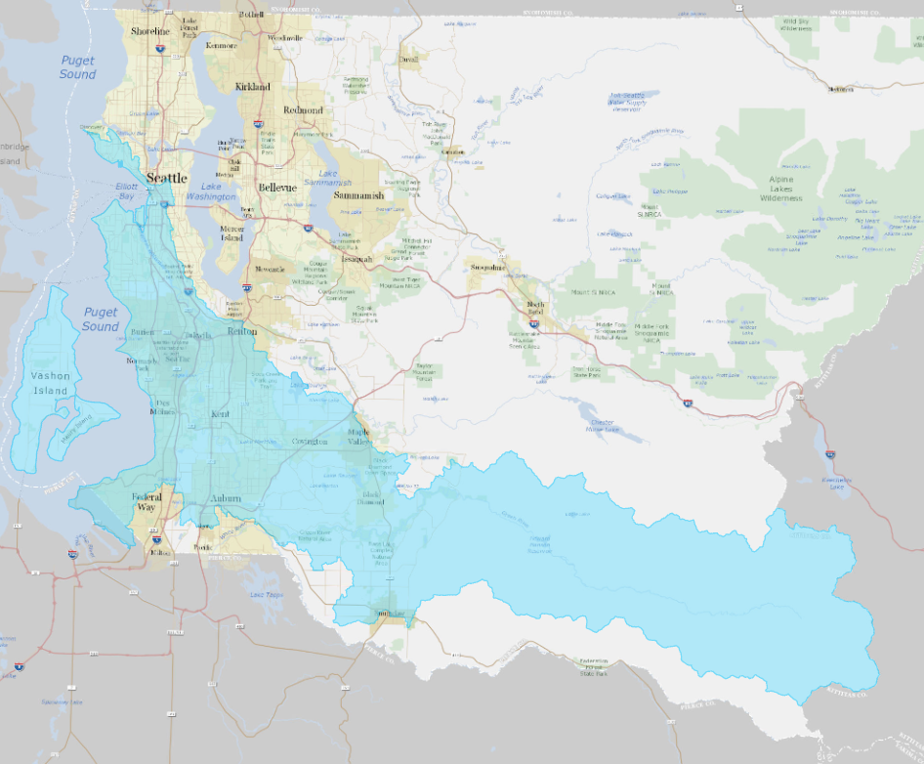
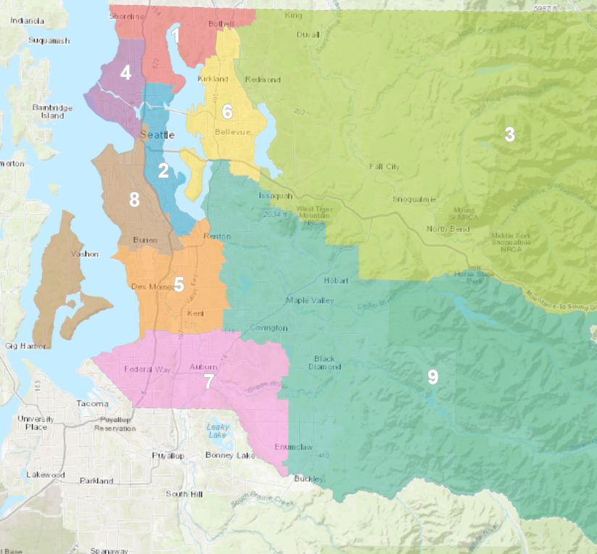
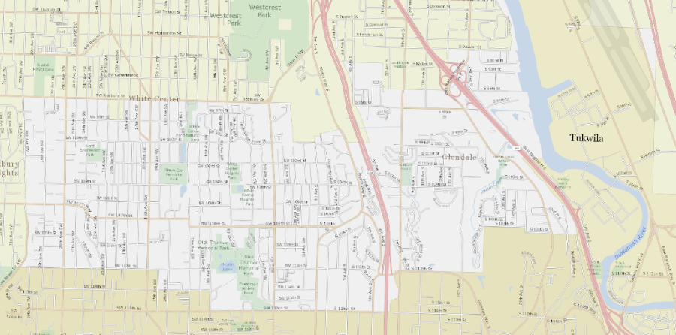
Why create the data?
Solution to answer commonly asked questions
Provided authoritative resource for staff
Automatically updates with latest attributes
Old feature class was manually updated and incomplete
Effort was underway at Roads to standardize project management data
Division was still missing spatial component

Slide 4
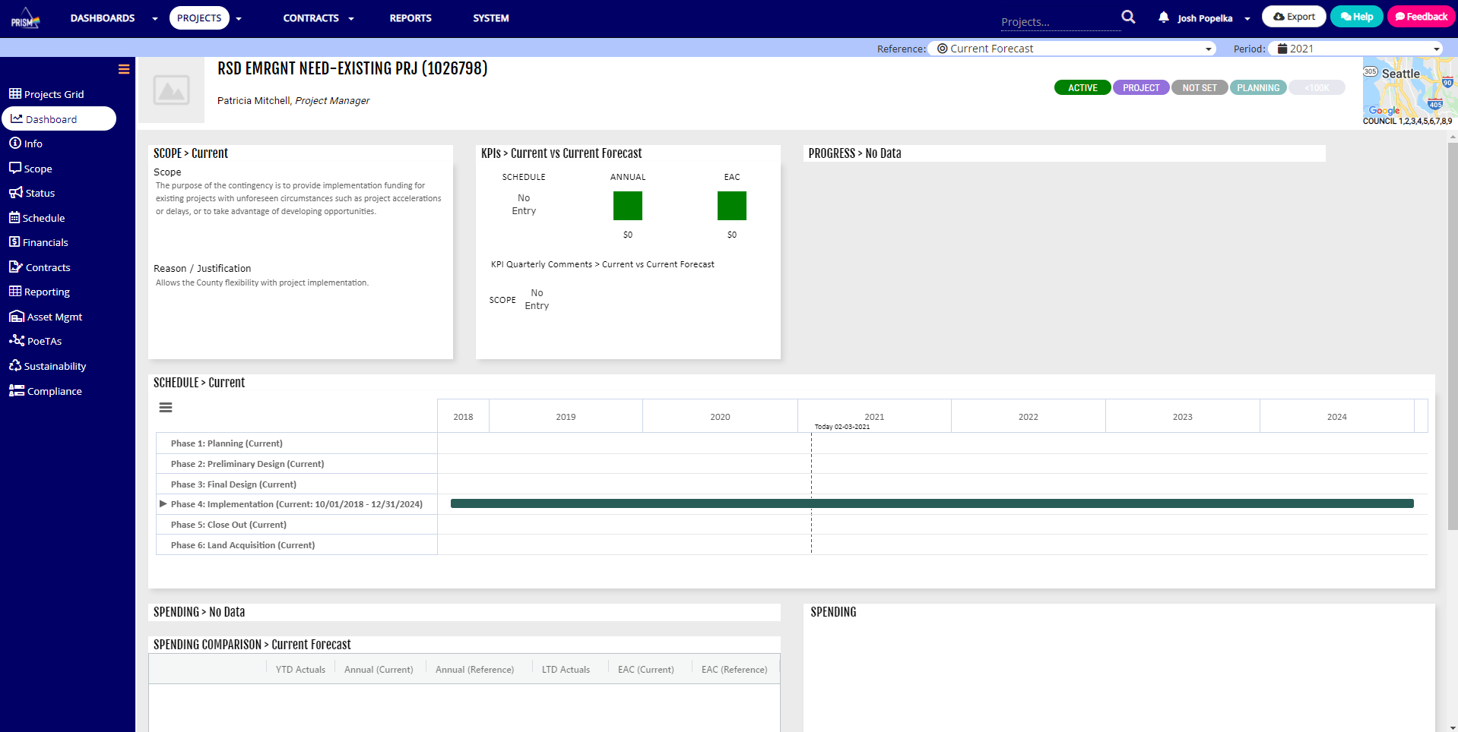
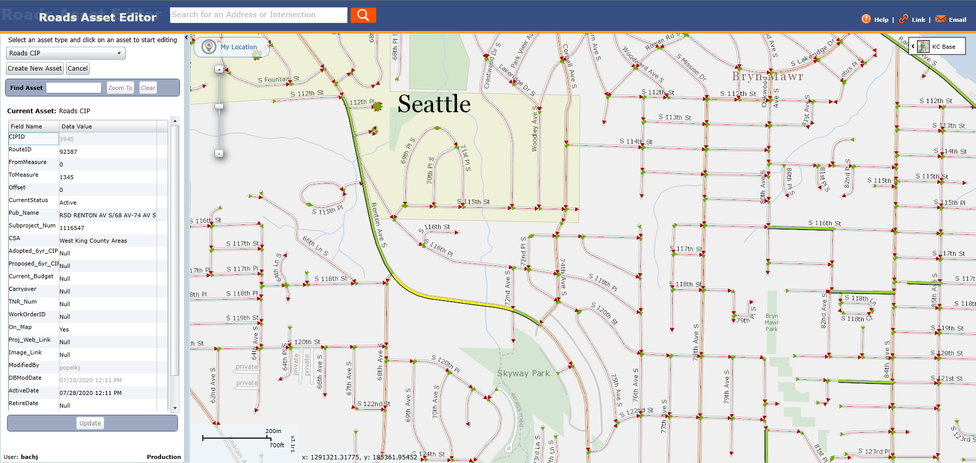
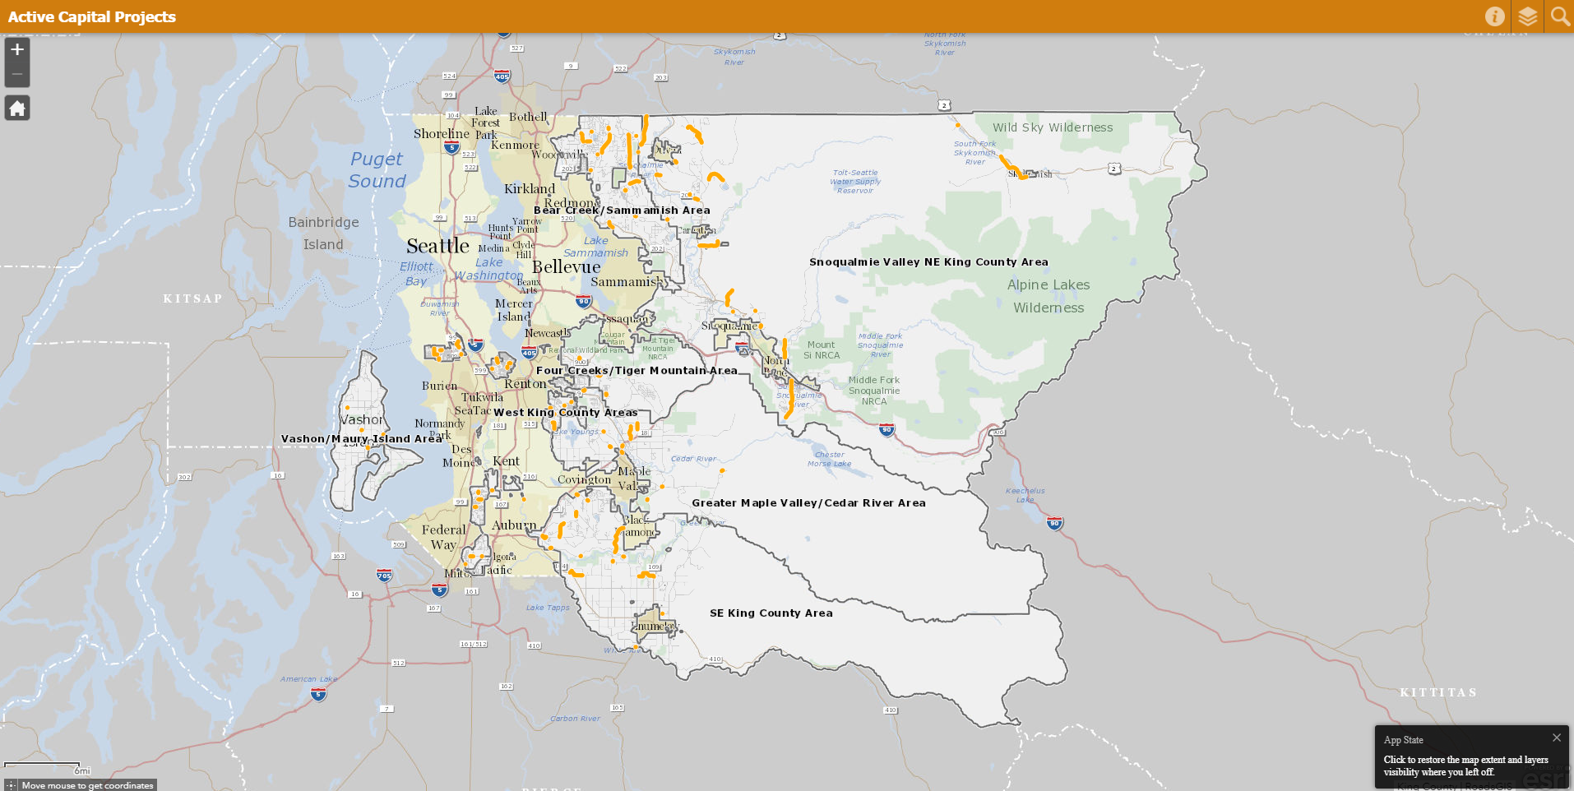
Data flow & Process
database view
provides attribution to feature class
existing workflows
Event based online editor
feature classes created
Combining event layer and database view
internal feature class
1. Spatial analysis
2. Internal map applications
3. dashboards
Spatial view
Removes fields from internal version
Public facing feature class
Simplified for public web application

Slide 5
Live (!) Application demo

Slide 6
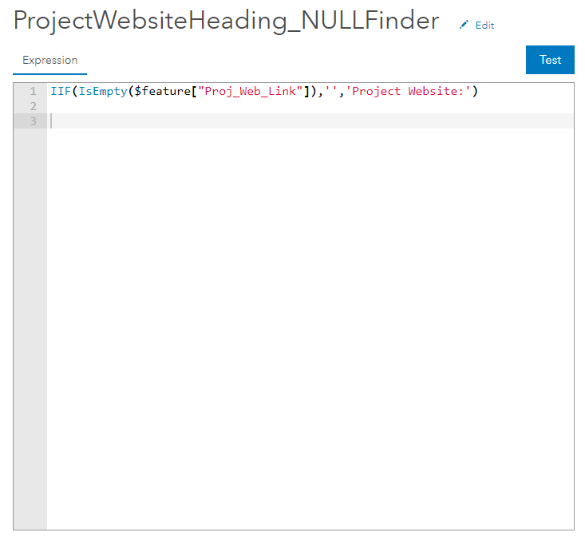
Arcade expressions in popups
ESRI’s scripting language allows calculating “on the fly”
Easy to learn and apply
Remove NULL data and headings from popups
Perform basic spatial analysis (such as intersects)
I used Arcade to find NULL values in the fields:
Council District
Phase
Project Website Field Heading
Project Website Link
Image URL

Slide 7
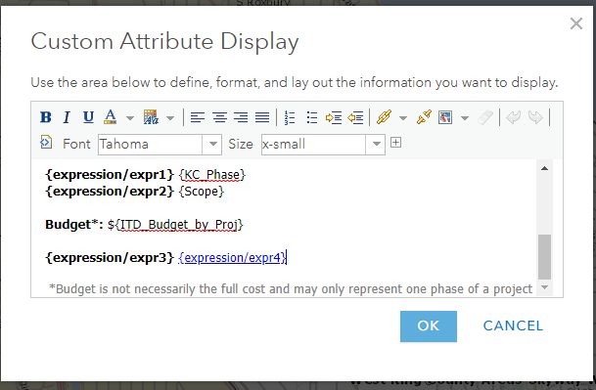
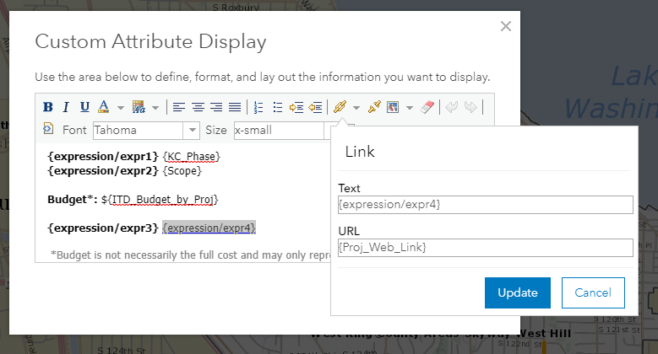
Arcade expressions in popups

Slide 8
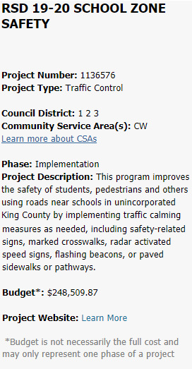
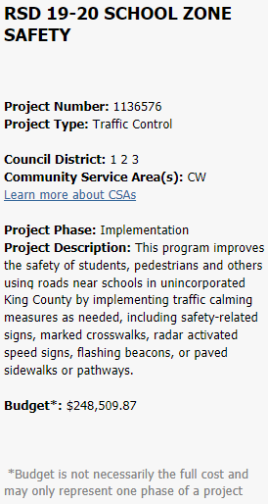
Arcade expressions in popups
Without Arcade Expression
With Arcade Expression
Heading and “Learn More” link removed

Slide 9
My email:
josh.popelka@kingcounty.gov
Thank you to:
James Bach
Mike Crippen
Adam Cabrera
Hans Erickson
Mark Foote
Jeff Gregg
David Hartwell
Ruth Harvey
Patrick Jankanish
Harkeerat Kang
Jennifer Knauer
Lisa Owen
Lydia Reynolds-Jones
Joshua Smith
John Vander Sluis
Stephanie Vitali
Anyone else I forgot to mention ☺

