Slide 1
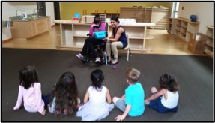
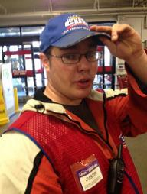

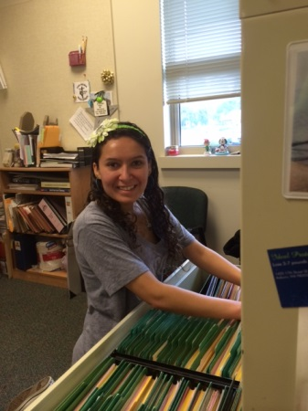

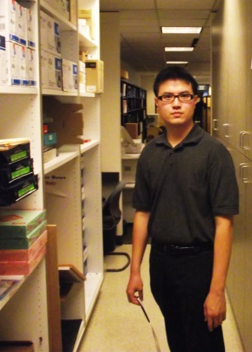

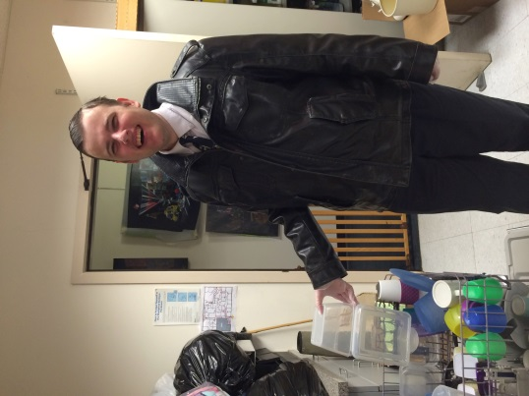
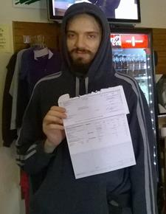


King County School-to Work
Board Presentation
February 6th, 2019

Slide 2

Your School-to-Work Team
Richard Wilson, Program Manager
Richard.Wilson@kingcounty.gov
(206) 263-9044
Emily Hart, Program Manager
Emily.Hart@kingcounty.gov
(206) 477-7661
Nigel-Andrew Paclibon, Program Manager
Nigel-Andrew.Paclibon@kingcounty.gov
(206) 263-1633

Slide 3
Our Aim for Today
A Shared Understanding of the Program, and its:
  Impact and outcomes
  Current challenges; and
  Goals for the future

Slide 4
What is the King County S2W Program?
A partnership that connects employment services to students with intellectual and developmental disabilities early:
while they are still in their high school transition programs.

Slide 5

S2W Partnership
Students and Families
Employers
Division of Vocational Rehabilitation
Developmental Disabilities Administration
King County School Districts
Employment Service Providers
Technical Assistance
Wise – Partners for Work Program
Family Advocacy Organizations
Partnership + Results Has Led To System Change

Slide 6
What is the Goal of S2W?
Assist students with intellectual and developmental disabilities
to obtain paid employment
prior to exiting their
high school transition programs
at age 21

Slide 7
What Are Employment Services?
Added or customized support the student needs to get and keep a job: employed by a business(s) at minimum wage or higher.
Includes requirements for customary wage, typical levels of interaction with those without disabilities, and similar access to advancement

Slide 8
Who Does S2W Serve?
Want to Work / Working is a Priority
King County Resident
    Some Partnering to Serve Students in Cross-County Districts
WA State Developmental Disabilities Administration Client
Enrolled in WA State Division of Vocational Rehabilitation
    Now Providing Referrals Fall of Student’s 2nd to Last Year
Last Year of Transition (Age 21) Who Want to Work
    Some Younger Students per Agreements with School Districts
Has or Will Obtain Medicaid Based on Disability
    No Later than Exiting School or Job Stabilization if post-June

Slide 9
S2W’s Service Approaches
General S2W Model
  Original Approach Open to All
District Model
  School Districts Co-Fund Working with 1 Employment Agency Embedded in Their Transition Program
Agency Collaboration Model
  School Districts Co-Fund Earlier Services and Built In Technical Assistance for Students Identified as Needing More Intensive Supports
Funding Employment Services Within Partnering Programs
  Project SEARCH
  Highline ACHIEVE

Slide 10
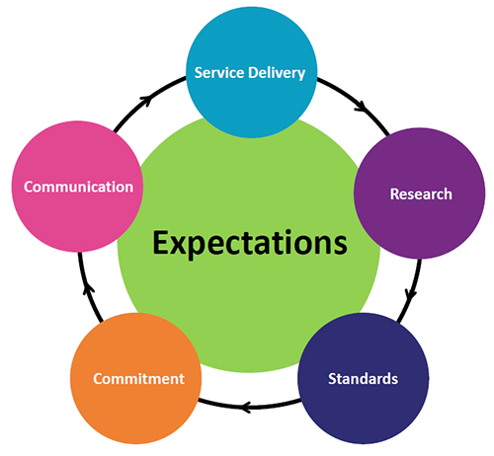
S2W’s Primary Program Functions
Outreach
Information & Education
System Navigation
Cross-System Coordination
Employment Services Contracting
Technical Assistance Contracting
Learning & Promoting Best Practices

Slide 11

Employment? What’s the Big Deal?

Slide 12
S2W Guiding Values
Employment as Foundation of a Good Life
Regardless of “Level of Disability”
One Person, One (or More) Individual Job(s)
Inclusion | Membership | Contribution | Typical | Relationships
Income | Community | Meaningful | Dignity | Identity

Slide 13
Work Experience
The Big Predictor
Students who participate in occupational education and special education in integrated settings are more likely to be competitively employed than students who have not participated in such activities (Blackorby & Wagner, 1996; Colley & Jamison, 1998; Luecking & Fabian, 2000; Rogan, 1997) National Collaborative On Workforce and Disability
One of the most important findings from the research shows that work experiences for youth with disabilities during high school (paid or unpaid) help them acquire jobs at higher wages after they graduate (Colley & Jamison, 1998) National Collaborative On Workforce and Disability

Slide 14

S2W Embodies Employment First

Slide 15

A Program?

Slide 16
Service Gap
School
(Entitlement)
18-21
Transition-Age
Services
Adult Living
(Eligibility)
Employment
and
Whole-Life
Services

Slide 17
Not an Entitlement
Its Complicated
Time Flies
Person & Family
By
Driven
WA DSHS DDA
WA DSHS DVR
Participant / SSA:
IRWE & PASS
Employment Supports
State Supplemental Payments
Out of Pocket
Savings / Special Needs Trust
County & School Programs

Slide 18
Before S2W
Six Months After Exiting School Programs
          2003-- 7.7%
          2004-- 14.6%
          2005-- 14.3%
While Over 600 Supported Employees Were Working in King County.
Transition Students with ID/DD Weren’t Getting Results:

Slide 19
National Employment for People with I/DD
The National Core Indicators Project shows that 4% of youth supported by state I/DD agencies aged 18–21 were employed in individual integrated jobs, and only 9% of those aged 22–30

Slide 20
National Employment for People with I/DD
      19% of adults (down from 22% in 2010) with I/DD, who receive day services are in some kind of community employment.
      The National Core Indicators show about 13% of adults with I/DD have community jobs.

Slide 21
King County Initiative to Close the Service Gap
School
Districts
18-21
Transition-Age
Services
King County DDD
School
-to-
Work
Employment
Services
Adult Service
Agencies
Employment
and
Whole-Life
Services
…and Improve
Collaboration

Slide 22


Slide 23
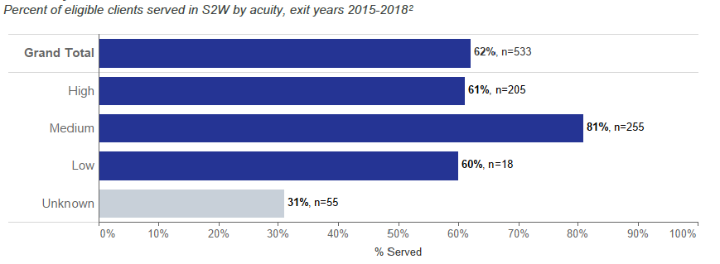
How Well is S2W Reaching Eligible Students?

Slide 24
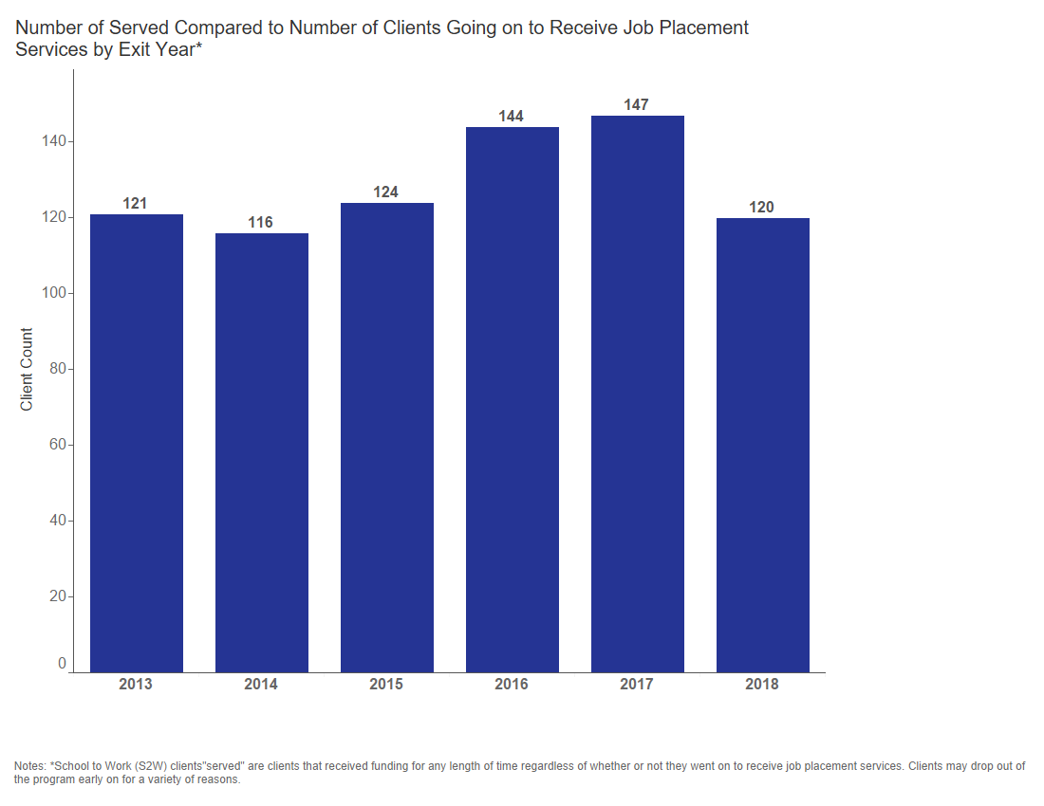
How Well is S2W Increasing Numbers Served?

Slide 25
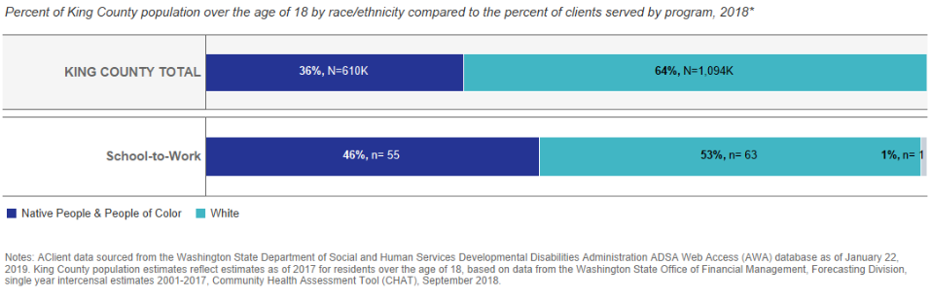
How Well is S2W Reaching More Diverse Communities

Slide 26
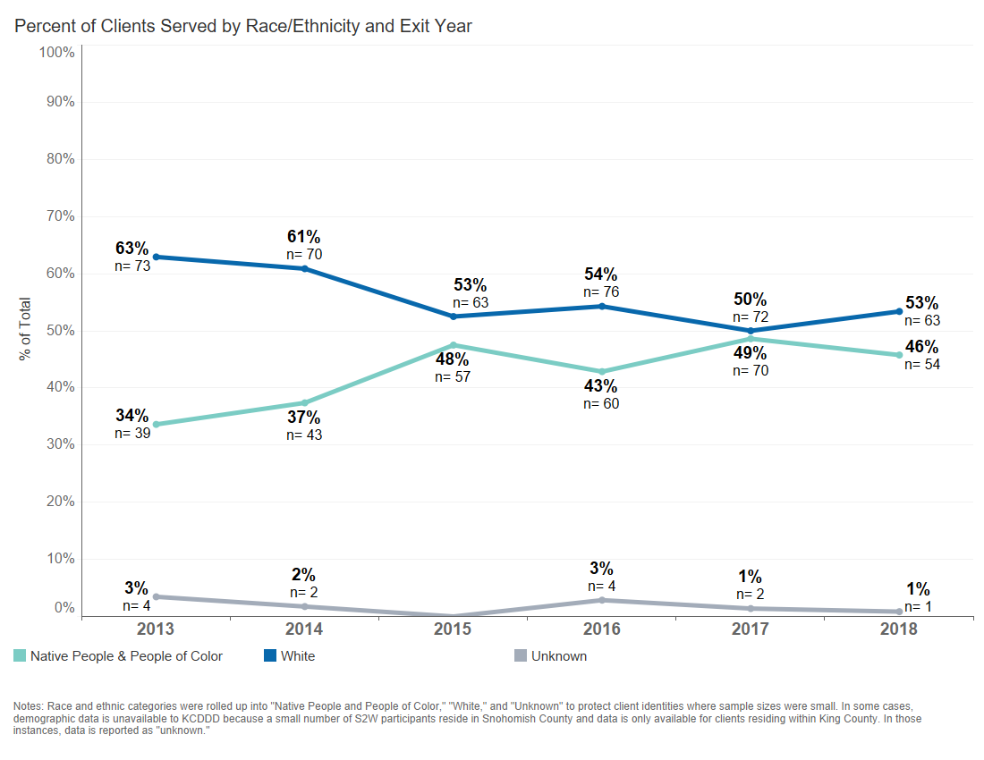
How Well is S2W Increasing Services to More Diverse Communities?

Slide 27
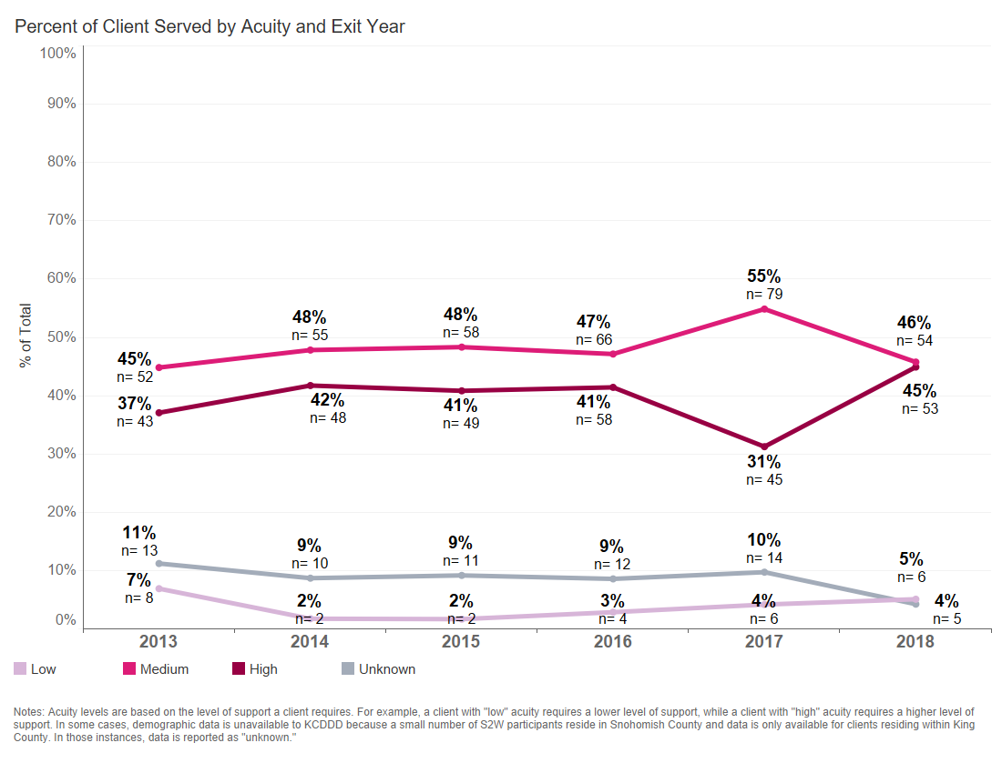
How Well is S2W Serving Students By Acuity?

Slide 28
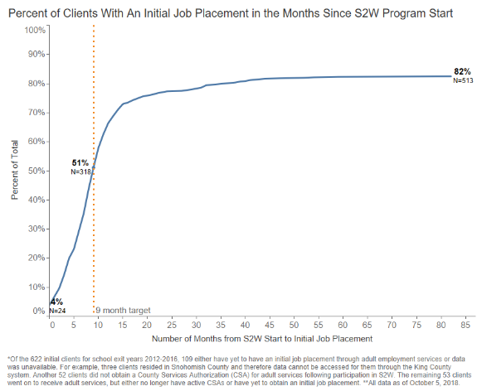
How Well Is S2W Supporting Students to Achieve Job Starts?

Slide 29
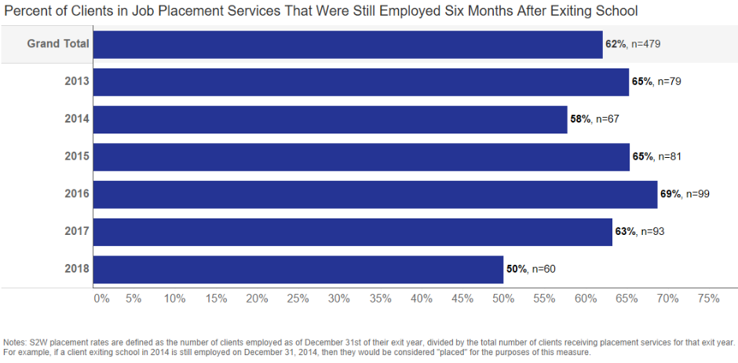
Who is Working 6 Months After School Ends?

Slide 30
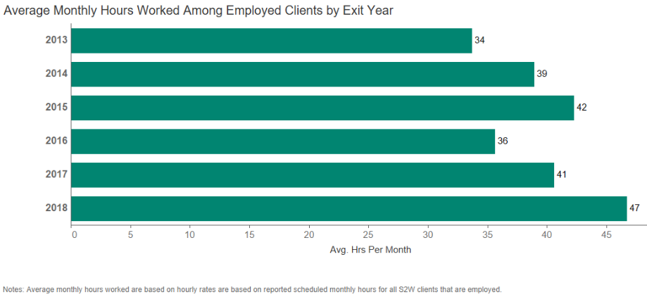
What are S2W Student’s Work Hours?

Slide 31
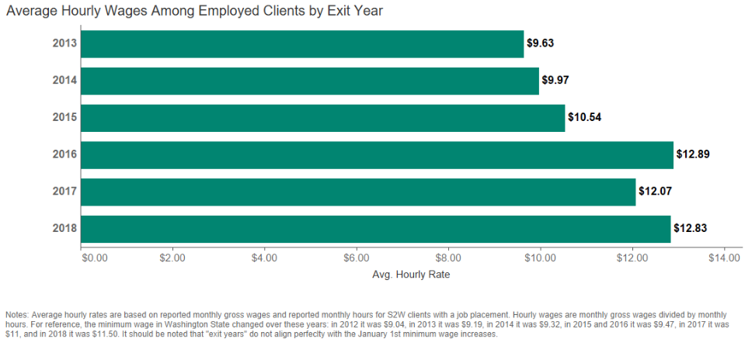
What are S2W Student’s Wages?

Slide 32
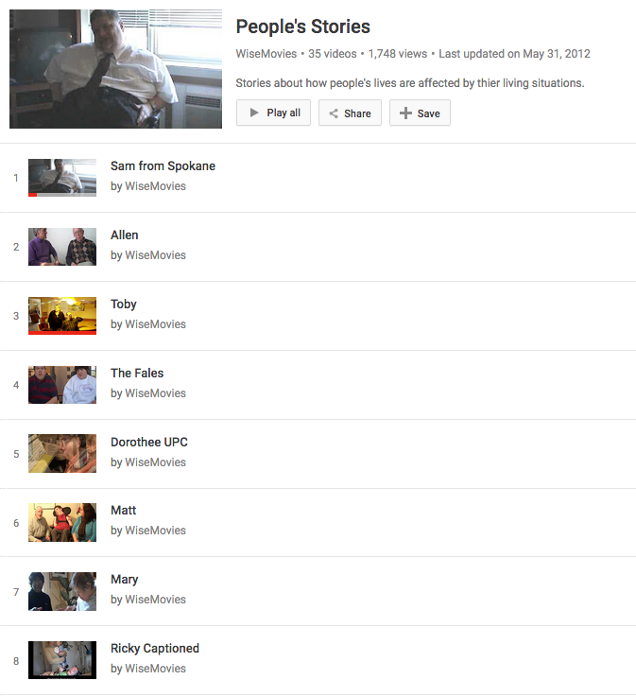
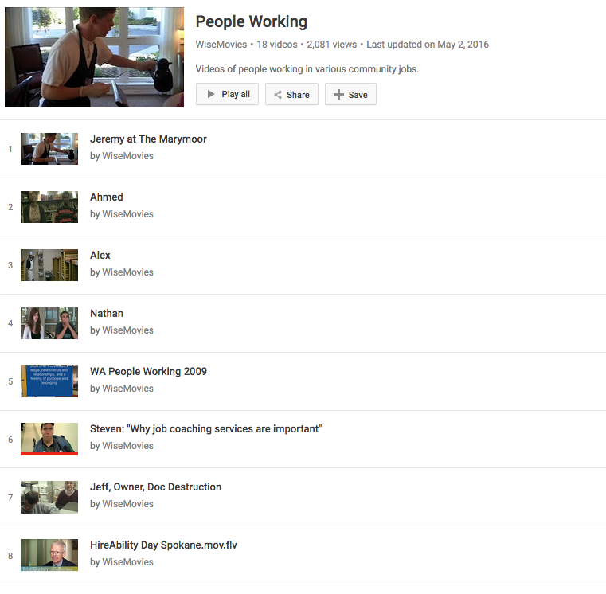
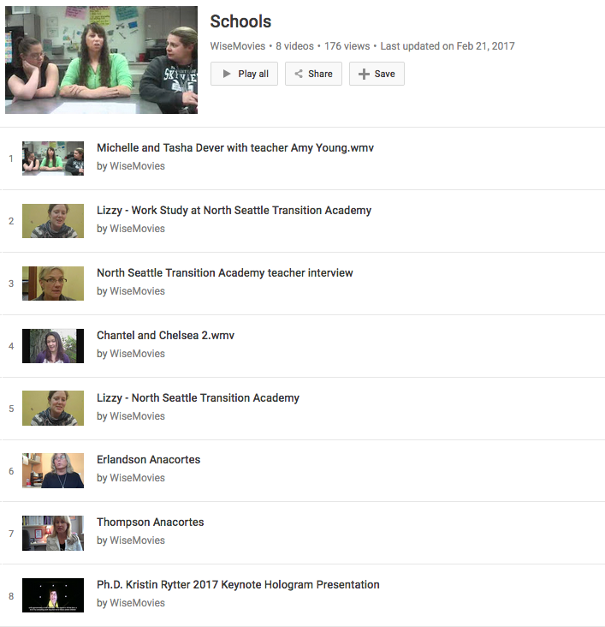
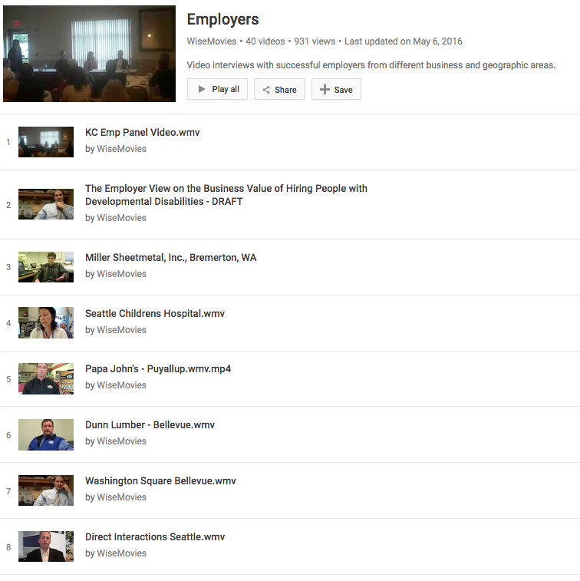
Working Together Gets Results
YouTube: “WiseMovies”

Slide 33
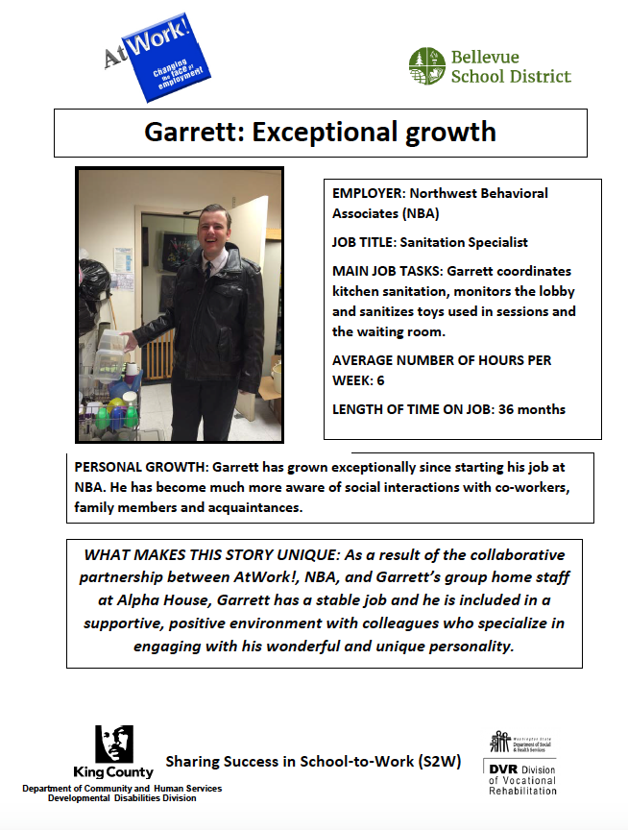
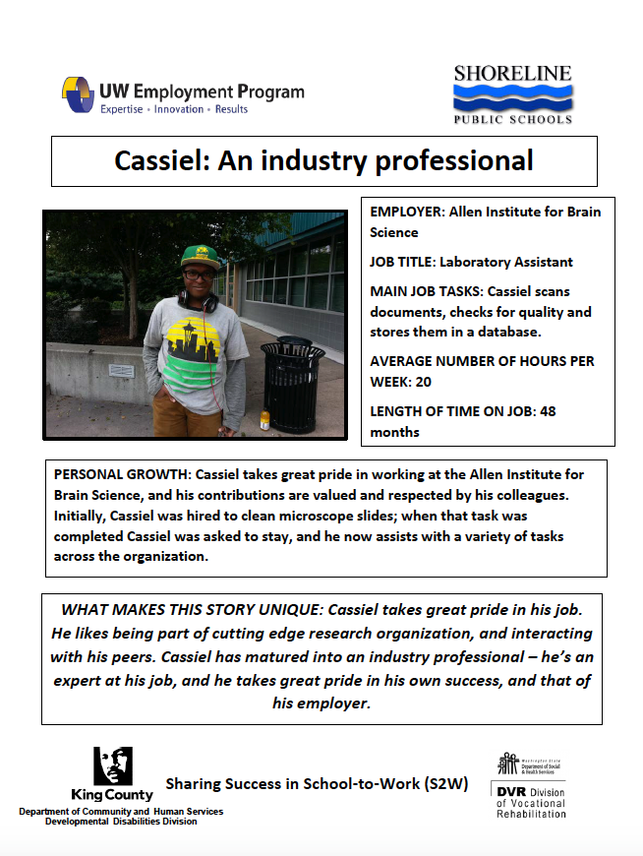
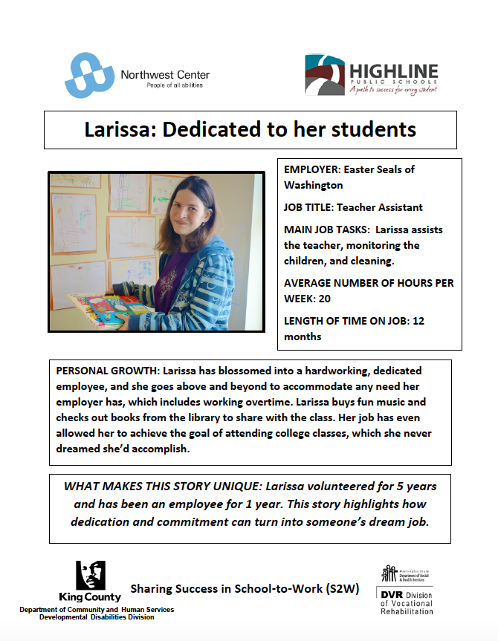
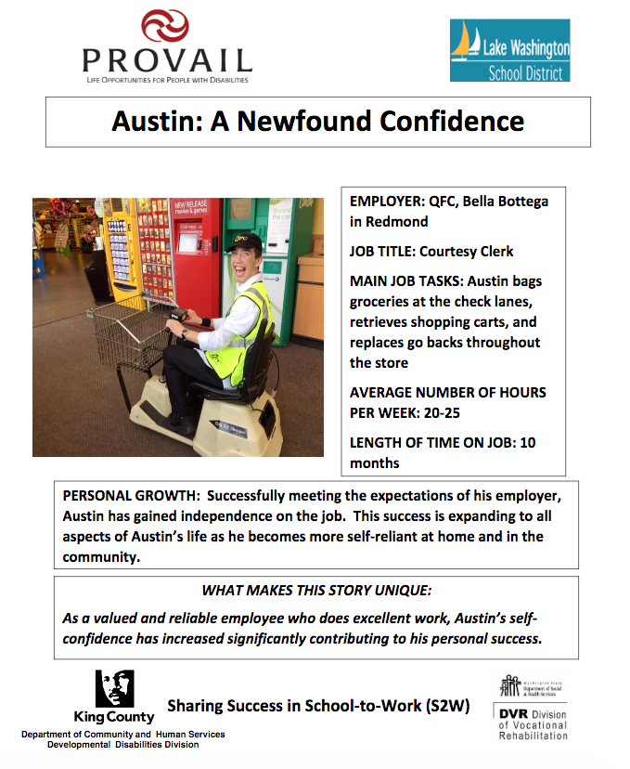
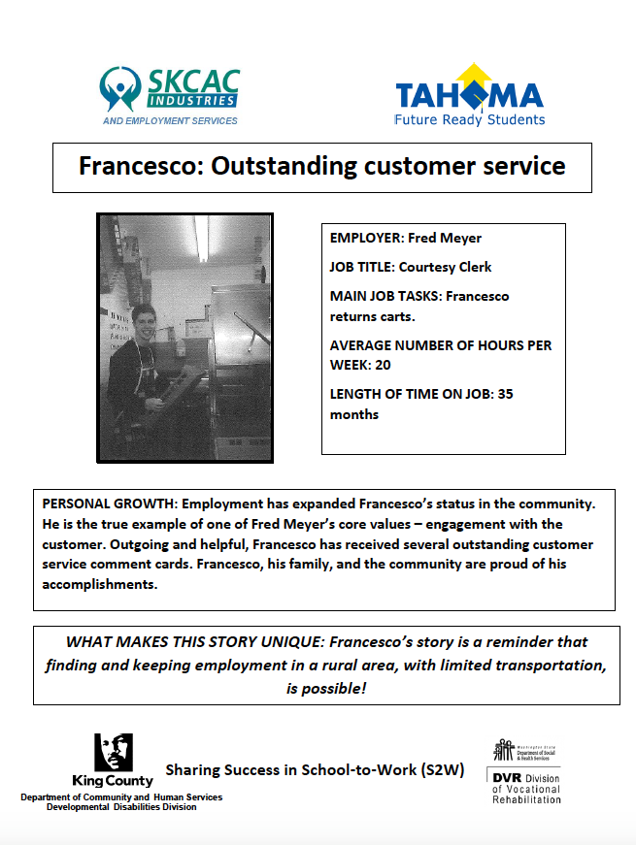
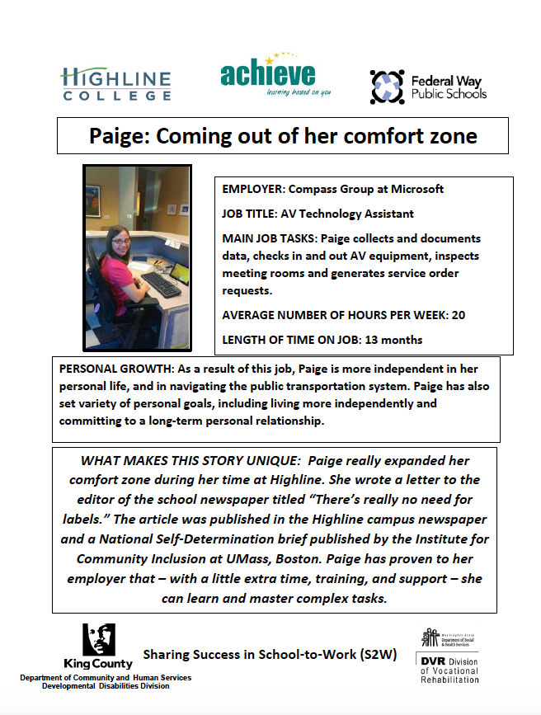
Working Together Gets Results
Search “King County School-to-Work”

Slide 34
Current Challenges
System Stability & Funding
Growing Demands on Capacity
Ensuring Equitable Outcomes

Slide 35
Looking Forward
Strong Partner & Community Support
Employment First Values & Policies
County Commitment to Equity & Social Justice
Division Leadership & New Capacity Development Position

Slide 36
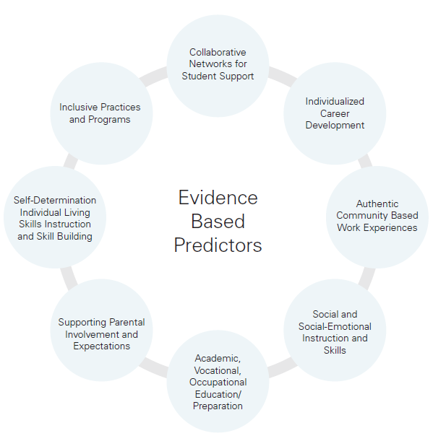
How is S2W Doing?
Ohio Employment First Transition Framework Evidence Based Predictors Tool

Slide 37

How is S2W Doing?
Predictors of Post-School Success

Slide 38


