Slide 1
Economic Opportunity and Empowerment Advisory Board
September 24, 2015
Contractor Inclusion Strategy

Slide 2
Process:

Slide 3
Desired Outcomes from the EAB:
TRAINING AND SUPPORT: Ensure success of apprentices, minorities and women who are equipped to compete and diversify the workforce (diversity reduces risk)
OUTREACH TO TRADES: Identify and support trades that need the most help in diversifying their workforce
UNION PARTICIPTION: Workers have the opportunity to be strong union members
ACCESS TO JOBS: Strengthen the pipeline to Public Works & other opportunities for those without prior work experience by making the opportunities widely available & accessible
LOCAL HIRES: Increase hires in zip codes with high minority populations
NEIGHBORHOOD PRESERVATION: Preserve the neighborhood with a positive perception of the construction project that engages workers that look like them
IMPLEMENTABLE: Ensure the CWA fits within the context of complicated legal framework

Slide 4
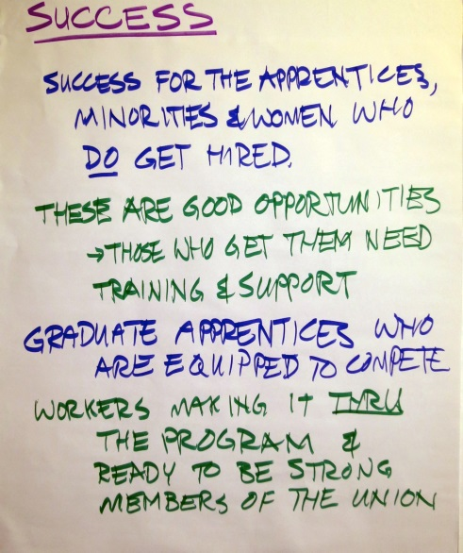
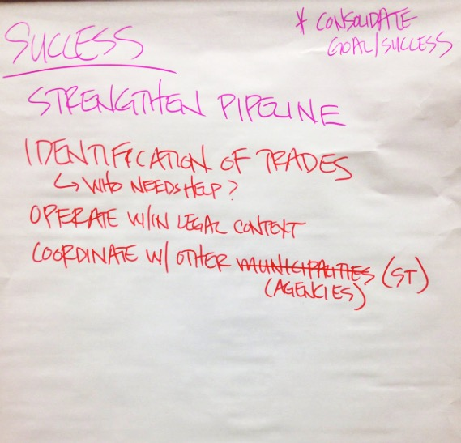
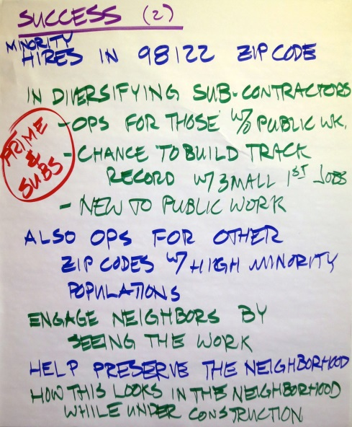
Meeting #1 – Aug 26: Goals & Desired Outcomes
Success for the apprentices, minorities, and women
Training and support
Graduate apprentices equipped to compete
Workers are strong union members
Hires in 98122 & other zip codes with high minority populations
Diversify subcontractors
Opportunities for those without prior public work experience
Lead to first jobs in Public Works projects
Engage neighbors by seeing the workers that look like them
Help preserve the neighborhood
Neighborhood perception of the construction project is important
Diversity reduces risk

Slide 5
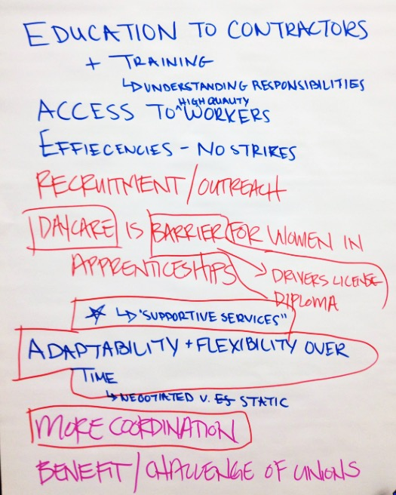
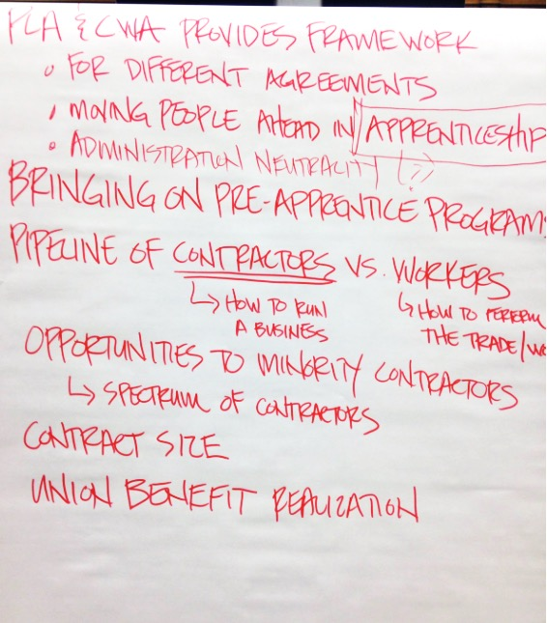
Meeting #2 – Sep 10: Community Workforce Agreements
How do CWA elements impact your stakeholders?
Supportive issues and barriers to access:
Driver’s license
GED
Child-care
If a PLA is less than a year non-union workers who pay in do not see the benefit.
Workers who may be trained but aren’t union can also have hard time entering the union.
Union’s need to keep quality of trained force, which drives their restrictions for new workers entering.

Slide 6
One on One Update
What should hold the most weight?
Balance between overall plan vs the pilot project
Information requests
Requested information should get to the board members more quickly
Reasons for delay
Success
Depends on implementation of successful supportive programs

Slide 7
Contractor Inclusion Strategic Approach
THE VALUE OF ACCESS IN CONTRACTING

Slide 8
DEFINITIONS:
Project Labor Agreement (PLA): Project owner ←→ labor unions agreement to establish:
Safe working conditions and rules
Accountability for project execution on the job
Protocols for resolving labor disputes
Community Workforce Elements (CWA) Part of a PLA to include targeted hiring goals

Slide 9
Value of Disadvantaged Contractor Inclusion
Local and regional economic growth through hiring and support of small business. Contracting access means contractors gain experience and grow the region.
Economic Development
Increase job access for low-income workers, women, veterans, people of color, and other disadvantaged workers.
Employment Opportunities
Connect contractors with business development training.
Educational Opportunities
Provide contractors with access to a trained, qualiﬁed workforce.
Skilled Workforce
Small Business Participation
Increase capacity of small minority- and women-owned businesses and develops their network for greater access to contracts

Slide 10
How Does Inclusion Currently Happen?
Agency Outreach and Certification through King County’s existing processes
Contractor Outreach when required in awarded work
Contracting Partnerships through subs who have working relationships with larger contractors

Slide 11
Inclusion Grows through Education Commitment
All parties agree to support contractor education throughout the life of the CWA:
Purchaser
Contractor
Unions
This also requires a commitment to additional stakeholder education – Public, Leaders, Etc.

Slide 12
Key Elements in Contractor Education
Program Information
Process Information
Project Expectations
Available Resources

Slide 13
Program Information (for contractors)
Program background; why they are being asked to engage
Program elements; how this is different than other contracts they may work on:
Non-Union Contractors & Workers NOT required to join unions
Use of an established dispatch system
Priority worker inclusion

Slide 14
Process Information (for contractors)
What happens beyond contract execution or award.
Pre-Job Meeting process
Core Worker and additional worker dispatch process
Reporting process
What to do if they have issues – grievances, etc.
What resources are available – General Contractor, TPA, etc.

Slide 15
Project Expectations (of contractors)
On time and On Budget Project Delivery
Participation in Pre-jobs
All workers come to the project through the dispatch system
Workers prioritized in accordance with PLA guidelines
Focus on use of disadvantaged contractors
Consistent verifiable reporting

Slide 16
Available Resources (for contractors)
Key Points of Contact
Documentation and Online information
Project Advisory Committee (PAC)
Administrative Leadership – Contractor, Unions, County

Slide 17
Discussion
Questions or concerns about King County’s existing contractor outreach efforts? Can the plan make them stronger?
What priorities do your stakeholders need to see in the education elements?

Slide 18
Economic Opportunity and Empowerment Advisory Board
September 24, 2015
Contractor Inclusion Strategy

