Slide 1
Regional Public Owners Construction Workforce Analysis FINAL REPORT August 2, 2018
Spencer Cohen, PhD Senior Economist Doudou Feng Economics Analyst

Slide 2
Outline
Terms and Concepts
Data Sources and Challenges
Key findings
Tri-County Construction Industry Forecast
RPO Construction Supply and Demand
Appendix

Slide 3
Terms and Concepts
The RPO (Regional Public Owner group) includes the City of Seattle, King County, Port of Seattle, City of Tacoma, Sound Transit, and the Washington State Department of Transportation.
The study region includes King, Pierce, and Snohomish counties (the “Tri-County Region”).
The construction industry forecast describes the anticipated equilibrium of future labor market supply and demand in the construction industry.
The construction occupation forecast is the detailed version of the construction industry forecast. This forecast only considers occupations in the construction industry that require construction skills, such as masons, electricians, and truck drivers. This forecast includes new openings and retained workers. The retained workforce includes turnover within the industry and region while new openings are entirely new jobs. In the gap analysis, the occupational forecast is referred to as occupational demand.
Workforce supply represents the pool of qualified workers and includes the following:
Existing workers from previous year
Unemployment Insurance (UI) claimants previously employed in construction occupations
New apprenticeship openings in construction crafts
Educational program completions in programs related to construction
The gap between demand and supply indicates a shortage in the overall labor in the region. However, while there is a projected gap, it is assumed these openings will be filled by workers from outside the region.
Job counts use 1,500 hours for Full Time Equivalent (FTE) employees.

Slide 4
Data Sources and Challenges
Data sources:
Data from RPO members, 2017
Conway Pedersen Economics,2017
Puget Sound Regional Council, 2017
Washington State Department of Revenue, 2017
Washington State Employment Security Department, 2016
Challenges:
Some RPO members do not have data on the duration of planned future projects, nor projections of construction labor demand for these projects.

Slide 5
Key Findings
For 2018-2022, the construction industry can expect an average annual region-wide labor shortage of 9.7% for the occupations it will need to execute construction projects. By comparison, the manufacturing industry in King County has less than a 1% annual shortage forecasted for the same time period.
The number of first-year apprentices increased from 330 in 2009 to 1,940 in 2017. The ratio of first-year apprentices out of total active apprentices increased from 7.5% in 2009 to 57.8% in 2017.
Out of 3,360 active construction apprentices within King, Snohomish and Pierce counties in 2017, 93.2% are male.
Construction projects from RPO members will support an estimated 6,700 full-time equivalent (FTE) positions per year through 2022. The top three occupations by demand will be carpenters (1,180 FTEs), heavy and tractor-trailer truck drivers (860 FTEs), and construction laborers (850 FTEs).
With a 15% apprenticeship utilization rate, apprentices needed by RPO construction projects is projected to be on average 1,000 per year between 2018 to 2022.

Slide 6
Tri-County Construction Forecast

Slide 7
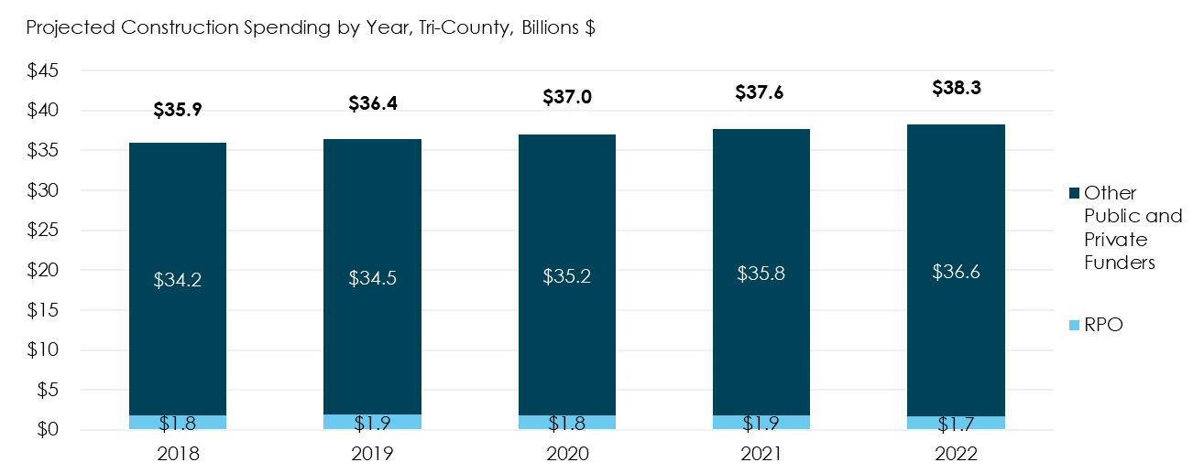
Projected Construction Spending Tri-county Region
Sources: Conway Pederson Economics, 2017; Puget Sound Regional Council, 2017; Washington State Employment Security Department, 2016; Community Attributes Inc., 2018.
Construction spending is predominately from the private sector. From 2018 to 2022, on average 95.1% of total construction spending is expected to come from private and other public (non-RPO) sources.
RPO members can expect strong labor force competition for construction workers.

Slide 8
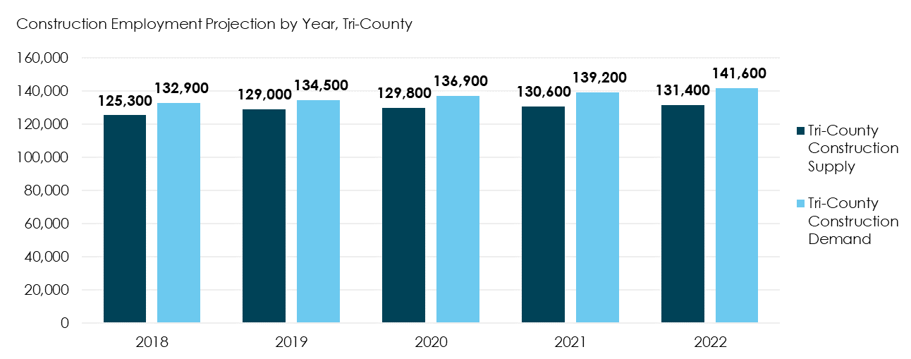
Projected Construction Supply and Demand Tri-county Region
The construction industry in King, Pierce and Snohomish counties is projected to reach 132,900 jobs in 2018 and grow at 1.6% per year through 2022.
In 2018, an estimated 125,300 jobs in the construction industry will be filled by workers living in King, Pierce and Snohomish counties. The supply within the Tri-County is expected to grow at a 1.2% compound annual growth rate (CAGR) through 2022.

Slide 9
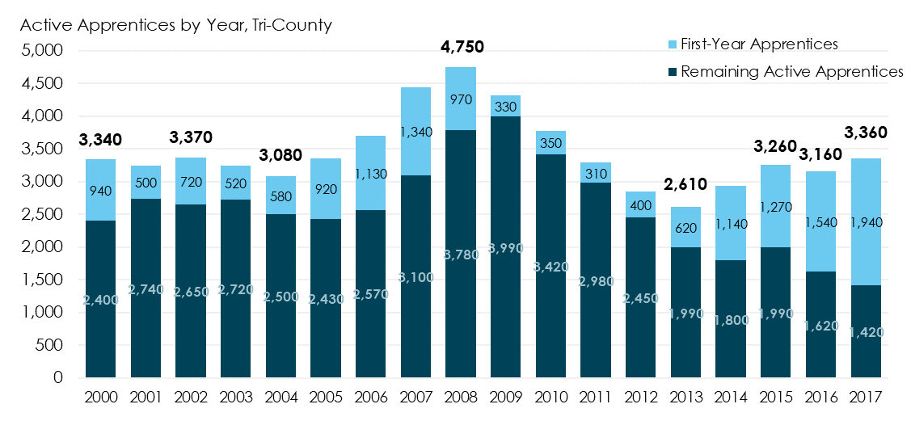
Active Construction Apprenticeship Tri-County Region
Sources: Washington State Labor & Industries Department, 2018; Community Attributes Inc., 2018.
The number of active construction apprentices reached a peak of 4,750 in 2008. Due to the recession in 2008-2009, the number decreased to recent low of 2,610 in 2013 and then recovered back to 3,360 in 2017.
The ratio of first-year apprentices out of total active apprentices increased from 7.5% in 2009 to 57.8% in 2017. In 2017, out of a total of 3,360 active apprentices, 1,940 were first-year apprentices.

Slide 10
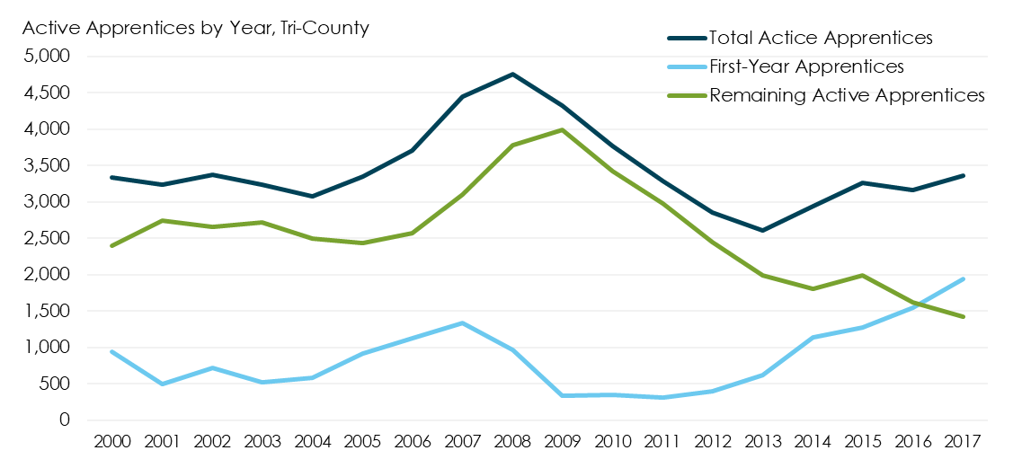
Active Construction Apprenticeship Tri-County Region
Sources: Washington State Labor & Industries Department, 2018; Community Attributes Inc., 2018.
The number of first-year apprentices grew at a 25.0% compound annual growth rate (CAGR) between 2009 and 2017.

Slide 11
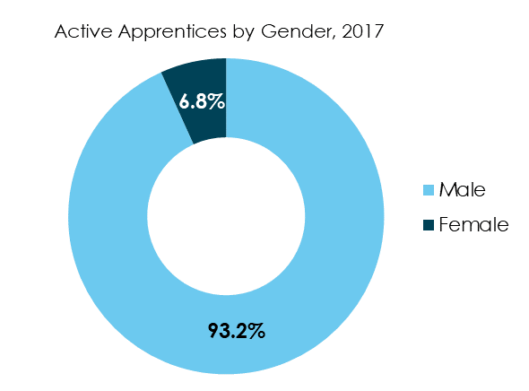
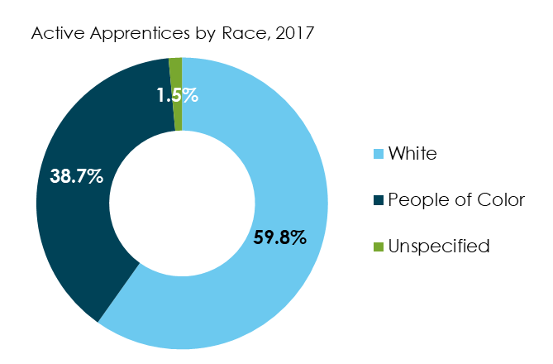
Active Construction Apprenticeship Tri-County Region
Sources: Washington State Labor & Industries Department, 2018; Community Attributes Inc., 2018.
The number of construction apprentices has remained primarily male. In 2017, 93.2% of active construction apprentices were male within a total of 3,360 construction apprentices in King, Snohomish, and Pierce counties.
The ratio of race composition (white-to-people of color) within total active construction apprentices in 2017 was 6:4.

Slide 12
Active Apprenticeship Projections Tri-County Region
Sources: Washington State Labor & Industries Department, 2018; Community Attributes Inc., 2018.
The table summarizes the short-term forecasts for active apprentices on an annual basis.
The number of occupations with more than 10 apprentices are rounded to the nearest multiples of 10. The sum total of all occupations may slightly differ with the total number in the table due to rounding.
On average, the number of active apprentices is projected to average 3,350 per year between 2018 to 2022.

Slide 13
First-Year Apprenticeship Projections Tri-County Region
Sources: Washington State Labor & Industries Department, 2018; Community Attributes Inc., 2018.
The table summarizes the short-term forecasts for apprentices newly registered on yearly basis.
The number of occupations with more than 10 apprentices are rounded to the nearest multiples of 10. The sum total of all occupations may slightly differ with the total number in the table due to rounding.
On average, the number of first-year apprentices is projected average 1,630 per year between 2018 to 2022.

Slide 14
Apprenticeship Completion Projections Tri-County Region
Sources: Washington State Labor & Industries Department, 2018; Community Attributes Inc., 2018.
The table summarizes the short-term forecasts for apprenticeship completions on an annual basis.
The number of occupations with more than 10 apprentices are rounded to the nearest multiples of 10. The sum total of all occupations may differ slightly with the total number in the table due to rounding.

Slide 15
RPO Construction Supply and Demand

Slide 16
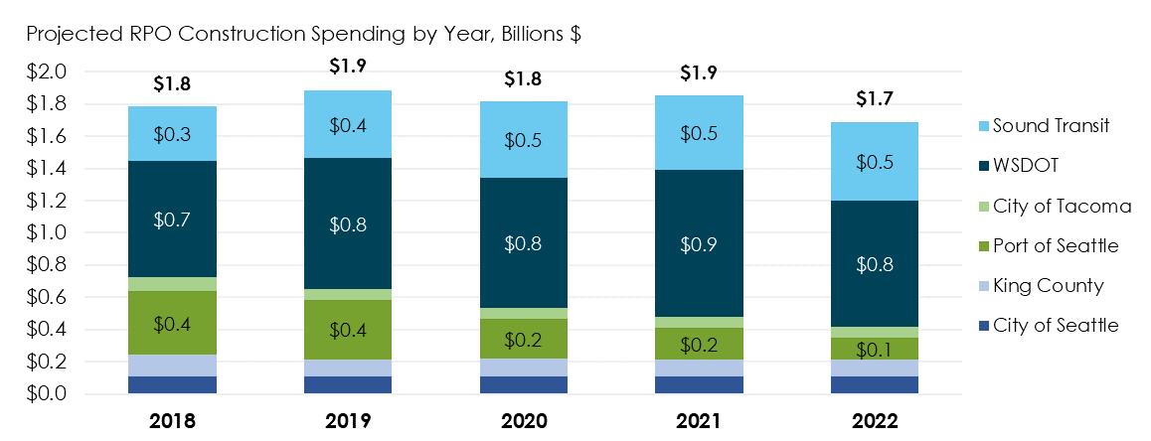
Projected Construction Spending RPO 2018-2022
Sources: Conway Pederson Economics, 2017; Puget Sound Regional Council, 2017; Washington State Employment Security Department, 2016; King County Finance & Business Operations Division, 2017; Port of Seattle, 2017; Washington State Department of Transportation, 2017; Sound Transit, 2017; Community Attributes Inc., 2018.
The RPO members are projected to spend $1.8 billion on construction projects in 2018. The spending is expected to be comparatively steady through 2022.
Due to data limitations and RPO projections, there is less certainty on RPO construction expenditures beyond the year 2022. The decrease from 2021 to 2022 may be due to uncertainty in forecasting future construction plans.

Slide 17
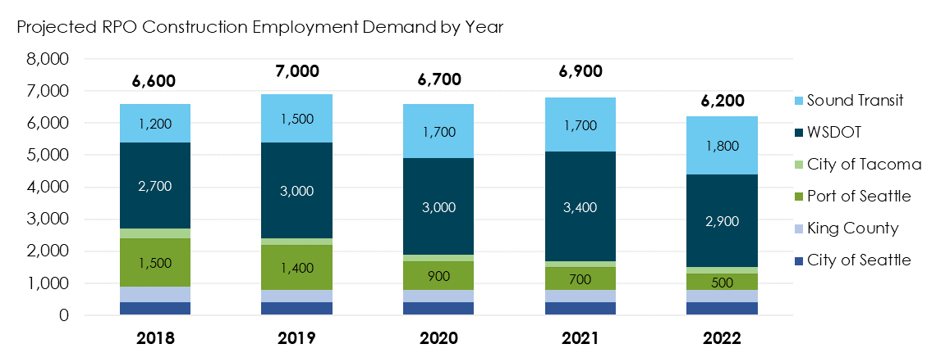
Projected Construction Employment Demand, RPO 2018-2022
Sources: Conway Pederson Economics, 2017; Puget Sound Regional Council, 2017; Washington State Employment Security Department, 2016; King County Finance & Business Operations Division, 2017; Port of Seattle, 2017; Washington State Department of Transportation, 2017; Sound Transit, 2017; Community Attributes Inc., 2018.
Based on an estimate of $270,400 in output per worker for Washington state construction workers, RPO construction projects are projected to require 6,600 construction workers in 2018 and average 6,700 workers per year between 2018 to 2022.

Slide 18
Projected Construction Occupational Demand, RPO 2018-2022
Estimates for Seattle and Tacoma are modeled estimates. Other RPO member demand projections are based on data provided by staff to CAI for inclusion in analytics, though some further modeling was required in some cases to estimate spending and employment demand per year.
Combined, WSDOT and Sound Transit constitute on average 68% of all RPO construction demand between 2018 and 2022. In 2018, these two sources will represent 59% of all demand.
The employment demand from Port of Seattle is expected to decrease to 60% of its 2018 employment demand in 2020. This may be due to the completion of the International Arrivals Fac-IAF project in 2020, which has been a major source of workforce demand.

Slide 19
Projected Construction Occupational Demand, RPO 2018-2022
The table above summarizes the short-term forecasts for select construction occupations. (Please see Appendix for the full list of occupational demand.)
The types of demand by RPO members differs from overall Tri-County industry occupational demand due to the types of projects funded by RPO members.

Slide 20
Projected Construction Occupational Demand, RPO 2018-2022
* Average Annual Gap data is from 2017 Sound Transit ST3 Occupational Analysis. Estimates represent the region-wide labor market, Including the residential and commercial market.

Slide 21
Projected Construction Apprenticeship Demand, RPO 2018-2022, based on 15% utilization rate
The table above summarizes the projection for apprentices required by RPO construction projects using a representative apprentice utilization rate of 15%.

Slide 22
Projected Residence of Construction Workers City of Seattle, Based on City Priority Hire Zip Code List, 2017 – 2022
Sources: Conway Pederson Economics, 2017; Puget Sound Regional Council, 2017; Washington State Employment Security Department, 2016; U.S. Census Bureau, 2018; City of Seattle, 2018; Community Attributes Inc., 2018.
Estimates were based on the distribution of construction workers by zip code of residence in the ACS, and then applied to total construction labor force in the region as a method of allocation.

Slide 23
Projected Residence of Construction Workers City of Seattle, Based on City Priority Hire Zip Code List, 2017 – 2022 (Continued)
Sources: Conway Pederson Economics, 2017; Puget Sound Regional Council, 2017; Washington State Employment Security Department, 2016; U.S. Census Bureau, 2018; City of Seattle, 2018; Community Attributes Inc., 2018.
The table above summarizes the projection for the supply of construction workers in selected zip-codes.
From 2017 to 2022, an annual average of 27,600 construction workers is anticipated to be supplied in all City of Seattle priority hire zip codes region. It reflects 21% of all tri-county regional construction workforce supply.

Slide 24
Projected Residence of Construction Workers King County, Based on County Priority Hire Zip Code List, 2017 – 2022
Sources: Conway Pederson Economics, 2017; Puget Sound Regional Council, 2017; Washington State Employment Security Department, 2016; U.S. Census Bureau, 2018; City of Seattle, 2018; Community Attributes Inc., 2018.

Slide 25
Projected Residence of Construction Workers King County, Based on County Priority Hire Zip Code List, 2017 – 2022 (Continued)
Sources: Conway Pederson Economics, 2017; Puget Sound Regional Council, 2017; Washington State Employment Security Department, 2016; U.S. Census Bureau, 2018; City of Seattle, 2018; Community Attributes Inc., 2018.
From 2017 to 2022, an annual average of 43,500 construction workers is anticipated to be supplied in all King County priority hire zip codes region. It reflects 33.5% of all tri-county regional construction workforce supply.
*The King County list of zip codes does not distinguish between tier I and tier II zip codes in this analysis.

Slide 26
Appendix

Slide 27
Appendix
Modeling Assumptions
Methodology
Projected Construction Occupational Demand, RPO 2018-2022
Projected Construction Apprenticeship Demand, RPO 2018-2022

Slide 28
Appendix Key Modeling Assumptions
Project Completion and Duration Given data on total project elements and project duration but not on the scheduled completion of elements, CAI assumed project elements were to be completed continuously for the duration of each project. For example, if a project comprised two underground stations and 3 miles of underground track to be completed in two years, CAI translated this to one station and 1.5 miles of track per year.
FTEs Translating hours to jobs requires using an annual average of hours. While the federal standard is 2,050 hours per FTE, local employment data represents a headcount of employees, counting both full-time and part-time workers equally. For this reason, CAI assumed one job was equal to 1,500 hours.
GBI/FTE ratio for Washington, NAICS Code 2373 To translate construction spending to FTEs, CAI assumed a GBI/FTE ratio of $270,400 per FTE for Washington State construction workers for all RPO projects. This ratio is generated from the 2017 Sounds Transit ST3 Occupational Analysis.
Construction Spending/CIP ratio (based on Port of Seattle ratio) For City of Tacoma, CAI assumed 41.4% of its CIP falls into construction spending, which is based on the Construction Spending/CIP ratio from Port of Seattle.

Slide 29
Appendix Methodology
METHODOLOGY – RPO EMPLOYMENT DEMAND FORECAST
Developing employment demand forecasts for RPO members relied heavily on Sound Transit ST3 Occupational Analysis. First, by collecting data about future construction projects from RPO members, CAI estimated the annual construction spending for each RPO members, and forecasted the construction spending through 2027 by applying industry growth rate from Conway Pedersen Economics Forecast.
The next key step was to translate the construction spending to FTE demand by using a estimated GBI/FTE ratio for Washington 2373 Worker.
The final step in estimating occupational needs by applying the occupation model that was developed based on Sound Transit ST3 Occupational Analysis for each RPO members.
METHODOLOGY – APPRENTICESHIPS AND EDUCATIONAL COMPLETIONS
The apprenticeship pipeline for each year in the 2018-2022 period represents the 2015-2017 annual average multiplied by the average industry growth rate for the two preceding years. This represents the scenario where programs expand or contract in response to general industry conditions. This methodology was informed by interviews conducted with five construction apprenticeship program representatives.

Slide 30
Appendix Methodology
METHODOLOGY – RESIDENCE OF CONSTRUCTION WORKERS PROJECTION. First, the ratios of construction workers in each tri-county zip codes out of the total construction workers in the tri-county region were calculated from 2014, 2015 and 2016 ACS five-year estimates of construction employment. The average of 2014, 2015 and 2016 ratios was used to estimate the construction workforce composition ratio in the tri-county region from 2017 to 2022. In the final step, the construction workforce supply in the tri-county from 2017 to 2022 from the previous analysis was used as control total and was distributed by the estimated ratio.

Slide 31
Projected Construction Occupational Demand, RPO 2018-2022

Slide 32
Projected Construction Occupational Demand, RPO 2018-2022 (Continued)

Slide 33
Projected Construction Apprenticeship Demand, RPO 2018-2022

Slide 34
Projected Construction Apprenticeship Demand, RPO 2018-2022 (Continued)

