Slide 1
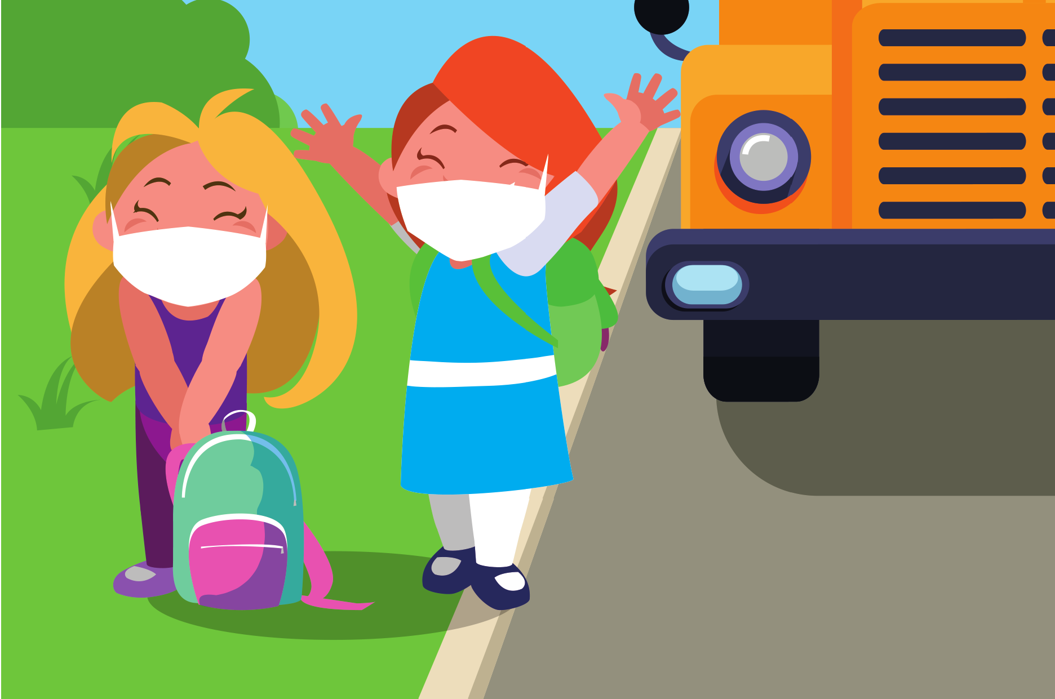
PARENT Q& A
RETURNING TO SCHOOL
SEPTEMBER 2021
COVID- 19 GUIDANCE FOR THE 2021 - 22 SCHOOL YEAR

Slide 2
We know this is a uniquely challenging time for families and that they have many questions about the upcoming school year.
To reduce risk of COVID-19, there are multiple strategies in place to keep students and staff safe.
Families can help by getting vaccinated, checking that masks fit snugly, and making sure students who have symptoms get tested and stay home.
SWIPE FOR SOME FAQS

Slide 3
WHAT ARE SCHOOLS DOING TO PREPARE FOR IN- PERSON LEARNING?
Q
A
To help prevent transmission, students and staff will wear masks indoors and social
distance at all t imes.
Schools are also following CDC guidelines to improve indoor
ventilation where possible and providing easy access to
COVID- 19 testing.

Slide 4
IS THERE A HIGHER RISK IN SCHOOLS WHERE YOUNGER KIDS ARE UNVACCINATED?
Q
A
There is increased risk with the
Delta variant, but students, staff, and families can help protect each other by getting vaccinated when eligible, wearing masks ( even for
those who are vaccinated) and
physically distancing, getting tested and staying home when having
symptoms, and improving indoor
ventilation.

Slide 5
Q
IS A COVID- 19 VACCINE
REQUIRED THIS YEAR FOR
PUBLIC SCHOOL STUDENTS?
A
No, not currently. We don' t anticipate that COVID- 19 vaccine will be required for public school students this year.
School vaccination requirements are
determined by the Washington State Board of Health.

Slide 6
HAVE A QUESTION NOT LISTED HERE?
SEE MORE FAQS:
KINGCOUNTY.GOV/COVID/SCHOOLS/FAQ
(Website available in English only)

