Slide 1
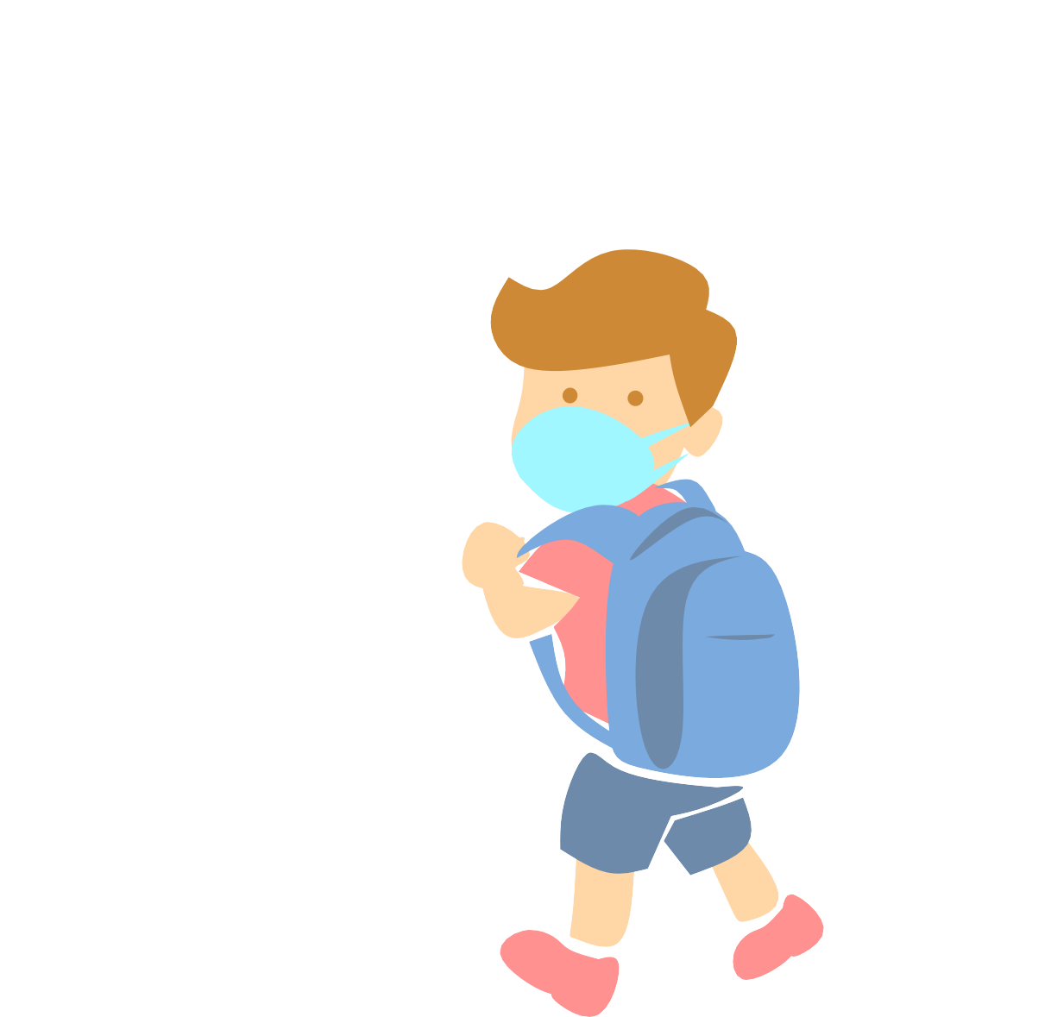
Returning to school
COVID-19 Guidance
What to expect this year
The State of Washington has provided guidance to lower the risk of COVID-19

Slide 2
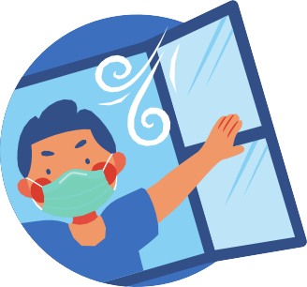
State Guidance: Multiple layers of protection
Vaccination
Masking required indoors for staff and students (ages 5+)
Improved indoor ventilation Access to COVID-19 testing
Stay home if sick policy
Social distancing and spacing between desks when possible

Slide 3
Vaccination
The best way to stay healthy and avoid school outbreaks is for students, families and staff to get vaccinated for routine vaccinations and COVID-19 when eligible.
Teachers and staff are required to be fully vaccinated for COVID-19 by October 18.

Slide 4
Masking
All staff and students ages 5+ are required to wear a mask indoors.
Families should make sure masks fit snugly and are cleaned or replaced often.
Masks protect yourself and others from COVID-19 and other respiratory illnesses.

Slide 5
Recess
The state is not requiring masks outdoors, as long as physical distancing can be maintained.
Some schools may require masks at all times.

Slide 6
Lunch time
The CDC has provided guidance for meal times that schools can adopt based on their situation. These include maximizing physical distancing as much as possible, 6 feet or more is preferred, one-direction pathways, and outdoor lunch when/where possible.

Slide 7
When to stay home
Students and staff need to stay home if:
The student/staff themselves have COVID-19 symptoms or tests positive
Someone in their household tests positive or has been diagnosed with COVID-19

Slide 8
What you can do now
Get caught up on routine vaccinations:
Check with your healthcare provider
Free and low-cost vaccination clinics:
kingcounty.gov/findaclinic
(Website available in English only)
3. Healthcare Access Line: 1-800-756-5437
Monday-Friday, 8am-5pm
(Language interpretation available)

