Slide 1
King County Bridges and Roads Task Force Roads Services Division Financial Review September 16, 2015

Slide 2
Road Services Funding Needs
Review of the estimated funding needs for KCDOT Road Services
BERK retained to review the basis the funding scenarios presented in the 2014 Strategic Plan
Also provide some context for the needs discussion by comparing King County with other local jurisdictions

Slide 3
BERK’s Charge
Review the estimates of need that are the basis for the Strategic Plan Funding Scenarios
In particular, we reviewed:
Data and inputs
Models
Methods
Assumptions
Where appropriate, we were to identify opportunities to improve or refine the estimates

Slide 4
2014 Strategic Plan Road Services
Funding needs were estimated based on best available information in 2012:
Actual expenditures (primarily used to derive unit costs)
Quantity, type and condition of facilities
Subject matter expert knowledge
Defined current needs (Transportation Needs Report and other internal documents)
Future funding scenarios were based on funding to achieve level-of-service or investment goals
Future needs do not account for the impact of weather-related damage or other potential natural disasters
Components of the Estimates
Fixed Costs:
Core operating structure
Maintenance
Roadway cleaning and clearing
Traffic features
Capital Investments (CIP):
Roadway reconstruction
Roadway surfacing
Bridges
Fish culvert and drainage
Safety Improvements
Capacity/Mobility
Debt service
Program contingency

Slide 5
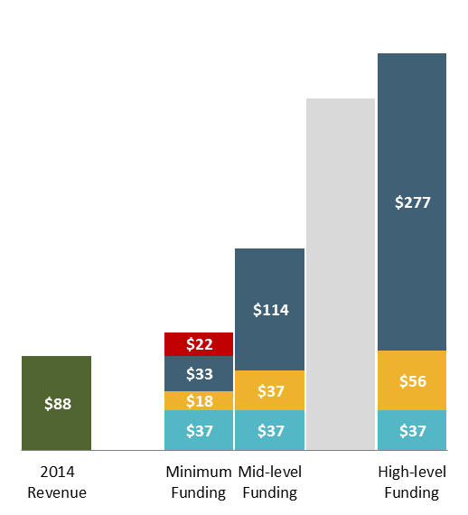
KCDOT’s Financial Model and SPRS Need
KCDOT RSD Needs Model 2014
Strategic Plan Road Services 2014 Update
$370M
$350M
○ Capital Improvement
○ Maintenance
Program (CIP)
○ Fixed Costs
○ Unfunded
○ Not Assessed
○ Capacity
○ Mobility
○ Maintenance and Preservation
○ Regulatory
○ Safety
○ Non-discretionary
$330M
$190M
$200M
$110M
$110M
$90M
2014 Revenue
Four Funding Scenarios
Annually
Annually

Slide 6
Overarching Findings
The estimates were based on reasonable methods and assumptions
While the estimation approach varied for some cost elements, this was done to reflect best available information at the time
Many assumptions were based on actual cost experience with appropriate adjustments based on input from subject matter experts
Estimates reflect current understanding of asset condition and capital replacement needs
The funding scenarios reasonably reflect planning-level costs to achieve service and investment goals

Slide 7
Refined Estimates
BERK identified several areas where estimates might be refined and/or potential risks captured
Areas where refinements were suggested:
Unit costs updated for some program elements
Refined the way certain programs were annualized
Cost escalation treatment was standardized
Some gaps were identified in program estimates
Some assumptions carried more risk
Results in a range of potential funding need to achieve the service and investment goals identified for each funding scenario

Slide 8
SPRS Need and Refined Estimates
$500M
Strategic Plan Road Services 2014 Update
2015 Refined Estimate of Needs
○ Capacity
○ Mobility
○ Maintenance and Preservation
○ Regulatory
○ Safety
○ Non-discretionary
$350M
$350M
$330M
$300M
$250M
$200M
$200M
$180M
$110M
$90M
2014 Revenue
Four Funding Scenarios
2014 Revenue
Four Funding Scenarios

Slide 9
Final Conclusions
At a planning level, Road Services Division’s need estimate is reasonable, though it is better understood as a point within a potential range
Condition data reflects current situation
Other uncertainties will drive actual future costs:
Costs will be improved as projects go through design
Unit costs will change over time
Potential future governance changes will likely change both available revenues and system needs
Priorities may need to change based on regulatory and/or new policy direction
The Strategic Plan estimates are a reasonable basis to support policy-level funding discussions

Slide 10
Funding Scenarios
Breakdown of spending for each funding scenario

Slide 11
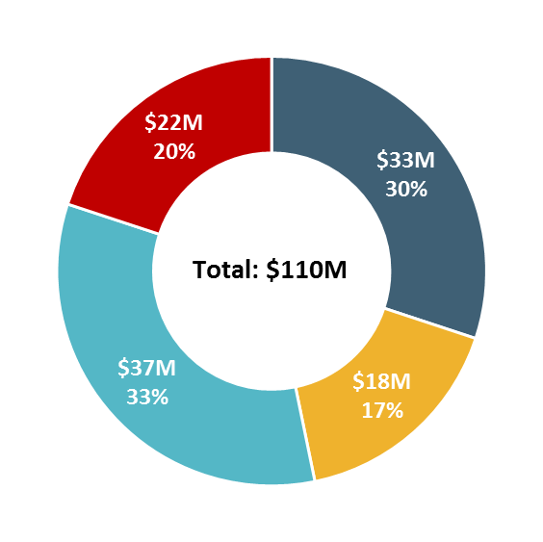
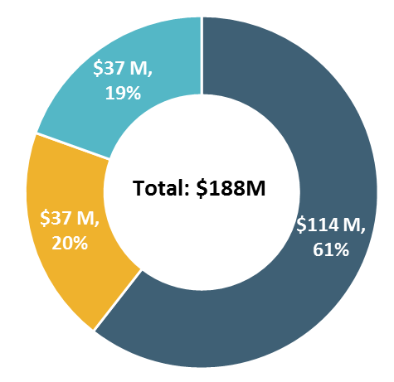
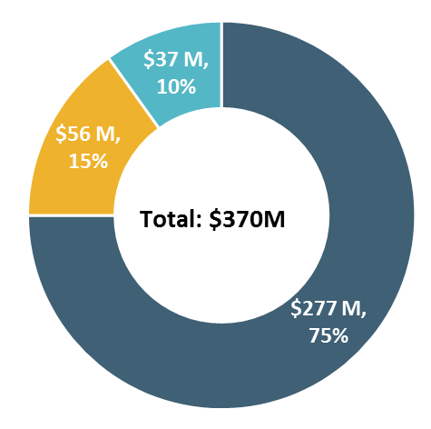
Annual Funding Level Scenarios
Fixed Costs
Maintenance
Capital Improvement Program (CIP)
Unfunded Costs
Minimum Funding
Manage risk in a declining system
Mid-level Funding Scenario
Moderate the decline in asset condition
High-level Funding Scenario
Annual funding scenarios from detailed program data; slightly different than totals that appeared in 2014 Strategic Plan
Approximately what is needed to maximize life cycles plus addressing some mobility and capacity needs

Slide 12
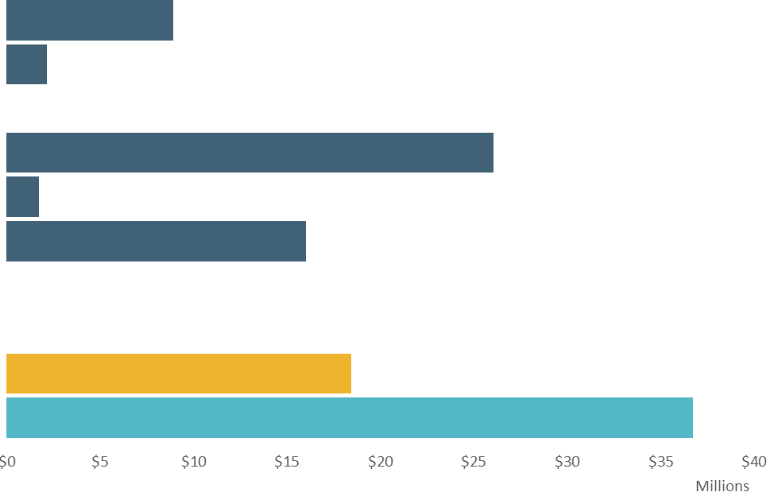
Annual Funding Level Scenarios: Minimum Funding
Debt Service
Contingency
This funding scenario:
Only provides 80% of the estimated minimum funding requirement
Moderately increases to maintenance
Begins to pay down 2014 known CIP backlog
Will not keep up with expected additional projects
Does not increase capacity or mobility
Mobility/Capacity
Other Capital Projects
Bridges Program
Roadway Surface
Roadway Reconstruct/Rehab
Maintenance
Fixed Costs
Minimum Funding
$22M
$22M
$18M
$18M
$37M
$37M
$33M
$33M
Fixed Costs
Maintenance
Minimum funding – with substandard and declining asset conditions, growing backlogs, very limited capital replacement, and increased risk
Capital Improvement Program
Unfunded Costs

Slide 13
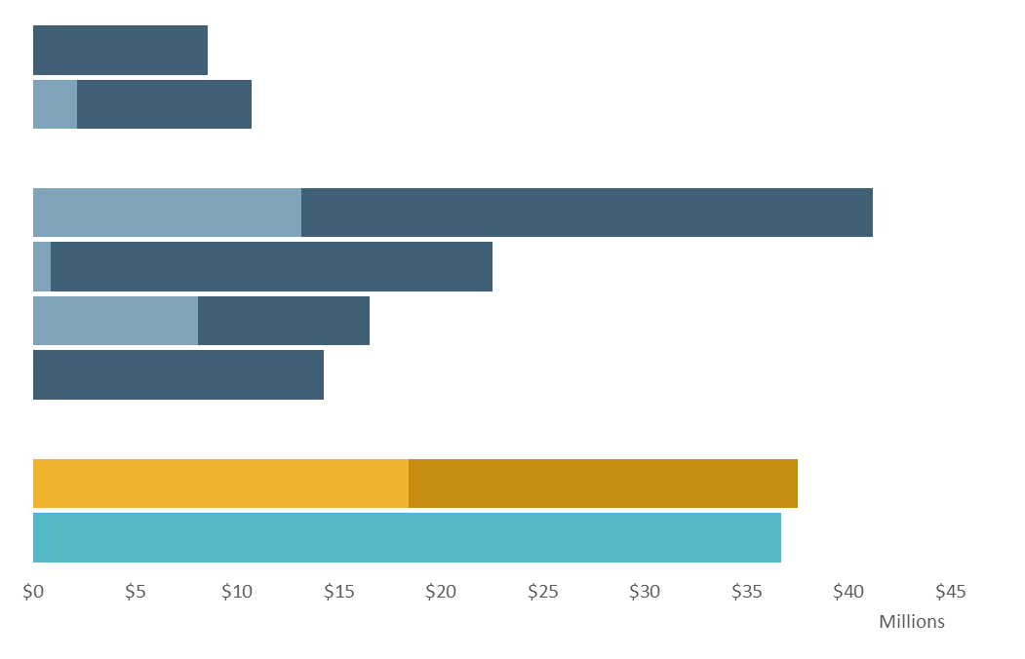
Annual Funding Level Scenarios: Mid-level Funding
Debt Service
Contingency
This funding scenario:
Doubles maintenance spending
Begins to pay down 2014 known backlog
Will not keep up with expected additional capital projects
Does not increase capacity or mobility
Mobility/Capacity
Other Capital Projects
Bridges Program
Roadway Surface
Roadway Reconstruct/Rehab
Maintenance
Fixed Costs
Minimum Funding
$22M
$22M
$18M
$18M
$37M
$37M
$33M
$33M
Mid-level Funding
$37M
Fixed Costs
$37M
$37M
$37M
$114M
$114M
Maintenance
Capital Improvement Program

Slide 14
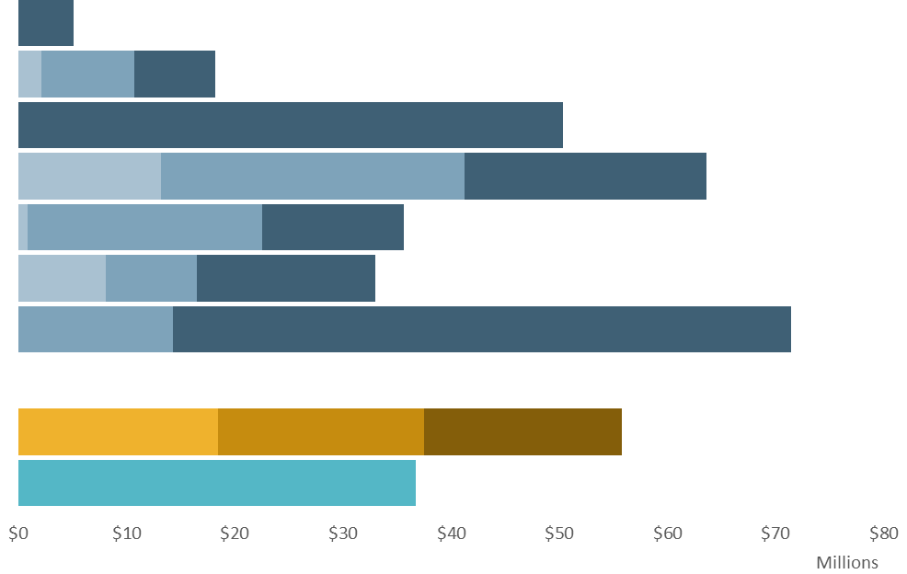
Annual Funding Level Scenarios: High-level Funding
Debt Service
Contingency
This funding scenario:
Fully funds maintenance
Can pay down known 2014 backlog to manageable levels
Funding can also be prioritized for additional projects
Or can be used to for capacity and mobility projects
Mobility/Capacity
Other Capital Projects
Bridges Program
Roadway Surface
Roadway Reconstruct/Rehab
Maintenance
Fixed Costs
Minimum Funding
$22M
$18M
$37M
$33M
Mid-level Funding
Fixed Costs
$37M
$37M
$114M
Maintenance
Capital Improvement Program
High-level Funding
$56M
$37M
$277M

Slide 15
Context
Funding needs in broader context

Slide 16
Comparison: Inventory and Population
 | Counties |  |  | City of
 | King | Pierce | Snohomish | Seattle
Roads (Lane Miles) | 2,961 | 3,100 | 3,257 | 3,954
Arterial Roads (Lane Miles) | 961 | 1,420 | 1,028 | 1,547
Bridges | 181 | 141 | 200 | 122
Population (2014)* | 252,050 | 381,970 | 320,335 | 668,342
Service Area (Sq. Miles) | 1,704 | 1,520 | 1,950 | 83
Note: County populations are for unincorporated areas only; road statistics do not include traffic volume
Source: Washington State OFM and U.S. Census Bureau, 2015. King County DOT, Pierce County Public Works, Seattle DOT, and Snohomish DOT.

Slide 17
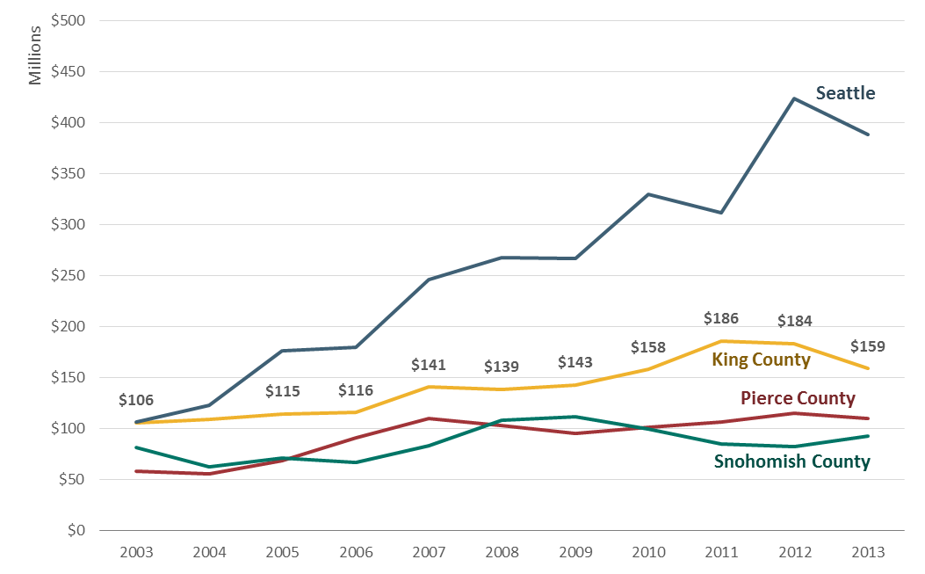
Comparisons: Expenditures (2013$)
Source: BERK, 2015 using: Washington State DOT County Road and City Street Revenues and Expenditures Database, 2003-2013

Slide 18
Infrastructure Challenges Nationwide
The funding challenges facing King County are not unique in the region or around the country
Nationally, local governments are dealing with:
Capital replacement needs related to infrastructure built to support the post-war building boom
ASCE 2013 Report Card for America’s Infrastructure
Overall: D+, Bridges: C+, Roads: D
TRIP Report found that more than ¼ of urban roads are in substandard condition

