Slide 1
SAFETY REQUIREMENTS FOR
COVID-19
Health and Safety Guidance for Employees During the Pandemic

Slide 2
WHY WE’RE CONCERNED ABOUT COVID-19 IN THE WORKPLACE
Potential for severe illness and pneumonia from COVID-19
Anyone can get it, and anyone can get a serious illness, though some people are at higher risk:
Age 60 +
Health conditions
You can be infected and not have any symptoms, so you can spread it without knowing
We must prevent workers from getting sick and taking COVID-19 home.
Notes:
Novel coronavirus (COVID-19) is a new virus strain that was only identified in 2019. It has the potential to cause severe illness and pneumonia. Anyone can get a severe illness from COVID, and especially people over age 60 or who have health conditions such as heart disease, diabetes, obesity, or kidney disease. As health experts learn more about COVID, they are finding that many other conditions may put people at higher risk, including asthma, pregnancy, smoking, and high blood pressure.
More information on who’s at risk: https://www.cdc.gov/coronavirus/2019-ncov/need-extra-precautions/index.html
Because this is a new virus, anyone can get it. Some people will get a milder illness or even not have any symptoms, but anyone of any age can get a more severe case. Those people who don’t have symptoms are still contagious and can spread it without knowing.
To prevent any outbreak in our workplace, and to prevent workers from getting sick or taking the virus back to loved ones at home, we need to take precautions for COVID-19 very seriously.

Slide 3
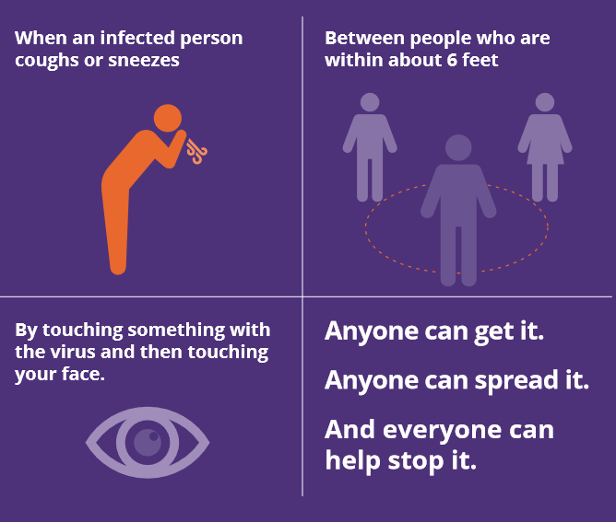
HOW COVID-19 SPREADS
Notes:
COVID-19 mainly spreads through close contact from person-to-person, when people are within six feet of each other for 15 minutes or more. Someone who is infected can spread the virus through the spray of droplets from their mouth when they cough, sneeze, or talk. Some people without symptoms may be able to spread the virus.
COVID-19 may also be spread by a person touching a surface or object that has the virus on it, then touching their own mouth, nose, or eyes. But health experts don’t think that this is a the main way this virus is spreading—the main way it spreads is through people in close contact.
If you are exposed to the virus, you can develop COVID anytime between 2-14 days after you were exposed.

Slide 4
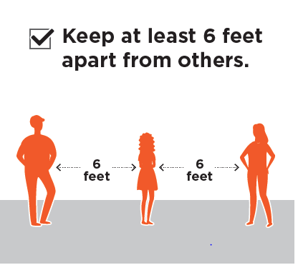
MAINTAIN PHYSICAL DISTANCE
Notes:
Since the main way that COVID spreads is through close contact, we need to protect ourselves and each other by keeping space between us.
In cases where you cannot maintain at least six feet of distance, we will provide alternative protections, such as installing plastic shields between you and the closest work station, or finding an alternate location where you can perform the necessary tasks.

Slide 5
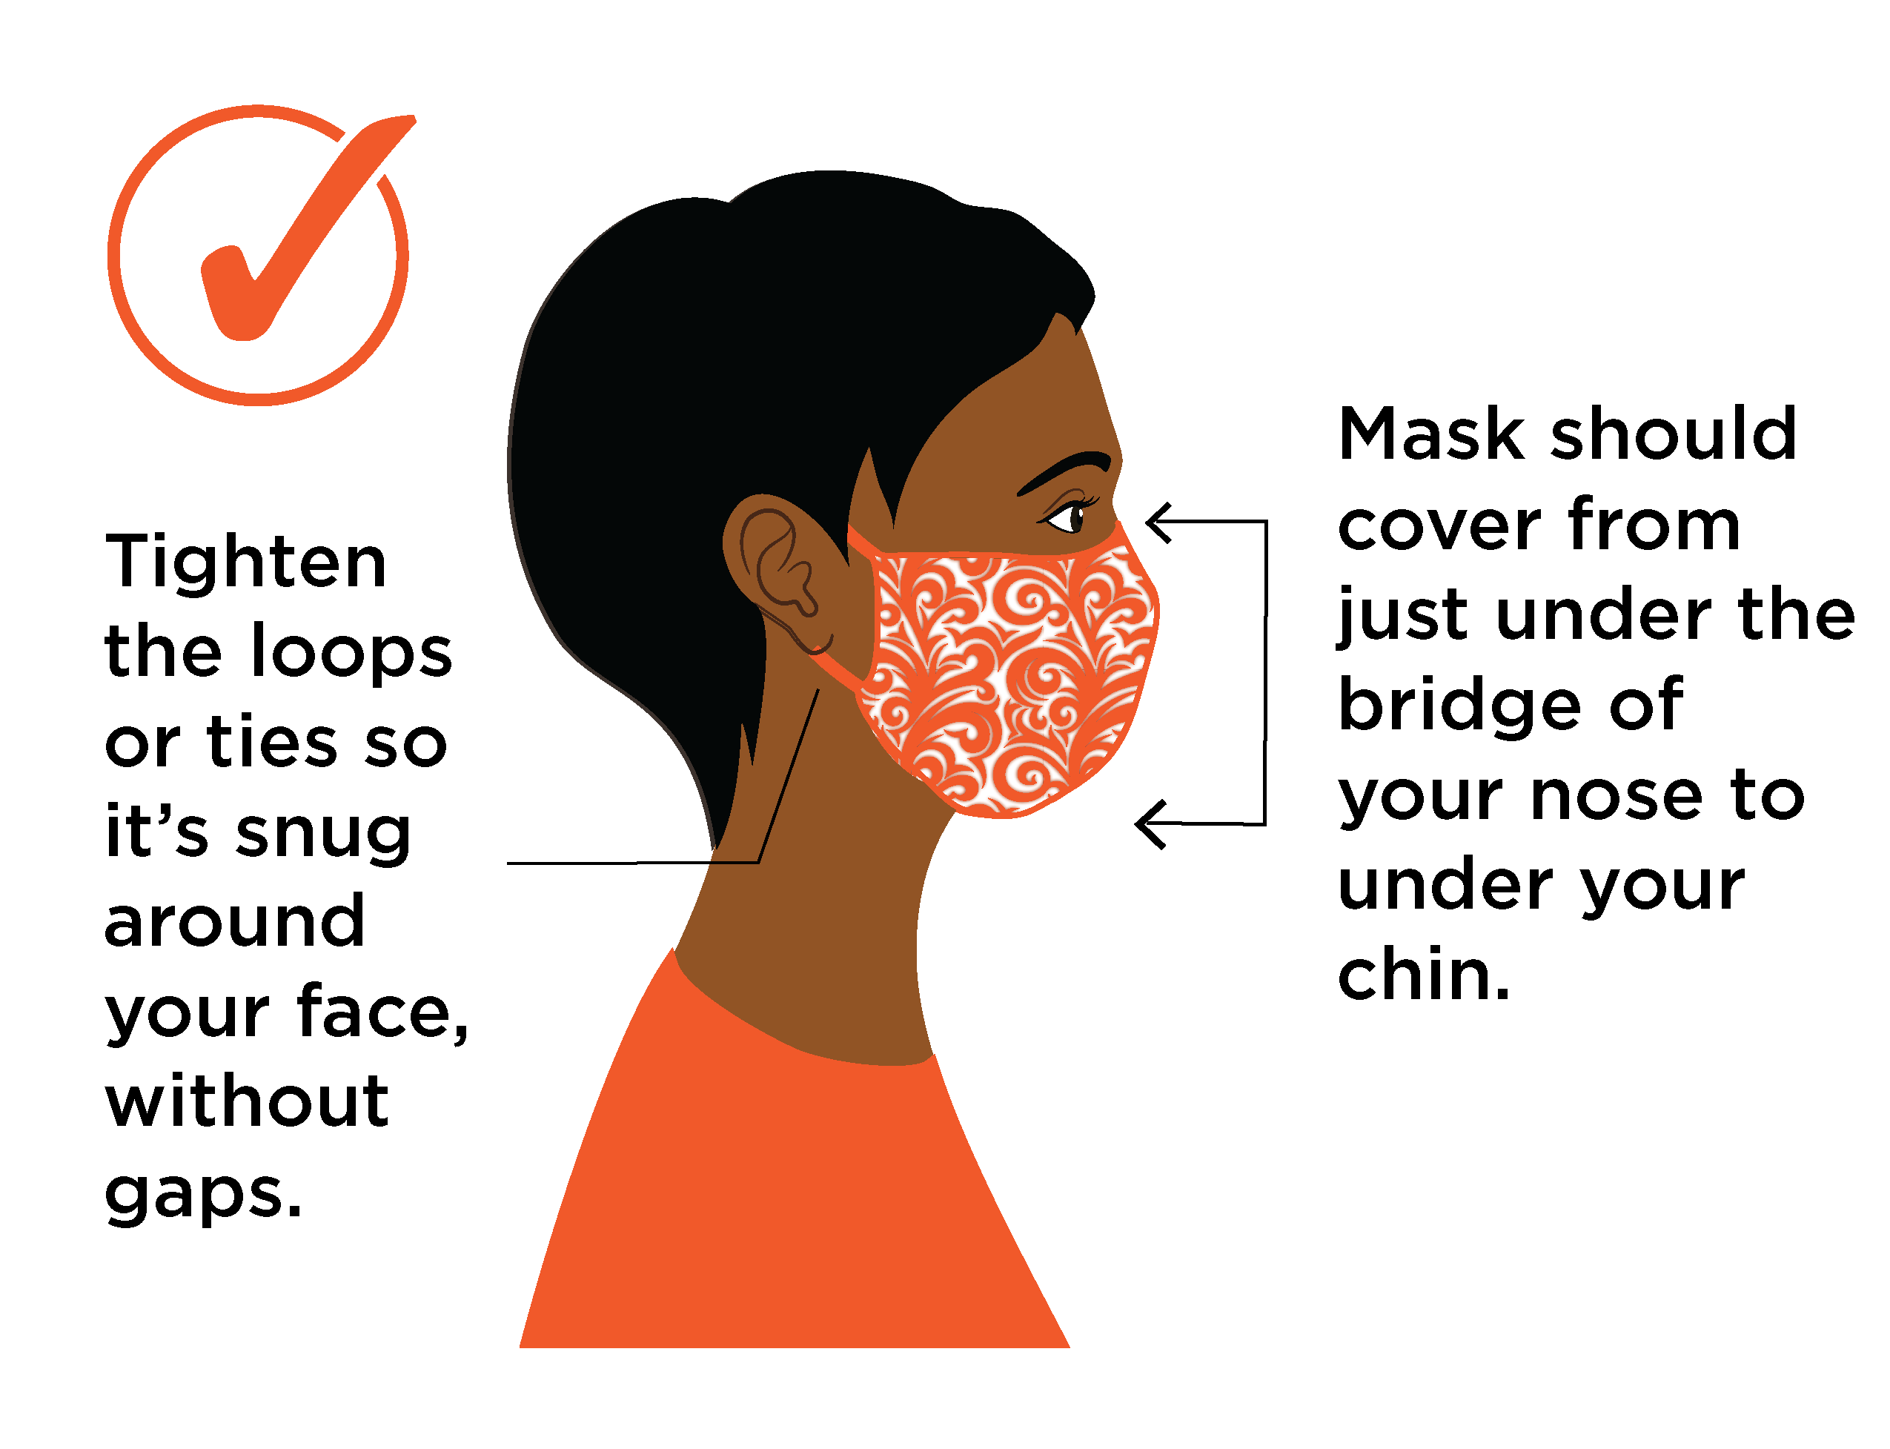
WEAR A FACE COVERING AT ALL TIMES
Notes:
We also need to prevent exposing each other to droplets from our mouths and noses.
All employees must wear cloth face coverings, unless they have a medical condition or disability that makes this unsafe or impractical.
If you don’t have one, we will provide one for you.
It is important to wear the mask properly, ensuring that it covers both your nose and mouth.
If you do a job that puts you at higher risk, we will provide masks that provide a higher level of protection.
If you have a job that makes it impractical to wear a mask, we can provide other protective options, such as installing a plastic barrier between you and your co-workers or finding a location where you can perform your job at a distance from other people.
If you have a condition that makes it unsafe to wear a mask, we will provide other protective options or make other reasonable accommodations.

Slide 6
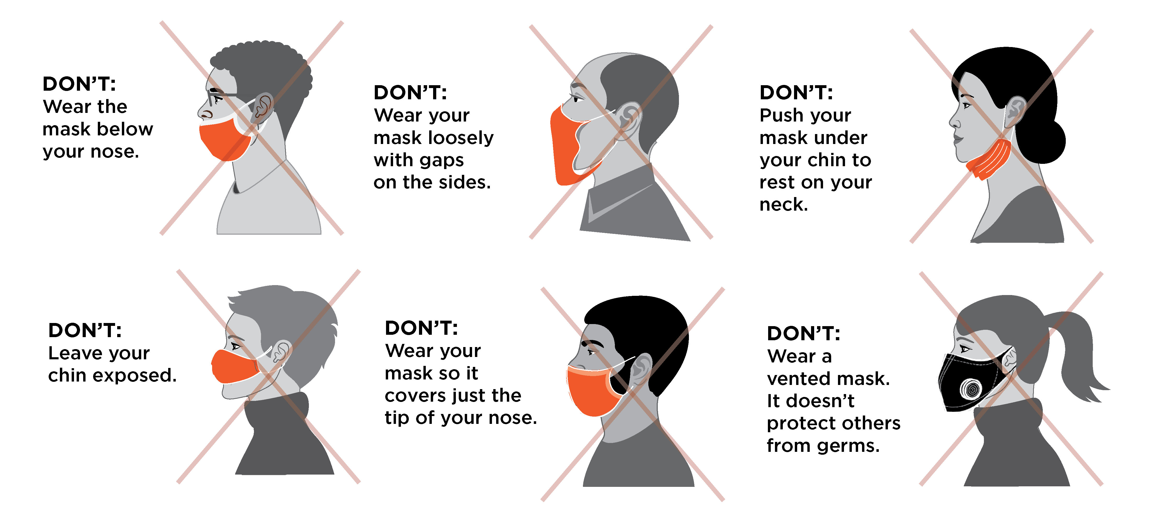
WEARING YOUR MASK LIKE THIS WON’T PROTECT YOU OR OTHERS
Notes:
How you wear your mask makes a big difference in whether it works to prevent exposure to COVID.
Try not to touch the front of your mask, and remove it using the ties or ear loops.
Wash cloth masks regularly, and wash your hands before putting on a mask and after taking it off.
Keep it in a clean, dry place when you’re not wearing it.

Slide 7
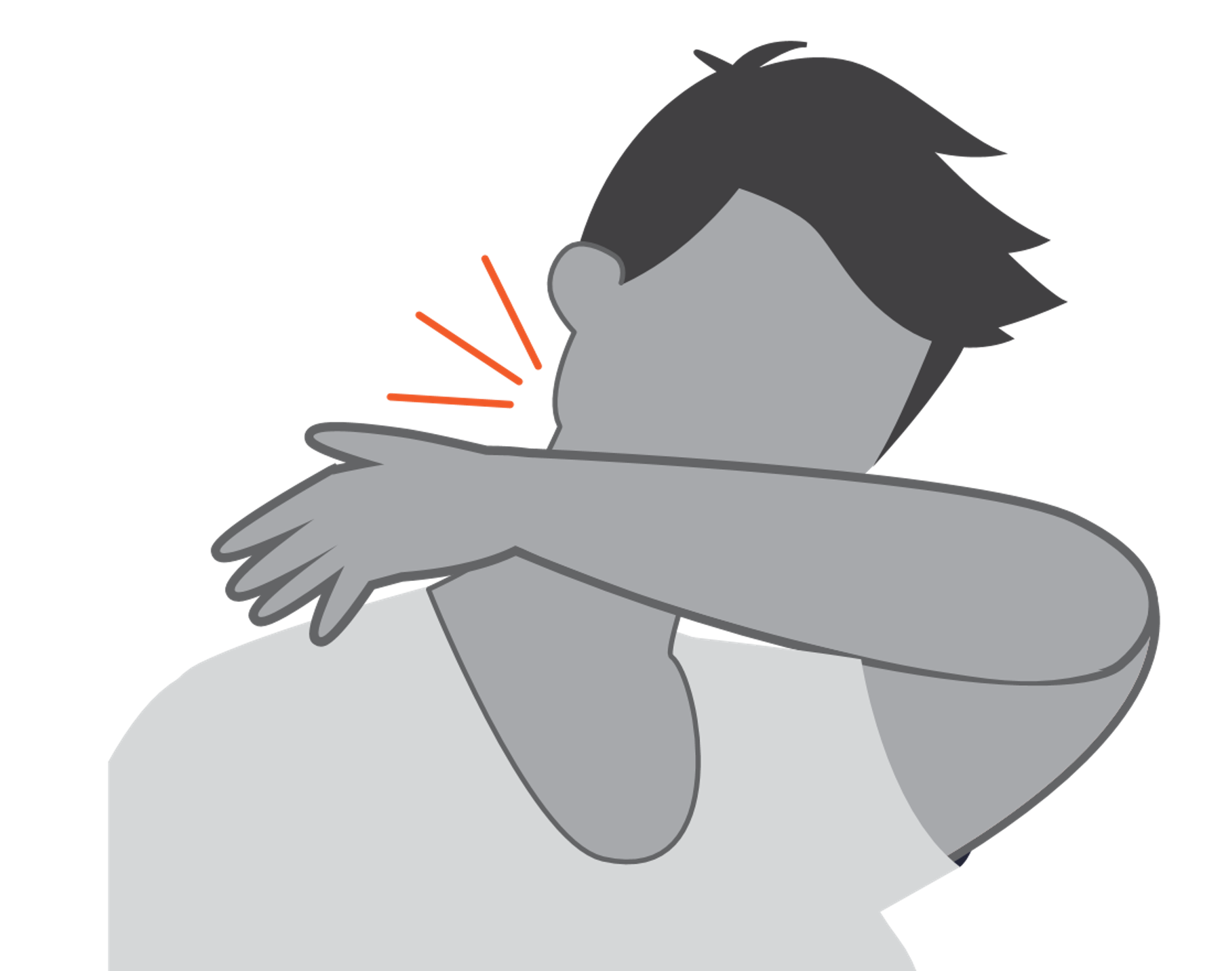
PRACTICE GOOD HEALTH HABITS
Cover coughs and sneezes.
Wash hands thoroughly and often.
Notes:
Basic steps are effective in preventing the spread of coronavirus:
Wash your hands frequently and thoroughly with soap and water – for at least 20 seconds each time. If you don’t have soap and water handy, use hand santizer.
Cough or sneeze into your sleeve or elbow. If you cough or sneeze into your hands, make sure you wash them immediately. If you are wearing gloves and cough or sneeze on them, replace them.
Avoid touching your face with unwashed hands or gloves.

Slide 8
CLEANING AND DISINFECTING
Clean surfaces using soap and water, then use disinfectant.
Practice routine cleaning of high touch surfaces.
Notes:
Keeping the workplace clean is also an important part of preventing spread of viruses. We will have a regular schedule for cleaning and disinfecting, especially for surfaces that people touch frequently, like door handles, elevator buttons and light switches. Some of these surfaces will need to be cleaned and disinfected before each use. Others will be cleaned hourly. Cleaning and disinfecting will be done according to CDC cleaning guidelines using an approved disinfectant.
https://www.epa.gov/pesticide-registration/list-n-disinfectants-use-against-sars-cov-2-covid-19

Slide 9
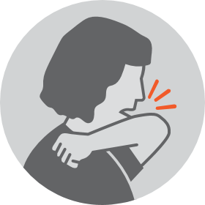
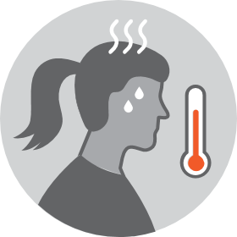
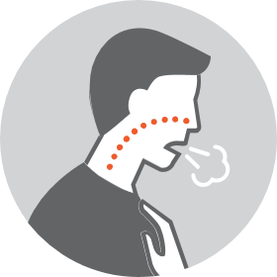
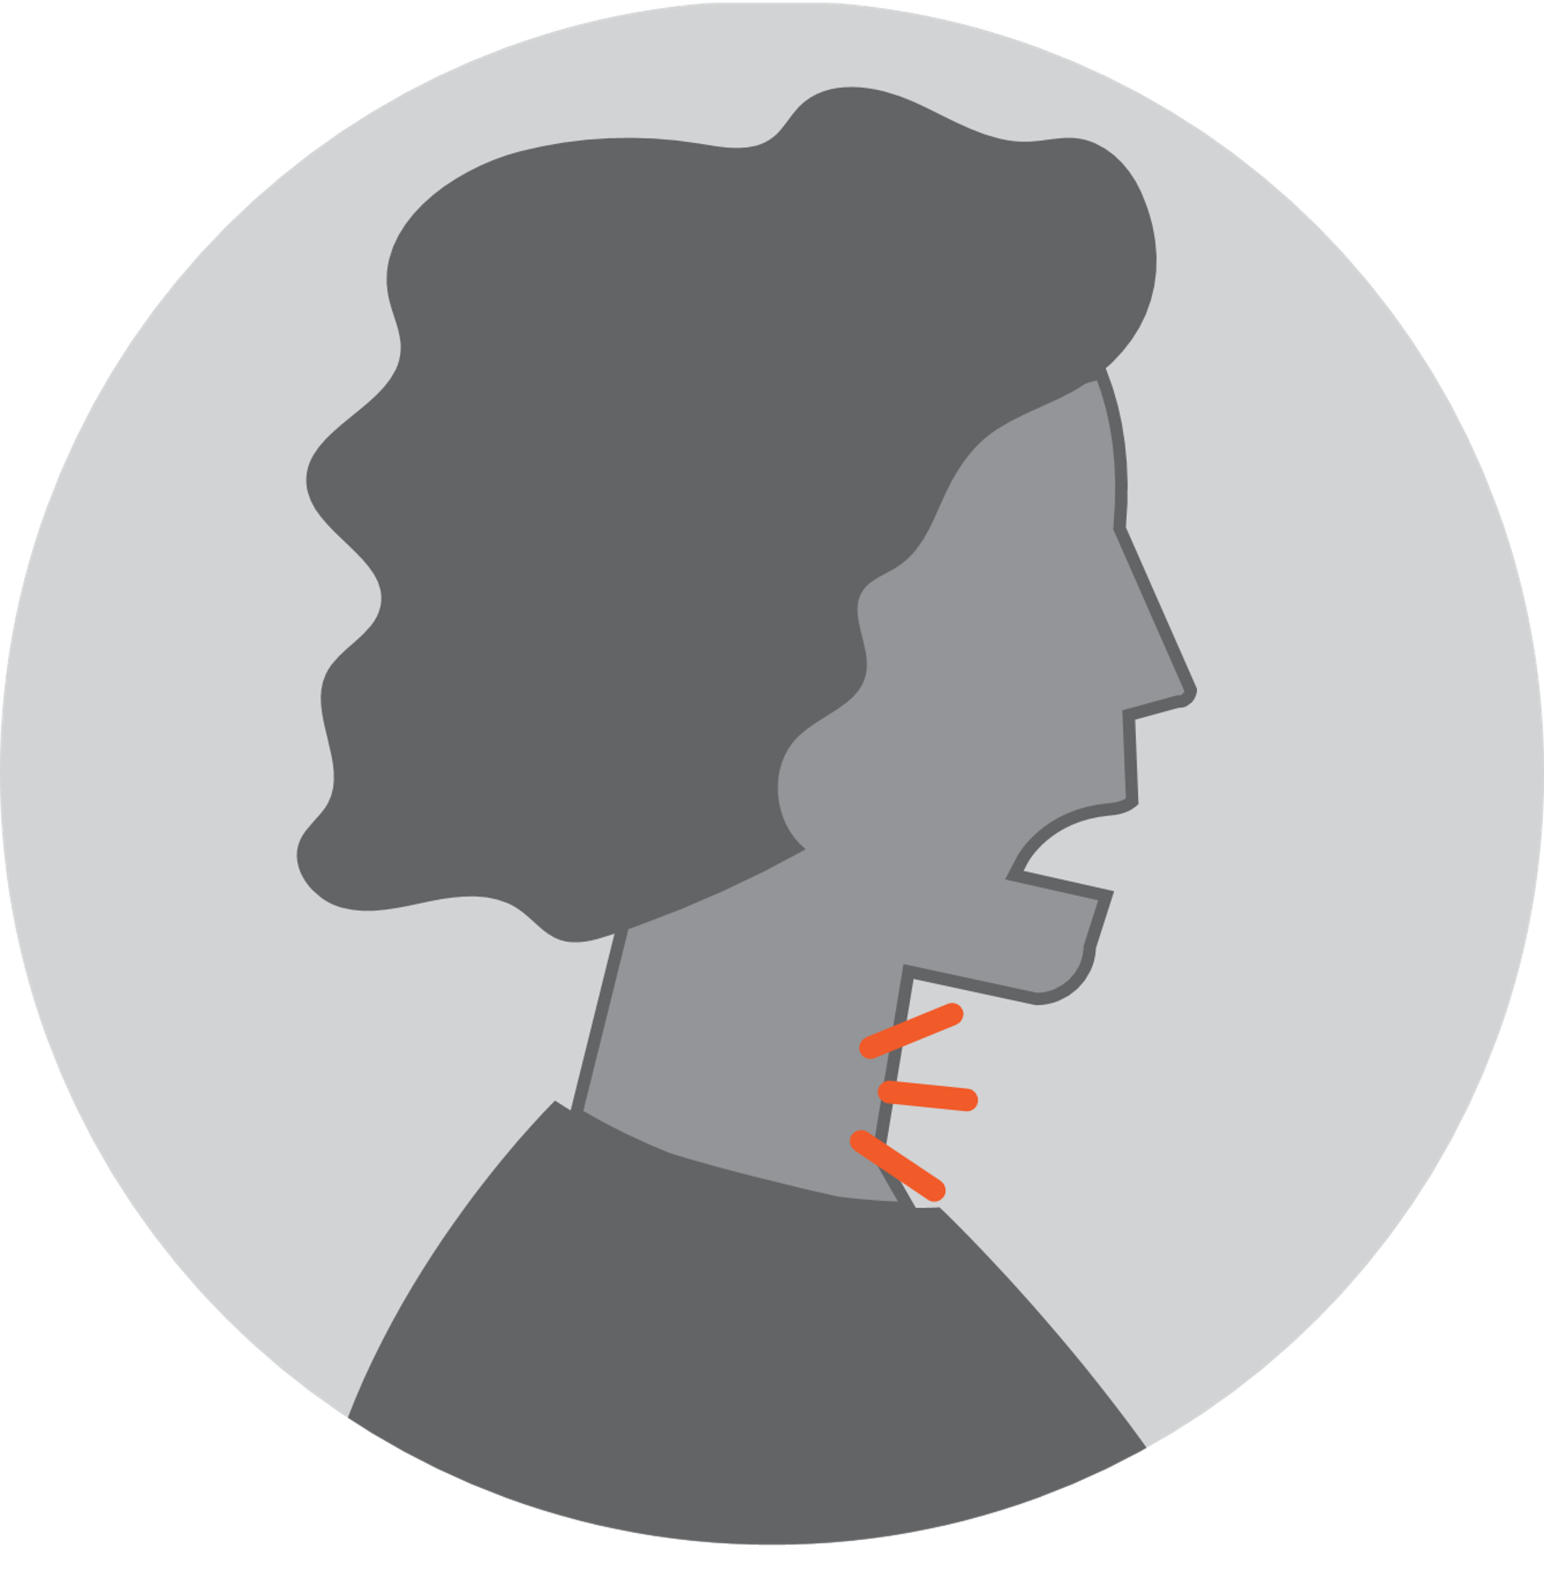
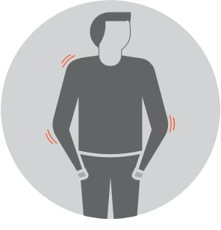
Common symptoms include:
WATCH FOR THE SIGNS AND SYMPTOMS
OF COVID-19
Cough
Fever (higher than 100○F)
Shortness of
breath
Sore throat
General body
aches
Notes:
Before you come to work, it’s important to check to see if you feel any signs of illness.
Common COVID-19 symptoms include those shown. They can also include fatigue; loss of taste or smell; or nausea and vomiting.
To keep everyone safe, we will also screen employees daily to make sure no one has symptoms.

Slide 10
If you don’t have a doctor, call the King County COVID-19 call center. 206-477-3977 Interpreters available Open 8 am – 7pm
Feel sick? Stay home and call a doctor.
Notes:
If you have any coronavirus symptoms, even if they are mild, you must stay home. If you develop symptoms after you get to work, you will need to go home.
If you feel sick, keep apart from others as much as possible, even inside your home, so that you don’t expose them.
Call your doctor for medical advice. If you do not have a healthcare provider, call the King County COVID-19 call center between 8 a.m. and 7 p.m. The number is 206-477-3977.

Slide 11
Ask your doctor to arrange a test, even if your symptoms are mild. If you don’t have a doctor, call the King County COVID-19 call center. 206-477-3977
Get tested at the first sign of illness.
Notes:
If you have any COVID-19 symptoms or have been in close contact with somebody who has the virus, you should get tested as soon as possible. The sooner you know whether or not it’s COVID, the sooner you will know whether you need to isolate yourself to prevent spreading it.
Call your doctor to arrange a test. If you don’t have a doctor, call the King County call center at 206-477-3977. They can help you arrange a free test if you do not have a doctor or health insurance.

Slide 12
Had close contact with someone with COVID? Stay home.
If you have had close contact with someone who has the virus, stay home for 14 days.
Do this even if you don’t feel sick yourself.
Notes:
You can have coronavirus without having any symptoms, so it’s possible to be infected without even knowing it. It’s also possible to spread it before you start ot feel sick. That means you could also spread it without knowing it. So if you’ve had close contact with someone who has COVID, please stay home so that you don’t potentially infect people at work.
You will need to stay home for 14 days after your first exposure to the infected person since you could develop an infection up to 14 days after that exposure.

Slide 13
You can use your paid sick leave:
If you must isolate yourself because you are sick or have been exposed to someone with the virus.
If you must stay home to care for a family member who is sick
Notes:
The Federal government requires us to provide two weeks of sick leave so you can isolate or quarantine. We also must provide leave so that you can take care of a child who is out of school or whose daycare is closed.
You can find more information on paid leave specified in the Families First Coronavirus Response Act: https://www.dol.gov/agencies/whd/pandemic/ffcra-employee-paid-leave

Slide 14
Other steps we’re taking for safety
in our workplace
Notes:
Discuss your workplace’s additional policies and procedures for COVID-19.

Slide 15
kingcounty.gov/covid
For more information about COVID-19:

