Slide 1
Automating Map folio production
Fred Lott, KC GIS Center

Slide 2
The problem

Slide 3
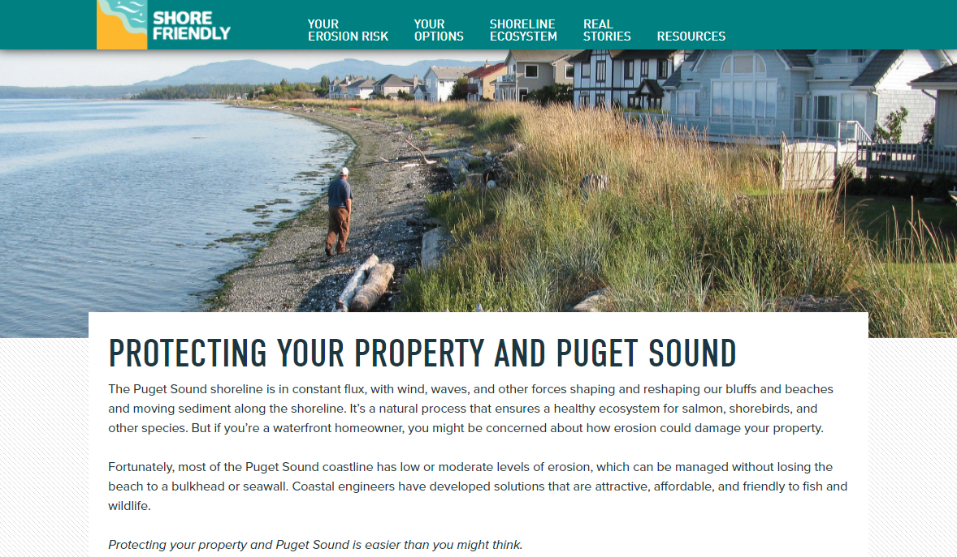

Slide 4
Project request
"As part of this program staff from 3 agencies will be going out and meeting with around 100 different shoreline residents over the next few years. After the visit, there is an intent to provide individual reports to each landowner about the specific issues that were noted on site and possible solutions. I think the current report format would require around 10 maps for each report. There will be three different groups writing these reports and there is a desire for some level of consistency in look and information provided to the landowner as well as interest in finding out if there is a more time saving way to generate multiple maps over and over again.
Is it possible to create a GIS project or application where all three agencies could 1) access/use it and 2) have some functionality where you plug in a parcel number and it can generate 10 different layouts (each containing different data displayed) or something like that which could reduce the amount of time spent creating maps for each property owner?"

Slide 5
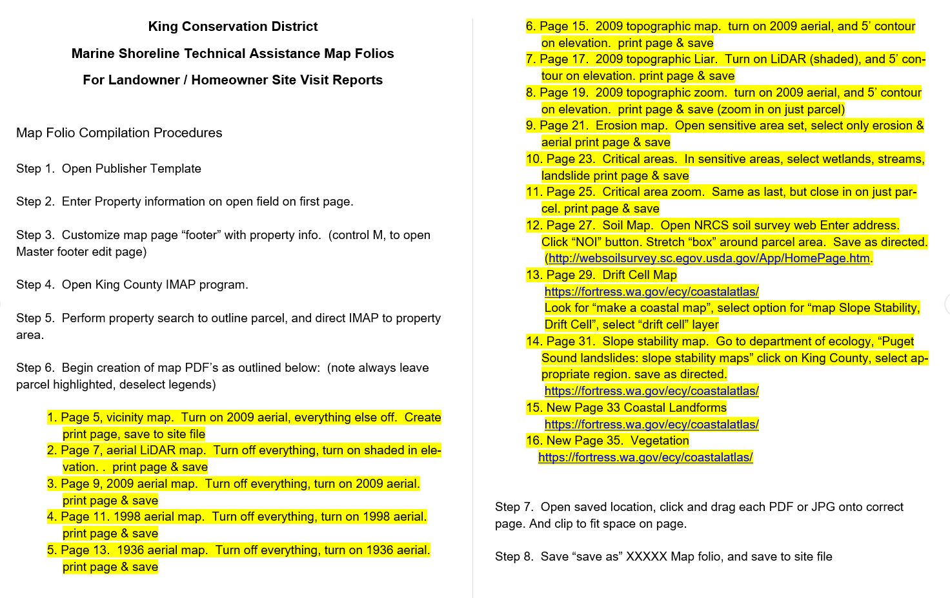
Original workflow

Slide 6
Map automation

Slide 7
Making lots of maps
Manual
Map Series
Multiple Maps
Multiple Layouts
Definition queries
Scale
Title and text
Manual PDF export
Time consuming, inconsistent
One Map, one Layout
Cycle through locations
By feature
By bookmark
By grid
Dynamic text from index feature
Fixed or dynamic scale
Automated PDF export
Multiple locations, one view style. Not what's needed!
This Photo by Unknown Author is licensed under CC BY

Slide 8
Solution: arcpy.mp

Slide 9
arcpy.mp overview
Access and manipulate the contents of projects and layers
Maps
Layouts
Layers
Automate map production and export
Formerly known as arcpy.mapping
Python 3
New classes to work with Pro
New functions
New export options
Map/MapFrame/Camera

Slide 10
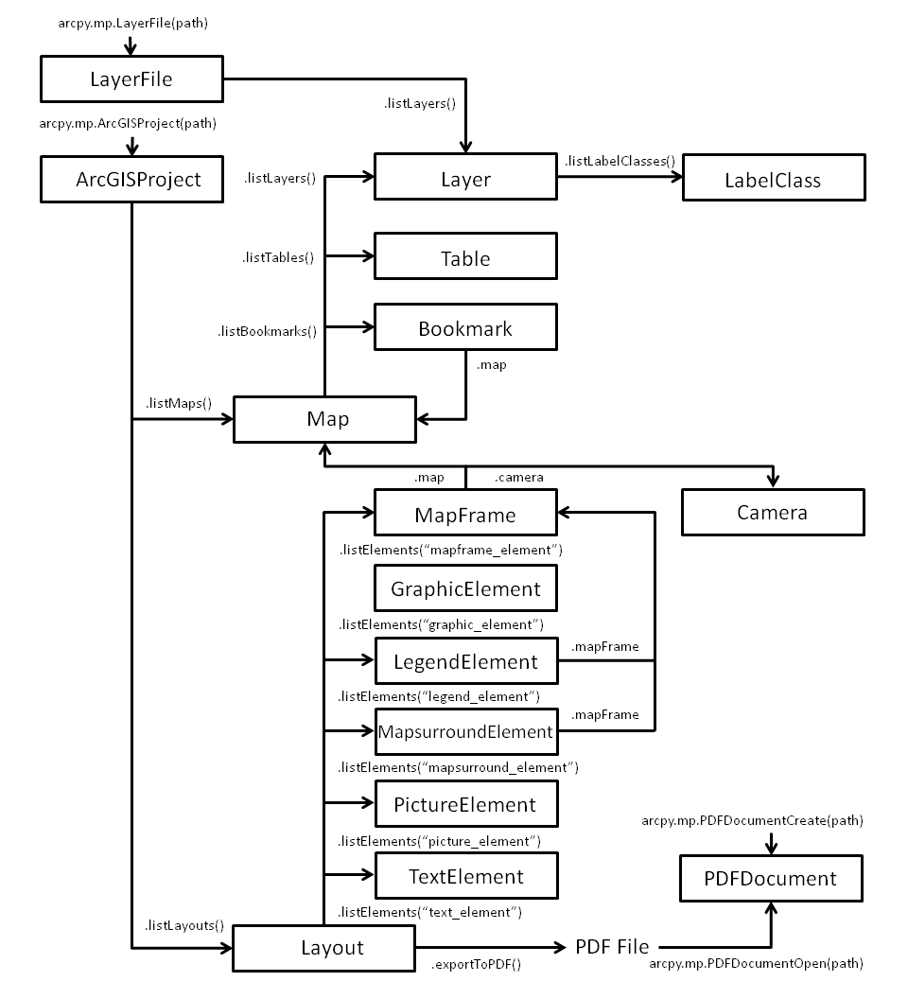
arcpy.mp
objects
Notes:
This is how the different classes and functions are accessed and related. I've highlighted the ones I used. You don't have to use all of them!

Slide 11
arcpy.mp resources
Introduction to arcpy.mp
Tutorial: Getting started with arcpy.mp
Migrating from arcpy.mapping to ArcGIS Pro
Updating and fixing data sources

Slide 12
Project setup
Static
Dynamic
One Map
One Layout
Parcel selection
Layer visibility
Title
Text box content
Scale
Export
Notes:
Other big benefit is that this is easier for the client to work with as an exploratory map. Less complicated.

Slide 13
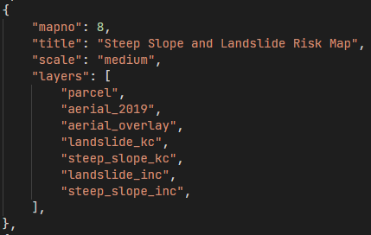
Code structure
Map specifications as a dictionary
Map number
Title
Scale
Layer list
Select PIN(s) with a definition query
Adjust the scale
Turn layers on/off
Change layout text contents
Export to PDF

Slide 14
Getting fancier
Select multiple PINs
Custom selection of maps
Change PIN display based on how many are selected
Change title based on location
Add disclaimer text for a specific map
This Photo by Unknown Author is licensed under CC BY

Slide 15
Making a script tool

Slide 16
Python Script Tools in ArcGIS Pro
Take advantage of functions / modular design
Specify your script parameters
Type, single/multiple
Input or output
Filter with a value list
Validation
Add Progressors and Messages to your script
A quick tour of creating tools with Python
Notes:
Demo project toolbox and creation of new script tool
Difference between Script Tool and Python Toolbox
Debugging
Plug the Python User Group!

Slide 17
Python User Group
3rd Wednesday of the month @ 10 am
ArcGIS Pro Coaching
1st and 3rd Thursdays @ 2 pm
geoCODE
monthly
Notes:
Look for them on Teams!

