Slide 1
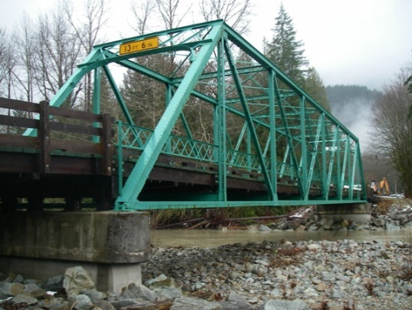
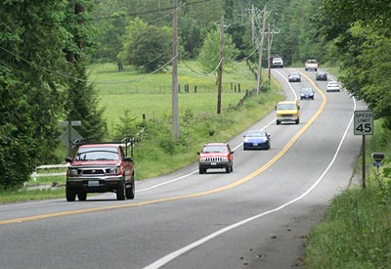
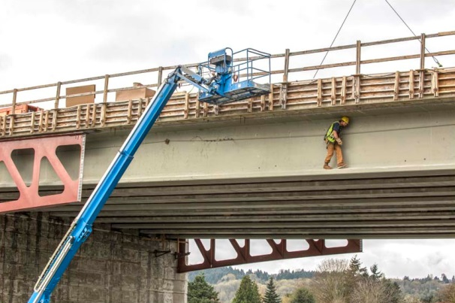
King County
Bridges and Roads Task Force
Summary of Task Force Findings
and Recommendations
January 20, 2016 Report

Slide 2
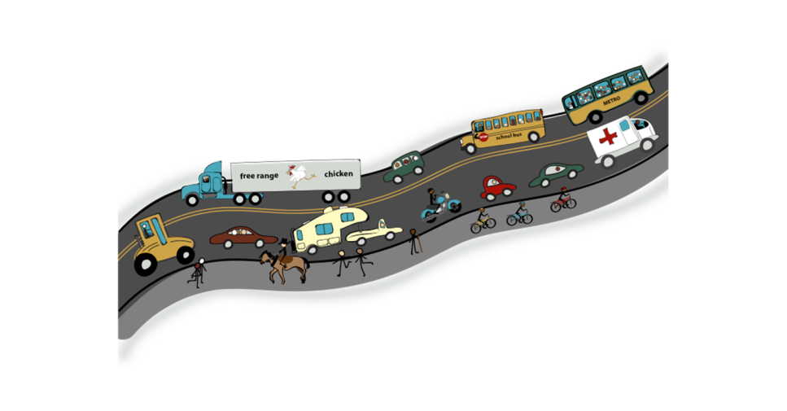
Task Force Charge
Recommend financially sustainable and equitable strategies to deliver an unincorporated road system that supports people’s transportation needs, local and regional economic development and quality of life.

Slide 3
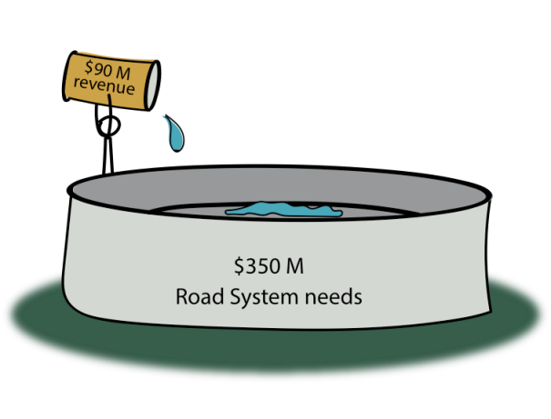
Challenge: Revenue Gap

Slide 4
Challenge: Revenue vs. Need
$500M
Strategic Plan Road Services
BERK Consulting Refined Estimate of Needs
○ Capacity
○ Mobility
○ Maintenance and Preservation
○ Regulatory
○ Safety
○ Non-discretionary
$350M
$350M
$330M
$300M
$250M
$200M
$200M
$180M
$110M
$90M
Revenue
Four Funding Scenarios
Revenue
Four Funding Scenarios
The county asked BERK consulting to review these cost estimates of road system needs. BERK concluded the estimate fairly represents potential costs, although they recommend that the county use ranges, given the many unknown factors that can affect large capital infrastructure needs.

Slide 5
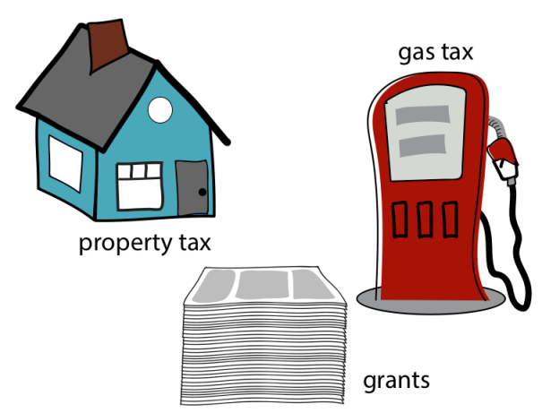
Challenge: Shrinking Revenue Sources

Slide 6
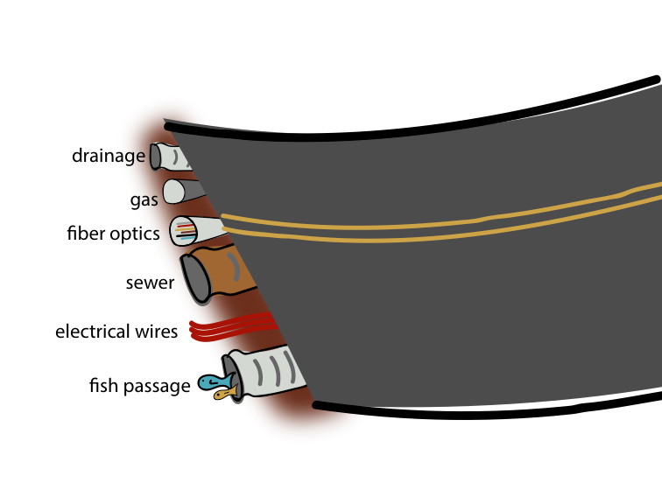
Challenge: Not just travelers

Slide 7
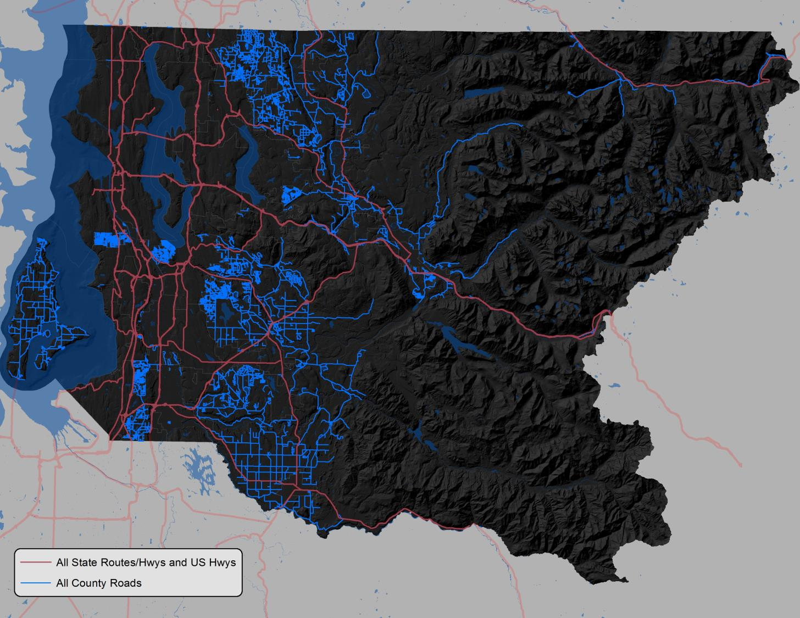
Challenge: Bridges & Roads Use
1 million trips a day
Half of the trips on high volume roads come from cities and other counties
Two million residents in King County
Only 250,000 unincorporated residents
1,486 miles county maintained roads

Slide 8
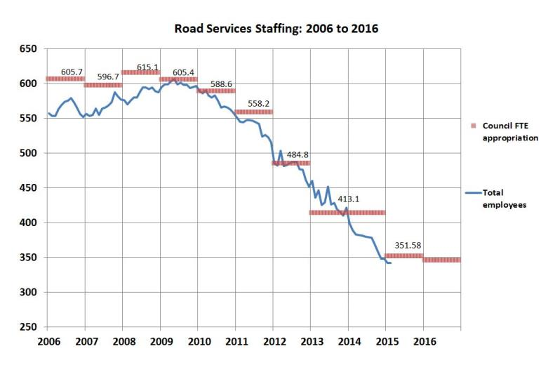
Challenge: Few Efficiencies or Responsible Cuts Left

Slide 9
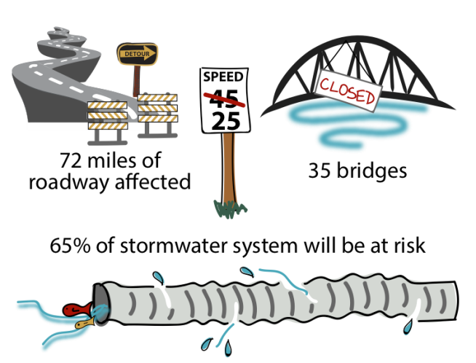
Consequence: Infrastructure at Risk

Slide 10
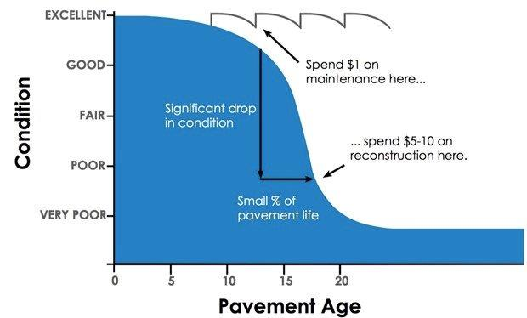
Consequence: Deferred Maintenance Costs

Slide 11
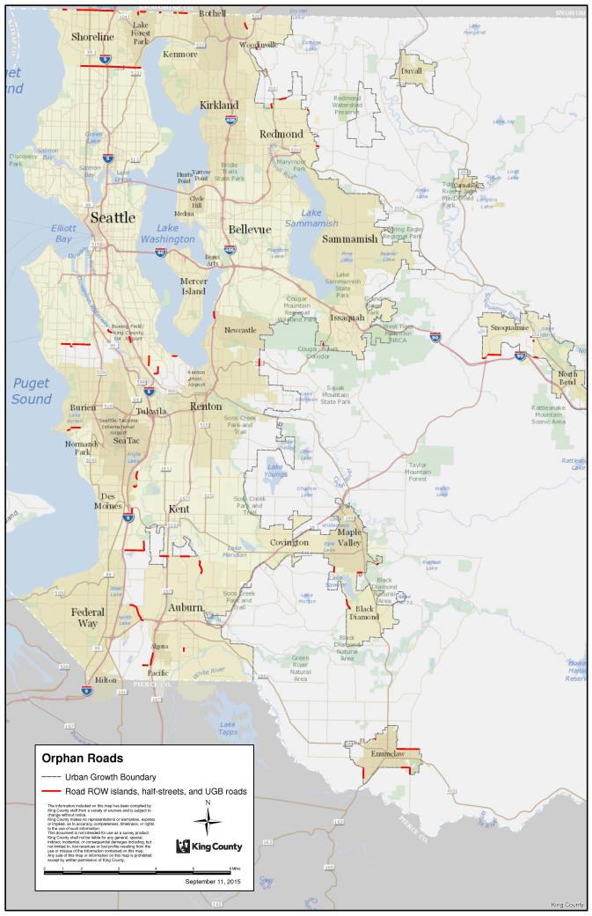
Orphan Roads
Over 60 segments
24 centerline miles
21 cities

Slide 12
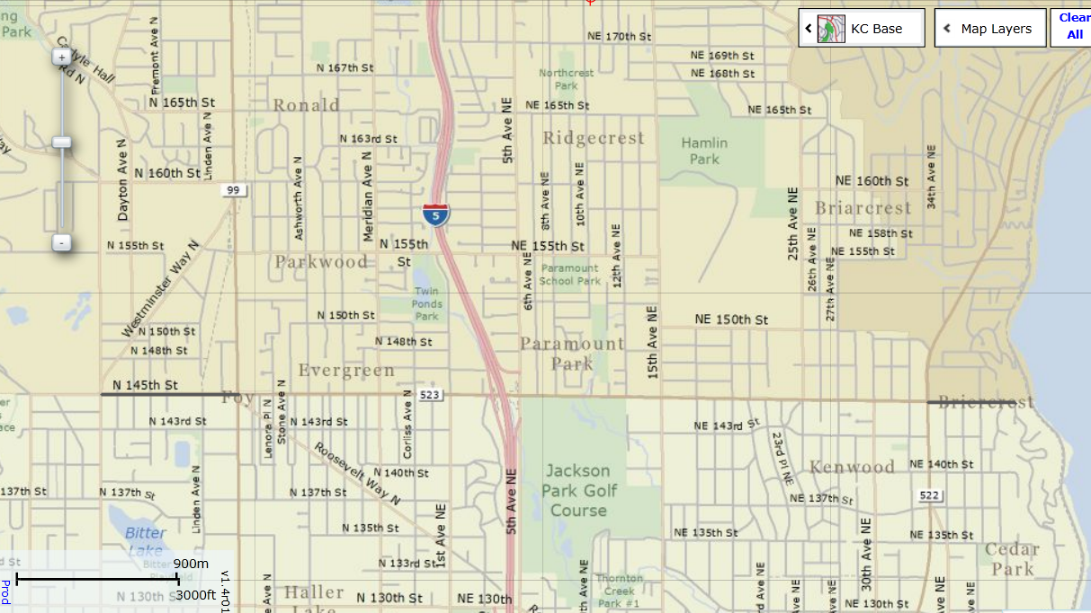
Seattle - N 145th St. Half Street
Shoreline
Lake Forest Park
Seattle

Slide 13
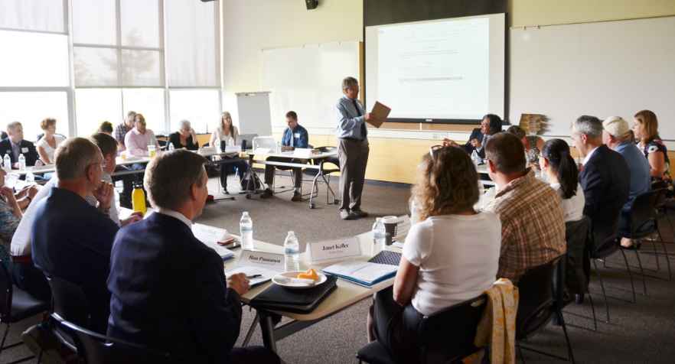
Task Force Findings
Validated the significance of the problem
Acknowledged that the county has responded effectively
Identified the need for high impact solutions
Determined that additional solutions must come from collaboration with cities and the state
Advised the county to make increased efforts to communicate with stakeholders and the public

Slide 14

High Impact Recommendations
$
Revenue:
New revenue tools should:
  Be tied to inflation, sustainable, and long-term
  Benefit cities and counties
  Not be regressive
Work with State Legislature
Work with city partners

Slide 15
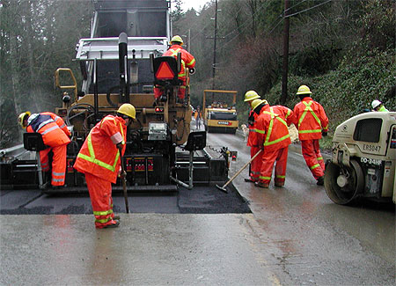
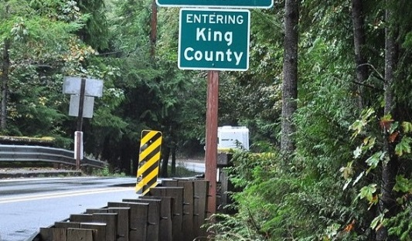
High Impact Recommendations
Infrastructure
Solutions needed:
  Stranded/orphan roads
  Islands of roads
  Potential Annexation Areas

Slide 16
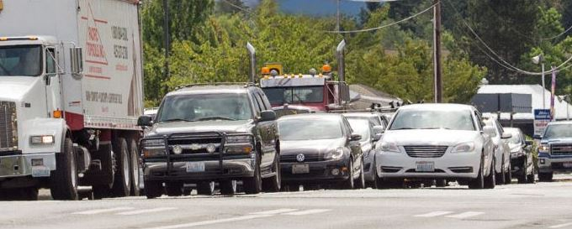
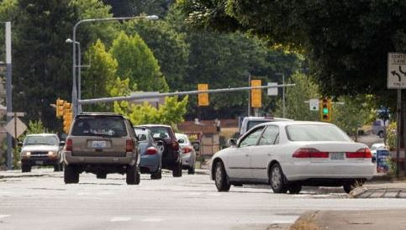
High Impact Recommendations
Further Study
Options for future tax or fee based on vehicle miles traveled or congestion pricing and/or tolling

Slide 17

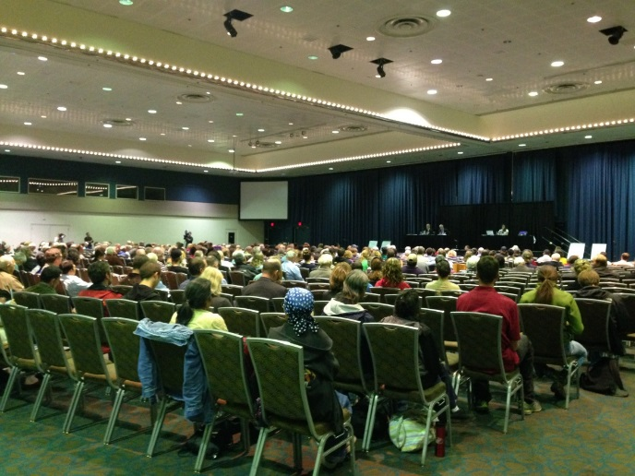
High Impact Recommendations
Outreach
More communication to:
  Elected bodies
  Other agencies
  The media
  The public
Work with cities to develop a joint funding package for local transportation

Slide 18

Next Steps
Task Force members are available as speakers and as a resource for cities and the county
Task Force members agreed to share findings with their networks
The county should work with regional partners on high impact recommendations
County staff should continue efficiency efforts and evaluate other Task Force recommendations

Slide 19
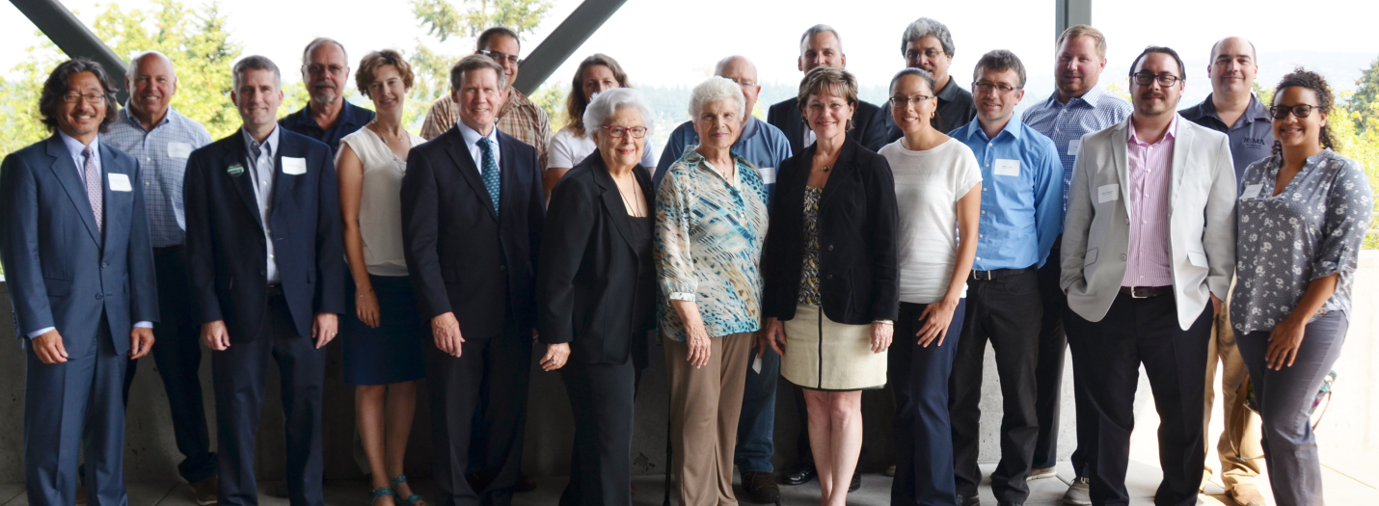
QUESTIONS?

